Slide 1
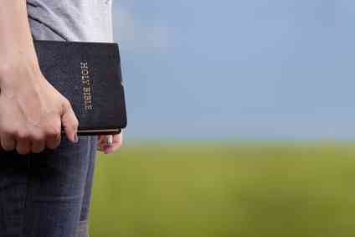
Worthy of the Gospel
Philippians 1:27-30

Slide 2
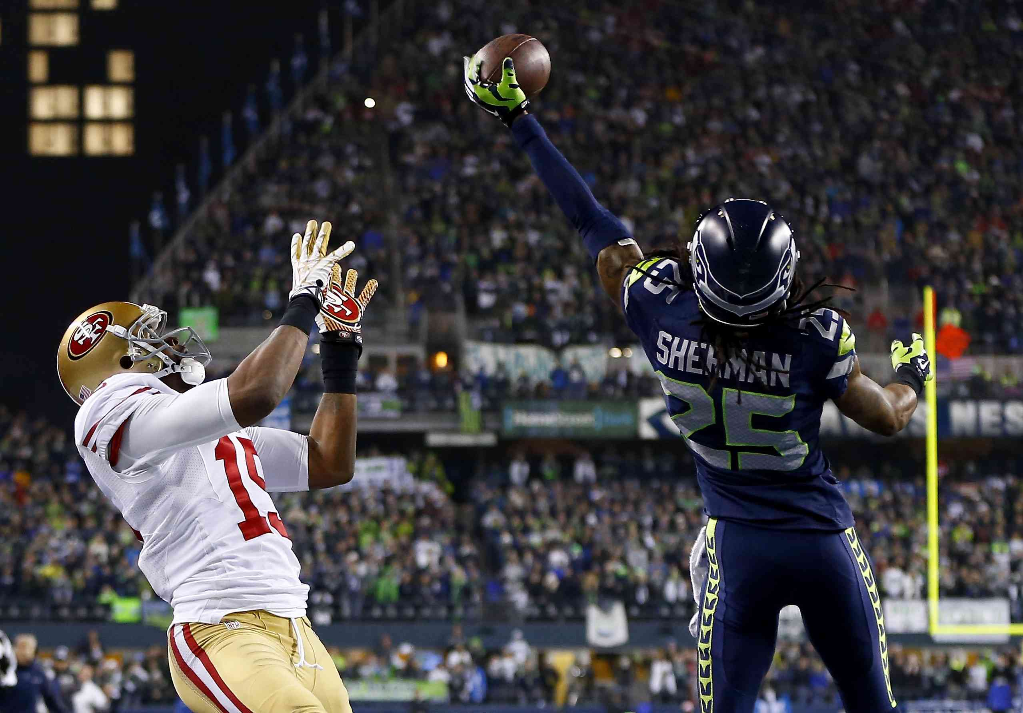

Slide 3
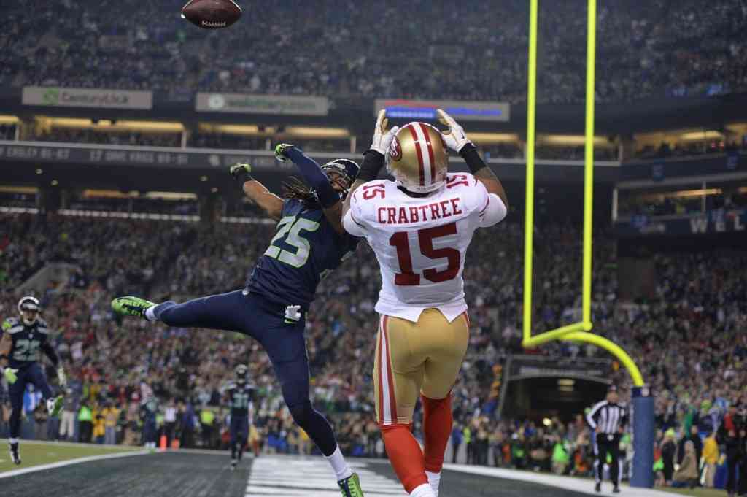

Slide 4
Manner of life…
Whatever happens, conduct yourselves in a manner worthy of the gospel of Christ. Then, whether I come and see you or only hear about you in my absence, I will know that you stand firm in one spirit, contending as one man for the faith of the gospel …

Slide 5
Living worthy of the gospel..
Romans 1:16 For I am not ashamed of the gospel of Christ, for it is the power of God to salvation for everyone who believes, for the Jew first and also for the Greek.

Slide 6
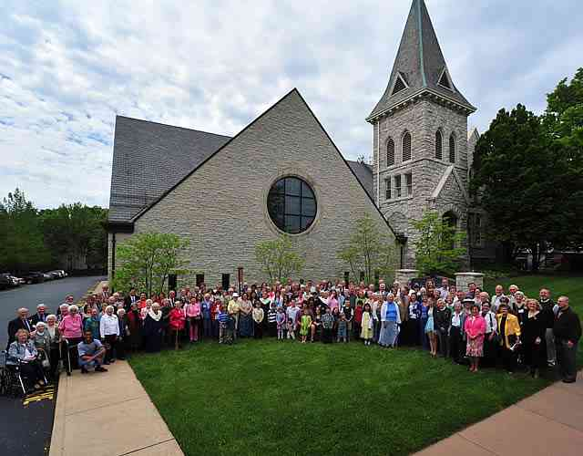
“Whatever happens, conduct yourselves in a manner worthy of the gospel of Christ.”

Slide 7
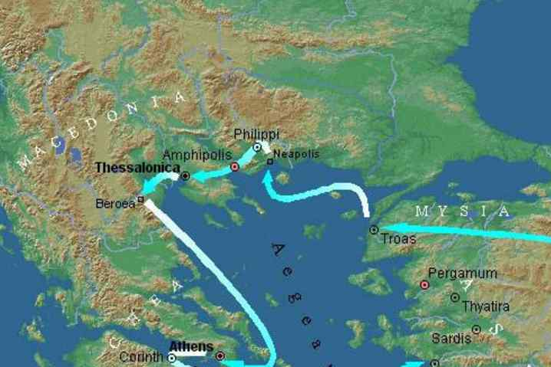
Paul changes from his condition to the Philippians’ situation..

Slide 8
Living worthy of the Gospel..
“Conduct yourselves in a manner worthy of the gospel..”
“that you stand firm in one spirit, contending as one man for the faith of the gospel without being frightened in any way by those who oppose you..”

Slide 9
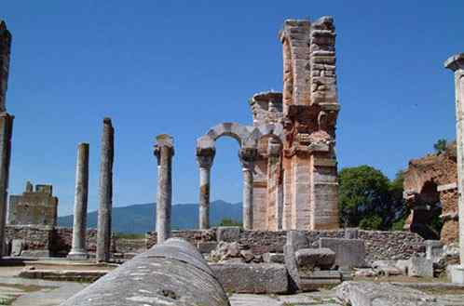
Conduct (as citizens)..
Politeuma (politics/polis = city)
Philippians 3:20 For our citizenship is in heaven, from which we also eagerly wait for the Savior, the Lord Jesus Christ..

Slide 10
Living worthy of the Gospel..
Because we find VALUE in the Gospel…
Citizens of heaven value what heaven values …

Slide 11
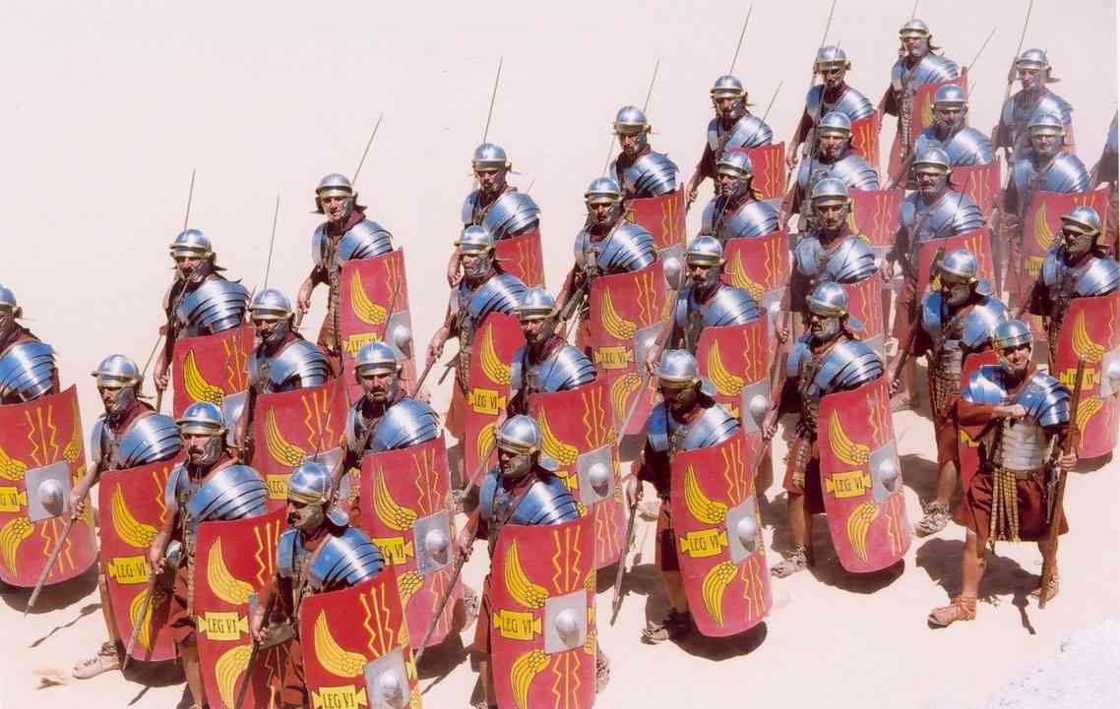
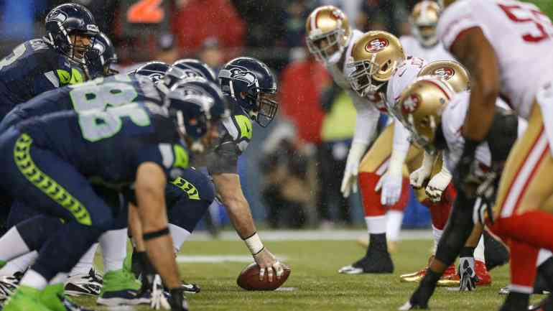
What living worthy entails..
Standing firm in one spirit..
Contending as one man for the gospel..
Not frightened by those who oppose you..

Slide 12
What living worthy means for us..
We have a goal
We are opposed
We are in a struggle…
Worth fighting for..
Worth uniting for..
(advance the gospel)
(by world system)

Slide 13
Be part of a community of fellow followers..
Contend for the faith as part of a team (part of a city, military unit)..
Not alone, but the community bringing to the world the good news it needs..

Slide 14
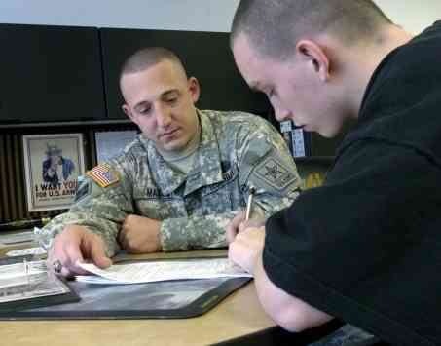
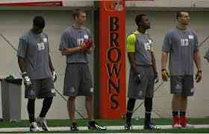
Making the team..
Enlisting in Army
Professional sports..
Everyone who wants to be on the team is on the team

Slide 15
What living worthy indicates to the world..
Vs 28 “This is a sign to them that they will be destroyed, but that you will be saved — and that by God.”

Slide 16
What living worthy results in..
Vs 29-30 For it has been granted to you on behalf of Christ not only to believe on him, but also to suffer for him, 30 since you are going through the same struggle you saw I had, and now hear that I still have.
2 Corinthians 4:11-12 For we who live are always delivered to death for Jesus' sake, that the life of Jesus also may be manifested in our mortal flesh. 12 So then death is working in us, but life in you.
Acts 5:41 So they departed from the presence of the council, rejoicing that they were counted worthy to suffer shame for His name.

Slide 17
Called to suffer but standing firm..

Slide 18
Worthy of the Gospel
Philippians 1:27-30

