Slide 1
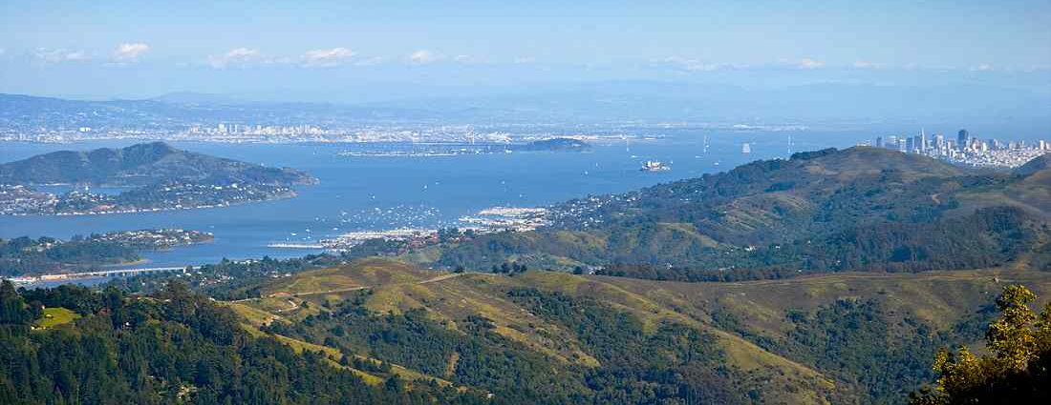
Take the Low Road
Philippians 2:5-11

Slide 2
Paul’s Goal of Unity…
Philippians 2:2-4 fulfill my joy by being like-minded, having the same love, being of one accord, of one mind. 3 Let nothing be done through selfish ambition or conceit, but in lowliness of mind let each esteem others better than himself. 4 Let each of you look out not only for his own interests, but also for the interests of others...

Slide 3
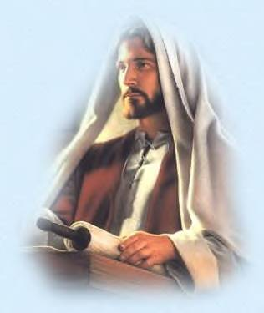
Our ultimate role model…
Philippians 2:2-4 fulfill my joy by being like-minded, having the same love, being of one accord, of one mind. 3 Let nothing be done through selfish ambition or conceit, but in lowliness of mind let each esteem others better than himself. 4 Let each of you look out not only for his own interests, but also for the interests of others...
Humility, unselfishness, concern for others as shown by Jesus…

Slide 4
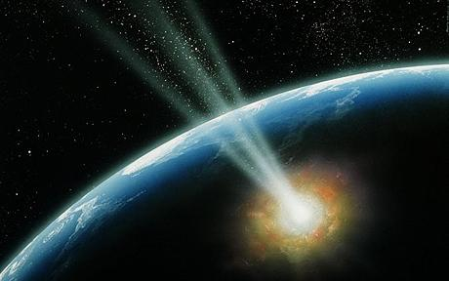
The One Mind…
5 Let this mind be in you which was also in Christ Jesus, 6 who, being in the form of God…. humbled Himself and became obedient to the point of death, even the death of the cross. …

Slide 5
Follow His Example...
1 John 2:6 He who says he abides in Him ought himself also to walk just as He walked.

Slide 6
Philippians 2:5-11
Christ’s Example of Humility
BEFORE
In His pre-existent state before His birth
DURING
In His earthly existence
AFTER
In His exalted state in heaven

Slide 7
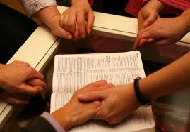
BEFORE Coming to Earth..
Philippians 2:5-6 Let this mind be in you which was also in Christ Jesus, 6 who, being in the form of God, did not consider it robbery to be equal with God..

Slide 8
Philippians 2:6
John 1:1-3,14
Isaiah 9:6-7
Col. 1:16-18
Heb 1:3
Existing in the form of God
In His pre-existent state before His birth
In His earthly existence
In His exalted state in heaven

Slide 9
Philippians 2:6
Existing in the form of God
Counted not being on an equality
with God a thing to be grasped..
Matt. 5:44-45; Acts 14:16-17; 17:25

Slide 10
Philippians 2:6
Existing in the form of God
… emptied Himself, taking the form of a servant, made in the likeness of men..
John 5:18; 14:9; 20:27; Heb 13:8

Slide 11
The form of God..
The exact image, perfect replica or representation of God …

Slide 12
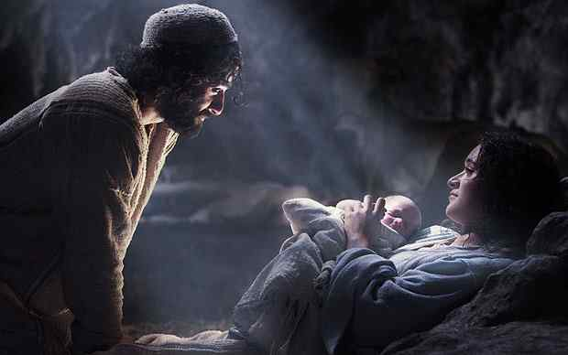
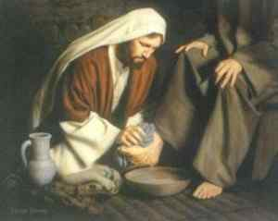
Did not consider robbery to be equal with God..
“Did not regard equality with God a thing to be grasped” but emptied Himself taking the form of a bondservant and being made in the likeness of men..

Slide 13
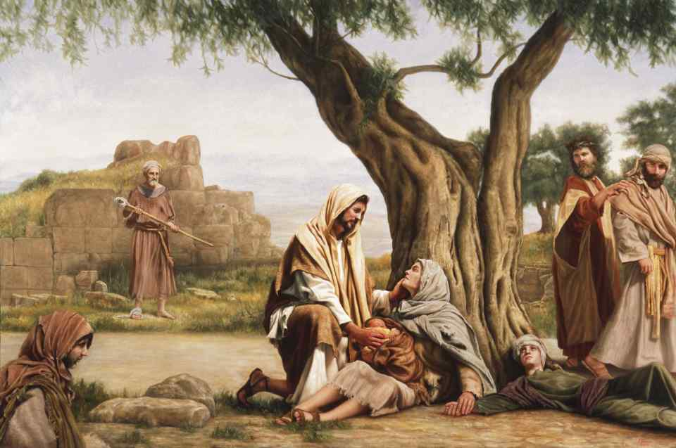
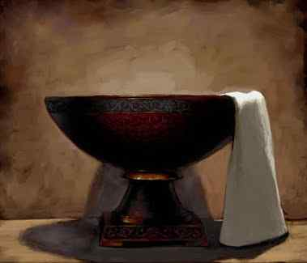
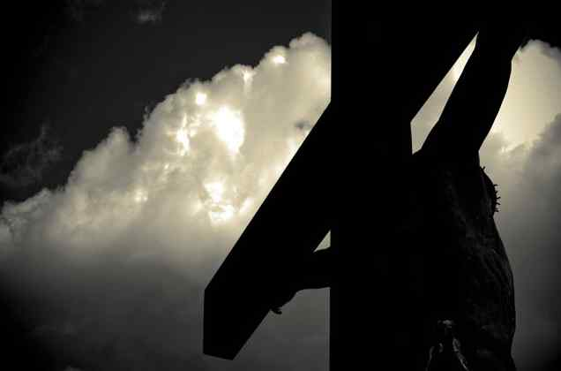
DURING His time on earth..
Philippians 2:7-8 but made Himself of no reputation, taking the form of a bondservant, and coming in the likeness of men. 8 And being found in appearance as a man, He humbled Himself and became obedient to the point of death, even the death of the cross.

Slide 14
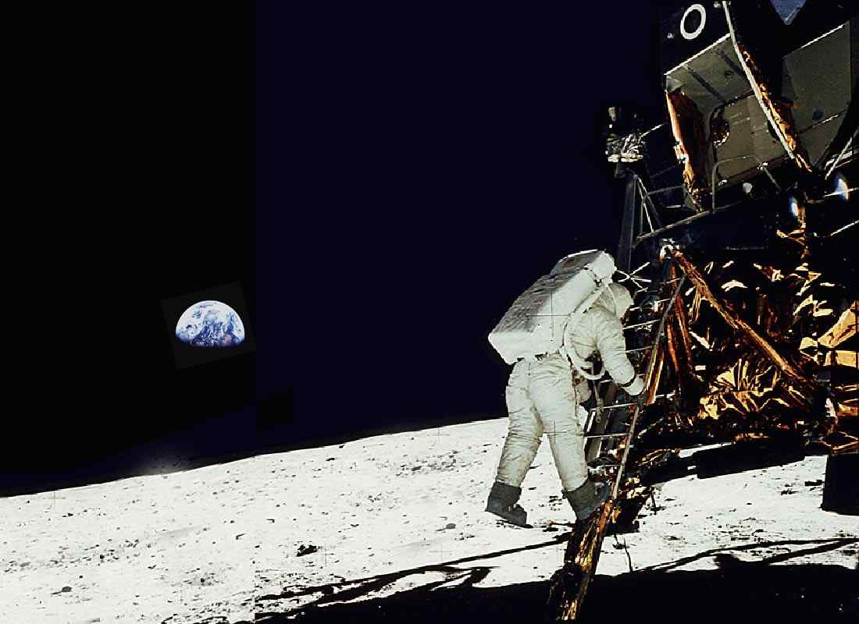
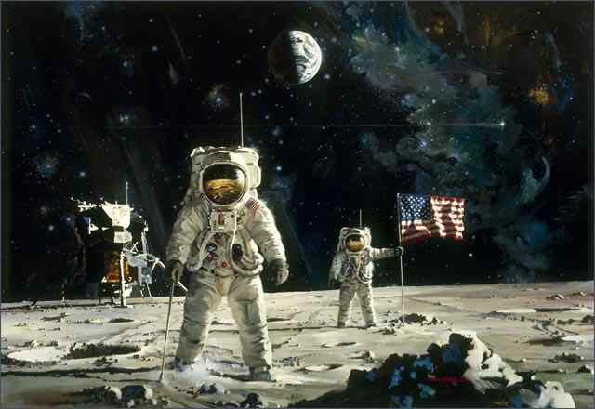
One small step for a man..
One giant step for mankind …

Slide 15
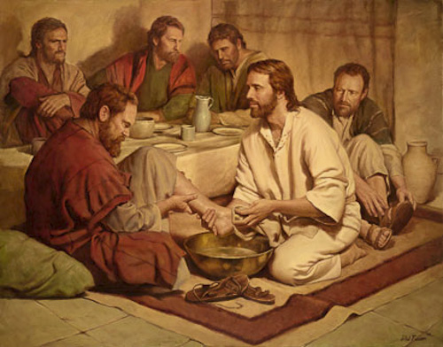
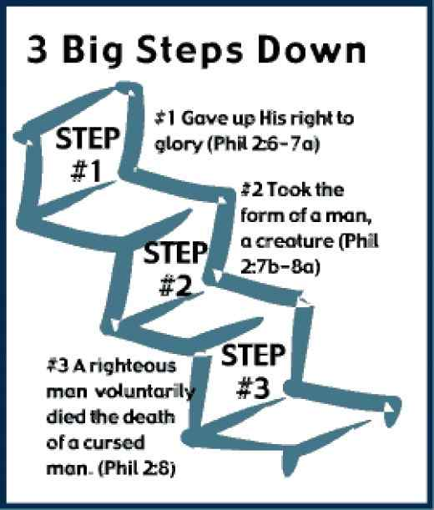
Took the form of a servant…
Mark 10:44-45 For even the Son of Man did not come to be served, but to serve, and to give His life a ransom for many."

Slide 16
Even the death of the cross..
Most degrading death .. Humiliation
A death for slaves, low class criminals
Hebrews 12:2 looking unto Jesus, the author and finisher of our faith, who for the joy that was set before Him endured the cross, despising the shame, and has sat down at the right hand of the throne of God.

Slide 17
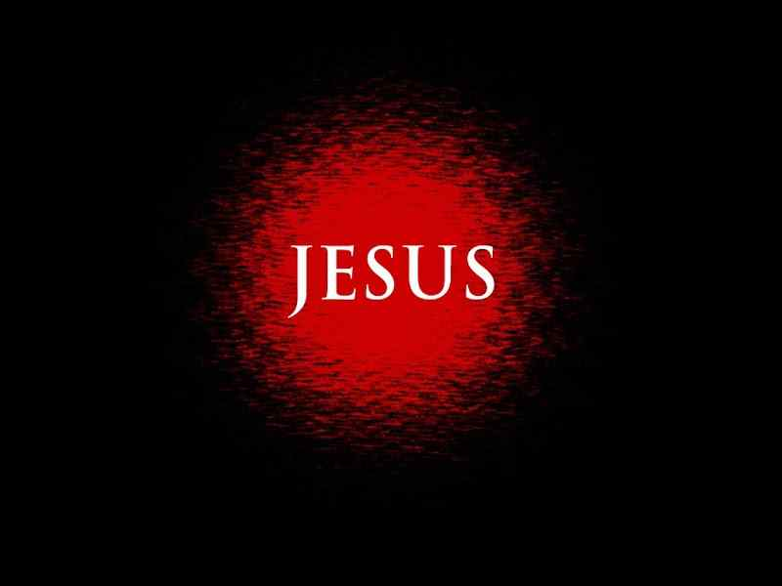
AFTER coming to earth..
Philippians 2:9-11 Therefore God also has highly exalted Him and given Him the name which is above every name, 10 that at the name of Jesus every knee should bow, of those in heaven, and of those on earth, and of those under the earth, 11 and that every tongue should confess that Jesus Christ is Lord, to the glory of God the Father.

Slide 18
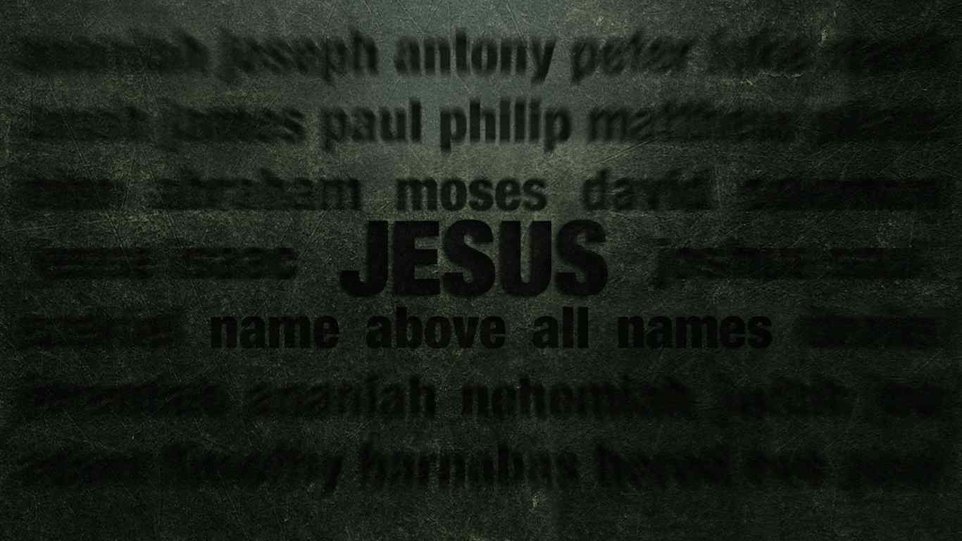
Every tongue should confess that Jesus Christ is Lord…
Romans 10:9-10 that if you confess with your mouth the Lord Jesus and believe in your heart that God has raised Him from the dead, you will be saved. 10 For with the heart one believes unto righteousness, and with the mouth confession is made unto salvation.

Slide 19
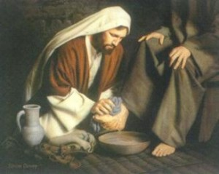
Have This Mind in You
Philippians 2:5-11

Slide 20
Take the Low Road
Philippians 2:5-11

