Slide 1
Philippians 1:19-30

Slide 2
Phil 1:19-21..
For I know that this will turn out for my deliverance through your prayer and the supply of the Spirit of Jesus Christ, 20 according to my earnest expectation and hope that in nothing I shall be ashamed, but with all boldness, as always, so now also Christ will be magnified in my body, whether by life or by death. 21 For to me, to live is Christ, and to die is gain.

Slide 3
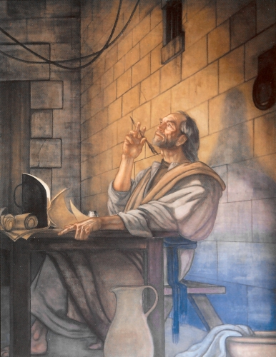
Context..
Philippians 1:16-18 The former preach Christ from selfish ambition, not sincerely, supposing to add affliction to my chains; 17 but the latter out of love, knowing that I am appointed for the defense of the gospel. 18 What then? Only that in every way, whether in pretense or in truth, Christ is preached; and in this I rejoice, yes, and will rejoice.

Slide 4
Paul’s dilemma..
Phil 1:22-24 But if I live on in the flesh, this will mean fruit from my labor; yet what I shall choose I cannot tell. 23 For I am hard-pressed between the two, having a desire to depart and be with Christ, which is far better. 24 Nevertheless to remain in the flesh is more needful for you.

Slide 5
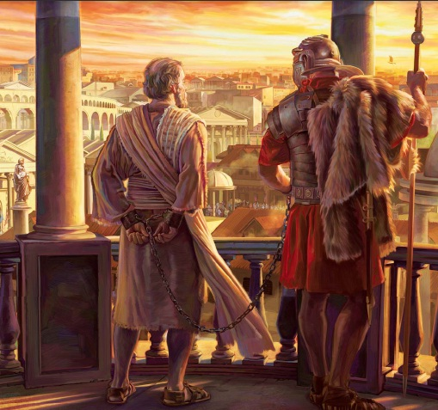
Paul’s sources of joy..
1st Their prayers for him..
19 For I know that this will turn out for my deliverance through your prayer and the supply of the Spirit of Jesus Christ

Slide 6
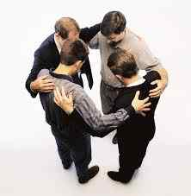
Praying for others..
Romans 15:30-32 Now I beg you, brethren, through the Lord Jesus Christ, and through the love of the Spirit, that you strive together with me in prayers to God for me..

Slide 7
Paul’s sources of joy..
2nd Christ will be magnified in his body..
20 according to my earnest expectation and hope that in nothing I shall be ashamed, but with all boldness, as always, so now also Christ will be magnified in my body, whether by life or by death.

Slide 8
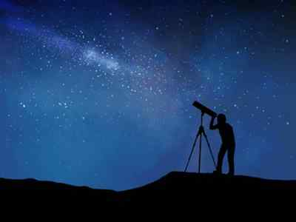
Christ magnified..
We are in our bodies to be telescopes that bring Jesus close to people as they watch us deal with crises..

Slide 9
He must increase..
Paul sought to draw attention not to himself but to Christ ..

Slide 10
Our bodies are His..
Christ is to be magnified and glorified in our bodies ..

Slide 11
Paul’s sources of joy..
3rd because of what Christ means to him..
21 For to me, to live is Christ, and to die is gain. 22 But if I live on in the flesh, this will mean fruit from my labor; yet what I shall choose I cannot tell.

Slide 12
Christ was everything to Paul..
The reason Paul anticipated heaven joyfully was because Christ was His all in all…

Slide 13
Christ was everything to Paul..
If Christ is not my all in all, then the hope of being with Christ is hollow..
If all of my joy is earthly, the thought of going to see Jesus is nothing to me..

Slide 15
The right way to make decisions..
Desires/
Preferences
Responsibilities/
Needs of Others
Things we would like to do for our own enjoyment
Personal feelings and emotions..
Immediate benefits..
Consider the needs of those around us.. family, church..
Weigh the overall outcome and consequences..
Look at the bigger picture..

Slide 16
The right way to make decisions..
Desires/
Preferences
Responsibilities/
Needs of Others
23 For I am hard-pressed between the two, having a desire to depart and be with Christ, which is far better.
Instantly be with Christ..
No more beatings..
Unending peace in the presence of God
24 Nevertheless to remain in the flesh is more needful for you…I know I shall remain and continue with you all for your progress and joy..
Give them greater maturity..
Would bring Paul joy..
Stay here instead of heaven

Slide 17
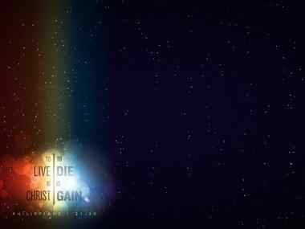
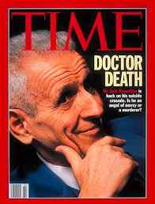
Paul’s reasons for wanting to depart..
Not wanting death to escape his bodily existence..
Rather to be with Christ whom He loves and wants to know even more..

Slide 18
Paul’s choice…
Phil 1:25-26 And being confident of this, I know that I shall remain and continue with you all for your progress and joy of faith, 26 that your rejoicing for me may be more abundant in Jesus Christ by my coming to you again.

Slide 19
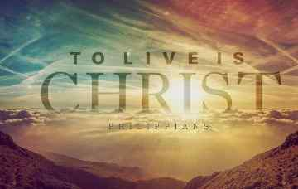

Slide 20
Philippians 1:19-30

