Slide 1
When Life Gets Real .. Where Can I Find Joy?
Philippians 1:1-11

Slide 2
Problems in real life..
Is there any way to deal with the reality of living? …

Slide 3
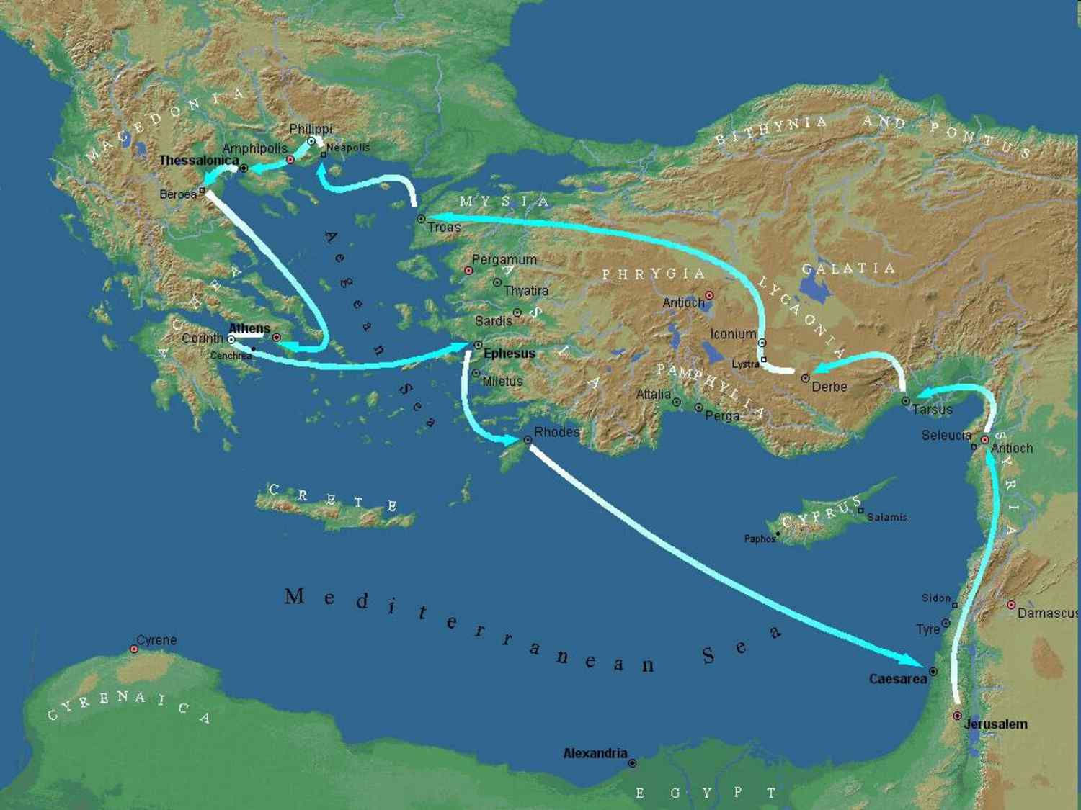
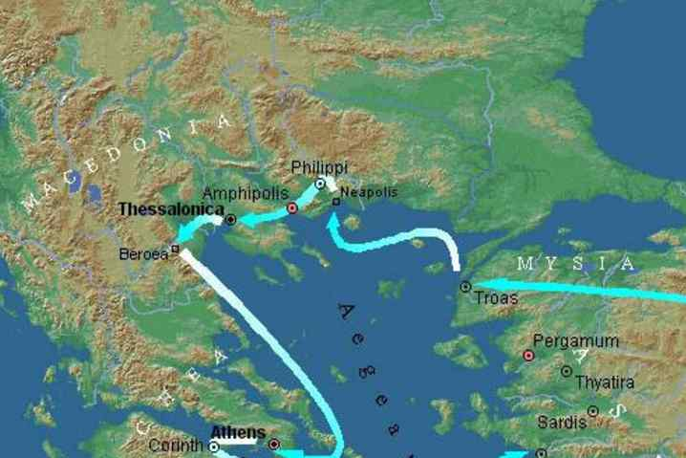
Acts 16 voyage..
Acts 16:9-10 And a vision appeared to Paul in the night. A man of Macedonia stood and pleaded with him, saying, "Come over to Macedonia and help us." 10 Now after he had seen the vision, immediately we sought to go to Macedonia, concluding that the Lord had called us to preach the gospel to them.

Slide 4
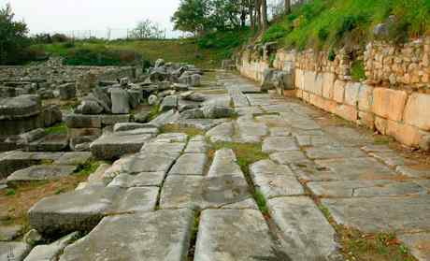
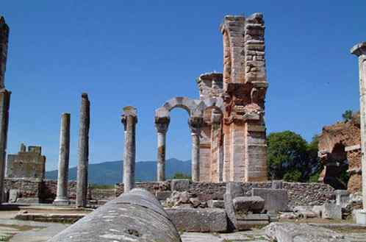
Paul in Philippi..
Acts 16:11-15 Conversion of Lydia..
16:16-21 Opposition develops..
16:22-24 Paul and Silas arrested..
16:25-34 Conversion of jailer..

Slide 5
Ten years later Paul writes as a prisoner..
Gratitude for gift they had sent (3t) ..
Concerns for their unity ..
The day of the Lord is at hand (6t) ..
Rejoice (9t).. Joy (5t)..rejoice with (2t)..

Slide 6
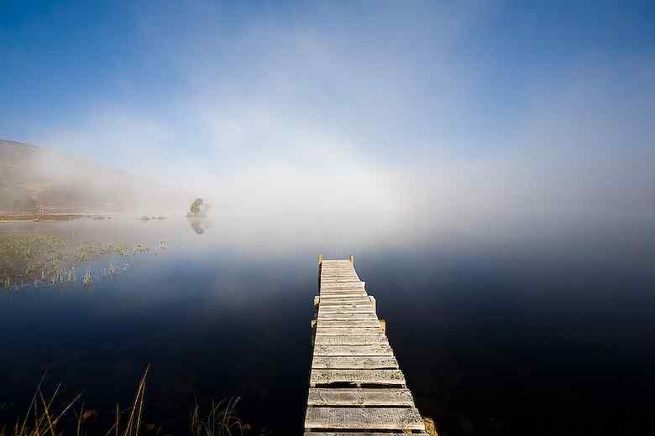
I thought it was supposed to be different now…
Still problems, worries, depression?
They heard Paul was in prison..
Paul shows how to still find joy..

Slide 7
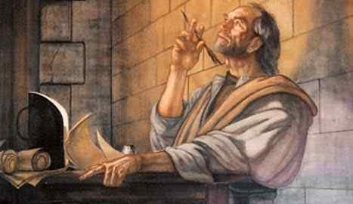
1 Humble Servant..(1-2)
Phil 1:1-2 Paul and Timothy, bondservants of Jesus Christ, to all the saints in Christ Jesus who are in Philippi, with the bishops and deacons: 2 Grace to you and peace from God our Father and the Lord Jesus Christ.

Slide 8
1 Humble Servant..(1-2)
Philippians 1:7,13 both in my chains and in the defense and confirmation of the gospel, you all are partakers with me of grace. it has become evident to all my chains are in Christ..
Philippians 2:5-7 Let this mind be in you which was also in Christ Jesus, 6 who, being in the form of God, did not consider it robbery to be equal with God, 7 but made Himself of no reputation, taking the form of a bondservant, and coming in the likeness of men.

Slide 9
1 Humble Servant..(1-2)
Philippians 1:7,13 both in my chains and in the defense and confirmation of the gospel, you all are partakers with me of grace. it has become evident to all my chains are in Christ..
Philippians 2:5-7 Let this mind be in you which was also in Christ Jesus, 6 who, being in the form of God, did not consider it robbery to be equal with God, 7 but made Himself of no reputation, taking the form of a bondservant, and coming in the likeness of men.

Slide 10
2 Loving Fellowship..(3-5)
Philippians 1:3-5 I thank my God upon every remem-brance of you, 4 always in every prayer of mine making request for you all with joy, 5 for your fellowship in the gospel from the first day until now..
7 just as it is right for me to think this of you all, because I have you in my heart, inasmuch as both in my chains and in the defense and confirmation of the gospel, you all are partakers with me of grace. 8 For God is my witness, how greatly I long for you all with the affection of Jesus Christ.

Slide 11
2 Loving Fellowship..(3-5)
Philippians 1:1-2 .. To all the saints in Christ Jesus who are in Philippi, with the bishops and deacons: 2 Grace to you and peace from God our Father and the Lord Jesus Christ.
I thank my God on every remembrance of you… I have you in my heart… I long for you..

Slide 12
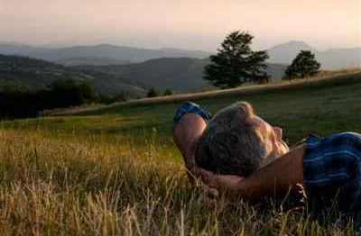
3 Eternal confidence..(6-8)
Phil 1:6-8 being confident of this very thing, that He who has begun a good work in you will complete it until the day of Jesus Christ..
7 just as it is right for me to think this of you all, because I have you in my heart, inasmuch as both in my chains and in the defense and confirmation of the gospel, you all are partakers with me of grace. 8 For God is my witness, how greatly I long for you all with the affection of Jesus Christ.

Slide 13
4 Mature wisdom..(9-11)
Philippians 1:9-11 And this I pray, that your love may abound still more and more in knowledge and all discernment, 10 that you may approve the things that are excellent, that you may be sincere and without offense till the day of Christ, 11 being filled with the fruits of righteousness which are by Jesus Christ, to the glory and praise of God.

Slide 14
When Life Gets Real .. Where Can I Find Joy?
Philippians 1:1-11

