Slide 1
Forgetting the Past and Looking Forward
Philippians 3:12-21

Slide 2
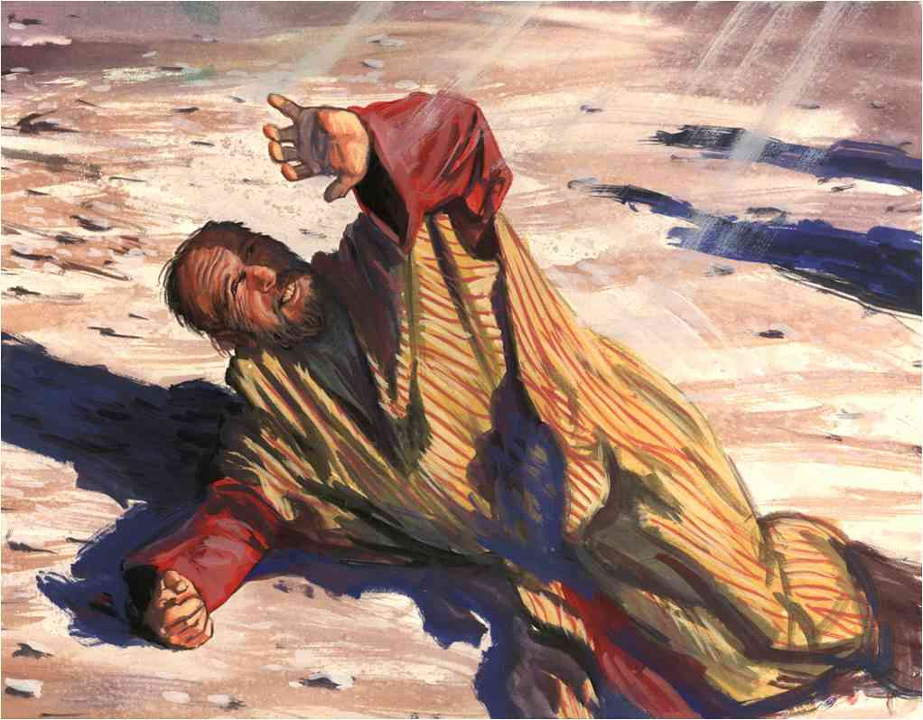
Paul’s own past ..
4-6 though I also might have confidence in the flesh. If anyone else thinks he may have confidence in the flesh, I more so: 5 circumcised the eighth day, of the stock of Israel, of the tribe of Benjamin, a Hebrew of the Hebrews; concerning the law, a Pharisee; 6 concerning zeal, persecuting the church; concerning the righteousness which is in the law, blameless.

Slide 3
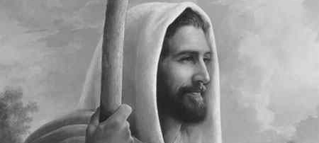
His changed life and goals..
8-9 I count all things loss for the excellence of the knowledge of Christ Jesus my Lord.. that I may.. be found in Him, not having my own righteousness, which is from the law, but that which is through faith in Christ…

Slide 4
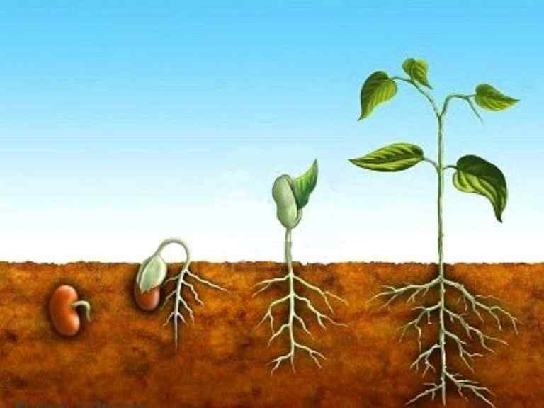
God’s order of growth..

Slide 5
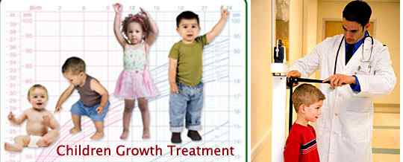
God intends growth..
Gaining salvation in Christ is only the beginning… we continue to grow..

Slide 6
Forgetting the past..
Philippians 3:13-14 Brethren, I do not count myself to have apprehended; but one thing I do, forgetting those things which are behind and reaching forward to those things which are ahead, 14 I press toward the goal for the prize of the upward call of God in Christ Jesus.

Slide 7
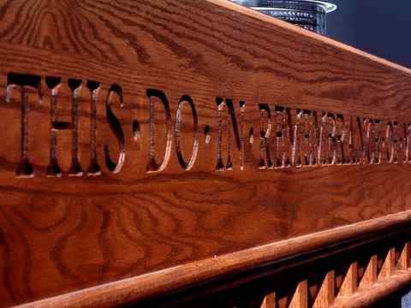
Some things should not be forgotten..
1 Cor 11:23-26 Remembering Jesus’ death .. “in remembrance of me”..

Slide 8
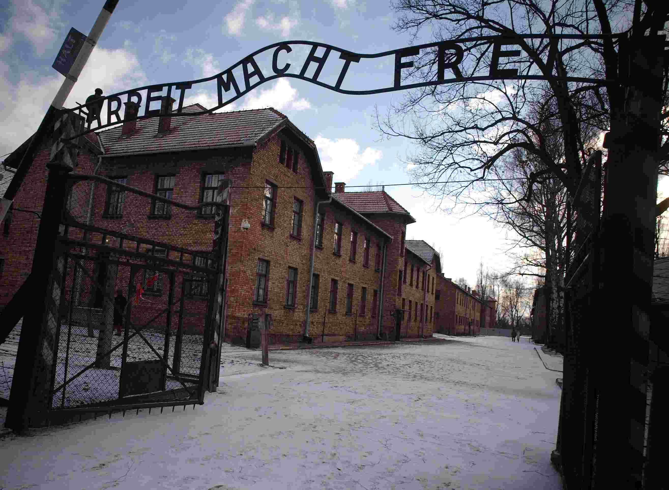
Auschwitz..
“Those who cannot remember the past are condemned to repeat it..”

Slide 9
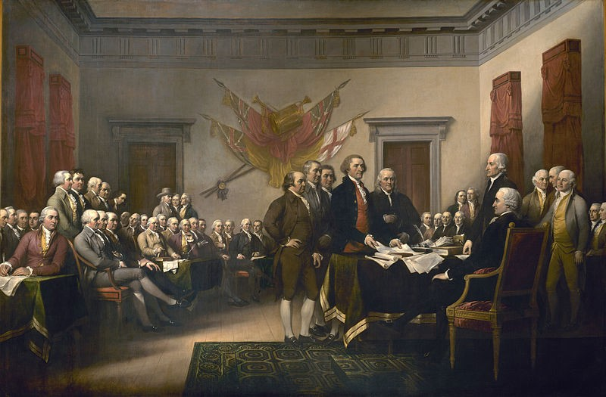
The lessons of history..
Reasons listed for Declaration of Independence…

Slide 10
Forgetting our past ..
Our sins are forgiven .. Heb 8:8-12
Don’t rest on laurels ..

Slide 12
.. But one thing I do, forgetting those things which are behind and reaching forward to those things which are ahead, 14 I press toward the goal for the prize of the upward call of God in Christ Jesus.

Slide 13
Reaching forward..

Slide 14
We must move forward..
God’s plan is progress, not perfection..
The past is over… don’t keep reliving it..
The future holds out hope.. reach for it..
The secret is determination.. maintain it..

Slide 15
A Mature attitude..
Philippians 3:15-16 Therefore let us, as many as are mature, have this mind; and if in anything you think otherwise, God will reveal even this to you. 16 Nevertheless, to the degree that we have already attained, let us walk by the same rule, let us be of the same mind.

Slide 16
God will reveal this to you..
Growing and looking forward to the future will be revealed as we listen to God’s voice in His word..

Slide 17
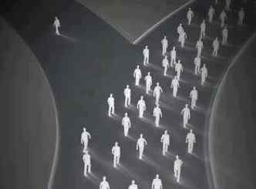
Following right examples..
Philippians 3:17 Brethren, join in following my example, and note those who so walk, as you have us for a pattern.

Slide 18
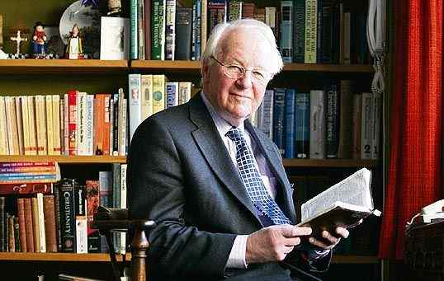
Observe godly examples..

Slide 19
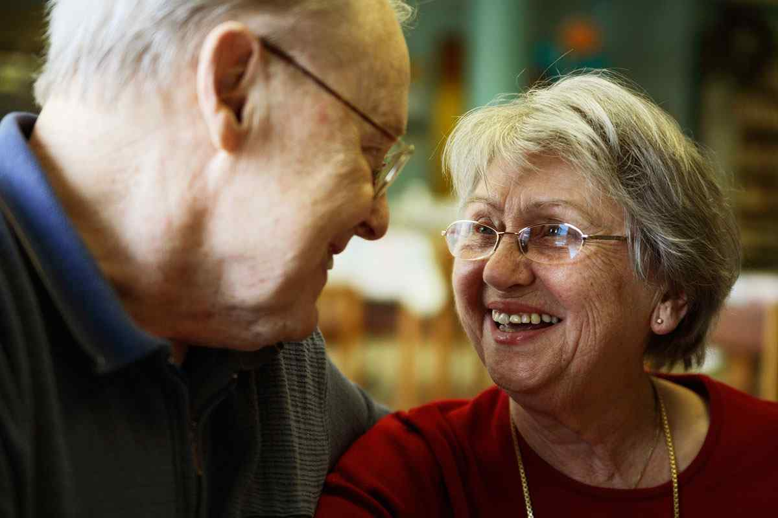
Observe godly examples..

Slide 20
Enemies of the cross..
Philippians 3:18-21 For many walk, of whom I have told you often, and now tell you even weeping, that they are the enemies of the cross of Christ: 19 whose end is destruction, whose god is their belly, and whose glory is in their shame — who set their mind on earthly things.

Slide 21
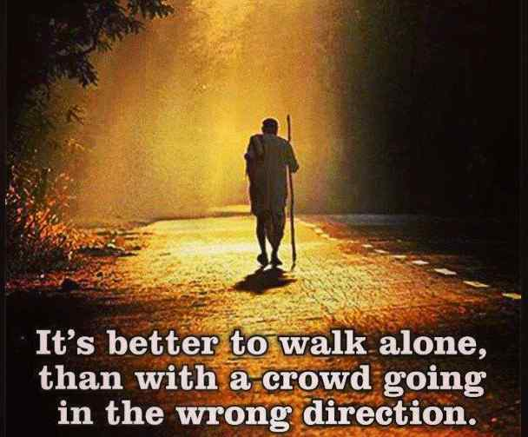

Slide 22
Bound for heaven..
20 For our citizenship is in heaven, from which we also eagerly wait for the Savior, the Lord Jesus Christ, 21 who will transform our lowly body that it may be conformed to His glorious body, according to the working by which He is able even to subdue all things to Himself.

Slide 23
Forgetting the Past and Looking Forward
Philippians 3:12-21

