Slide 1
Learn to Live in Peace
Philippians 4:1-7

Slide 2
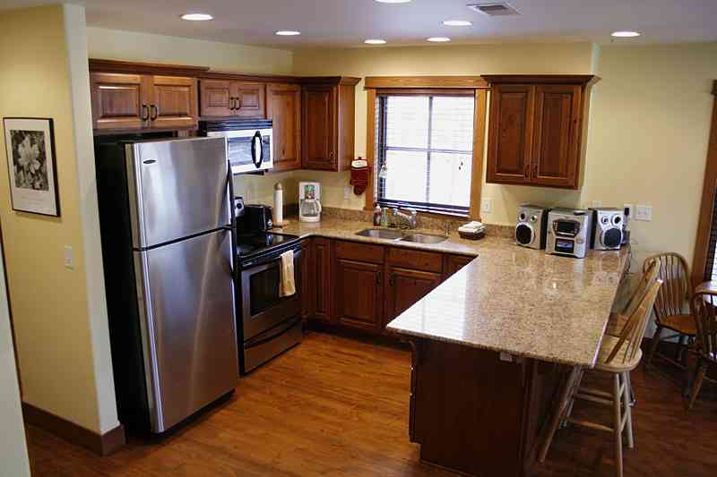
Convenience living..

Slide 3
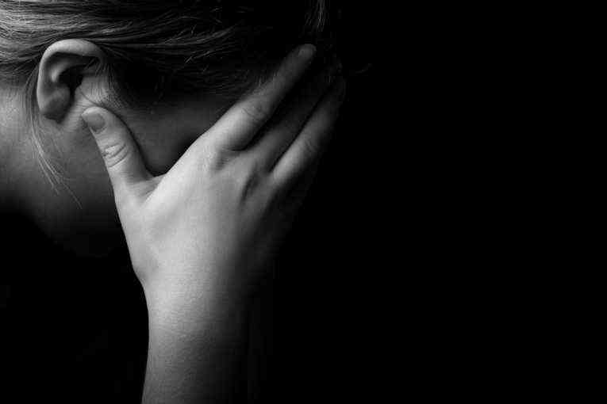
Why do so many lack peace of mind?

Slide 4
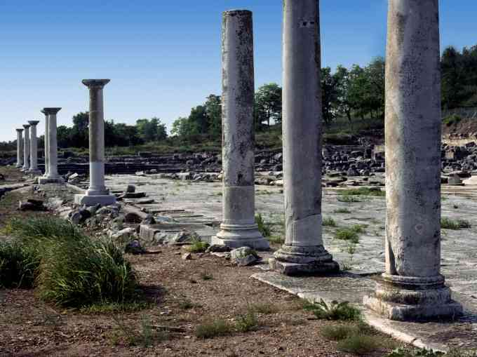
Letter to Philippi..
Paul explains a way of life that brings joy and peace …

Slide 5
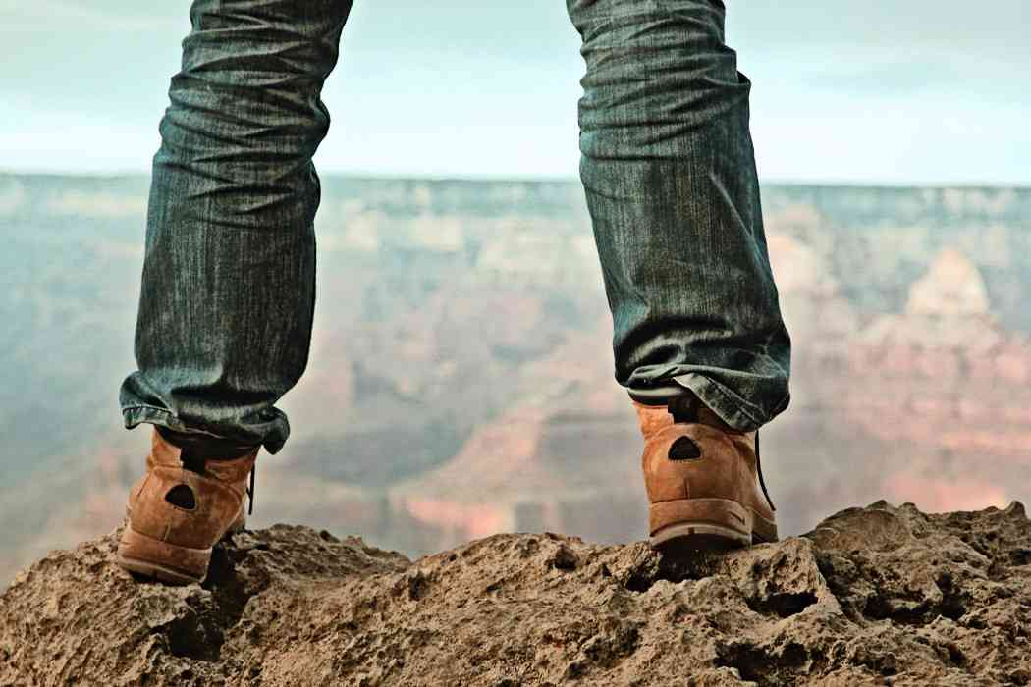
1 Stand Firm…
Philippians 4:1 Therefore, my beloved and longed-for brethren, my joy and crown, so stand fast in the Lord, beloved.

Slide 6
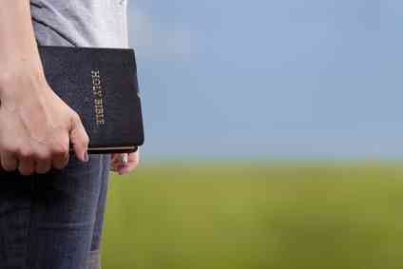
1 Stand firm..
“that you stand fast in one spirit, with one mind striving together for the faith of the gospel and not in any way terrified by your adversaries ..”

Slide 7
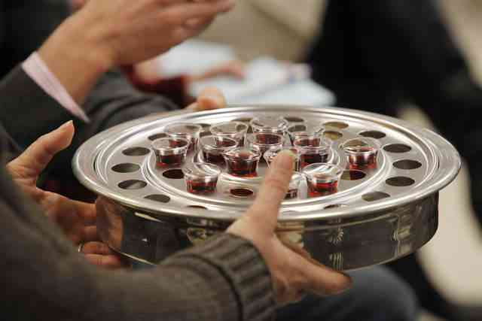
Beloved brethren…
Philippians 1:7 I have you in my heart, inasmuch as .. you all are partakers with me of grace.

Slide 8
2 Settle differences..
2 I implore Euodia and I implore Syntyche to be of the same mind in the Lord.

Slide 9
Settle your differences..
Implore .. to be of the same mind in the Lord..
2:1-2 if there is any consolation in Christ.. , 2 fulfill my joy by being like-minded, having the same love, being of one accord, of one mind.

Slide 10
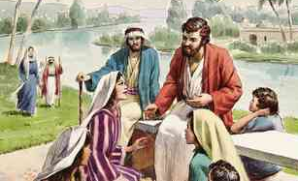
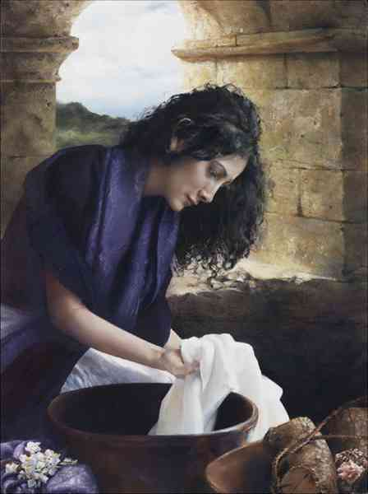
Faithful women…
3 And I urge you also, true companion, help these women who labored with me in the gospel…

Slide 11
Names in book of life..
Luke 10:20
written in heaven
Rev 20:12 judged by the things which were written in the books.
Rev 3:5 I will not blot out his name from the Book of Life
Rev 21:27 only those who are written in the Lamb's Book of Life.
.. with Clement also, and the rest of my fellow workers, whose names are in the Book of Life.

Slide 12
Principles for settling disputes..
Take initiative to seek reconciliation..
Be willing to ask forgiveness..
Pray for success of other person..
Ask God to remove bitterness..
Show kindness in small ways..

Slide 13
3 Resolve to Rejoice..
4 Rejoice in the Lord always. Again I will say, rejoice!
“Rejoice always, everything give thanks”
Gal 3:26-27 have put on Christ
Phil 4:11 learned to be content

Slide 14
Habakkuk learned to rejoice..
Hab 3:18-19 Yet I will rejoice in the Lord, I will joy in the God of my salvation. 19 The Lord God is my strength; He will make my feet like deer's feet, And He will make me walk on my high hills.

Slide 15
4 Reflect His Presence…
5 Let your gentleness be known to all men. The Lord is at hand.

Slide 16
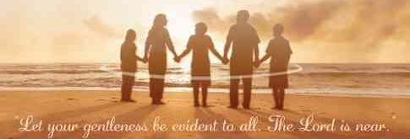
Gentleness..
Gentleness, Reasonableness, modera-tion, forbearing spirit..

Slide 17
5 Give worries to God..

Slide 18
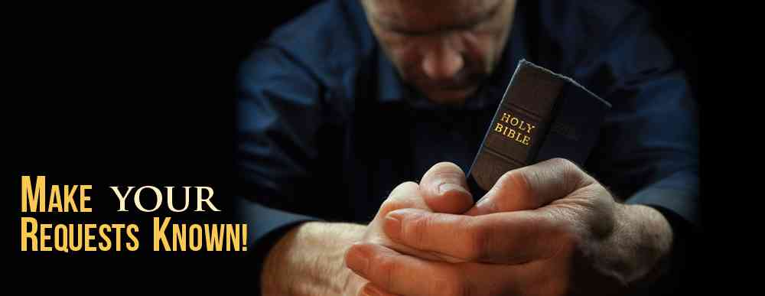
6 Be anxious for nothing, but in everything by prayer and supplication, with thanksgiving, let your requests be made known to God..

Slide 19
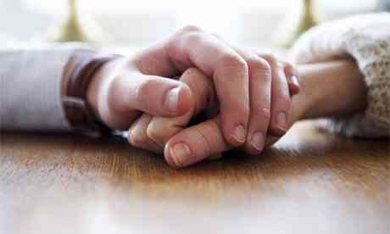
and the peace of God, which surpasses all understanding, will guard your hearts and minds through Christ Jesus.

Slide 20
Learn to Live in Peace
Stand fast in the Lord ..
Same mind in the Lord..
Rejoice in the Lord ..
Presence of the Lord..
Pray to the Lord..
Philippians 4:1-7

