Slide 1
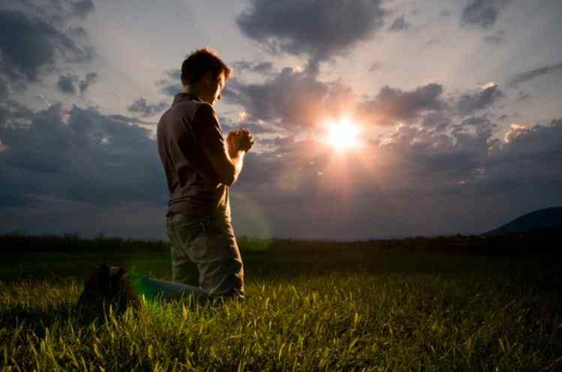
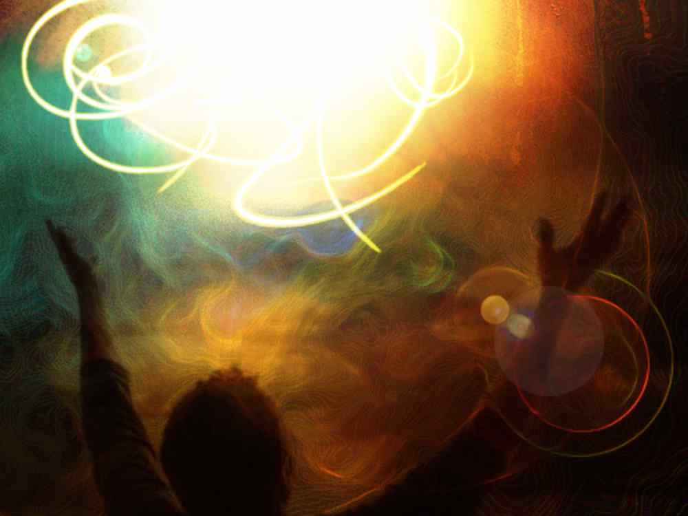
Righteousness from God
Philippians 3:1-11

Slide 2
World’s view of success..
To be rewarded perform well ..
Value is based on success..
Achievement must be earned..

Slide 3
Heavenly rewards
Earthly achievements

Slide 4
Striving to earn salvation..
Leads to pride, struggle to find glory..
Harder we try, more joyless/judgmental..

Slide 5
Paul’s honest story..
“Let me warn you again..”
Philippians 3:1 Finally, my brethren, rejoice in the Lord. For me to write the same things to you is not tedious, but for you it is safe.

Slide 6
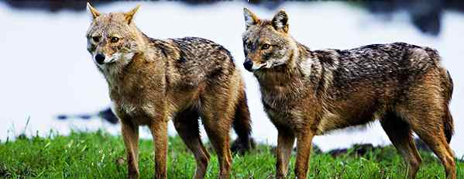
Serious warning!
2 Beware of dogs, beware of evil workers, beware of the mutilation!

Slide 7
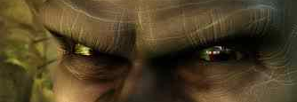
Evil workers..
Perverting the gospel
Galatians 1:6-9, 5:1-4
Acts 15:1-5 certain men came down from Judea and taught the brethren, "Unless you are circumcised according to the custom of Moses, you cannot be saved." ... 5 some of the sect of the Pharisees who believed rose up, saying, "It is necessary to circumcise them, and to command them to keep the law of Moses."

Slide 8
Contrast true believers..
Worship in the Spirit of God..
Glory in Christ …
Put no confidence in flesh..
3 For we are the circumcision, who worship God in the Spirit, rejoice in Christ Jesus, and have no confidence in the flesh ..

Slide 9
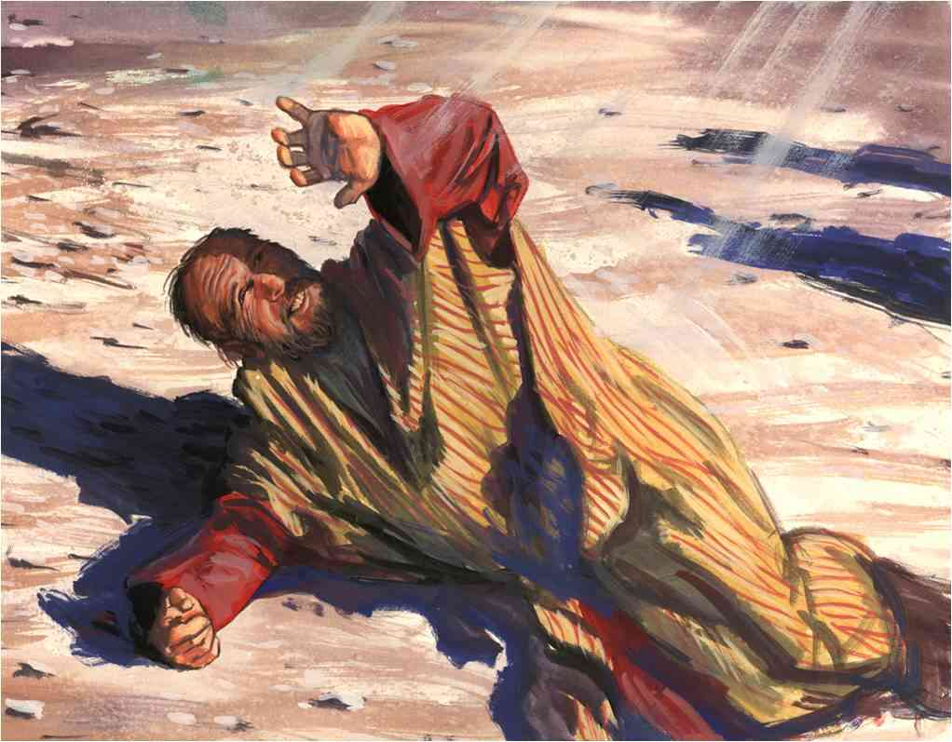
Paul’s proud record..
4-6 though I also might have confidence in the flesh. If anyone else thinks he may have confidence in the flesh, I more so: 5 circumcised the eighth day, of the stock of Israel, of the tribe of Benjamin, a Hebrew of the Hebrews; concerning the law, a Pharisee; 6 concerning zeal, persecuting the church; concerning the righteousness which is in the law, blameless.

Slide 10
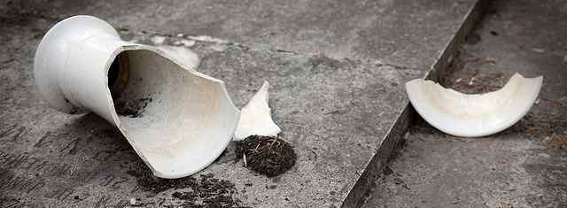
Changed his entire life..
7 But what things were gain to me, these I have counted loss for Christ. 8 Yet indeed I also count all things loss for the excellence of the knowledge of Christ Jesus my Lord, for whom I have suffered the loss of all things, and count them as rubbish, that I may gain Christ ..

Slide 11
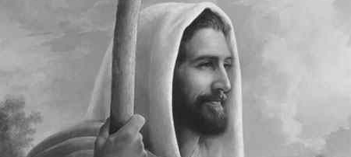
His consuming passion..
9 be found in Him, not having my own righteousness, which is from the law, but that which is through faith in Christ, the righteousness which is from God by faith;

Slide 12
His consuming passion..
10 that I may know Him and the power of His resurrection, and the fellowship of His sufferings, being conformed to His death, 11 if, by any means, I may attain to the resurrection from the dead.

Slide 13
The plain truth..
Trusting our own achievements brings glory now but not spiritually for eternity..
Trusting in Christ’s perfect accomplishment gives Him glory and results in our eternal righteousness..

Slide 14
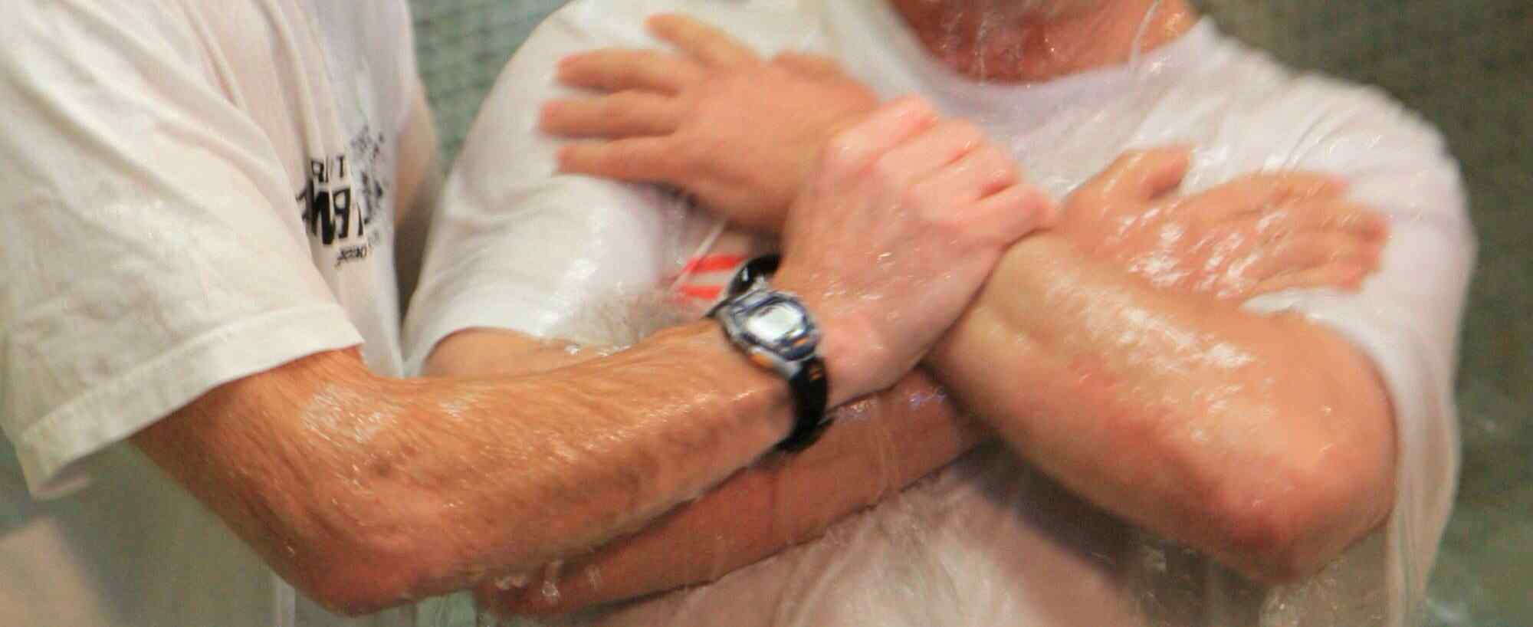
Joy is knowing Christ..
Romans 6:1-4 What shall we say then? Shall we continue in sin that grace may abound? 2 Certainly not! How shall we who died to sin live any longer in it? 3 Or do you not know that as many of us as were baptized into Christ Jesus were baptized into His death? 4 Therefore we were buried with Him through baptism into death, that just as Christ was raised from the dead by the glory of the Father, even so we also should walk in newness of life.

Slide 15
Righteousness from God
Philippians 3:1-11

