Slide 1
Servants and Friends
Philippians 2:19-30

Slide 2
Lights in the world..
Phil 2:15-16 children of God without fault in the midst of a crooked and perverse generation, among whom you shine as lights in the world, 16 holding fast the word of life, so that I may rejoice in the day of Christ that I have not run in vain or labored in vain.

Slide 3
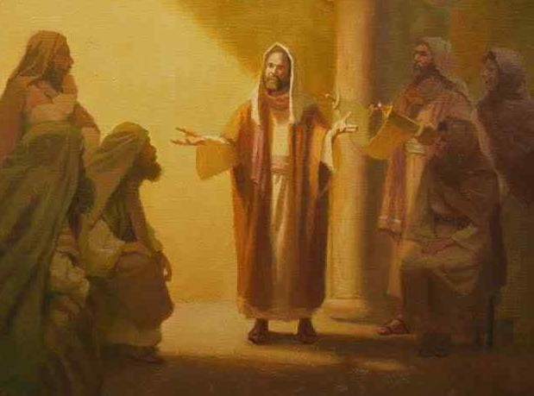
Paul’s example..
2:17-18 Yes, and if I am being poured out as a drink offering on the sacrifice and service of your faith, I am glad and rejoice with you all. 18 For the same reason you also be glad and rejoice with me.

Slide 4
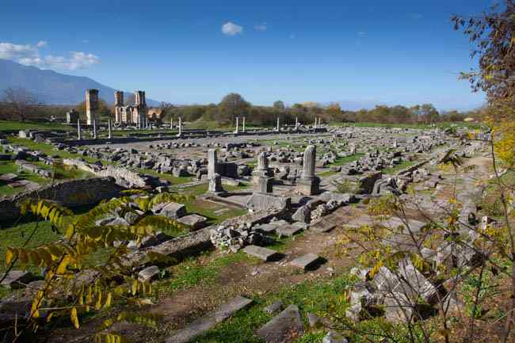
Living out your faith..
Life worthy of the gospel (1:27)
Of one accord, one mind (2:2-4)
Have the mind of Christ (2:5-8)
Do all without complaining (2:14)

Slide 5
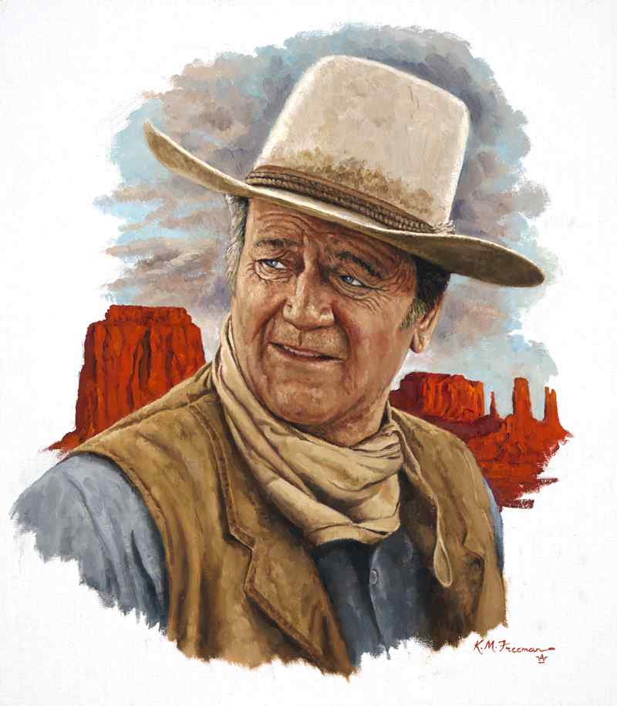
Was Paul a loner?
Paul needed friends .. he was supported by a strong circle of friends..
Barnabas, Silas, Luke, Titus, Priscilla and Aquila.. but none closer than Timothy

Slide 6
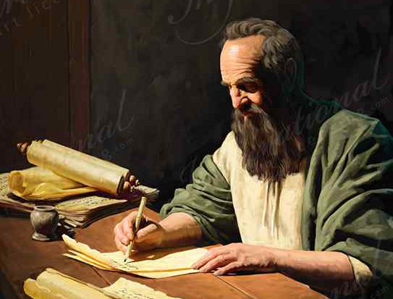
Actions louder than words..
To show the principles he is exhorting of them Paul cites two men who manifested the mind of Christ .. Timothy and Epaphroditus

Slide 7
True friends are gold...
Proverbs 17:17 A friend loves at all times, and a brother is born for adversity.

Slide 8
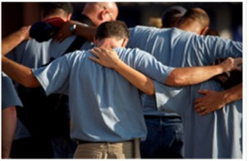
Good friends are loyal..
Proverbs 18:24 A man of many com-panions may come to ruin, but there is a friend who sticks closer than a brother.

Slide 9
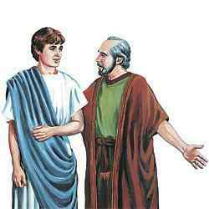
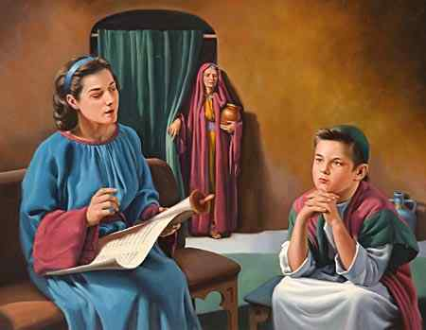
Paul’s “son” Timothy..
Phil 2:19 But I trust in the Lord Jesus to send Timothy to you shortly, that I also may be encouraged when I know your state. 20 For I have no one like-minded, who will sincerely care for your state.

Slide 10
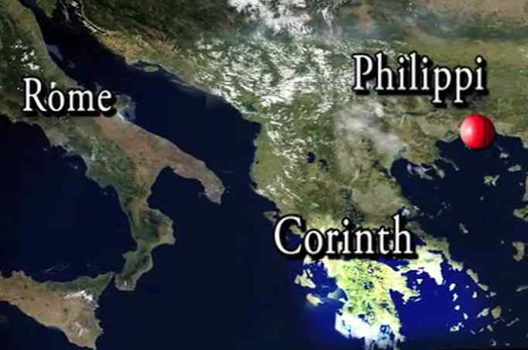
Timothy’s willingness as messenger for Paul..

Slide 11
Timothy’s willingness as messenger for Paul..
Paul had sent Timothy to Thessalonica, to Corinth, and to Philippi ..

Slide 12
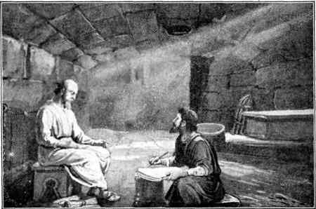
His proven character..
Phil 2:21 For all seek their own, not the things which are of Christ Jesus. 22 But you know his proven character, that as a son with his father he served with me in the gospel. 23 Therefore I hope to send him at once, as soon as I see how it goes with me. 24 But I trust in the Lord that I myself shall also come shortly.

Slide 13
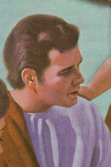
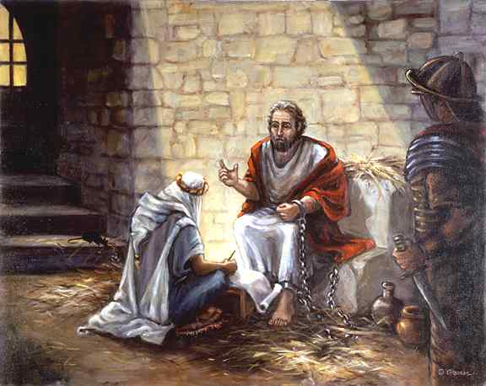
A brother named Epaphroditus..
Phil 2:25-27 Yet I considered it necessary to send to you Epaphroditus, my brother, fellow worker, and fellow soldier, but your messenger and the one who ministered to my need; 26 since he was longing for you all, and was distressed because you had heard that he was sick. 27 For indeed he was sick almost unto death; but God had mercy on him, and not only on him but on me also, lest I should have sorrow upon sorrow.

Slide 14
Esteem such men..
28 Therefore I sent him the more eagerly, that when you see him again you may rejoice, and I may be less sorrowful. 29 Receive him therefore in the Lord with all gladness, and hold such men in esteem; 30 because for the work of Christ he came close to death, not regarding his life, to supply what was lacking in your service toward me.

Slide 15
Servants and friends...
Present – they are by your side in need
Sacrifice – willing to give of themselves
Endurance – faithful at their own risk

Slide 16
Servants and Friends
Philippians 2:19-30

