Slide 1
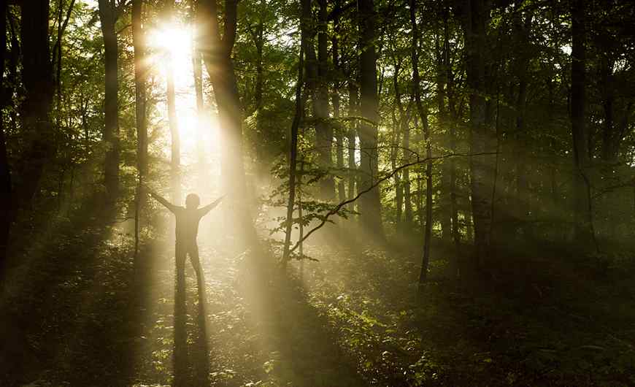
Shine for His Glory
Philippians 2:12-18

Slide 2
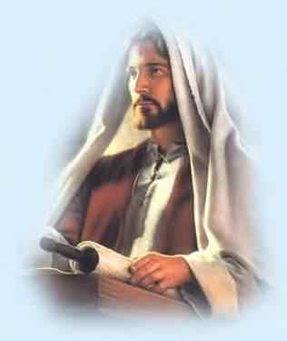
God’s recipe for joy..
(from Philippians)
Praying for others .. 1:3-11
Triumph over trouble .. 1:12-26
Standing firm together .. 1:27-30
Counting others better .. 2:1-4
Ultimate servanthood .. 2:5-11

Slide 3
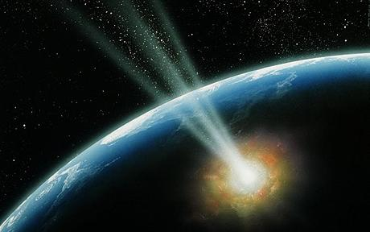
Jesus’ great example…
Vs 5 Let this mind be in you which was also in Christ Jesus..
GLORY
GLORY
(vs 9-11)
CROSS
(vs 6-8)

Slide 4
1 I Will Do My Part …
Phil 2:12 Therefore, my beloved, as you have always obeyed, not as in my presence only, but now much more in my absence, work out your own salvation with fear and trembling…

Slide 5
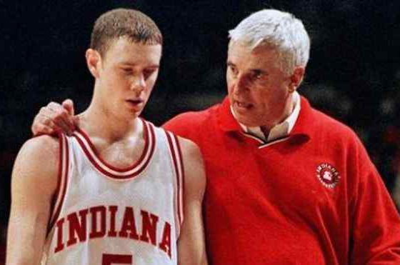
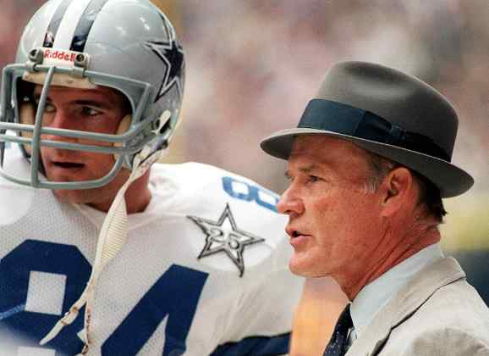
Great coaches on discipline..
Bobby Knight
Tom Landry
1 Do what has to be done
2 When it has to be done
3 As well as it can be done
4 Do it that way all the time
“Setting a goal is not the main thing. It is deciding how you will go about achieving it and staying with that plan. The key is discipline. Without it there is no morale.”

Slide 6
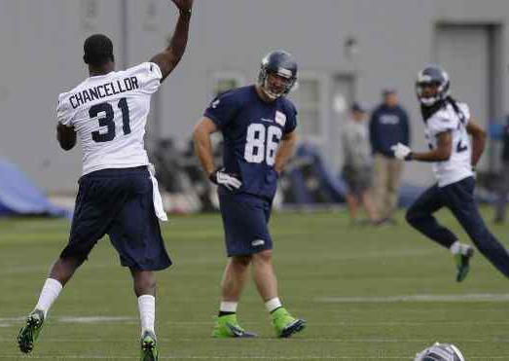
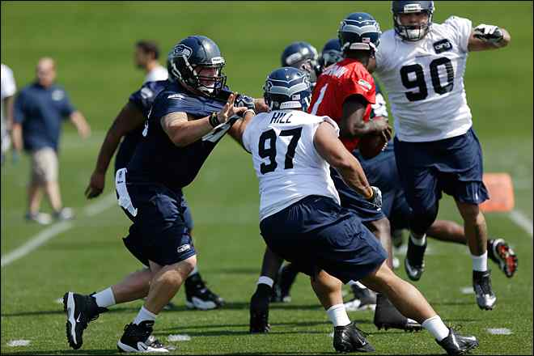
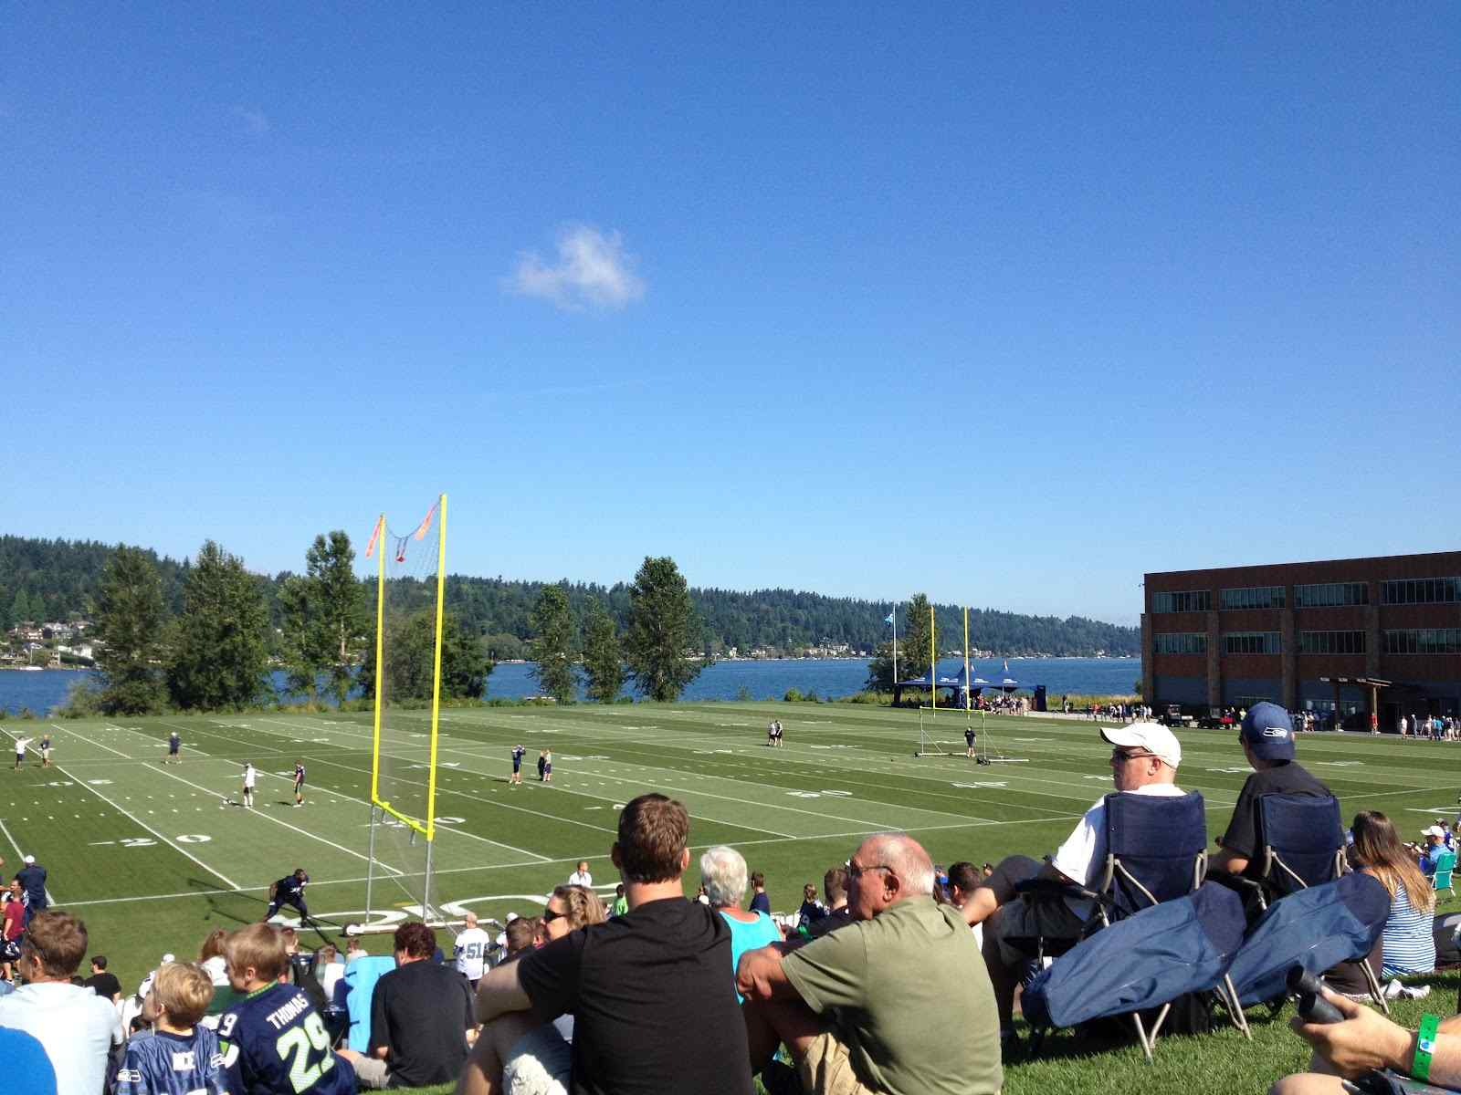
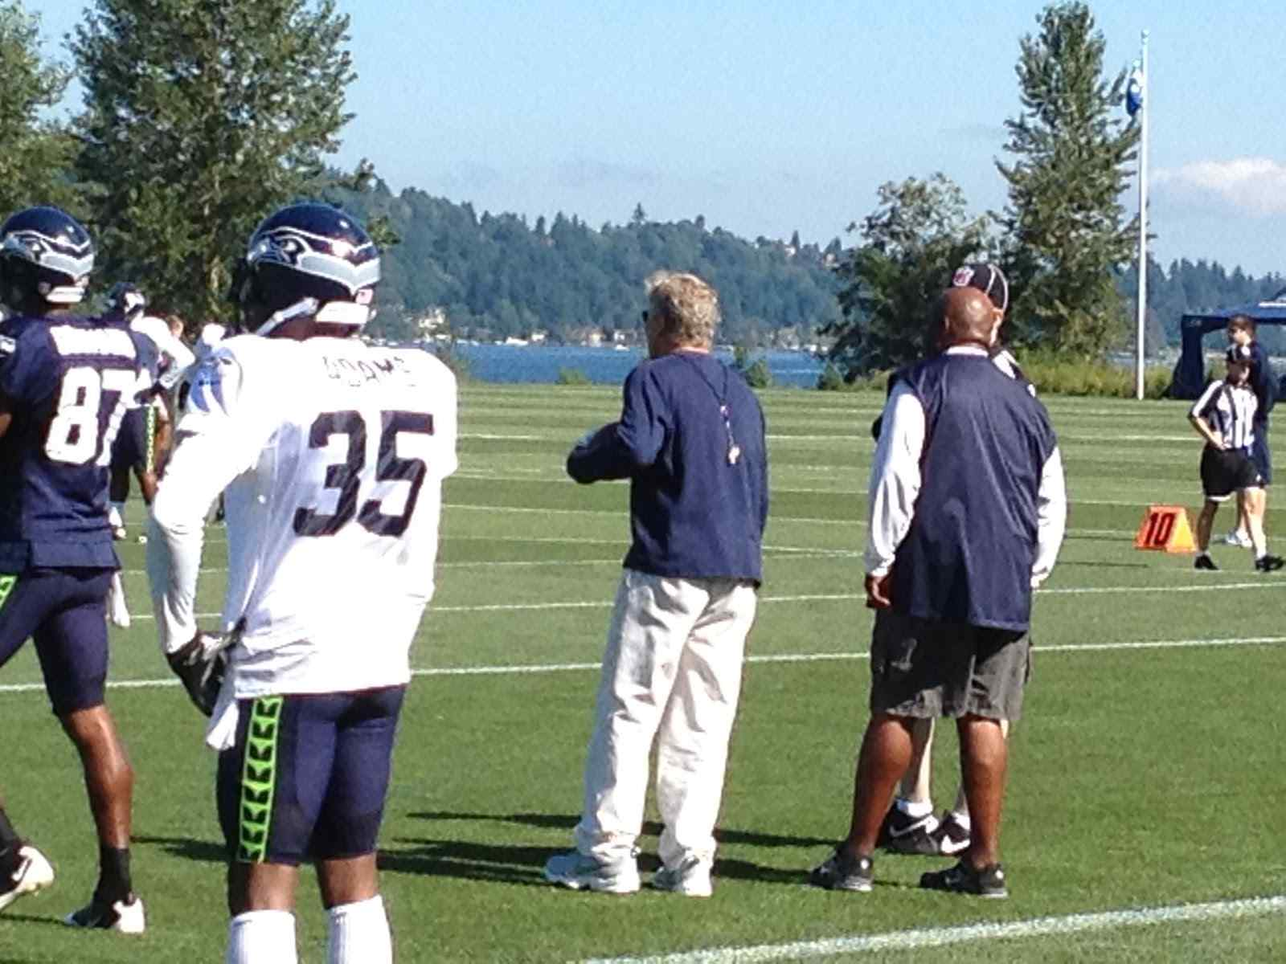
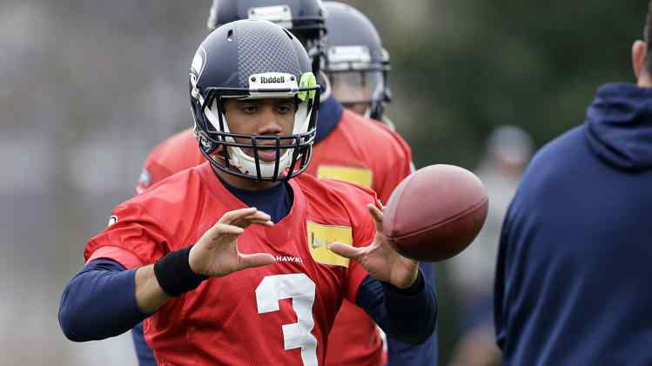
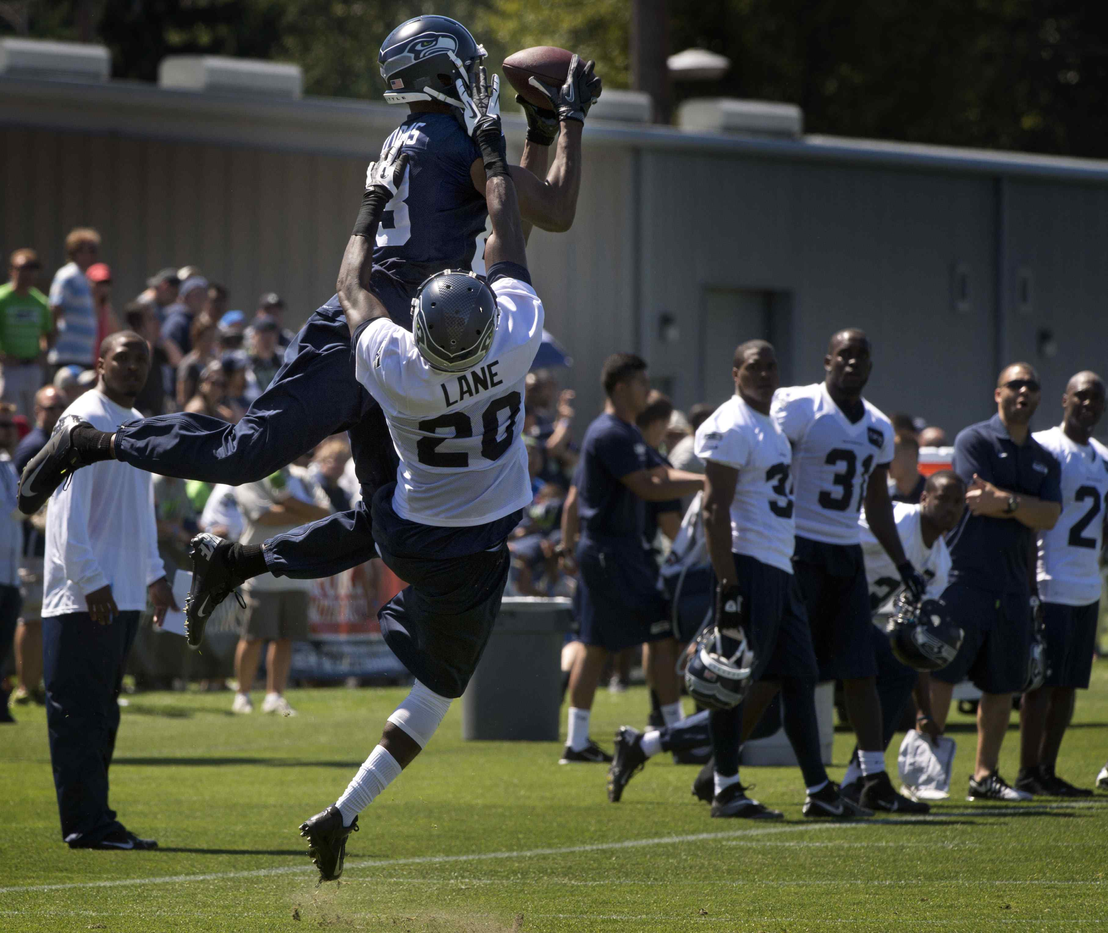
Seahawks training camp..

Slide 7
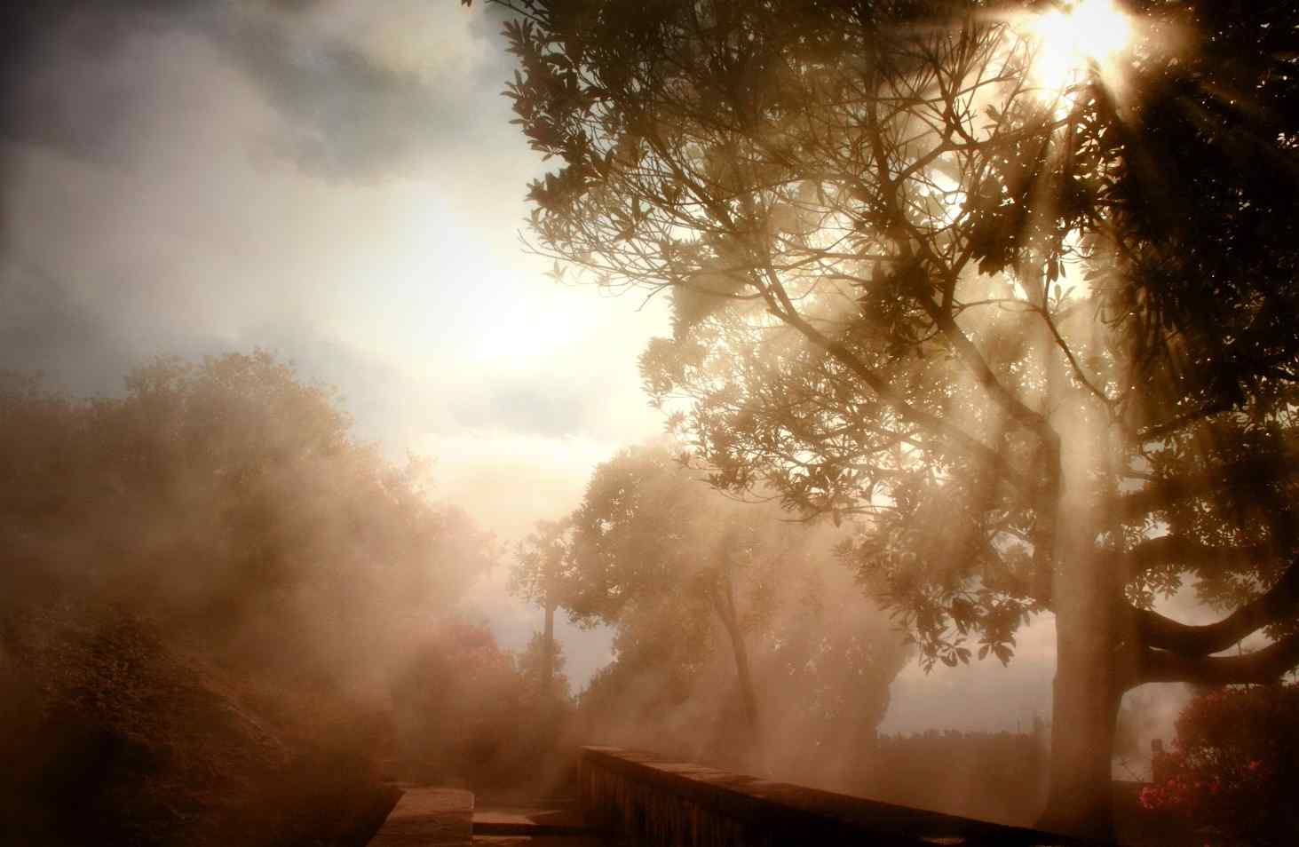
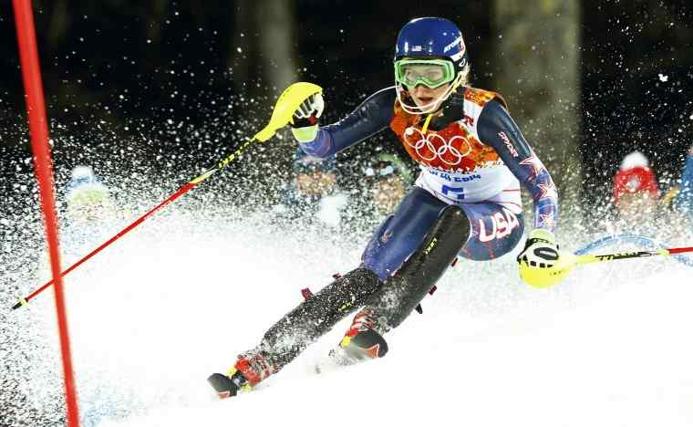
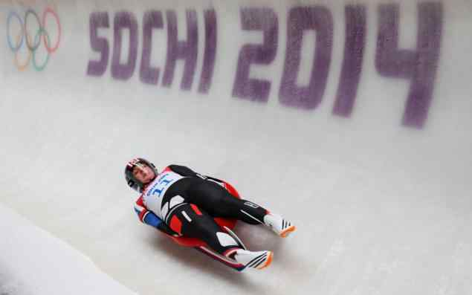
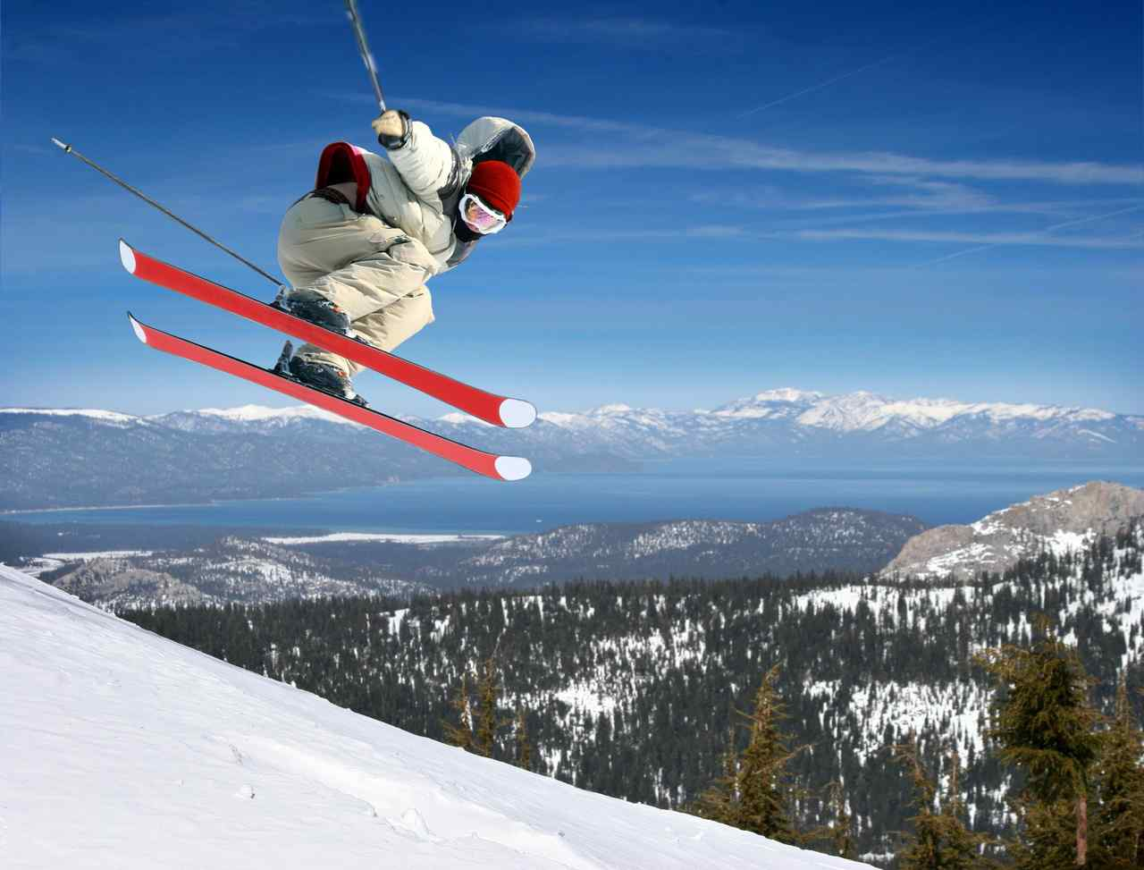

Slide 8
Work out what God has worked in you…
Ephesians 2:8-10 For by grace you have been saved through faith, and that not of yourselves; it is the gift of God, 9 not of works, lest anyone should boast. 10 For we are His workmanship, created in Christ Jesus for good works, which God prepared beforehand that we should walk in them.
Titus 2:13-14 looking for the blessed hope and glorious appearing of our great God and Savior Jesus Christ, 14 who gave Himself for us, that He might redeem us from every lawless deed and purify for Himself His own special people, zealous for good works.

Slide 9
2 I Will Depend on God…
Phil 2:13 13 for it is God who works in you both to will and to do for His good pleasure.
Ephesians 3:20 Now to Him who is able to do exceedingly abundantly above all that we ask or think, according to the power that works in us...

Slide 10
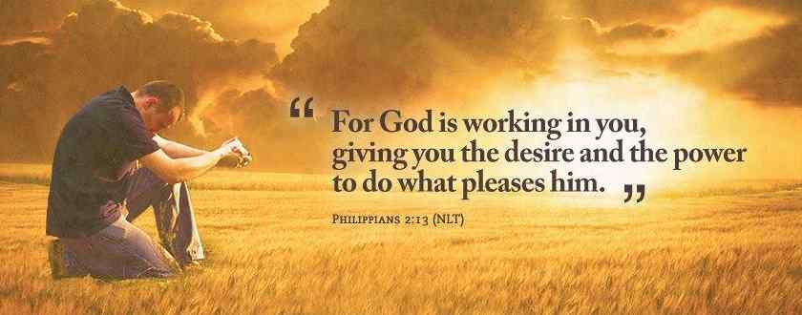
1 Corinthians 15:10 But by the grace of God I am what I am, and His grace toward me was not in vain; but I labored more abundantly than they all, yet not I, but the grace of God which was with me.

Slide 11
God’s part and our part (grace and works) …
2 Peter 1:3-4 as His divine power has given to us all things that pertain to life and godliness, through the knowledge of Him who called us by glory and virtue, 4 by which have been given to us exceedingly great and precious promises, that through these you may be partakers of the divine nature..
2 Peter 1:5-8 But also for this very reason, giving all diligence, add to your faith virtue, to virtue knowledge, 6 to knowledge self-control, to self-control perseverance, to perseverance godliness, 7 to godliness brotherly kindness, and to brotherly kindness love…

Slide 12
3 I Will Be Different from the World…
14 Do all things without complaining and disputing, 15 that you may become blameless and harmless, children of God without fault in the midst of a crooked and perverse generation, among whom you shine as lights in the world, 16 holding fast the word of life, so that I may rejoice in the day of Christ that I have not run in vain or labored in vain.

Slide 13
Cheerful in an unhappy world…
14 Do all things without complaining and disputing…
Murmuring” to mutter, grumble
1 Corinthians 10:10 nor complain, as some of them also complained, and were destroyed by the destroyer.
Disagree without being disagreeable.. (Paul and Barnabas – Acts 15:36-40)

Slide 14
Straight in a crooked world..
15 that you may become blameless and harmless, children of God without fault in the midst of a crooked and perverse generation..
Matthew 10:16 "Behold, I send you out as sheep in the midst of wolves. Therefore be wise as serpents and harmless as doves.
Romans 16:19 ; but I want you to be wise in what is good, and simple concerning

Slide 15
Shining bright in a dark world ..
15-16 among whom you shine as lights in the world, 16 holding fast the word of life, so that I may rejoice in the day of Christ that I have not run in vain or labored in vain.
Matthew 5:14-16 "You are the light of the world. A city that is set on a hill cannot be hidden. 15 Nor do they light a lamp and put it under a basket, but on a lampstand, and it gives light to all who are in the house. 16 Let your light so shine before men, that they may see your good works and glorify your Father in heaven.

Slide 16
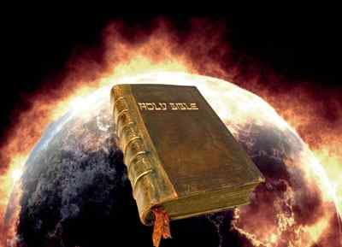
Holding forth the word of life…
so that I may rejoice in the day of Christ that I have not run in vain or labored in vain.

Slide 17
Shine for His Glory
Philippians 2:12-18

