Slide 1
Think on These Things Whatever things are true.. noble.. pure.. lovely..
Philippians 4:8-9

Slide 2
Battle for our minds..
Prov 4:23 Keep your heart with all dili-gence, for out of it spring the issues of life.
23:7 As a man thinks in his heart, so is he.

Slide 3
Set your mind..
Col 3:1-2 If then you were raised with Christ, seek those things which are above, where Christ is, sitting at the right hand of God. 2 Set your mind on things above, not on things on the earth.

Slide 4
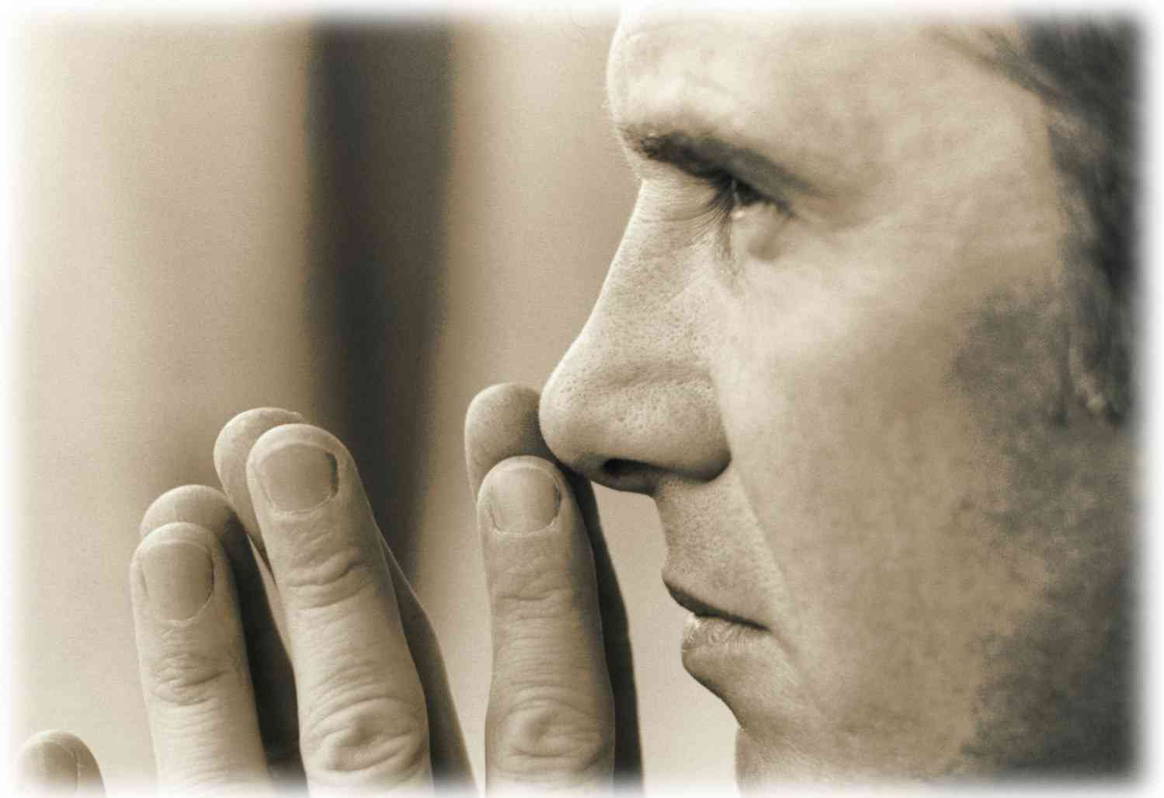
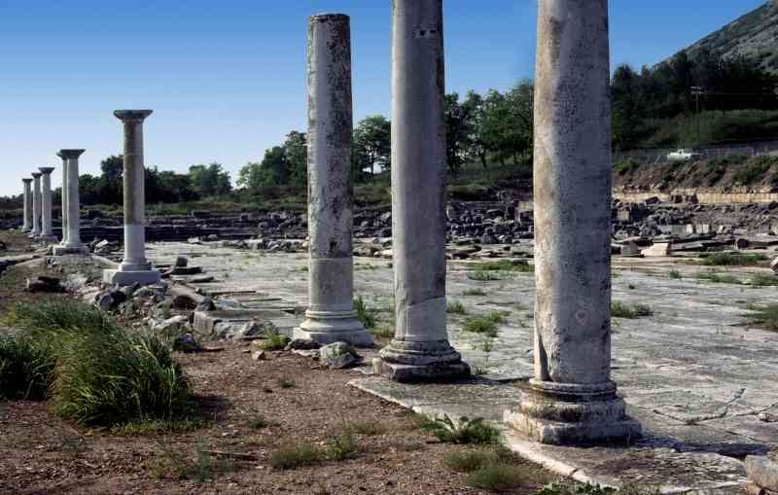
We are in a war..
The world’s goal: to control our actions by controlling our minds…

Slide 5
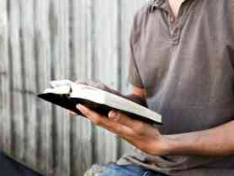
Dwell on these…
8 Finally, brethren, whatever things are true, whatever things are noble, whatever things are just, whatever things are pure, whatever things are lovely, whatever things are of good report, if there is any virtue and if there is anything praiseworthy — meditate on these things.

Slide 6
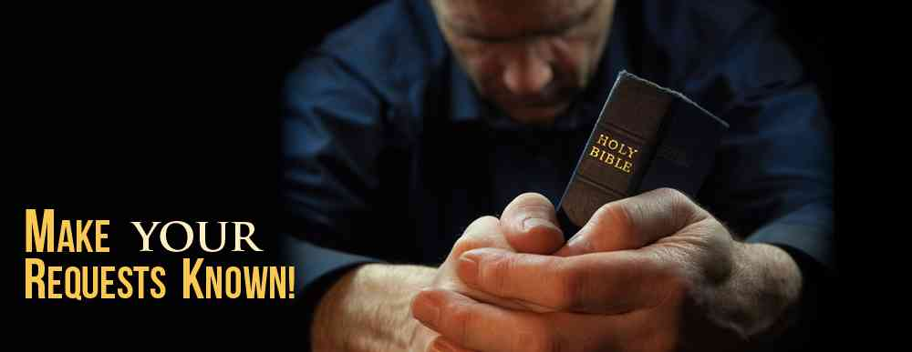
Context..
Our thought life is essential to healthy relationships, a life of joy and peace..

Slide 7
Whatever is true..
John 3:33 He who has received His testimony has certified that God is true.
Titus 1:2 in hope of eternal life which God, who cannot lie..
John 8:32 And you shall know the truth, and the truth shall make you free.
John 17:17 Your word is truth.

Slide 8
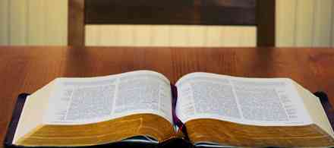
Satan’s deception..
Tolerance
Emotions
Pragmatism
John 8:44 He was a murderer from the beginning.. for he is a liar and the father of it.
2 Cor 11:3 as the serpent deceived Eve by his craftiness, so your minds may be corrupted from the simplicity that is in Christ.

Slide 9
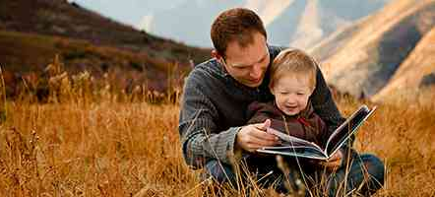
Whatever is honorable..
1 Timothy 3:8 Likewise deacons must be reverent (worthy of respect)..
1 Timothy 3:11 Likewise, their wives must be reverent (worthy of respect)..
Titus 2:2 that the older men be sober, reverent, temperate, sound in faith..

Slide 10
Whatever is pure..
1 Timothy 5:22 keep yourself pure.
James 3:17 the wisdom that is from above is first pure, then peaceable, gentle, willing to yield, full of mercy and good fruits, without partiality and without hypocrisy.

Slide 11
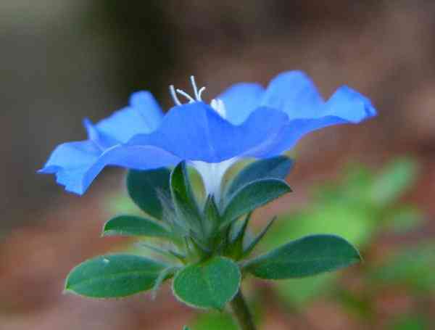
Whatever is lovely..
Admirable, agreeable, winsome..

Slide 12
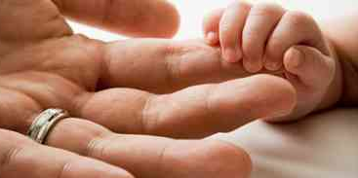
Whatever is of good report..
1 Corinthians 13:4-7 Love suffers long and is kind; love does not envy..does not rejoice in iniquity, but rejoices in the truth; .. bears all things, believes all things, hopes all things, endures all things.

Slide 13
If there is any excellence..
Philippians 1:9-11 that you may approve the things that are excellent, that you may be sincere and without offense till the day of Christ..
1 Peter 2:9 His own special people, that you may proclaim the excellencies of Him who called you out of darkness into His marvelous light;
2 Pet 1:5 add to your faith virtue, to virtue knowledge

Slide 14
Anything worthy of praise..
1 Corinthians 4:5 Then each one's praise will come from God.
Philippians 1:11 filled with the fruits of righteousness which are by Jesus Christ, to the glory and praise of God.

Slide 15
Meditate on these..
Watch your thoughts- they become your words.
Watch your words – they become your actions.
Watch your actions – they become character.
Watch your character – it become your destiny.

Slide 16
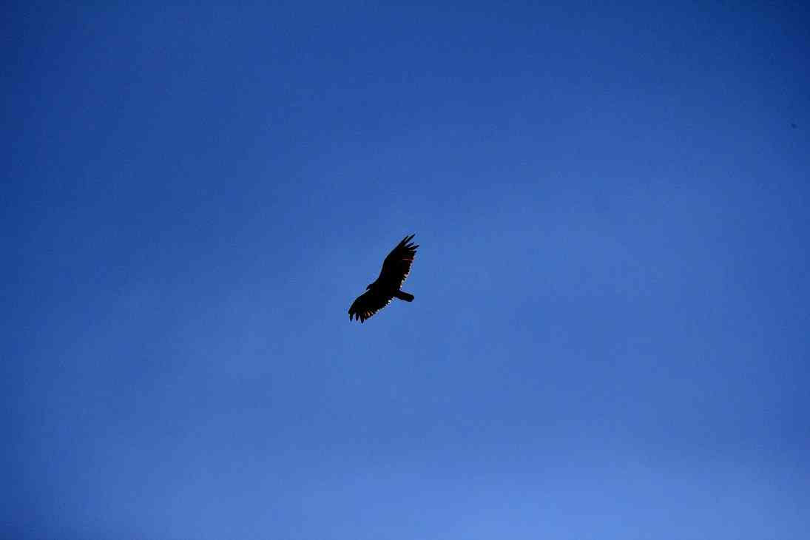
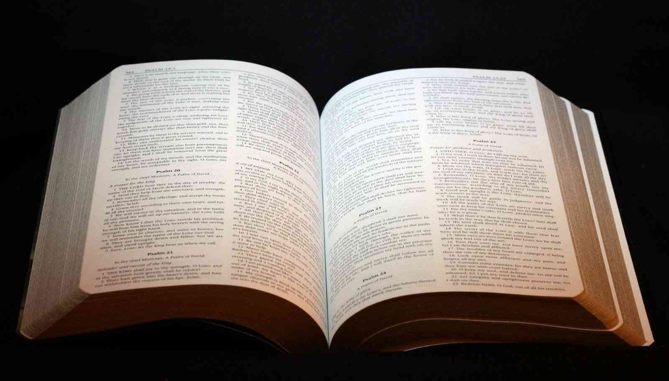
Vultures …

Slide 17
What you have learned..
9 The things which you learned and received and heard and saw in me, these do, and the God of peace will be with you.
Matthew 11:29 Take My yoke upon you and learn from Me, for I am gentle and lowly in heart, and you will find rest for your souls.

Slide 18
The God of Peace..
Isaiah 26:3 You will keep him in perfect peace, whose mind is stayed on You, because he trusts in You.
John 14:27 Peace I leave with you, My peace I give to you; not as the world gives do I give to you. Let not your heart be troubled, neither let it be afraid.

Slide 19
Think on These Things Whatever things are true.. noble.. pure.. lovely..
Philippians 4:8-9

