Slide 1
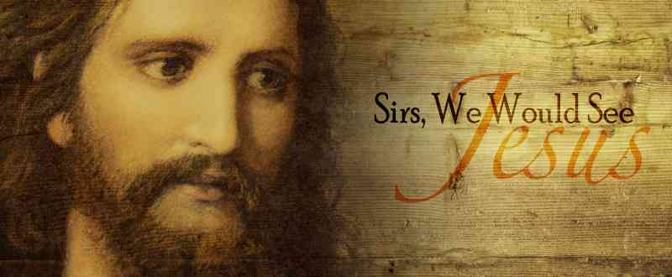
Feel His Passion
Luke 19:37-48

Slide 2
Handling our emotions..
We feel alive .. powerful, pleasant
Follow our feelings? .. or unreliable?

Slide 3
God has emotions..
Grieved, angry, love, joy…
Image of God.. use emotions properly

Slide 4
Jesus’ emotions…
What stirred His emotions?
What ignited His passion?

Slide 5
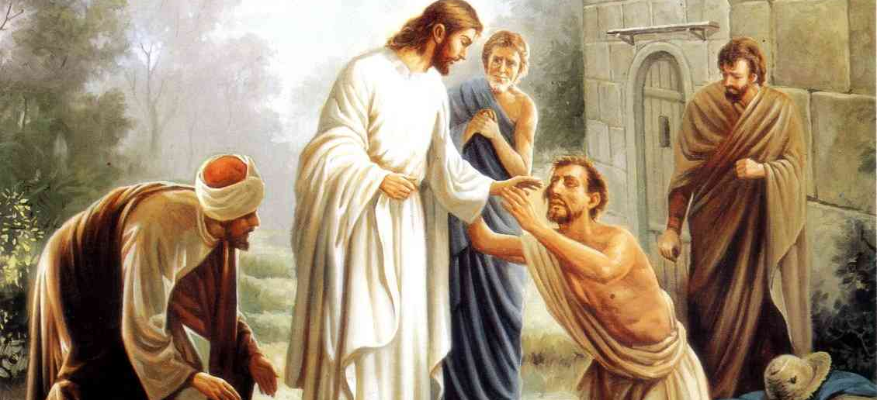
People in physical distress..
He was moved with compassion..
Healed the sick..
Touching the afflicted..
Feeding the hungry..
Sympathy for the grieving..

Slide 6
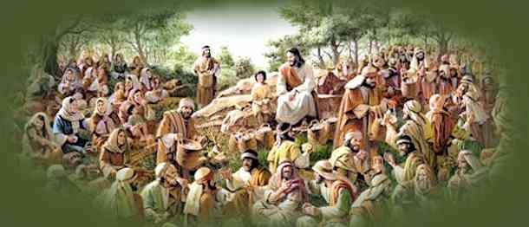
For the spiritually seeking..
Passion for those who were lost ..
Taught with passion … Mark 6:34; Jer 20:9
Passionate about worship .. John 4:24
Condemned hypocritical worship .. Matt 23
Intensifying our worship … “Oh, Lord…”

Slide 7
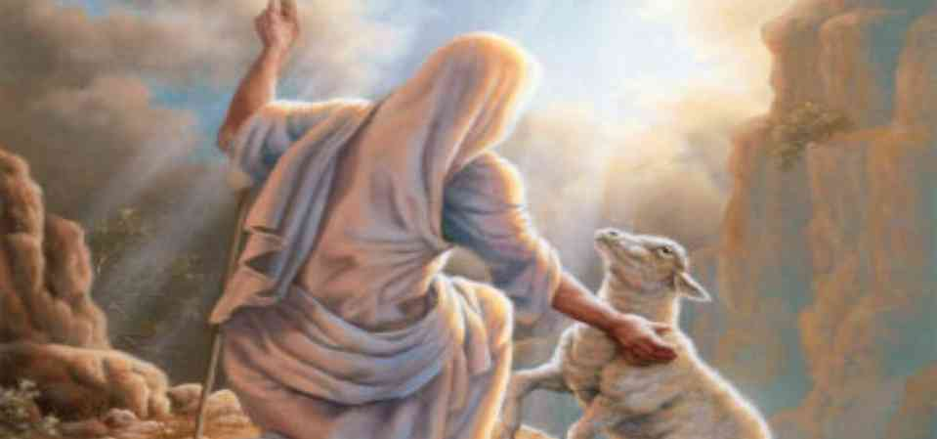
The spiritually wandering..
He cared when people departed ..
Wept over Jerusalem .. Luke 19:42; Matt 23:37
Rich young ruler .. Mark 10:19-20
Those spiritually immature .. Mark 2:5
Even the rebellious … James 5:19-20

Slide 8
Doing the will of God..
The last week .. Passion (suffering)
In Gethsemane .. Not my will but thy will
For this purpose I have come .. John 12:27
My food is to do the will of My Father

Slide 9
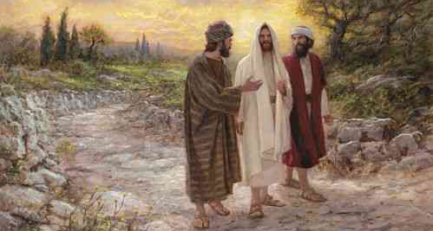
Mind and emotions..
The mind is the controller ..
Emotions will lead to ruin…
Romans 10:1-3
Luke 24:25 – our hearts burned when He opened the scriptures…

Slide 10
Feel His Passion
Luke 19:37-48

