Slide 1
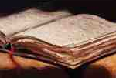
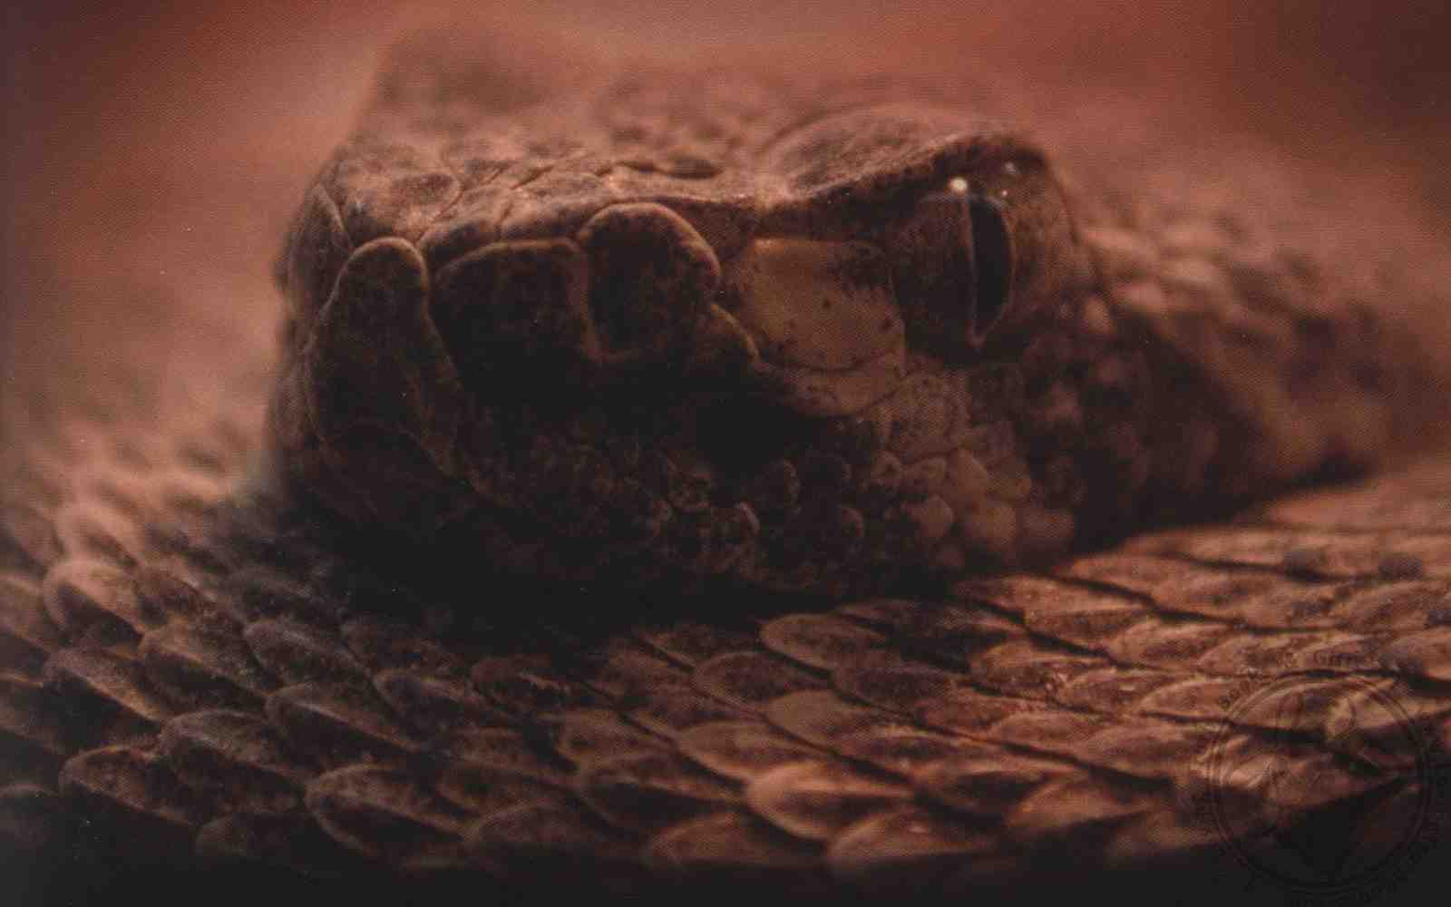
Is Truth Worth Fighting For?
Proverbs 23:16-23

Slide 2
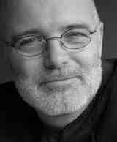
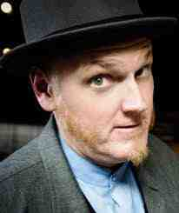
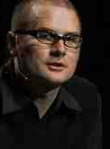
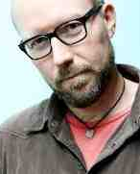
Questioning truth…
Truth is uncertain ???

Slide 3
Know and love truth..
2 Thess 2:10 those who perish, because they did not receive the love of the truth, that they might be saved.
John 8:32 you shall know the truth, and the truth shall make you free.

Slide 4
Eternal value of truth..
1 Timothy 3:15 the church of the living God, the pillar and ground of the truth.

Slide 5
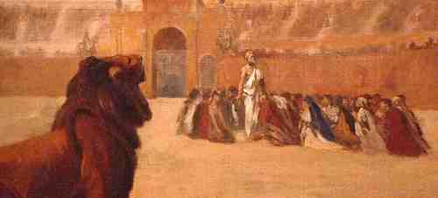
Many died for the truth..
Ignatius, Polycarp knew and were taught by the apostle John…

Slide 6
Faithfulness costs us..
2 Timothy 3:12 all who desire to live godly in Christ Jesus will suffer persecution.
Luke 9:23 "If anyone desires to come after Me, let him deny himself, and take up his cross daily, and follow Me.

Slide 7
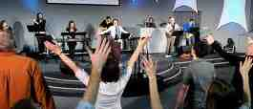
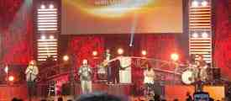
Seeking popularity ..
Draw people in by making the church cool for unbelievers ..

Slide 8
Willing to live and die for the truth..
Know the truth .. the truth set us free
We love the truth .. Saved by it
Psalms 107:2 Let the redeemed of the Lord say so, whom He has redeemed from the hand of the enemy..

Slide 9
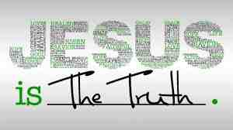
What is Truth?
Psa 31:5 You have redeemed me, O Lord God of truth.
Truth belongs to and comes from God..
Man’s sin is hostile to truth .. Rom 8:7

Slide 10
The church is to defend truth..
Eph 6:12 For we do not wrestle against flesh and blood, but against principalities, against powers, against the rulers of the darkness of this age, against spiritual hosts of wickedness in the heavenly places.

Slide 11
Unconcerned?
Exodus 20:5 For I, the Lord your God, am a jealous God, visiting the iniquity of the fathers upon the children to the third and fourth generations of those who hate Me..

Slide 12
No compromise..
John 8:44 You are of your father the devil, and the desires of your father you want to do. He was a murderer from the beginning, and does not stand in the truth, because there is no truth in him. When he speaks a lie, he speaks from his own resources, for he is a liar and the father of it.

Slide 13
What is our response?
Acts 20:28 Therefore take heed to yourselves and to all the flock, among which the Holy Spirit has made you overseers, to shepherd the church of God which He purchased with His own blood.

Slide 14
Closing epistles.. Devotion to the Truth
2 John 7 For many deceivers have gone out into the world who do not confess Jesus Christ as coming in the flesh. This is a deceiver and an antichrist. 8 Look to yourselves, that we do not lose those things we worked for, but that we may receive a full reward.

Slide 15
Closing epistles.. Devotion to the Truth
9 Whoever transgresses and does not abide in the doctrine of Christ does not have God. He who abides in the doctrine of Christ has both the Father and the Son. 10 If anyone comes to you and does not bring this doctrine, do not receive him into your house nor greet him; 11 for he who greets him shares in his evil deeds.

Slide 16
Closing epistles.. Devotion to the Truth
9 I wrote to the church, but Diotrephes, who loves to have the preeminence among them, does not receive us. 10 Therefore, if I come, I will call to mind his deeds which he does, prating against us with malicious words. And not content with that, he himself does not receive the brethren, and forbids those who wish to, putting them out of the church.
11 Beloved, do not imitate what is evil, but what is good. He who does good is of God, but he who does evil has not seen God.

Slide 17
Closing epistles.. Devotion to the Truth
Jude 3-4 Beloved, while I was very diligent to write to you concerning our common salvation, I found it necessary to write to you exhorting you to contend earnestly for the faith which was once for all delivered to the saints. 4 For certain men have crept in unnoticed, who long ago were marked out for this condemnation, ungodly men, who turn the grace of our God into lewdness and deny the only Lord God and our Lord Jesus Christ.

Slide 18
The Battle for Truth..

Slide 19
Is Truth Worth Fighting For?
Proverbs 23:16-23

