Slide 1
Teach Us to Pray
Petition and Intercession
Matthew 7:7-11

Slide 2
Worship

Slide 3
Petitions..
To ask, to beg or solicit ..
Asking something from God..
A wanting, need, entreaty, supplication..

Slide 4
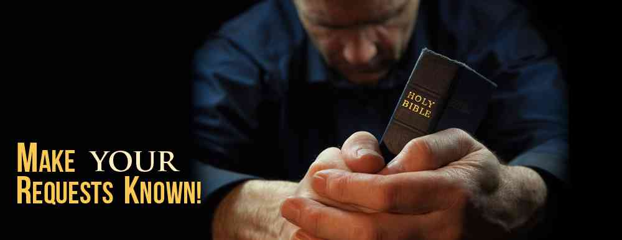
God wants us to petition Him..
Psalms 50:15 Call upon Me in the day of trouble; I will deliver you, and you shall glorify Me."
Jeremiah 33:3 'Call to Me, and I will answer you, and show you great and mighty things, which you do not know

Slide 5
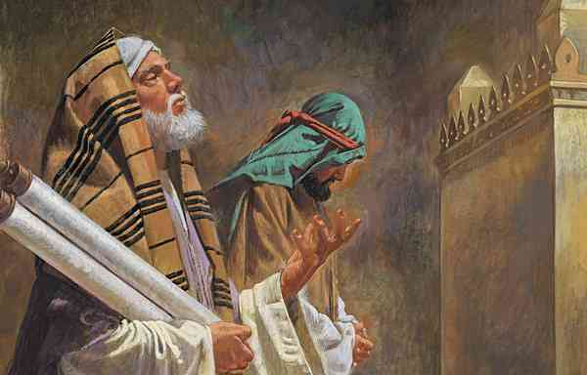
Only prayer not commended..
11 The Pharisee stood and prayed thus with himself, 'God, I thank You that I am not like other men — extortioners, unjust, adulterers, or even as this tax collector. 12 I fast twice a week; I give tithes of all that I possess.'

Slide 6
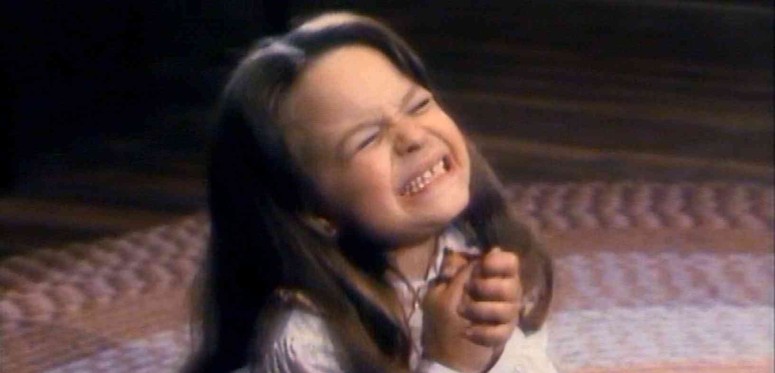
Are our requests immature?
If our prayers are almost all asking for our own needs ..
Maturity .. learning to be content (Phil 4:11)
Showing more concern for others (Phil 1:3-4)

Slide 7
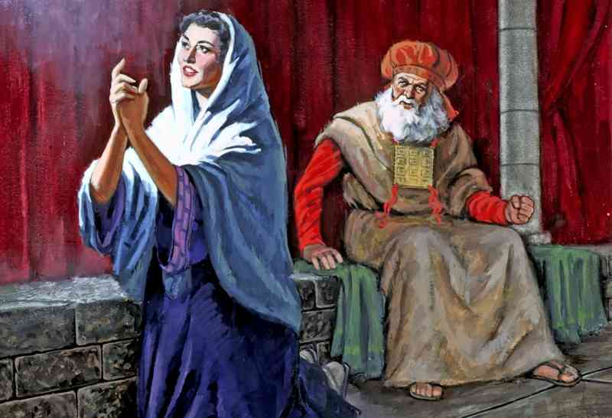
Hannah’s prayer..
1 Samuel 1:9-15 she prayed earnestly for a child and promised to dedicate him to the Lord…

Slide 8
Make your requests..
Philippians 4:6-7 Be anxious for nothing, but in everything by prayer and supplication, with thanksgiving, let your requests be made known to God; 7 and the peace of God, which surpasses all understanding, will guard your hearts and minds through Christ Jesus.

Slide 9
Ask in humble faith..
Mark 11:24 Therefore I say to you, whatever things you ask when you pray, believe that you receive them, and you will have them.
John 15:7 If you abide in Me, and My words abide in you, you will ask what you desire, and it shall be done for you.

Slide 10
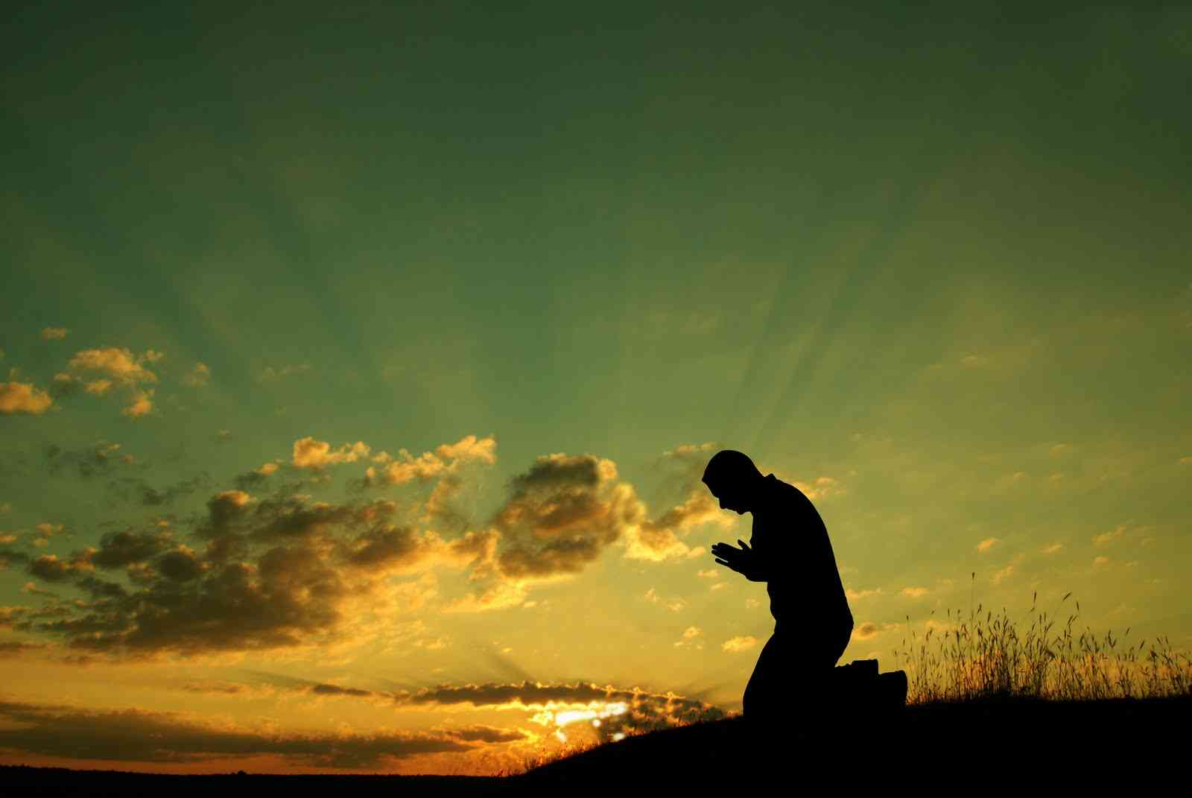
Give it to God…
1 Peter 5:6-7 Therefore humble yourselves under the mighty hand of God, that He may exalt you in due time, 7 casting all your care upon Him, for He cares for you.

Slide 11
Intercessions..
1 Timothy 2:1-2 Therefore I exhort first of all that supplications, prayers, intercessions, and giving of thanks be made for all men, 2 for kings and all who are in authority, that we may lead a quiet and peaceable life in all godliness and reverence.
To go between as a representative..
To approach God as a king..

Slide 12
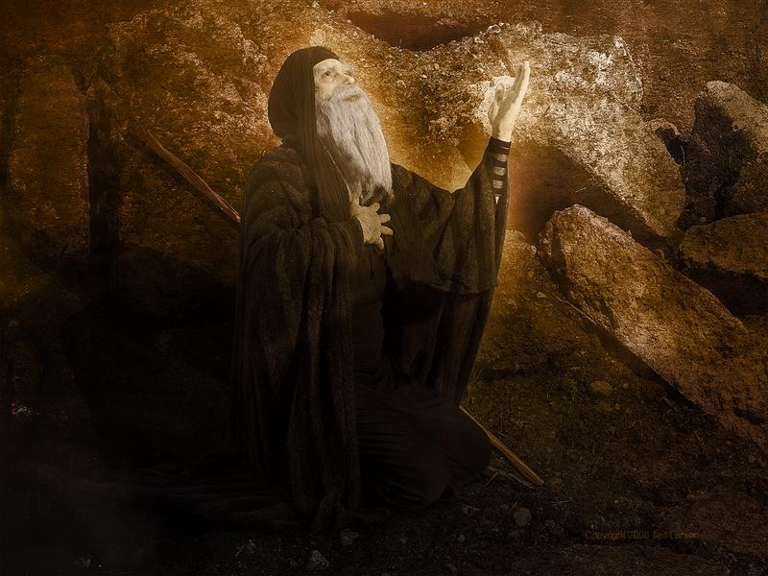
Moses…
Exodus 32:11-15 Then Moses pleaded with the Lord his God, and said: "Lord, why does Your wrath burn hot against Your people whom You have brought out of the land of Egypt with great power and with a mighty hand? "
14 So the Lord relented from the harm which He said He would do to His people.

Slide 13
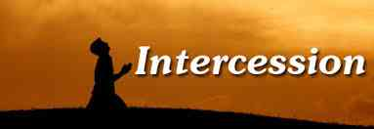
To intercede ..
Step in between two parties ..
We must have proper qualifications..
Proverbs 26:17 He who passes by and meddles in a quarrel not his own is like one who takes a dog by the ears.

Slide 14
Qualifications..
Purity of a righteous life..
James 5:16 Confess your trespasses to one another, and pray for one another, that you may be healed. The effective, fervent prayer of a righteous man avails much.
Abraham … Genesis 18; compare 1 Pet 3:7

Slide 15
Qualifications..
Realizing how vital it is..
1 Samuel 12:23 Moreover, as for me, far be it from me that I should sin against the Lord in ceasing to pray for you; but I will teach you the good and the right way.
1 Timothy 2:1-2 praying for all men, rulers..

Slide 16
Qualifications..
Selfless love for others…
Ezra 9 and Daniel 9 praying for Israel confessing the sins of the people…

Slide 17
Teach Us to Pray
Petition and Intercession
Matthew 7:7-11

