Slide 1
Teach Us to Pray
Luke 11:1-4

Slide 2
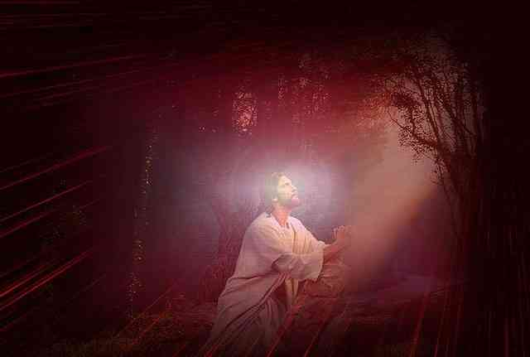
As Jesus was praying..
“Lord, teach us to pray”
Not as our personal experience, but what the word of God says…

Slide 3
Teach Us to Pray
God reveals a higher level of praying than we usually engage in today..

Slide 4
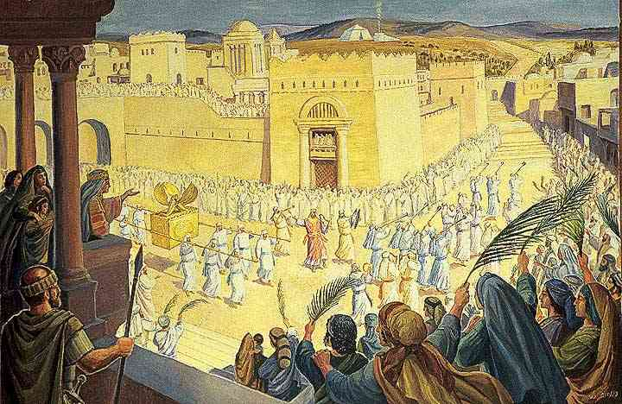
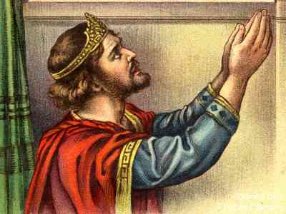
King David’s blessing
1 Chronicles 29:10-18
Do we pray like this … greatness in learning to communicate with God

Slide 5
The way Jesus prayed..
Prayed all night .. Luke 6:12
Agonizing prayer.. Luke 22:42

Slide 6
Teach Us to Pray
We haven’t fully realized the importance and power of prayer..

Slide 7
How important is prayer?
To Jesus .. before death
To the apostles.. Acts 6:1-4
“DEVOTE ourselves to prayer”
No limit if believe.. Mk 11:22-25
John 14:13-14; 15:7; 1 John 5:14-15

Slide 8
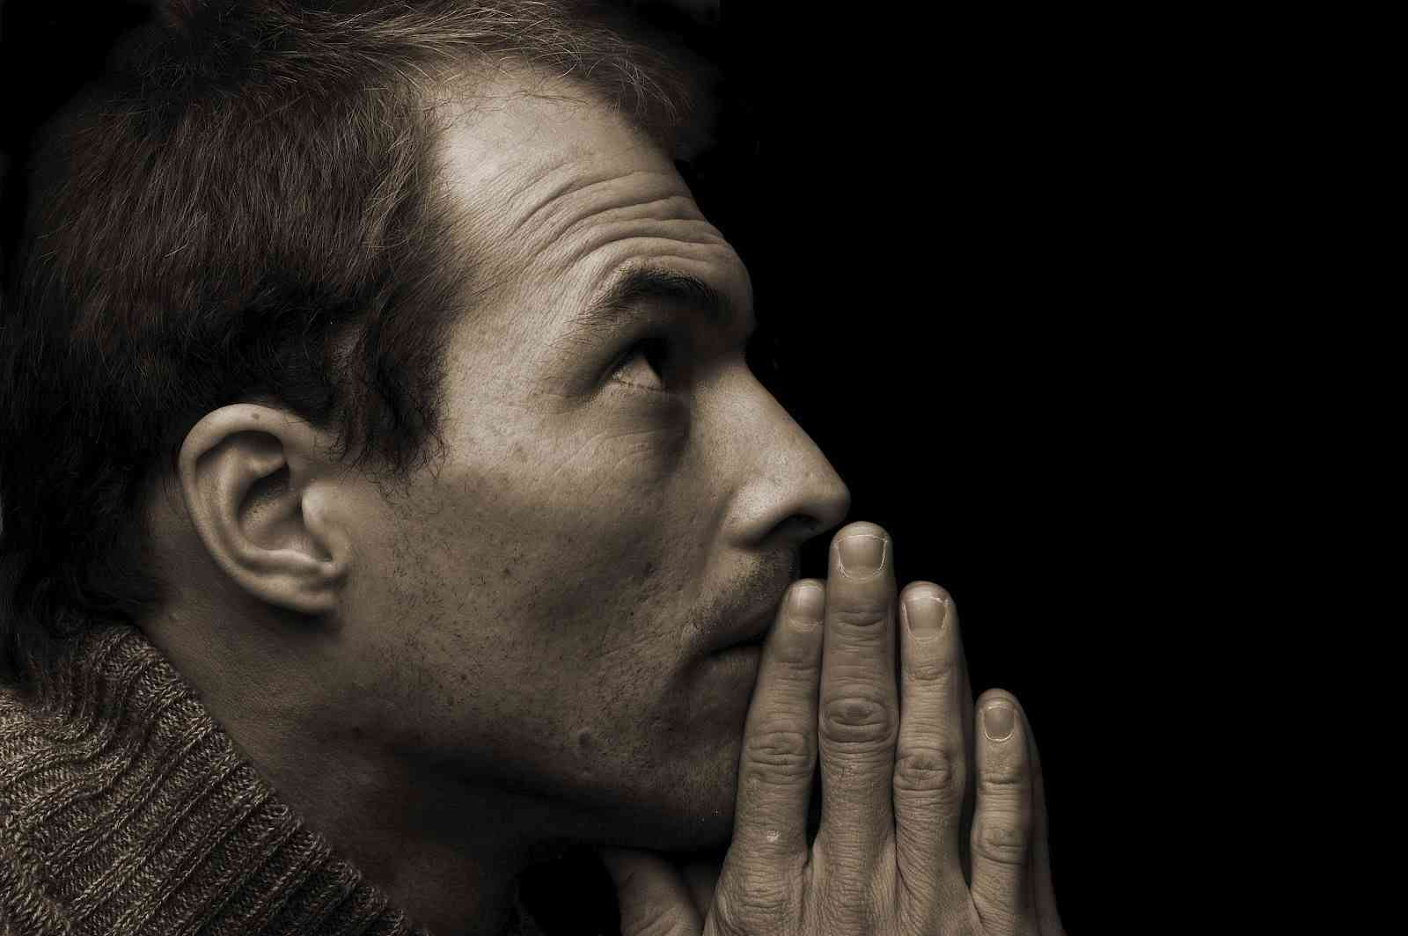
Achieve anything the mind can believe…
Mark 11:22-24 whoever says and has no doubt in his heart, but believes..
John 14:13-14; 15:7
1 John 5:14-15

Slide 9
Teach Us to Pray
Because prayer is a most difficult spiritual work..

Slide 10
Seems so simple..
“At first there is no work that appears so simple, but later on there is none more difficult.” (Andrew Murray - With Christ in the School of Prayer)

Slide 11
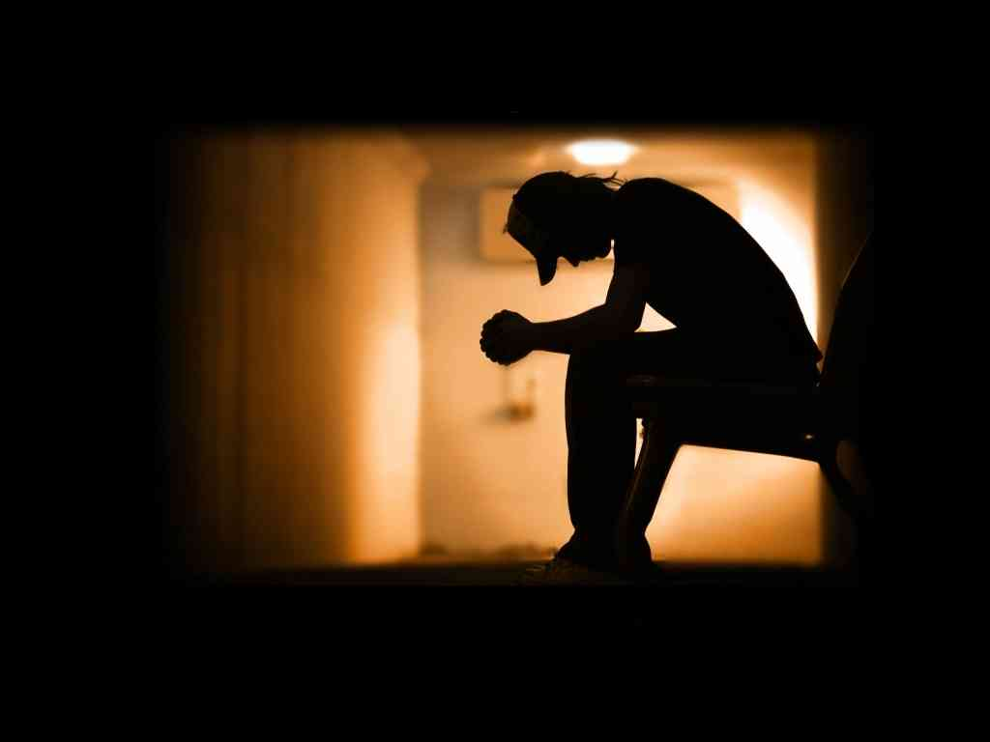
Why prayer is difficult..
Satan will allow almost anything if he can keep you from praying..
He will let you study prayer .. as long as you don’t pray..

Slide 12
Requires a life of righteousness…
Can’t pray effectively if don’t live it..
Active concern for others
Dedicated to God’s work

Slide 13
Prayer is deep exhausting spiritual work…
Like running a marathon, we are not strong enough to stay at our peak
Life interferes .. we become weak

Slide 14
Definition of Prayer
The means to achieve oneness with God where His will becomes ours and we allow Him to work through us..
Become effective tools for the Lord
We become God oriented

Slide 15
The variable is us..
Some of us are better conductors ..
Are we able to carry what we ask?

Slide 16
Teach Us to Pray
Luke 11:1-4

