Slide 1
Why Does God Allow Suffering?
1 Peter 4:12-19

Slide 2
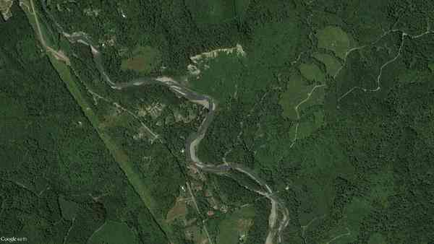
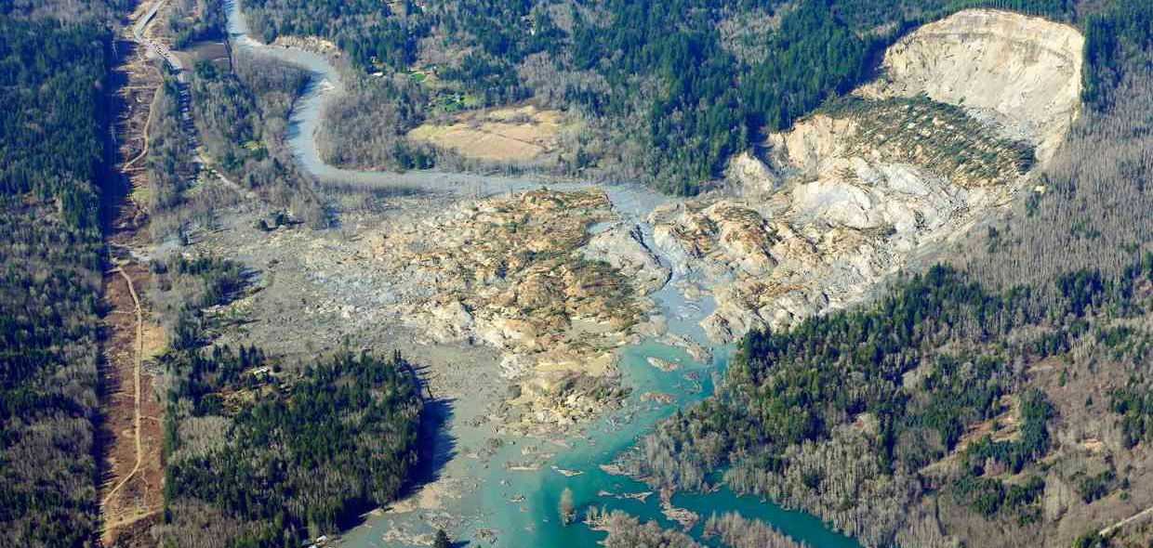
Evil, Suffering in the world…
The atheist says:”An all-powerful loving God wouldn’t allow such things to happen…

Slide 3
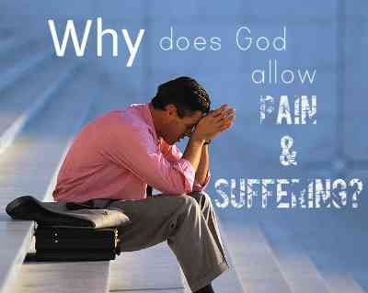
A question all struggle with…

Slide 4
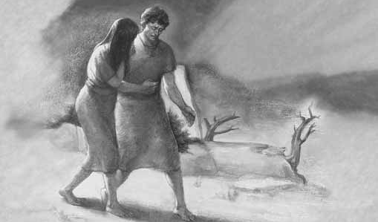
Biblical explanation…
Man given choice of good and evil, lost right to live in a world with no evil…

Slide 5
God of His love gave us free will..
Gen 2:16-17 "Of every tree of the garden you may freely eat; 17 but of the tree of the know-ledge of good and evil you shall not eat, for in the day that you eat of it you shall surely die."

Slide 6
We have same choice..
1 John 2:15 Do not love the world or the things in the world. If anyone loves the world, the love of the Father is not in him.

Slide 7
Why does God allow evil?
A world without choice would not allow the existence of love any more than evil..

Slide 8
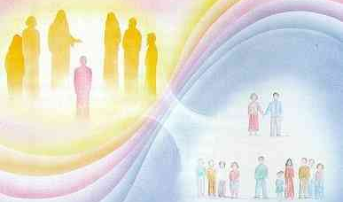
How other religions solve this problem…
Karma, reincarnation teach we are paying for wrong in a previous life..

Slide 9
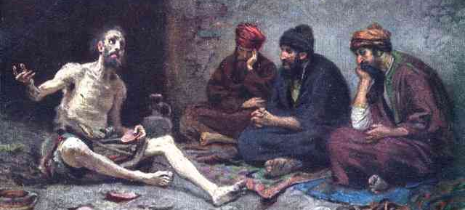
View of Job’s friends..
They each concluded Job must have done something to cause his suffering..

Slide 10
Life is not always fair..
The Bible promises a future life for the righteous where there will be no evil..

Slide 11
What can we do?..
1st, We can grieve and not attempt to deny our feelings of hurt…

Slide 12
What can we do?..
2nd, we should direct our questions to God, even as Job asked “Why, God?”…

Slide 13
What can we do?..
James 1:2-4 My brethren, count it all joy when you fall into various trials, 3 knowing that the testing of your faith produces patience. 4 But let patience have its perfect work, that you may be perfect and complete, lacking nothing.

Slide 14
What can we do?..
4th, our unanswered questions help us see our limitations and long for heaven..

Slide 15
Why Does God Allow Suffering?
1 Peter 4:12-19

