Slide 1
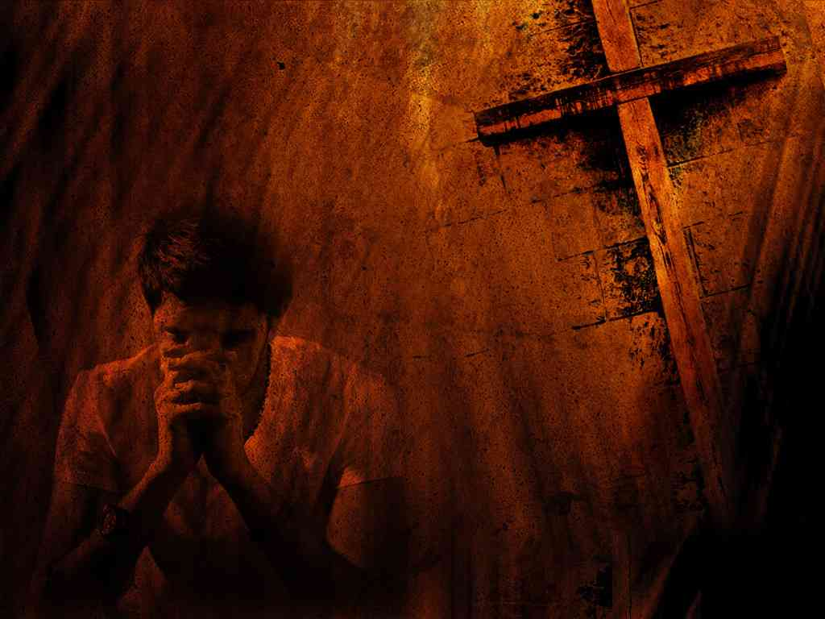
Teach Us to Pray
Worship and Confession
Matthew 6:9-15

Slide 2
Worship

Slide 3
Worship

Slide 4
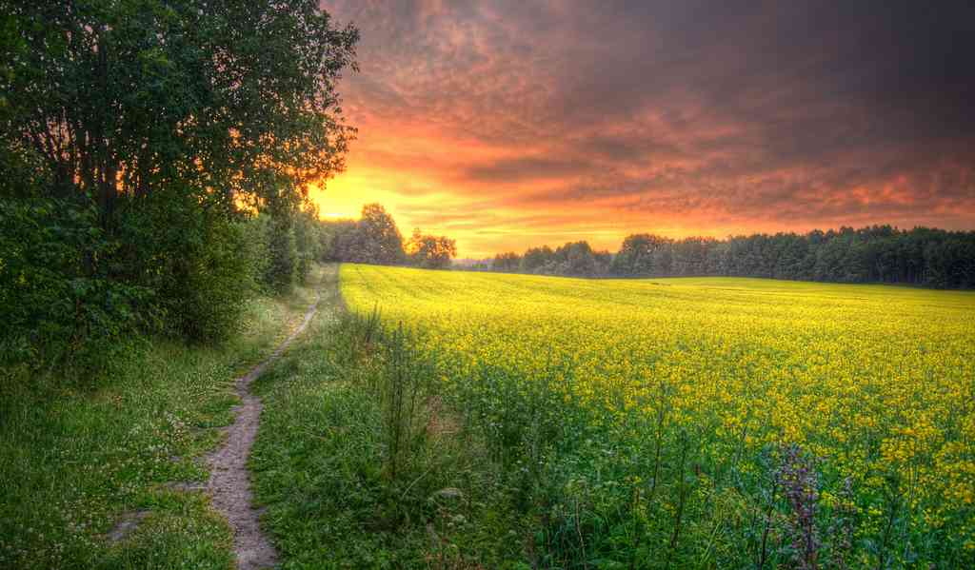
Begin in Worship..
Adoration & Praise
Thanksgiving

Slide 5
Praise is becoming ..
Psalms 33:1 Rejoice in the Lord, O you righteous! For praise from the upright is beautiful.

Slide 6
Praise Him continually..
Psalms 34:1-3 I will bless the Lord at all times; His praise shall continually be in my mouth. 2 My soul shall make its boast in the Lord; the humble shall hear of it and be glad. 3 Oh, magnify the Lord with me, and let us exalt His name together.

Slide 7
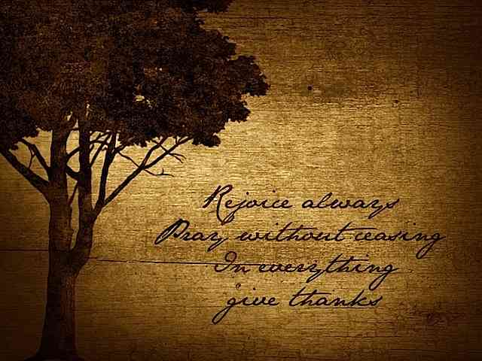
In everything give thanks ..
1 Thessalonians 5:16-18 Rejoice always, 17 pray without ceasing, 18 in everything give thanks; for this is the will of God in Christ Jesus for you.

Slide 8
The homemaker’s prayer..
Turn even adverse circumstances into prayers of thanksgiving to God ..

Slide 9
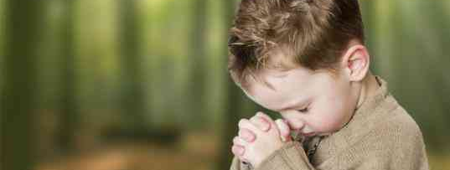
Pray like little children..
“Count your many blessings .. Name them one by one..”

Slide 10
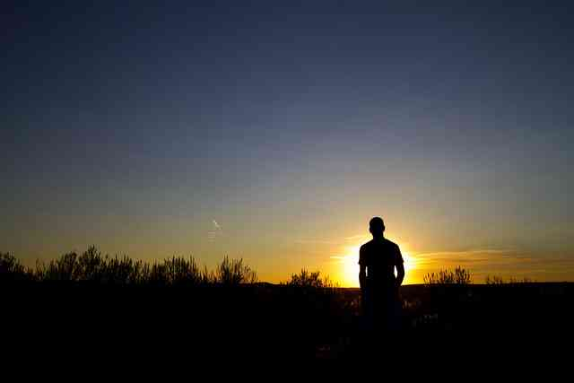
The highest form of praying..
"Praise lies on a higher plane than thanksgiving. When I give thanks my thoughts still circle about me. But in praise my soul climbs to self forgetting adoration, seeing and praising only the majesty of God and His power, grace, and redemption." O. Hallesby
Completely selfless .. no petitions, no wants … only adoration and praise

Slide 11
Scriptural examples..
2 Chronicles 20:6 "O Lord , the God of our fathers, art Thou not God in the heavens? And art Thou not ruler over all the kingdoms of the nations? Power and might are in Thy hand so that no one can stand against Thee.

Slide 12
Scriptural examples..
2 Samuel 22:1-4 "The Lord is my rock and my fortress and my deliverer; 3 The God of my strength, in whom I will trust; My shield and the horn of my salvation, My stronghold and my refuge; My Savior, You save me from violence. 4 I will call upon the Lord, who is worthy to be praised; So shall I be saved from my enemies.
31-32 As for God, His way is perfect; The word of the Lord is proven; He is a shield to all who trust in Him. For who is God, except the Lord? And who is a rock, except our God?

Slide 13
N.T. examples of praise..
1 Timothy 1:17 Now to the King eternal, immortal, invisible, to God who alone is wise, be honor and glory forever and ever. Amen.
Revelation 4:8-11: "Holy, holy, holy, Lord God Almighty, Who was and is and is to come!" 11 "You are worthy, O Lord, To receive glory and honor and power; For You created all things, And by Your will they exist and were created."

Slide 14
Suggestions for praise..
Begin sentences with THOU or YOU..
Use His various names …
Creator … for His love
Redeemer .. The Almight
The Rock of our Salvation.. Strong Deliverer
Use scriptures in your praise
Sing to Him in private prayer

Slide 15
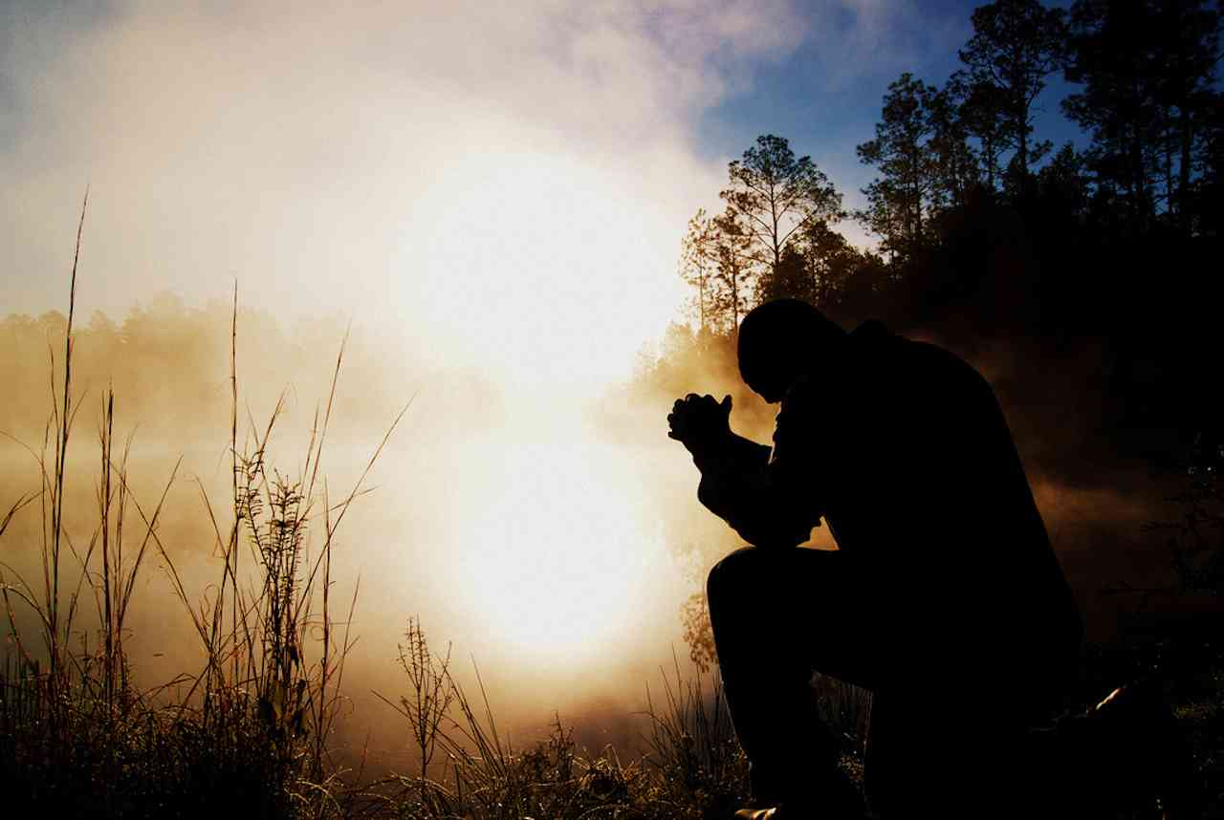
Confession..
CON.. FESS .. “speak the same thing”
Confess Jesus .. say same as God says
Confess sins .. say what God says

Slide 16
Not general ..
Not “Lord, forgive us of all our sins ..”
We need to be specific about our sins…
More painful, but more beneficial…

Slide 17
Deterrent effect..
Psalms 32:3-7 When I kept silent, my bones grew old Through my groaning all the day long. 4 For day and night Your hand was heavy upon me; My vitality was turned into the drought of summer. 5 I acknowledged my sin to You, And my iniquity I have not hidden. I said, "I will confess my transgressions to the Lord,"And You forgave the iniquity of my sin.

Slide 18
Can be very simple..
Luke 18:13 And the tax collector, standing afar off, would not so much as raise his eyes to heaven, but beat his breast, saying, 'God, be merciful to me a sinner!'

Slide 19
Corporate confession..
Ezra 9:6-7 "O my God, I am ashamed and embarrassed to lift up my face to Thee, my God, for our iniquities have risen above our heads, and our guilt has grown even to the heavens. 7 Since the days of our fathers to this day we have been in great guilt, and on account of our iniquities we, our kings and our priests have been given into the hand of the kings of the lands…

Slide 20
Corporate confession..
Ezra 9:9-12 For we are slaves; yet in our bondage, our God has not forsaken us, but has extended lovingkindness to us in the sight of the kings of Persia, to give us reviving to raise up the house of our God, to restore its ruins, and to give us a wall in Judah and Jerusalem. 10 And now, our God, what shall we say after this? For we have forsaken Thy command-ments,

Slide 21
Prayer changes things .. But more often, amazingly, it changes PRAY.. ERS

Slide 22
Teach Us to Pray
Worship and Confession
Matthew 6:9-15

