Slide 1
Duty to Christ and the Church
Avoiding Foolish Mistakes Christians Sometimes Make
Romans 1:14-18

Slide 2
Advice from the world…
“You have no duties to those people down at that church!”

Slide 3
Advice from the world…
Avoiding the foolish mistakes Christians sometimes make

Slide 4
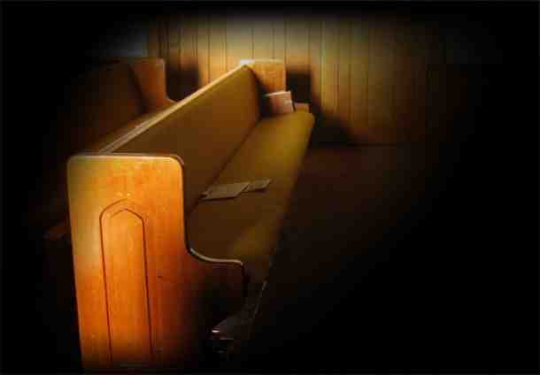
Foolish mistake #1 Dropping out …
Some people quit on the Lord, leave the church, abandon their faith…

Slide 5
Why is this foolish?
Hebrews 10:23-25 Let us hold fast the confession of our hope without wavering, for He who promised is faithful. 24 And let us consider one another in order to stir up love and good works, 25 not forsaking the assembling of ourselves together, as is the manner of some, but exhorting one another, and so much the more as you see the Day approaching.

Slide 6
Foolish mistake #2 Chronically complaining …
Not just some things, but habital … finding fault with everything…

Slide 7
Why is this foolish?
Ephesians 4:29 Let no corrupt word proceed out of your mouth, but what is good for necessary edification, that it may impart grace to the hearers.

Slide 8
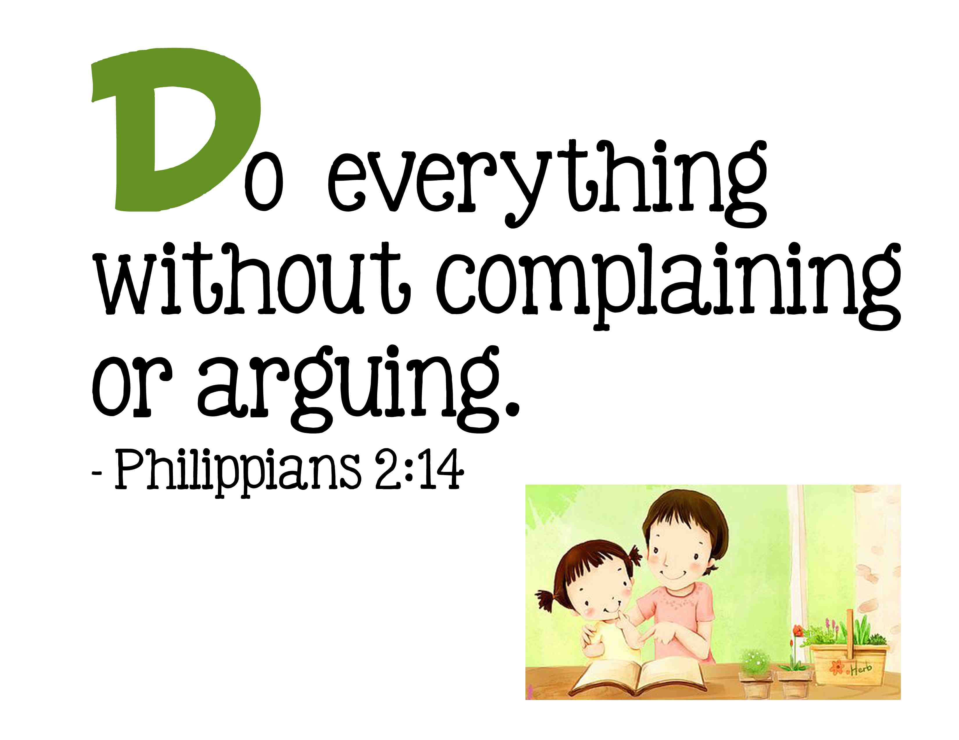

Slide 9
Foolish mistake #3 Taking without giving…
Some never seem to consider they ought to be giving of themselves..

Slide 10
Why is this foolish?
2 Corinthians 9:6-7 But this I say: He who sows sparingly will also reap sparingly, and he who sows bountifully will also reap bountifully. 7 So let each one give as he purposes in his heart, not grudgingly or of necessity; for God loves a cheerful giver.

Slide 11
We each have a part …
Ephesians 4:16 from whom the whole body, joined and knit together by what every joint supplies, according to the effective working by which every part does its share, causes growth of the body for the edifying of itself in love

Slide 12
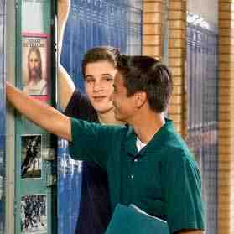
Foolish mistake #4 Living beneath your belief…
The real test of your faith is seen in how we live our lives..

Slide 13
Why is this foolish?
Titus 1:16 They profess to know God, but in works they deny Him, being abominable, disobedient, and disqualified for every good work.

Slide 14
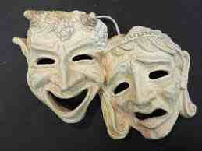
Hypocritical…
Matthew 23:1-4 they say and do not

Slide 15
Why is this foolish?
1 Peter 4:3-4 For we have spent enough of our past lifetime in doing the will of the Gentiles — when we walked in lewdness, lusts, drunkenness, revelries, drinking parties, and abominable idolatries. 4 In regard to these, they think it strange that you do not run with them in the same flood of dissipation, speaking evil of you.

Slide 16
Foolish mistake #5 Speaking w/o knowledge…
Don’t say what you don’t know… about the Bible or people…

Slide 17
Foolish mistake #5 Speaking w/o knowledge…
1 Peter 4:11 If anyone speaks, let him speak as the oracles of God. If anyone ministers, let him do it as with the ability which God supplies, that in all things God may be glorified through Jesus Christ, to whom belong the glory and the dominion forever and ever. Amen.
1 Peter 3:15 But sanctify the Lord God in your hearts, and always be ready to give a defense to everyone who asks you a reason for the hope that is in you, with meekness and fear.

Slide 18
Foolish mistake #6 Missing golden opportunities…
Passing up opportunities we have to talk to someone about Jesus and speak of the church…

Slide 19
Foolish mistake #6 Missing golden opportunities…
Ephesians 4:15 speaking the truth in love, may grow up in all things into Him who is the head — Christ

Slide 20
Duty to Christ and the Church
Avoiding Foolish Mistakes Christians Sometimes Make
Romans 1:14-18

