Slide 1
Teach Us to Pray
Praying for Specific Intervention
2 Corinthians 1:8-11

Slide 2
Luke 11:1-4

Slide 3
Worship

Slide 4
Begin in Worship..
Adoration & Praise
Thanksgiving

Slide 5
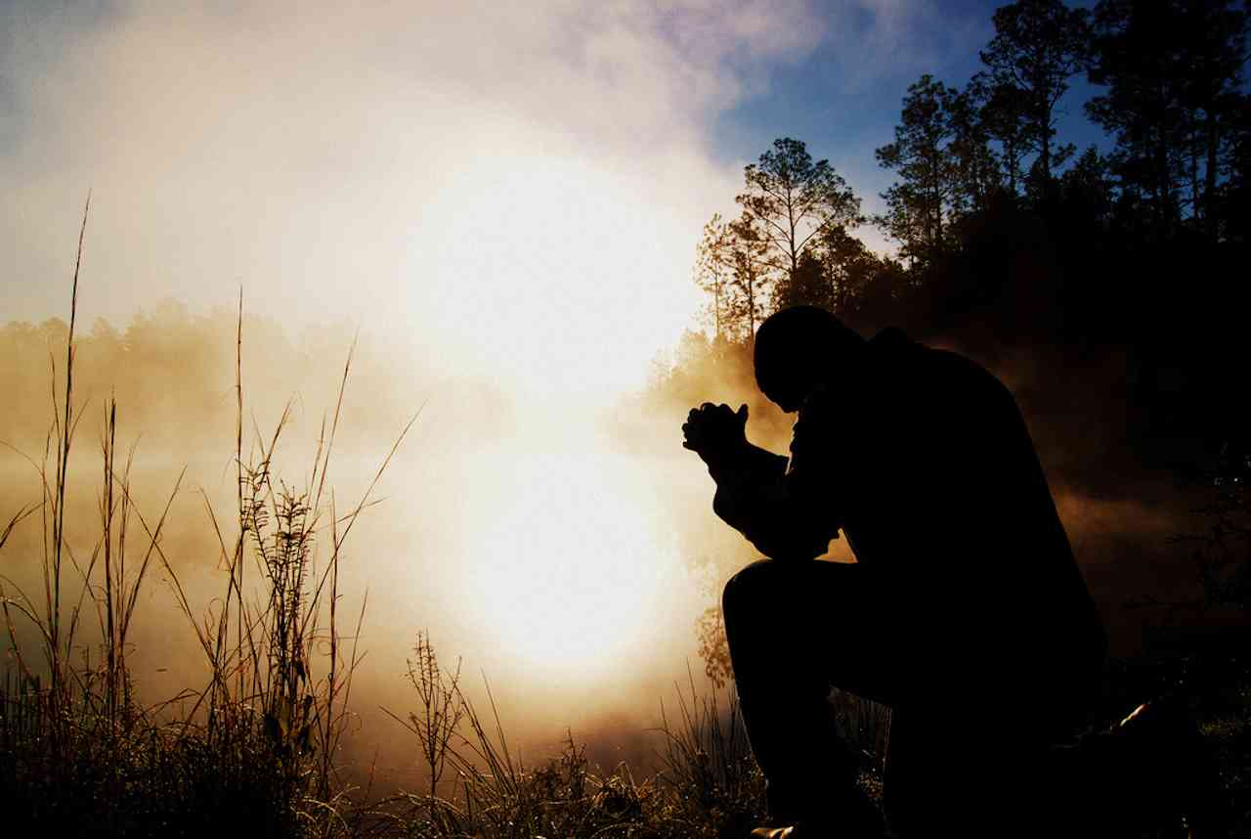
Confession..
CON.. FESS .. “speak the same thing”
Confess Jesus .. say same as God says
Confess sins .. say what God says

Slide 6
Petitions..
To ask, to beg or solicit ..
Asking something from God..
A wanting, need, entreaty, supplication..
Psalms 50:15 Call upon Me in the day of trouble; I will deliver you, and you shall glorify Me."

Slide 7
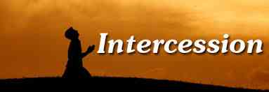
Intercession..
Step in between two parties ..
We must have proper qualifications..
Purity of Life
Vital importance
Selfless concern

Slide 8
What can we ask for..
James 4:2-3 you do not have because you do not ask…
Psalms 81:10 I am the Lord your God... open your mouth wide, and I will fill it.
Ephesians 3:20 Now to Him who is able to do exceedingly abundantly above all that we ask or think, according to the power that works in us …

Slide 9
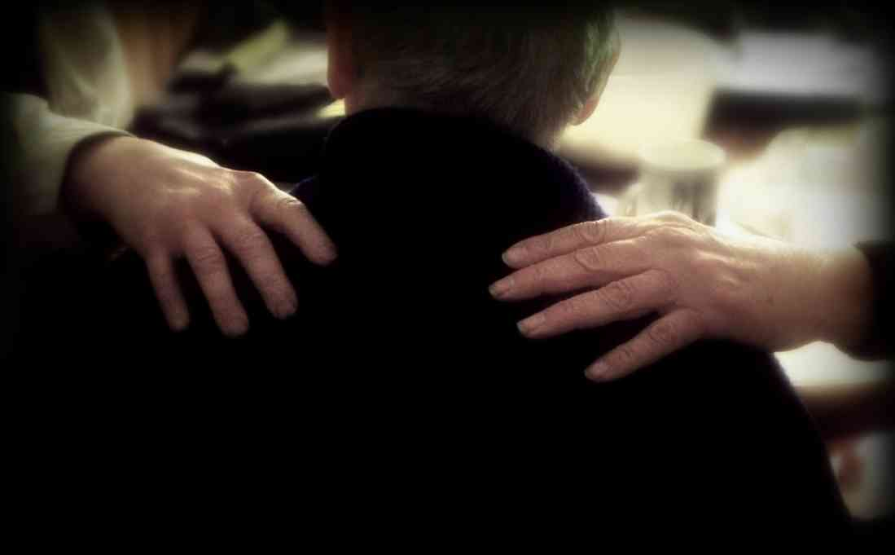
Praying for healing..
God does answer..
2 Corinthians 1:8-11 we had the sentence of death in ourselves, that we should not trust in ourselves but in God who raises the dead, who delivered us from so great a death..you also helping together in prayer for us..
Not necessarily by miracle.. God can intervene through prayers

Slide 10
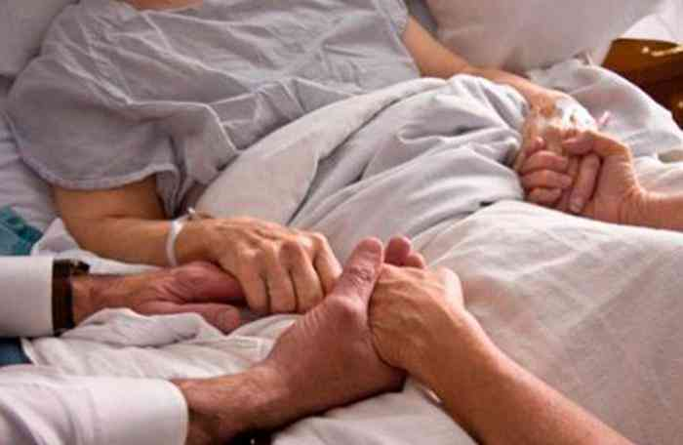
What if it is not removed..
God is not mainly concerned we are healthy and happy in this life…
We may not have enough faith .. “your faith has made you whole”
God can still be glorified.. one of best ways to show the difference of our life

Slide 11
Things to remember..
Show others how we are different…
Romans 8:28 all things work together for good to those who love God..
We get something greater than we expected..
2 Corinthians 4:17 For our light affliction, which is but for a moment, is working for us a far more exceeding and eternal weight of glory..
2 Corinthians 12:9-10 And He said to me, "My grace is sufficient for you, for My strength is made perfect in weakness."

Slide 12
Praying for salvation of others..
Matthew 7:7 "Ask, and it will be given to you; seek, and you will find; knock, and it will be opened to you.

Slide 13
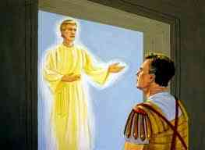
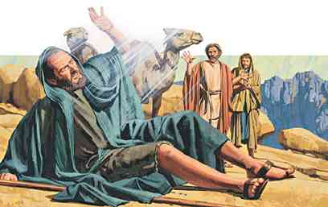
Scriptural cases..
Cornelius in Acts 10..
His prayers were heard
God answered by sending Peter to speak to him..
Saul in Acts 9..
Saul prayed three days..
God sent Ananias to tell him what to do…

Slide 14
Cannot pray outside God’s plan..
Jeremiah 7:16 "Therefore do not pray for this people, nor lift up a cry or prayer for them, nor make intercession to Me; for I will not hear you.
Luke 16:29-30 Abraham said to him, 'They have Moses and the prophets; let them hear them.' 30 And he said, 'No, father Abraham; but if one goes to them from the dead, they will repent.'

Slide 15
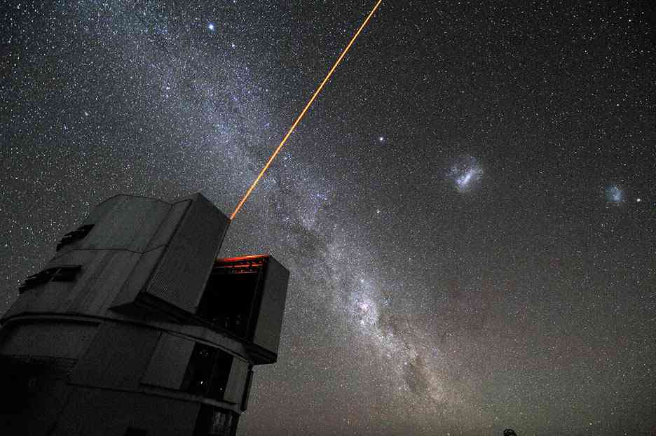
Laser specific prayer..
We don’t do this often because we lack faith
Instead of being specific, we pray in vague terms …

Slide 16
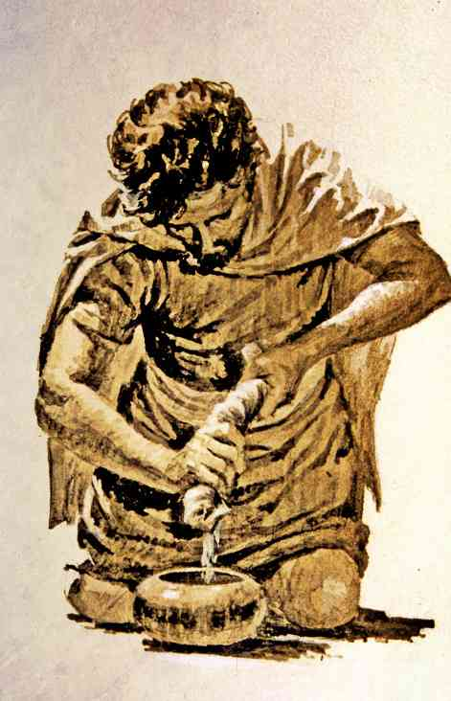
Gideon’s fleece..
Judges 7:36-40…
1st night, Want fleece wet and ground dry
2nd night, want fleece dry and ground wet

Slide 17
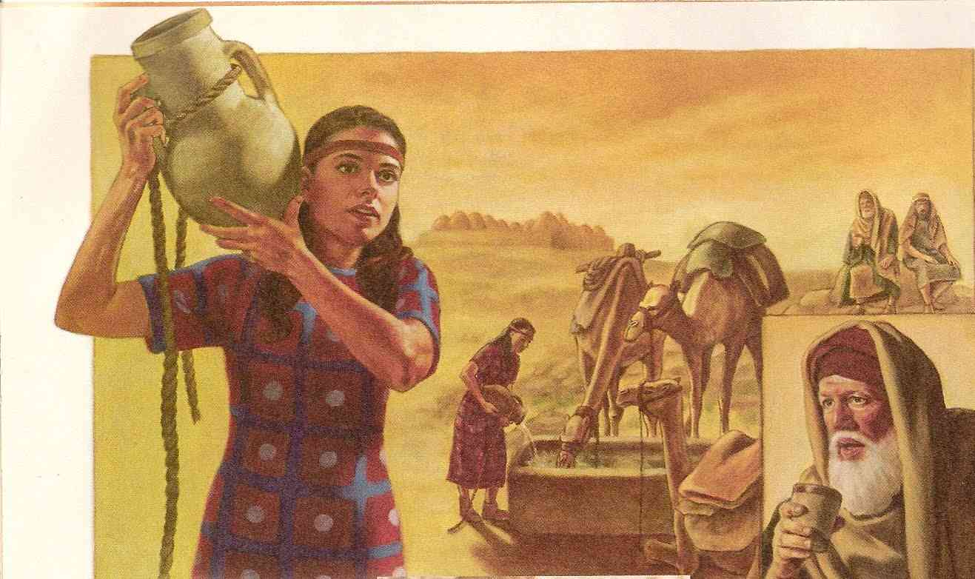
Prayer of Eliezer for wife for Isaac..
Genesis 24:12-14 His very specific request could not be misunderstood
God answered it exactly .. Vs 15-21

Slide 18
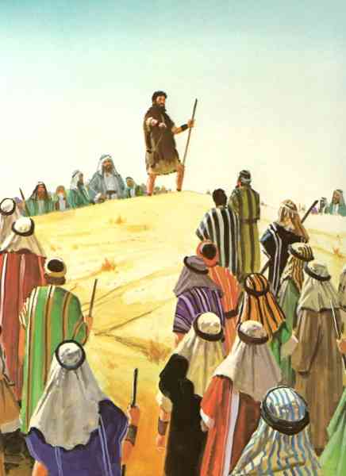
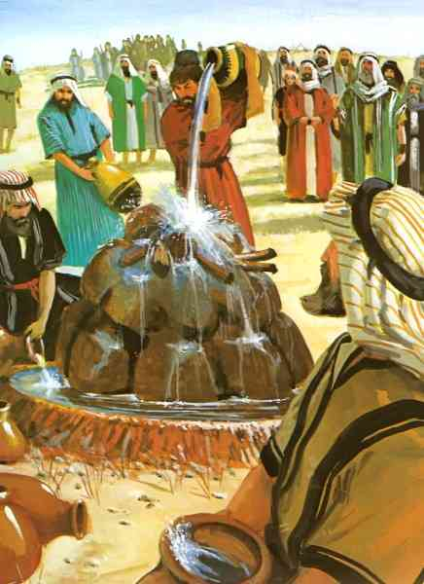
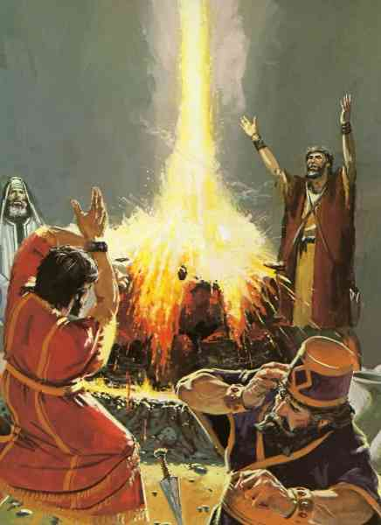
Elijah on Mt Carmel..
The God who answers by fire … let Him be God!

Slide 19
Teach Us to Pray
Praying for Specific Intervention
2 Corinthians 1:8-11

