Slide 1
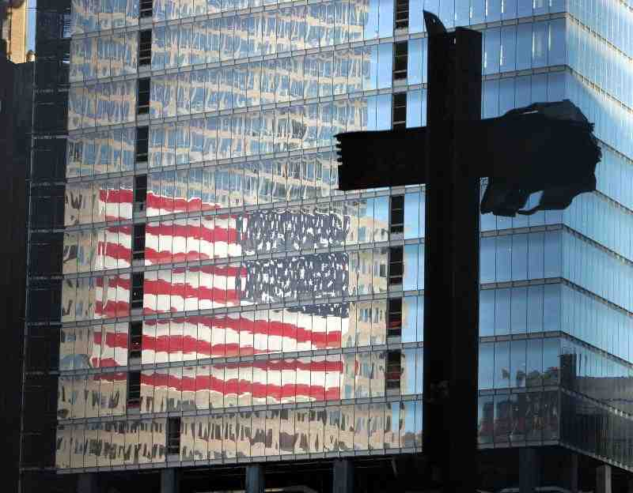
If the Foundations are Destroyed.. What Can the Righteous Do?
Psalm 11:1-7

Slide 2
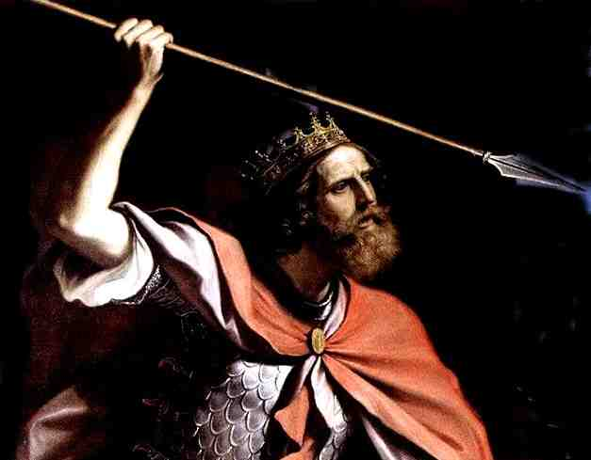
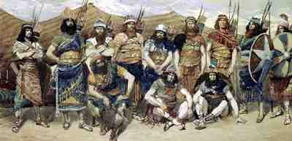
David in danger of enemies…

Slide 3
Troublesome times…
We must choose…
FEAR … or
HUMAN ADVICE..
FAITH…
WISDOM FROM GOD
Our way of life is under attack..

Slide 4
Psalms 11:1-3
1 In the Lord I put my trust; How can you say to my soul, "Flee as a bird to your mountain"? 2 For look! The wicked bend their bow, They make ready their arrow on the string, That they may shoot secretly at the upright in heart…
3 If the foundations are destroyed what can the righteous do?...

Slide 5
If the worst happens..
If the foundations are destroyed… what can the righteous do?
There is something the righteous can do.. even in the most disturbing trials of life!

Slide 6
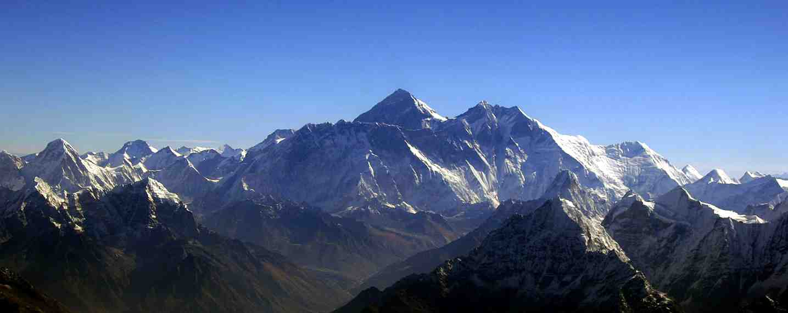
What should David do?
The question of fear..
Flee to the mountains (vs. 1)
Right to flee temptation (Gen 39:11-13; 2 Tim 2:22)
But not place of duty, leadership (John 10:12-13)
Evil plotting of enemies (vs. 2)
Deceptive, destructive words … (2 Sam 15:1-6)
David was upright in heart, righteous ..
.. If the foundations are destroyed what can the righteous do?...

Slide 7
When foundations are shaken..
Our government .. (Proverbs 14:34)
Economic security .. (Matt 6:19-21)
The family institution.. (Gen 2:18-25)
Dependence upon God.. (Rom 1:21-28)

Slide 8
What can the righteous do?
The Answer of Faith …
Psalms 11:4-7 The Lord is in His holy temple, The Lord's throne is in heaven; His eyes behold, His eyelids test the sons of men. 5 The Lord tests the righteous, But the wicked and the one who loves violence His soul hates. 6 Upon the wicked He will rain coals; Fire and brimstone and a burning wind Shall be the portion of their cup. 7 For the Lord is righteous, He loves righteousness; His countenance beholds the upright.

Slide 9
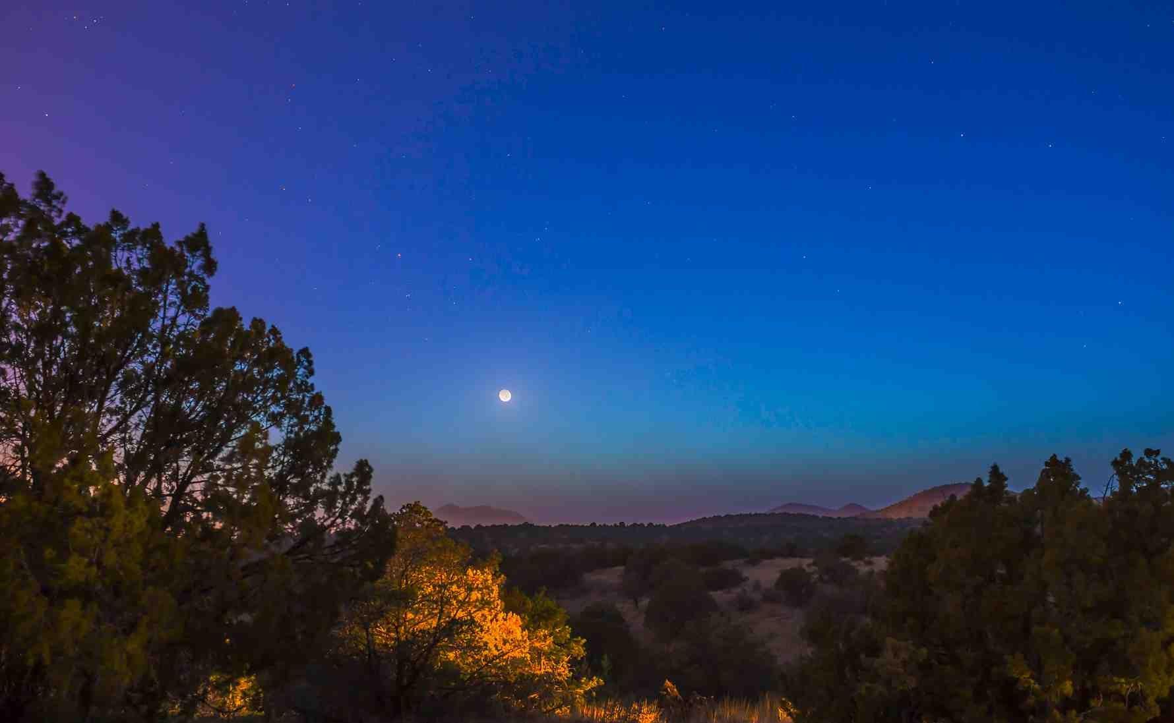
Remember who God is..
The Lord is in His holy temple.. Hab 2:20
The Lord’s throne is in heaven.. Rev 4:1
The Lord hasn’t gone anywhere…
so I won’t either!

Slide 10
Remember what God sees..
His eyelids behold the sons of men..
The Lord tests the righteous.. Heb 4:12
His soul hates …
The wicked…
The one who loves violence…

Slide 11
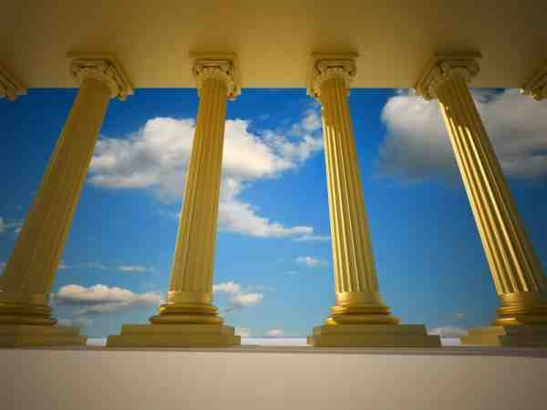
Remember what God sees..
The Destiny of the Wicked..
Upon the wicked He will rain coals, fire and brimstone, burning wind… Gen 19:24; Rev 9:17
The love and favor of God..
The Lord is righteous
He loves righteousness
He beholds the upright.. 1 John 3:1-3; Matt 25:34

Slide 12
A Reason for our Faith..
The word of God will never be destroyed ..
Isaiah 40:7-8
The work of Christ will never be destroyed..
Heb 9:24-28
Our hope in Christ will never be destroyed..
Heb 6:18-20

Slide 13
A Sure Foundation..
Isaiah 28:16 Therefore thus says the Lord God: "Behold, I lay in Zion a stone for a foundation, A tried stone, a precious cornerstone, a sure foundation; Whoever believes will not act hastily.

Slide 14
If the Foundations are Destroyed.. What Can the Righteous Do?
Psalm 11:1-7

