Slide 1
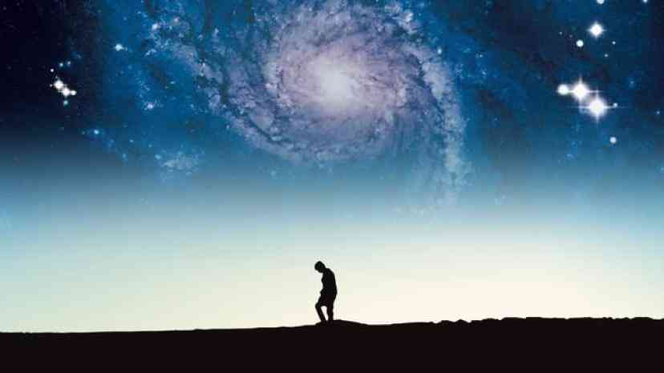
What is my Self-Worth?
Psalm 139:1-24

Slide 2
How society measures..
$240 million 7 yr deal

Slide 3
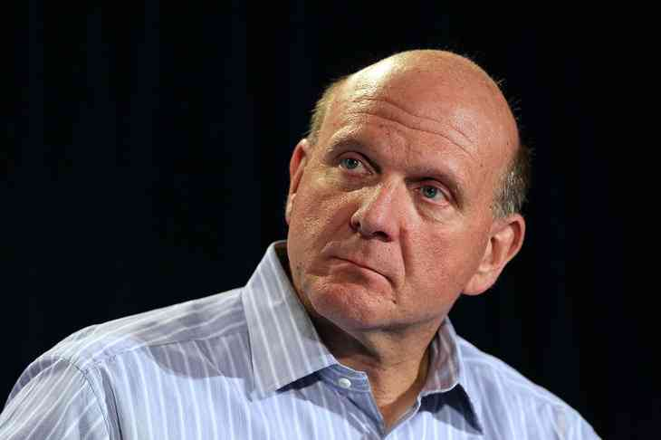
How society measures..
Microsoft CEO $2 Billion Offer

Slide 4
How society measures..
Physical Appearance

Slide 5
What is my life worth?
What have I ever done… what difference does my life make?

Slide 6
Psalm 139…
A different picture of your life …

Slide 7
God Knows You Psalm 139:1-6
1 O Lord, You have searched me and known me. 2 You know my sitting down and my rising up; You under-stand my thought afar off. 3 You comprehend my path and my lying down, And are acquainted with all my ways.
4 For there is not a word on my tongue, But behold, O Lord, You know it altogether. 5 You have hedged me behind and before, And laid Your hand upon me. 6 Such know-ledge is too wonderful for me; It is high, I cannot attain it.

Slide 8
You know my sitting down and my rising up…

Slide 9
You understand my thought afar off… acquainted with all my ways

Slide 10
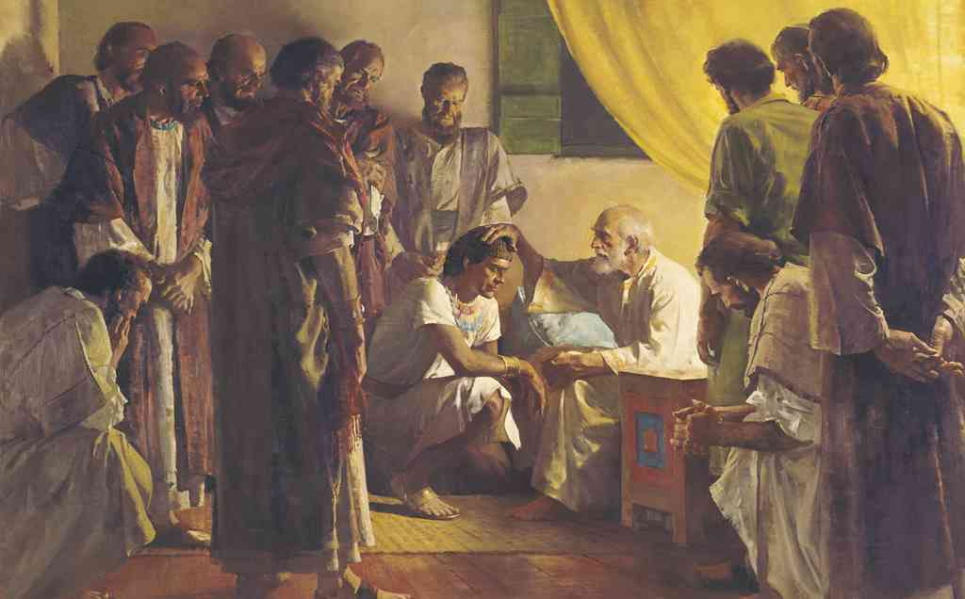
You have hedged me behind and before and laid Your hand upon me..

Slide 11
Such knowledge is too wonderful for me…

Slide 12
God is Near You Psalm 139:7-12
Where can I go from Your Spirit? Or where can I flee from Your presence? 8 If I ascend into heaven, You are there; If I make my bed in hell, behold, You are there. 9 If I take the wings of the morning, And dwell in the uttermost parts of the sea, 10 Even there Your hand shall lead me, And Your right hand shall hold me. .
11 If I say, "Surely the darkness shall fall on me," Even the night shall be light about me; 12 Indeed, the darkness shall not hide from You, But the night shines as the day; The darkness and the light are both alike to You.

Slide 13
Where can I flee from Your presence …

Slide 14
Where can I flee from Your presence …

Slide 15
If I take the wings of the morning even there Your hand shall lead me …

Slide 16
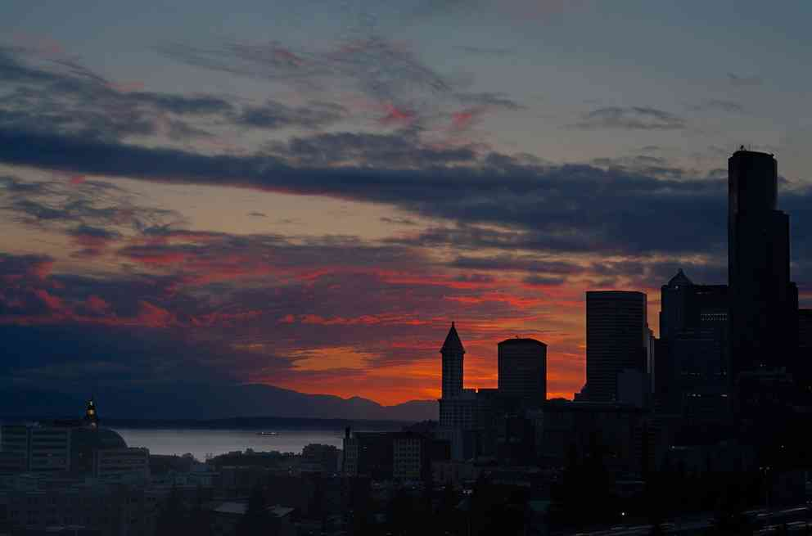
The darkness and the light are both alike to You…

Slide 17
God Made You Psalm 139:13-16
13 For You formed my inward parts; You covered me in my mother's womb. 14 I will praise You, for I am fearfully and wonderfully made; Marvelous are Your works, And that my soul knows very well.
15 My frame was not hidden from You, When I was made in secret, And skillfully wrought in the lowest parts of the earth. 16 Your eyes saw my substance, being yet unformed. And in Your book they all were written, The days fashioned for me, When as yet there were none of them.

Slide 18
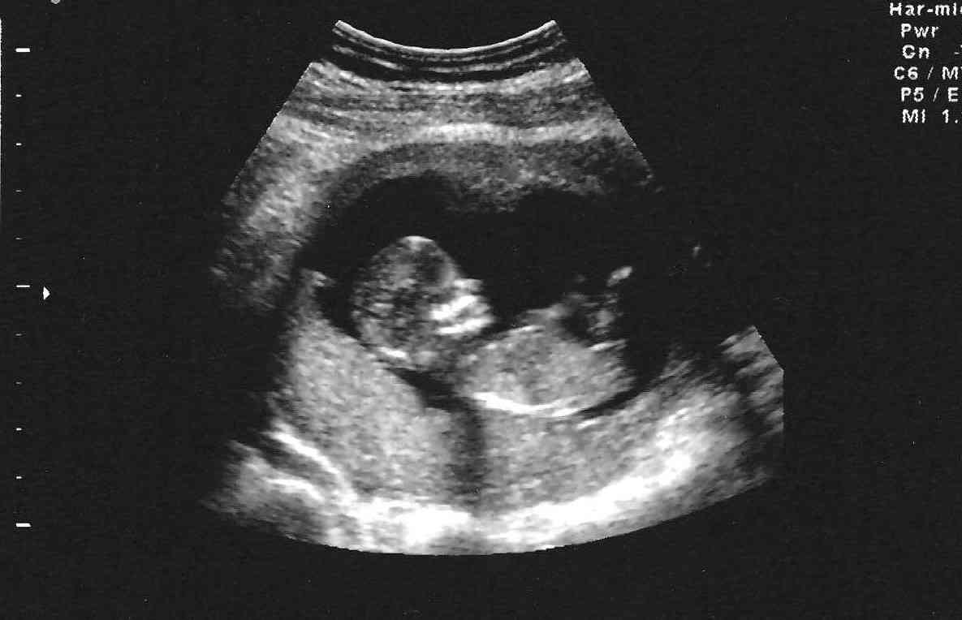
You formed my inward parts …

Slide 19
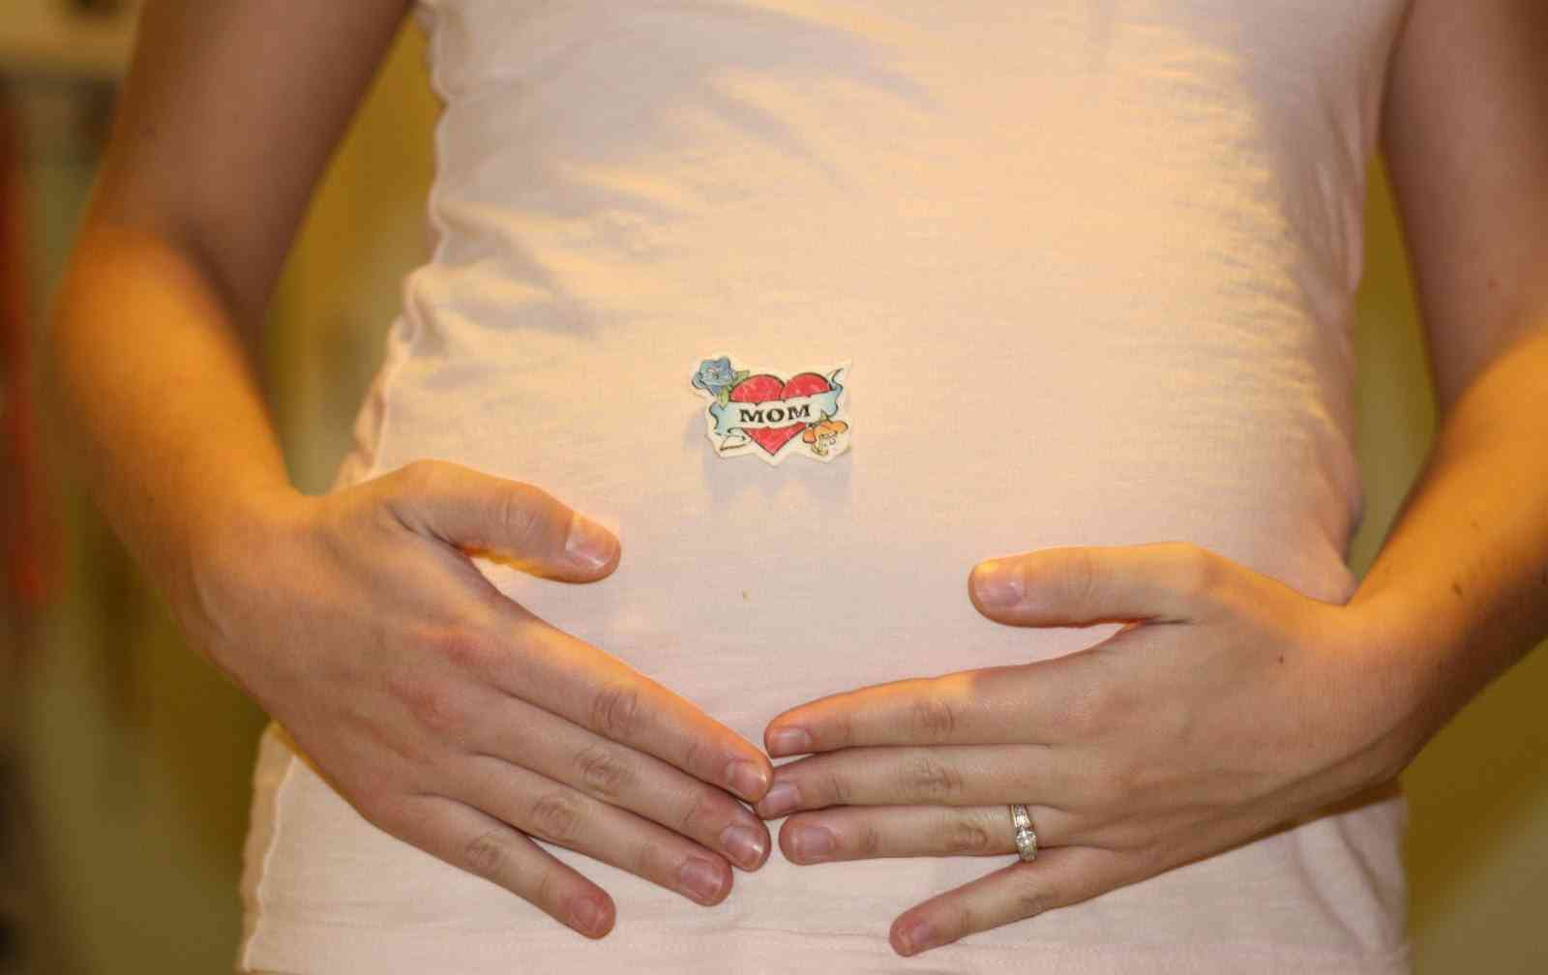
You covered me in my mother’s womb…

Slide 20
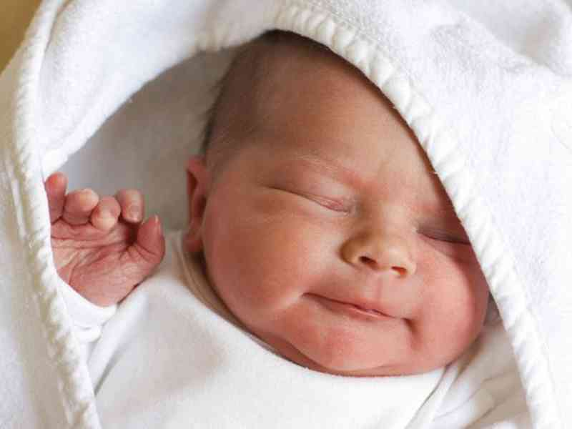
I will praise You, for I am fearfully and wonderfully made…

Slide 21
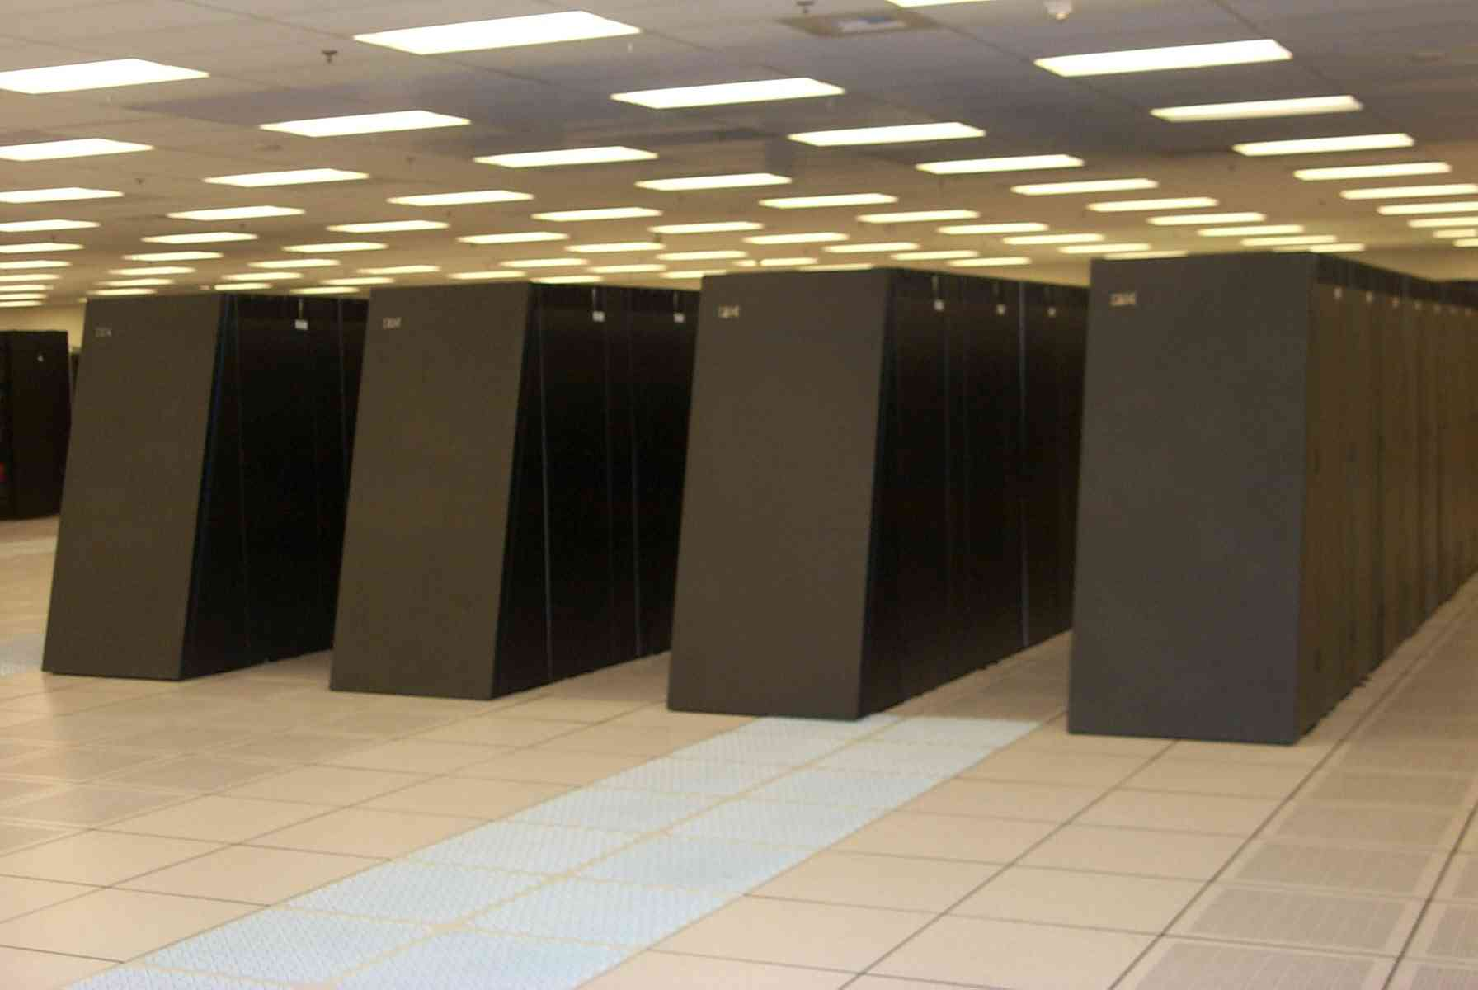
Supercomputer IBM BlueGene/L Lawrence Livermore Natl Laboratory…

Slide 22
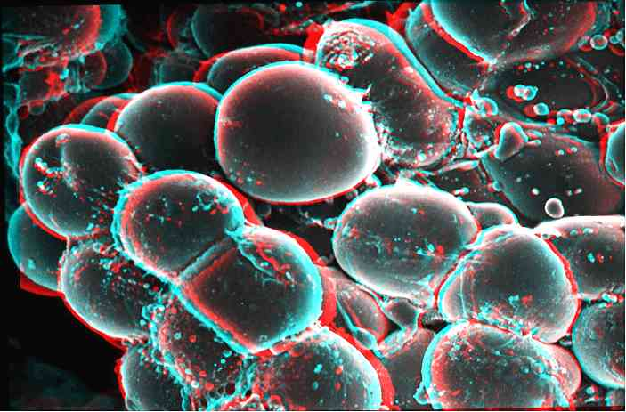
The human brain processes information even faster …

Slide 23
God is Thinking of You Psalm 139:17-18, 23-24
17 How precious also are Your thoughts to me, O God! How great is the sum of them! 18 If I should count them, they would be more in number than the sand; When I awake, I am still with You...
23 Search me, O God, and know my heart; Try me, and know my anxieties; 24 And see if there is any wicked way in me, And lead me in the way everlasting.

Slide 24
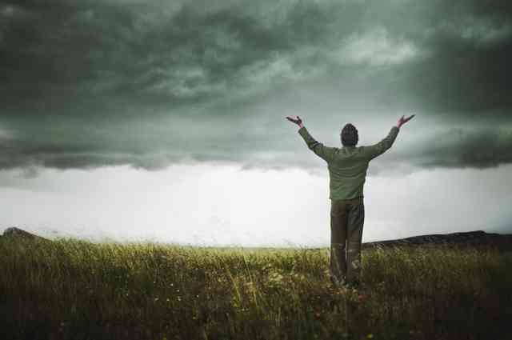
Impossible to number the ways God thinks of me…

Slide 25
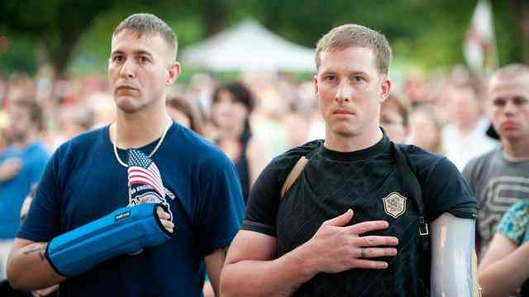
How precious are Your thoughts to me …

Slide 26
Search me O God and know my heart…

Slide 27
What is my Self-Worth?
Psalm 139:1-24

