Slide 1
Devoted to Worship
Acts 2:42-47

Slide 2
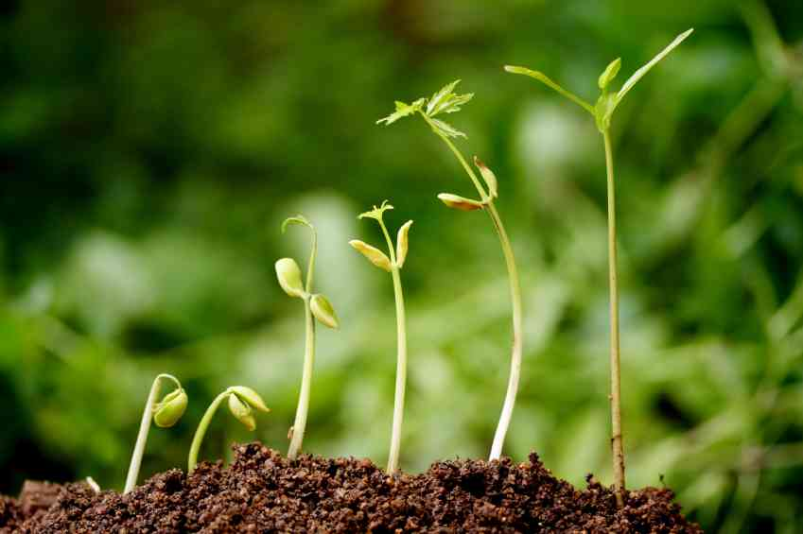
Growth of the church..
We are encouraged when we see the Lord bringing new growth…

Slide 3
Continually devoted (42) ..
Acts 2:42 And they continued steadfastly…
1 The apostles’ doctrine ..
2 Fellowship ..
3 The breaking of bread ..
4 Prayer ..

Slide 4
They feared God (43) ..
43 then fear came upon every soul ..
- The power of God.. Acts 5:11 9:31 19:17
- Miracles by apostles .. 43b
- Conviction, forgiveness .. 37-38
- Daily praise .. 47

Slide 5
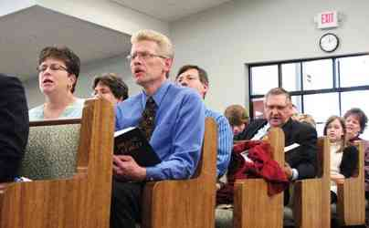
Serving each other (44-45) ..
44 now all who believed were together..
- Encourages one another.. Heb 10:25
- Singing edifies each other .. Col 3:16
- Praying for each other .. Eph 6:18
- Proclaiming Jesus’ death.. 1 Cor 11:26
- Sharing to provide .. 1 Cor 16:1-2

Slide 6
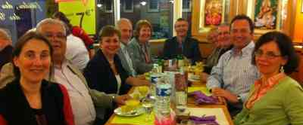
Sincerity of heart (44-45) ..
46-47 they ate their food with gladness and simplicity of heart..
- Rejoicing for salvation .. 2:42; 8:39
- Simplicity of heart .. purity of intention
- Praising God in daily lives ..
- The Lord added daily ..

Slide 7
Devoted to Worship
Acts 2:42-47

