Slide 1
Heaven Can Wait The World is Lying to Us
Philippians 1:21-23

Slide 2
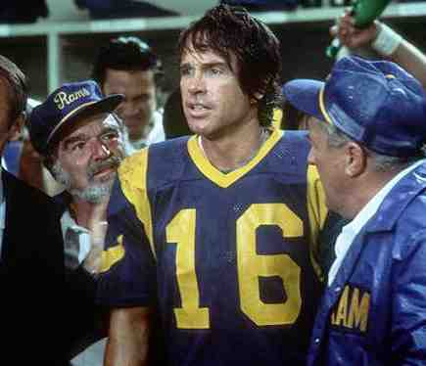
Joe Pendleton… L.A. Rams QB
“Heaven Can Wait” (1978)

Slide 3
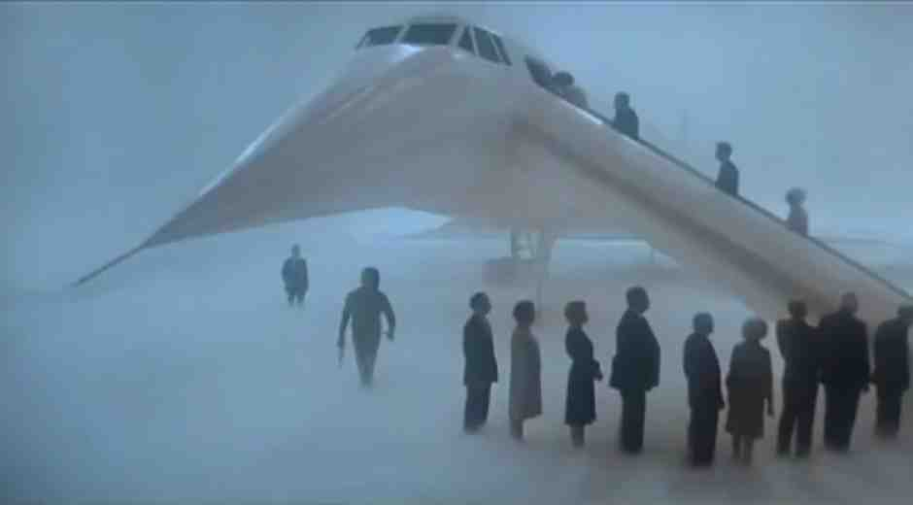
Joe is on his way to heaven…

Slide 4
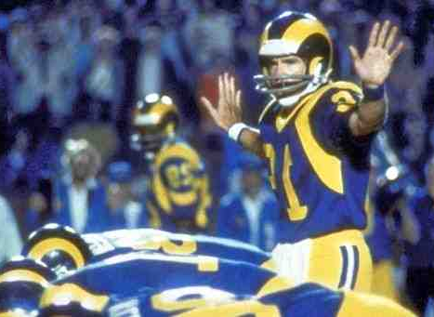
Joe has to be brought back …

Slide 5
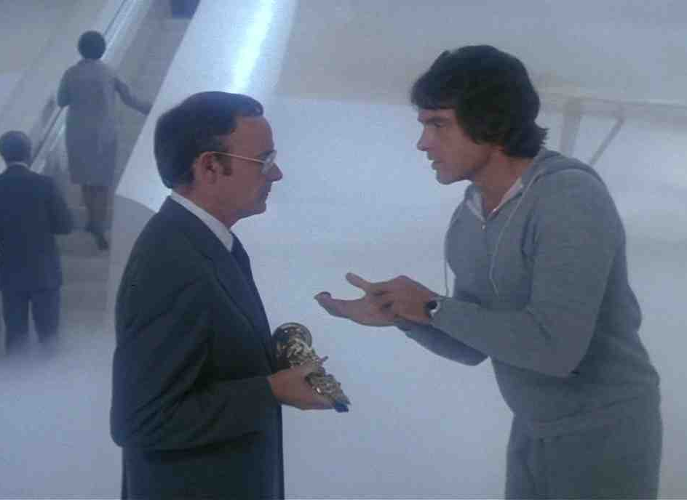
Joe is upset with the angel …

Slide 6
Attitude of Paul…
Philippians 1:21-23 For to me, to live is Christ, and to die is gain. .. having a desire to depart and be with Christ, which is far better.
Would you be happy on way to heaven..

Slide 7
Denials of heaven …
“You can’t really go to heaven…”

Slide 8
Reincarnation
Hebrews 9:27 And as it is appointed for men to die once, but after this the judgment...

Slide 9
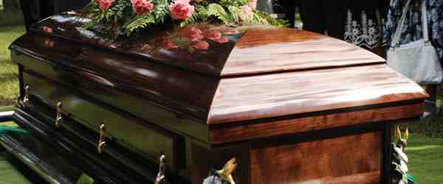
Annihilation..cease to exist
Matthew 10:28 And do not fear those who kill the body but cannot kill the soul. But rather fear Him who is able to destroy both soul and body in hell..

Slide 10
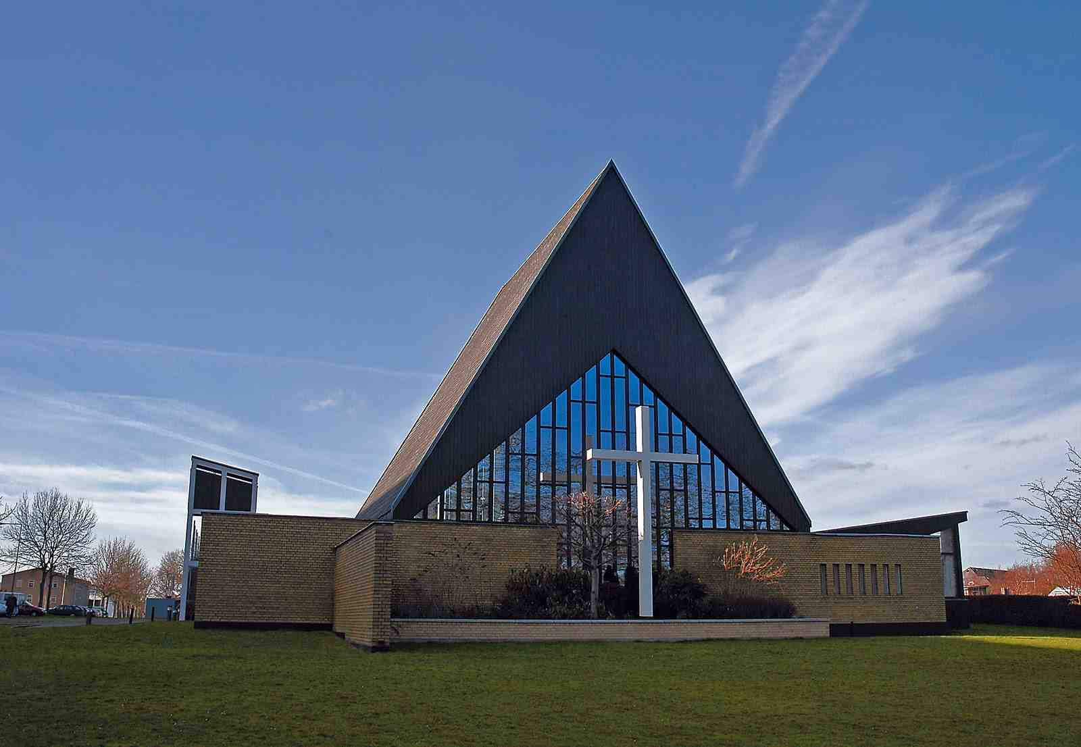
Modernism denies the supernatural..
Matthew 23:13 "woe to you, scribes and Pharisees, hypocrites! For you shut up the kingdom of heaven against men; for you neither go in yourselves, nor do you allow those who are entering to go in..

Slide 11
Eternal earth..
Jehovah’s Witnesses: "... "When mankind reaches perfection at close of the millennial age they will be admitted into membership in kingdom of God and given entire control of earth as it was first designed, each man a sovereign, each man a king"...

Slide 12
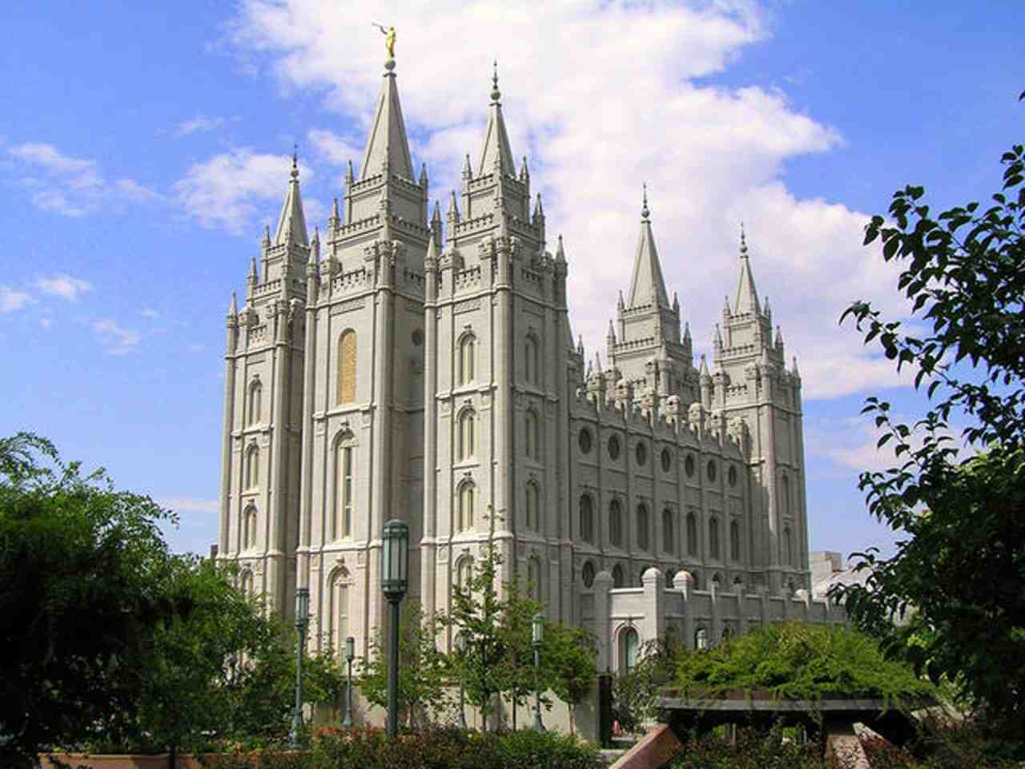
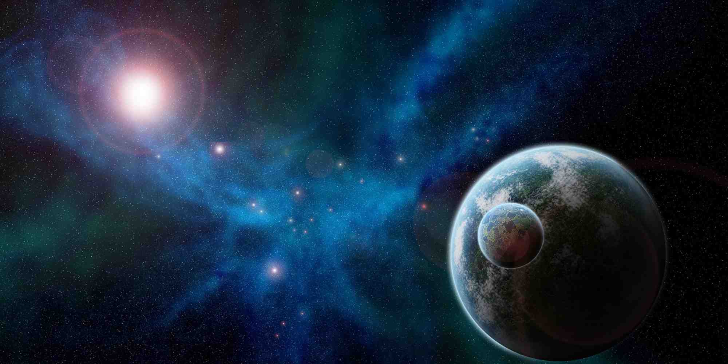
Mormonism..
Celestial marriage for time and eternity… Mormon men will occupy a planet in outer space as planet gods..

Slide 13
700 Club..
“heaven is a floating space station above the earth, the righteous will live on the earth for eternity"

Slide 14
Earth is not eternal..
2 Peter 3:10 But the day of the Lord will come as a thief in the night, in which the heavens will pass away with a great noise, and the elements will melt with fervent heat; both the earth and the works that are in it will be burned up.

Slide 15
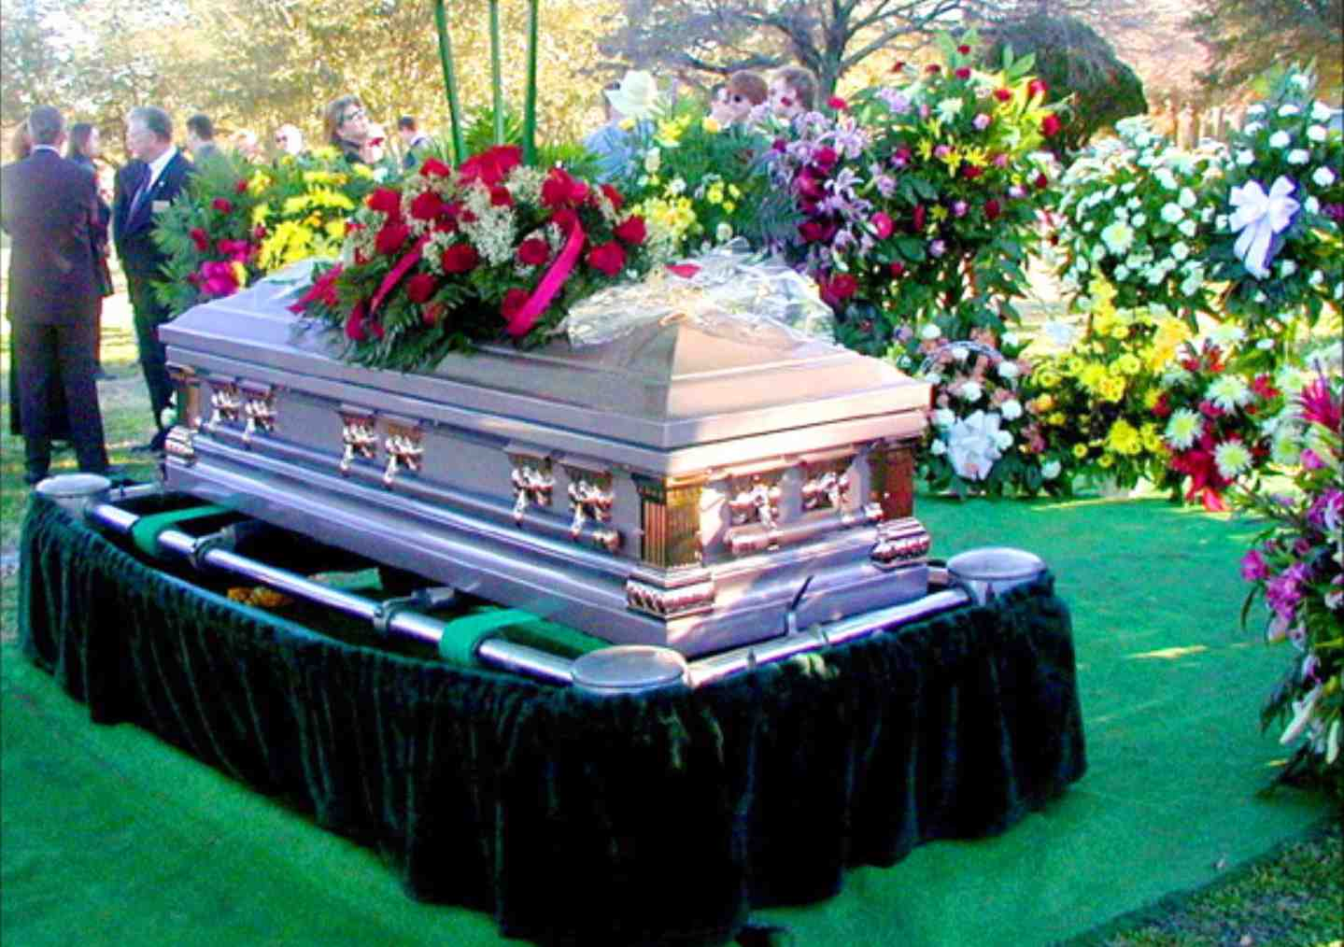
Indifference to heaven..
Seldom think of heaven other than at funerals of a loved one…

Slide 16
Our Eternal Home..
Colossians 1:5 because of the hope which is laid up for you in heaven, of which you heard before in the word of the truth of the gospel…

Slide 17
Citizenship..
Philippians 3:20 For our citizenship is in heaven, from which we also eagerly wait for the Savior, the Lord Jesus Christ

Slide 18
Inheritance…
1 Peter 1:3-4 speaks of how our God has begotten us again to a living hope through the resurrection of Jesus Christ from the dead, 4 to an inheritance incorruptible and undefiled and that does not fade away, reserved in heaven for you

Slide 19
Reward in heaven..
Matthew 5:11-12 when they revile and persecute you, and say all kinds of evil against you falsely for My sake. 12 Rejoice and be exceedingly glad, for great is your reward in heaven, for so they persecuted the prophets who were before you. where is your reward, He says it's in heaven.. Great is your reward in heaven...

Slide 20
Treasure..
Matthew 6:19-20 "Do not lay up for yourselves treasures on earth, where moth and rust destroy and where thieves break in and steal; 20 but lay up for yourselves treasures in heaven, where neither moth nor rust destroys and where thieves do not break in and steal...

Slide 21
How to get there…
Only Through Jesus…
John 14:6 Jesus said to him, "I am the way, the truth, and the life. No one comes to the Father except through Me

Slide 22
How to get there…
Faith … Eph 2:8-9
Repentance .. Acts 3:19
Confession … Romans 10:9-10
Baptism .. Mark 16:16
Faithfulness .. Revelation 2:10

Slide 23
Heaven Can Wait The World is Lying to Us
Philippians 1:21-23

