Slide 1
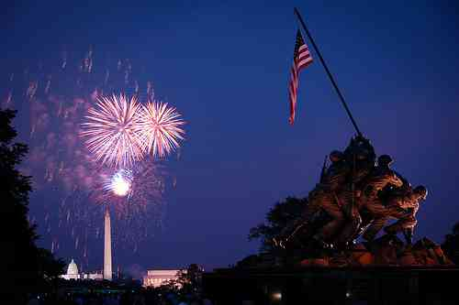
Independence Day
Colossians 2:8-15

Slide 2
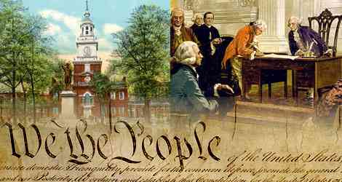
God’s blessings.. 238 years
The hand of God...

Slide 3
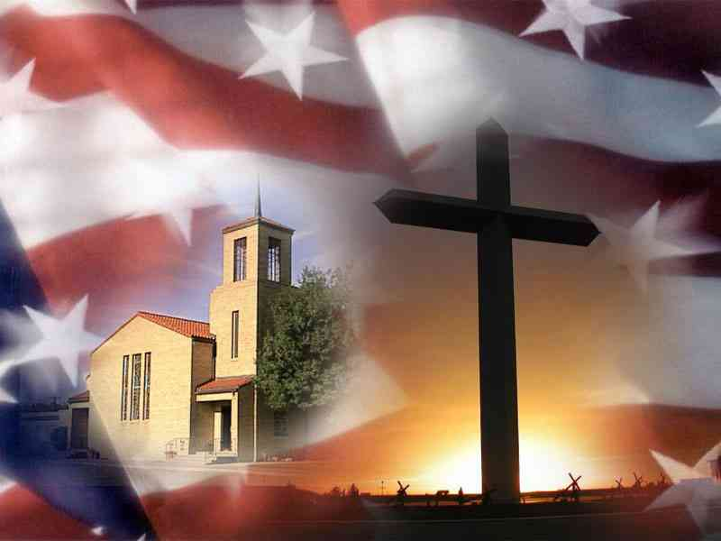
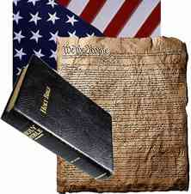
“Christian nation”…
What will the future hold?

Slide 4
Celebrating our freedom..
Best circumstance to serve Christ…

Slide 5
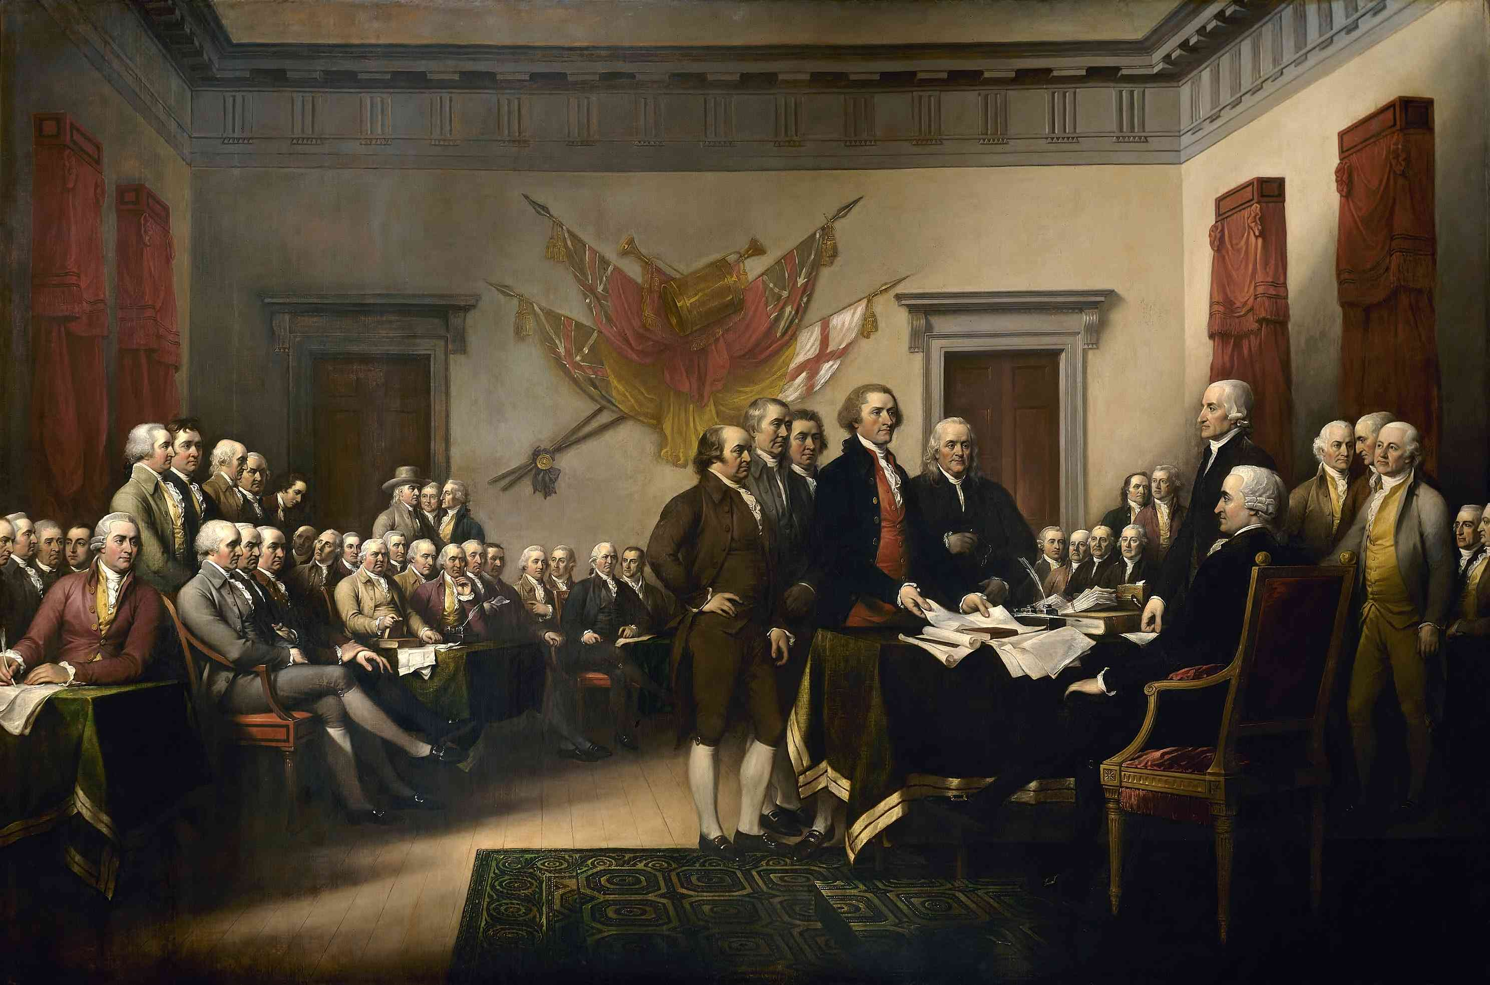
Vote for independence.. July 2nd, 1776
July 4th Declaration of Independence …
Committee of five to draft Declaration

Slide 6
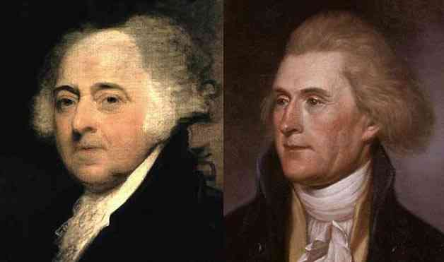
Two great patriots..
Died same day… July 4th, 1826

Slide 7
Desire for freedom grows from enslavement…
American colonies were being enslaved by power of Great Britain..

Slide 8
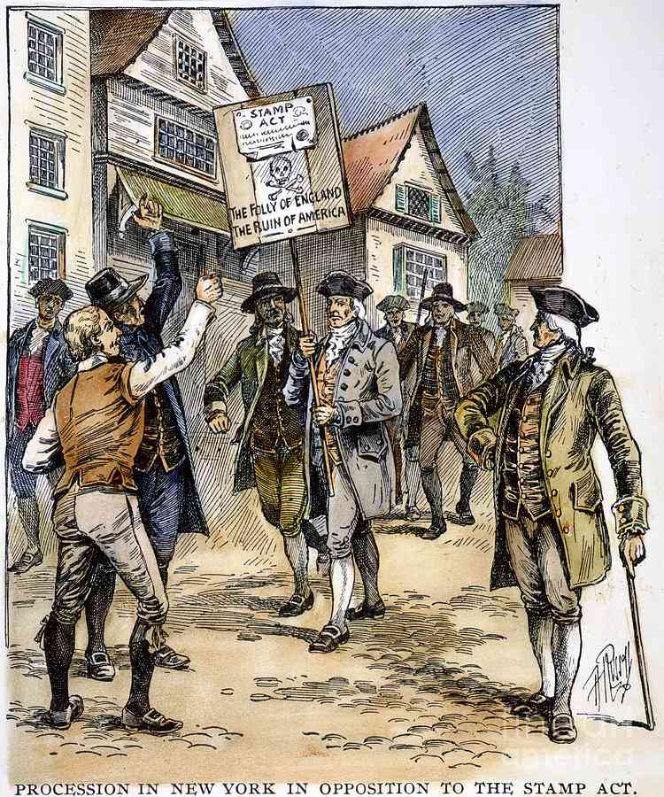
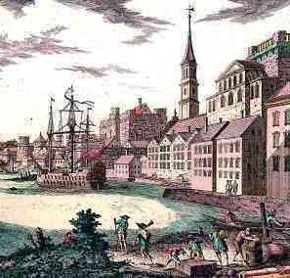
Decrees from England..
Stamp Act, Declaratory Act, Tea Act, Intolerable Acts…

Slide 9
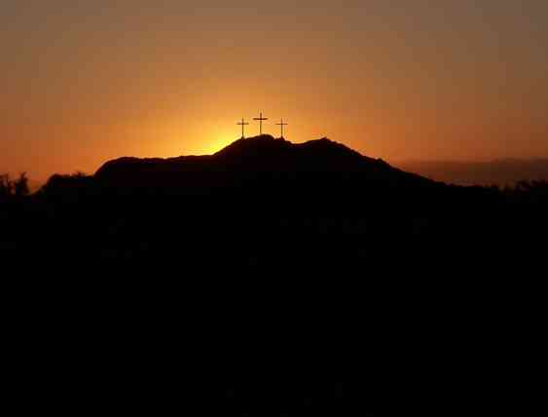
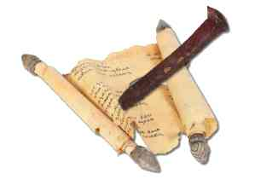
We also were enslaved..
Colossians 2:13-14 And you, being dead in your trespasses and the uncircumcision of your flesh, He has made alive together with Him, having forgiven you all trespasses, 14 having wiped out the handwriting of requirements that was against us, which was contrary to us. And He has taken it out of the way, having nailed it to the cross.

Slide 10
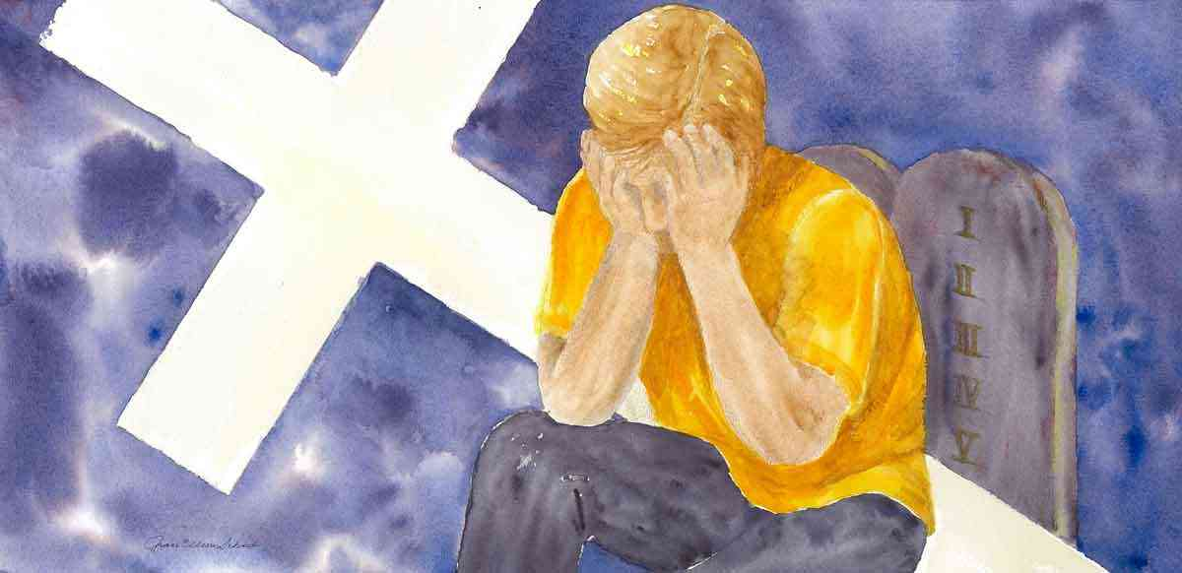
We also were enslaved..
Romans 7:22-24 For I delight in the law of God according to the inward man. 23 But I see another law in my members, warring against the law of my mind, and bringing me into captivity to the law of sin which is in my members. 24 O wretched man that I am! Who will deliver me from this body of death?

Slide 11
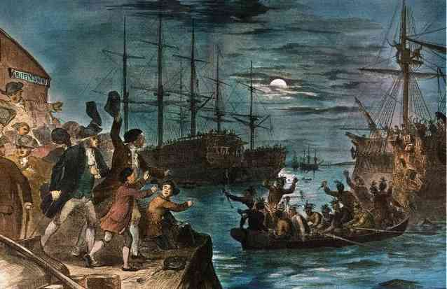
A Fight for victory over the power that enslaved us..
1773 … Boston Tea Party

Slide 12
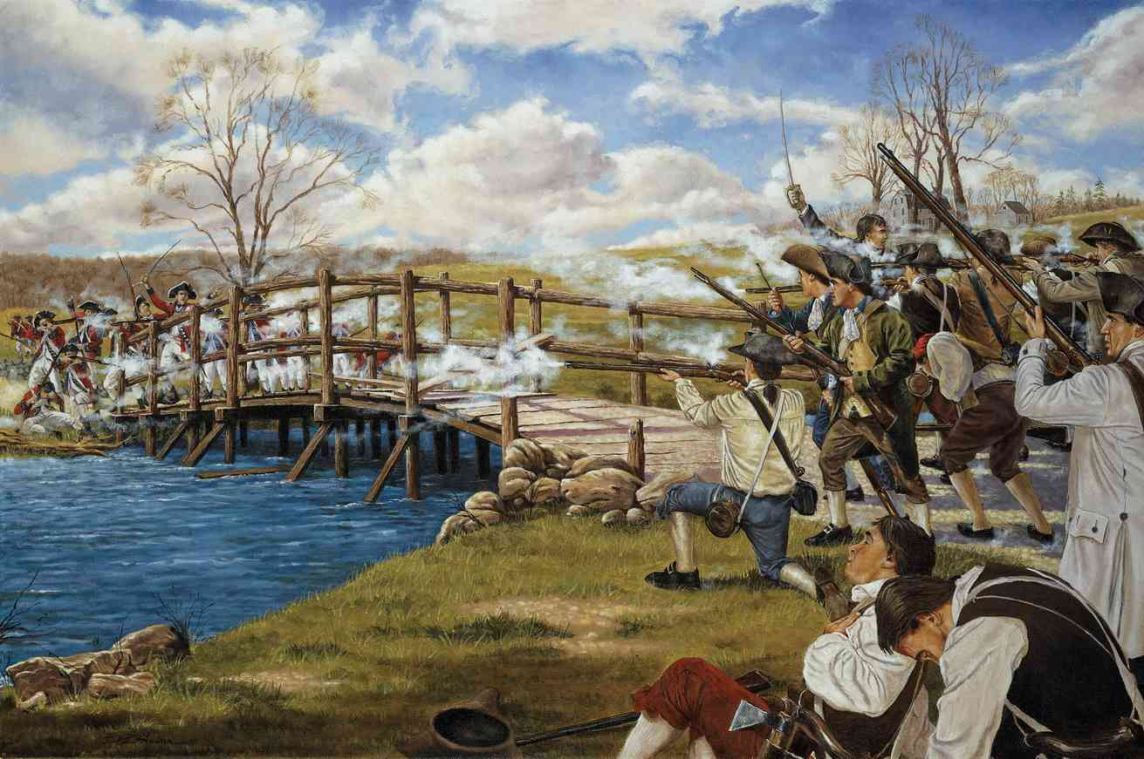
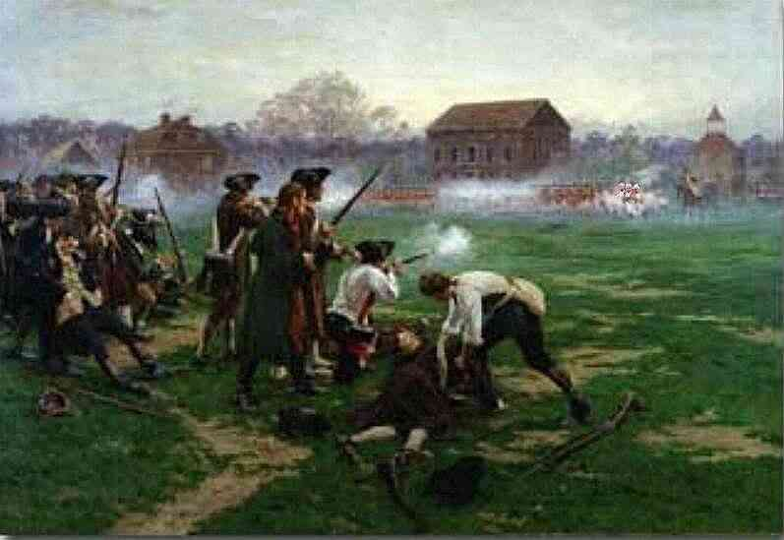
A Fight for victory over the power that enslaved us..
1775 … Lexington and Concord..

Slide 13
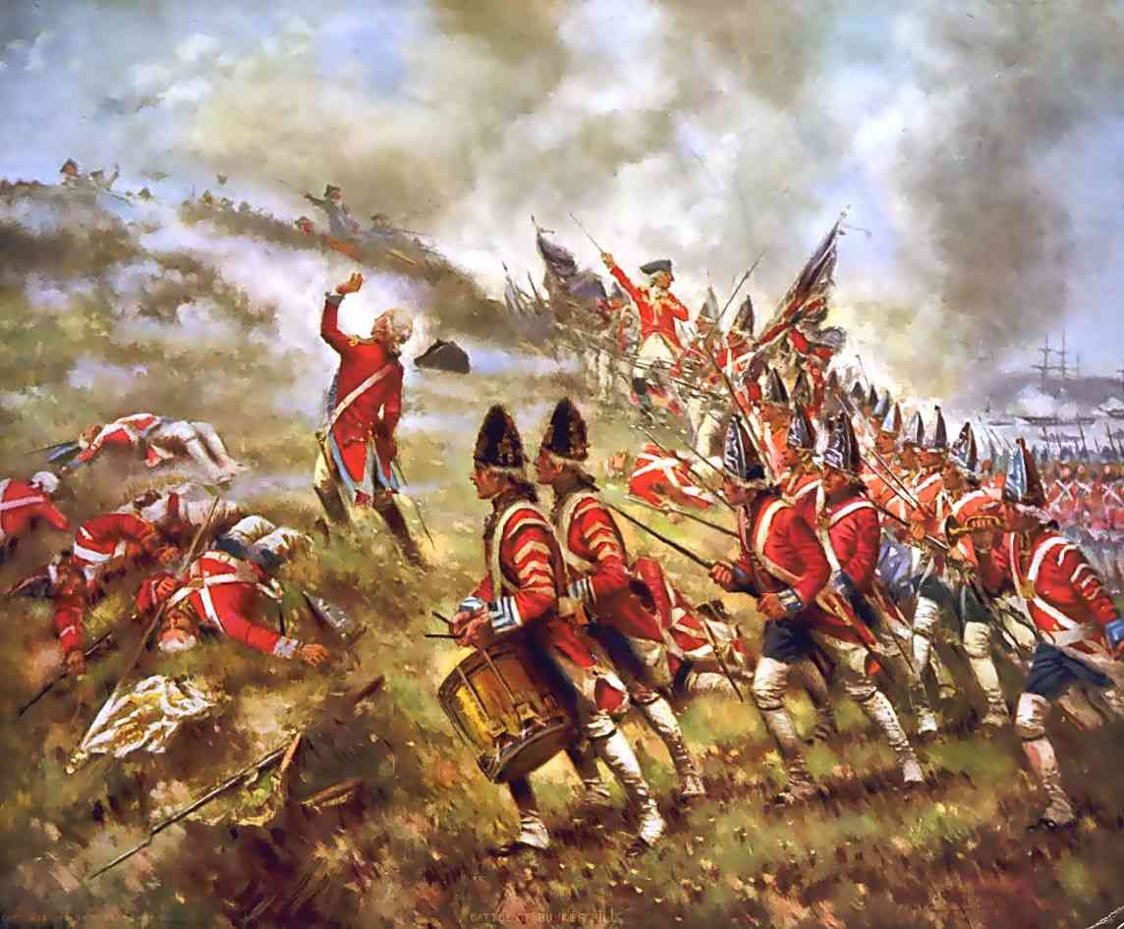
A Fight for victory over the power that enslaved us..
1775 … Battle of Ticonderoga..
Battle of Bunker Hill

Slide 14
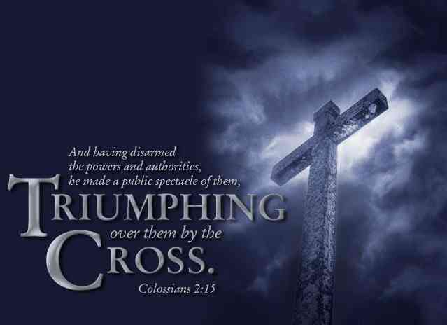
A Fight for victory over the power that enslaved us..
Colossians 2:15 Having disarmed principalities and powers, He made a public spectacle of them, triumphing over them in it.
Colossians 2:10 and you are complete in Him, who is the head of all principality and power.

Slide 15
A Fight for victory over the power that enslaved us..
Colossians 2:8 Beware lest anyone cheat you through philosophy and empty deceit, according to the tradition of men, according to the basic principles of the world, and not according to Christ.
Colossians 2:11 In Him you were also circumcised with the circumcision made without hands, by putting off the body of the sins of the flesh, by the circumcision of Christ..

Slide 16
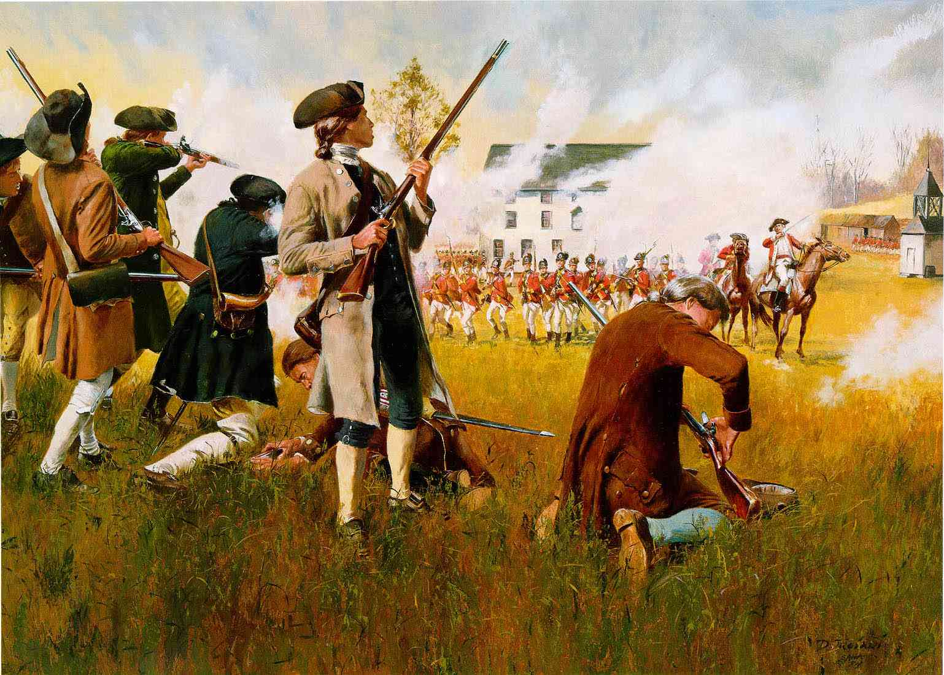
Our independence is due to the death of others..
"Posterity, you will never know how much it cost the present generation to preserve your freedom... I hope you will make a good use of it ... if you do not I shall repent it in heaven that I ever took half the pains to preserve it... (John Adams)

Slide 17
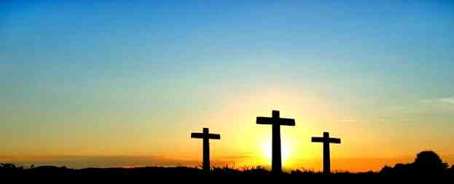
Our freedom in Christ…
Colossians 2:14 having wiped out the handwriting of requirements that was against us, which was contrary to us. And He has taken it out of the way, having nailed it to the cross.
Colossians 2:12 buried with Him in baptism, in which you also were raised with Him through faith in the working of God, who raised Him from the dead.

Slide 18
Independence Day
Colossians 2:8-15

