Slide 1
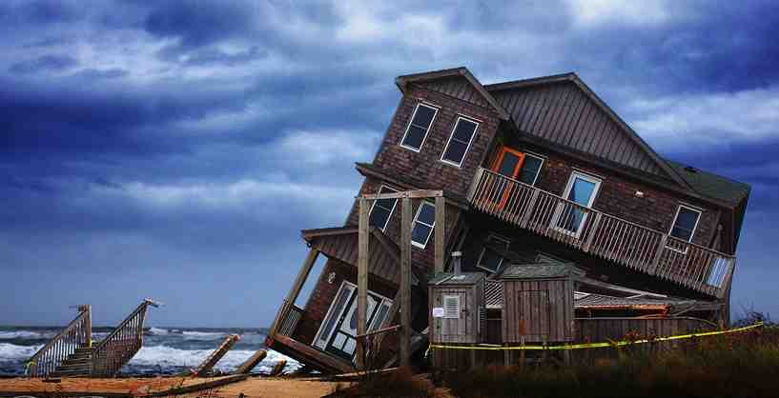
Building for Life
Matthew 7:24-27

Slide 2
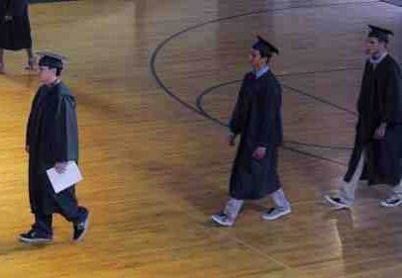
Graduation and the future..
A time to celebrate achievement…
A time to prepare for the future…

Slide 3
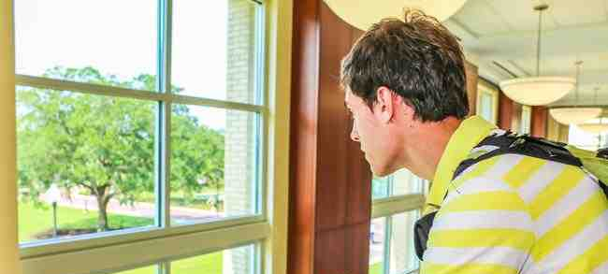
What are you building on..
What will be the foundation of your life?..

Slide 4
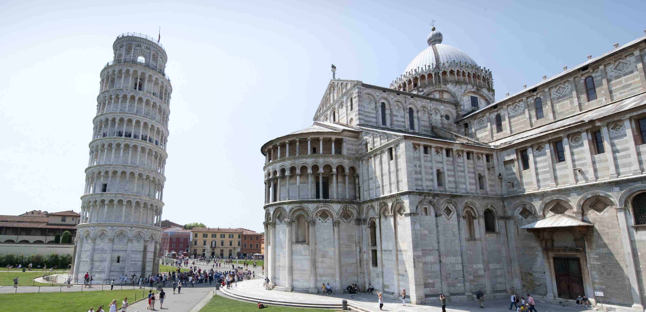
Tower of Pisa..
Poor architecture or poor foundation?

Slide 5
The need for wisdom..
Proverbs 4:7-8 Wisdom is the principal thing; Therefore get wisdom. And in all your getting, get understanding. 8 Exalt her, and she will promote you; She will bring you honor, when you embrace her.

Slide 6
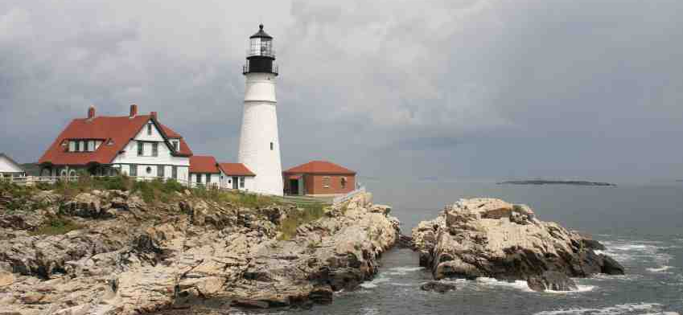
Each of us is building..
Matthew 7:24-27 "Therefore whoever hears these sayings of Mine, and does them, I will liken him to a wise man who built his house on the rock ..”

Slide 7
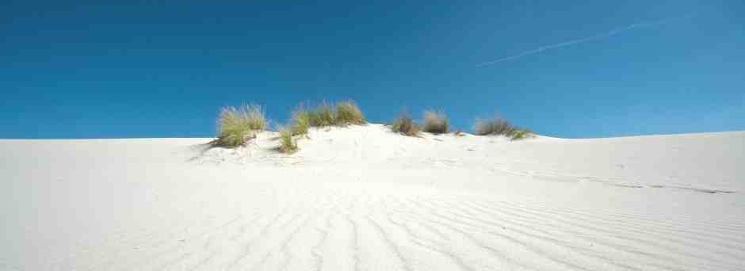
Jesus calls for a choice..
Matthew 7:13-14 "Enter by the narrow gate; for wide is the gate and broad is the way that leads to destruction, and there are many who go in by it. 14 Because narrow is the gate and difficult is the way which leads to life, and there are few who find it.

Slide 8
Wise or foolish?..
26 "But everyone who hears these sayings of Mine, and does not do them, will be like a foolish man who built his house on the sand: 27 and the rain descended, the floods came, and the winds blew and beat on that house; and it fell. And great was its fall."

Slide 9
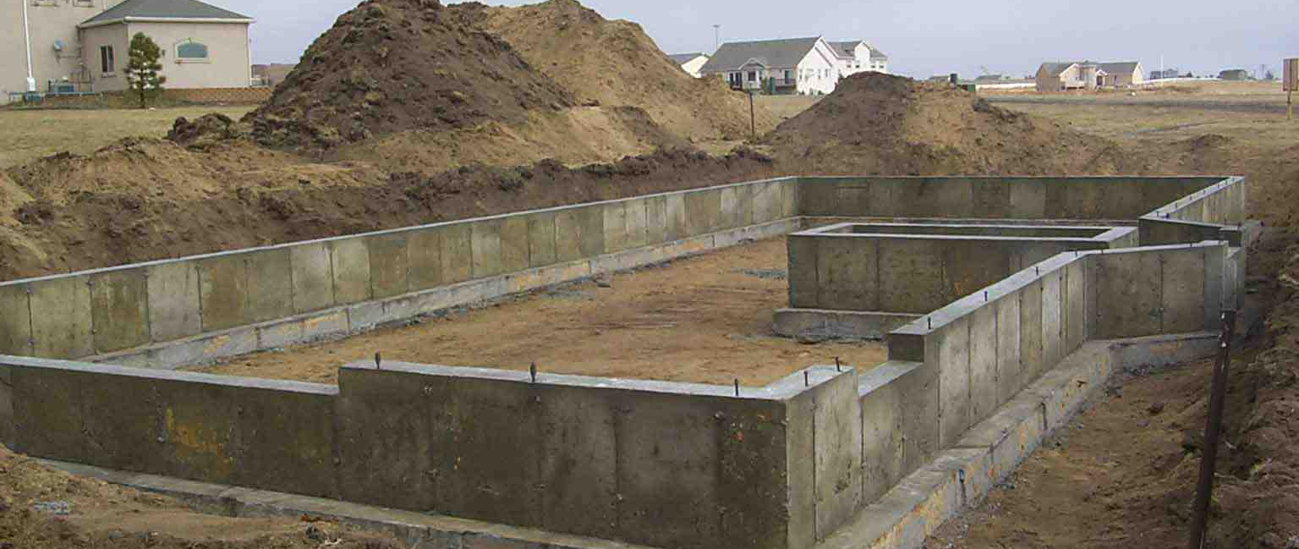
We all choose a foundation..
Matthew 16:18 on this rock I will build My church, and the gates of Hades shall not prevail against it.

Slide 10
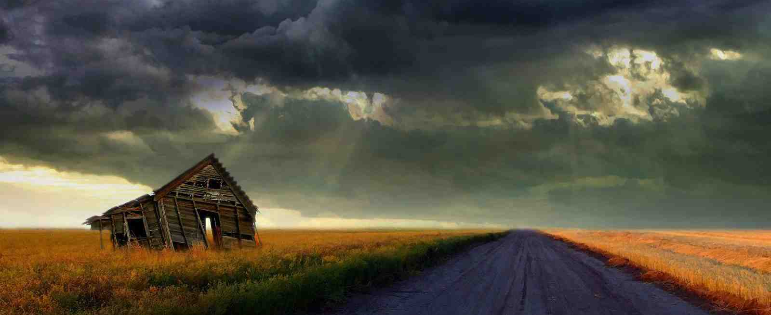
Storms will come in life..
Trials, tragedies come which test the strength of our lives…

Slide 11
Hearing only is not enough..
Matt 7:24-27 "whoever hears these sayings of Mine, .. and does them, I will liken him to a wise man..”

Slide 12
Strength in Jesus’ words..
Matthew 6:19-21 "Do not lay up for your-selves treasures on earth, where moth and rust destroy… but lay up for yourselves treasures in heaven, ..
Matthew 6:33 But seek first the kingdom of God and His righteousness…

Slide 13
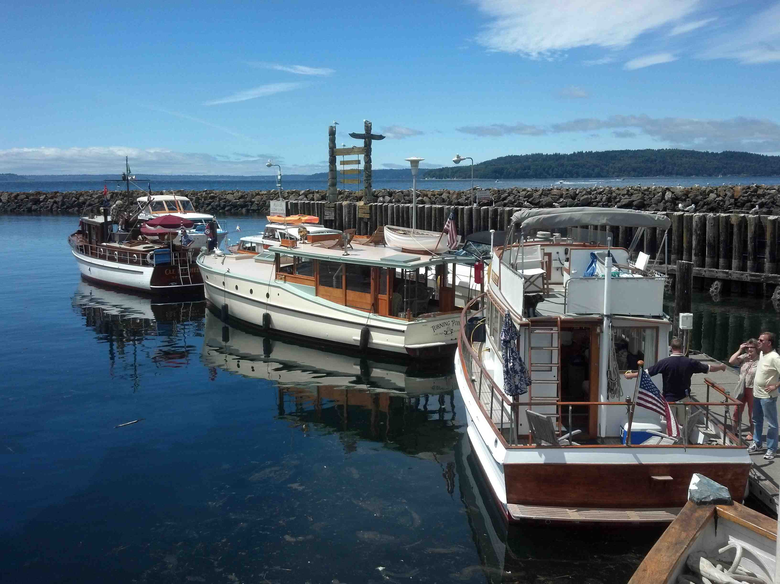
Wooden boat show..

Slide 14
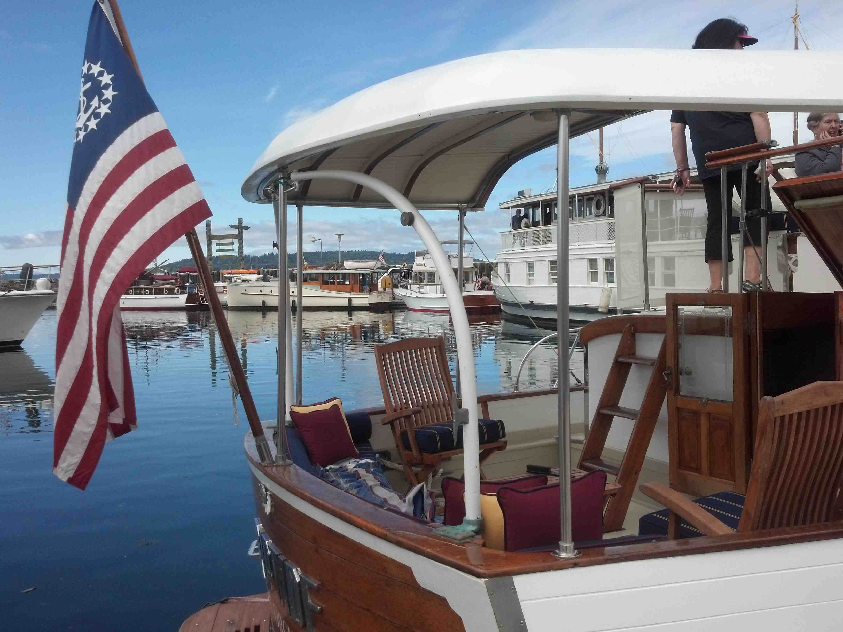

Slide 15
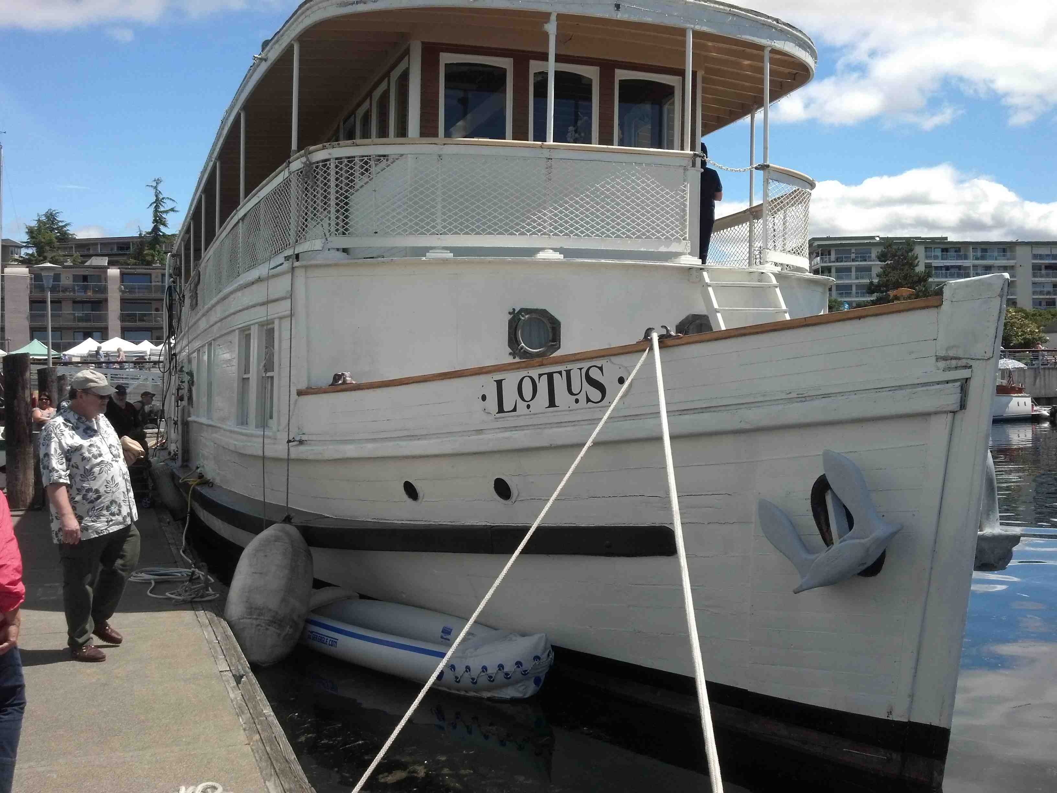
The Lotus … 85 ft vessel built in 1909…

Slide 16
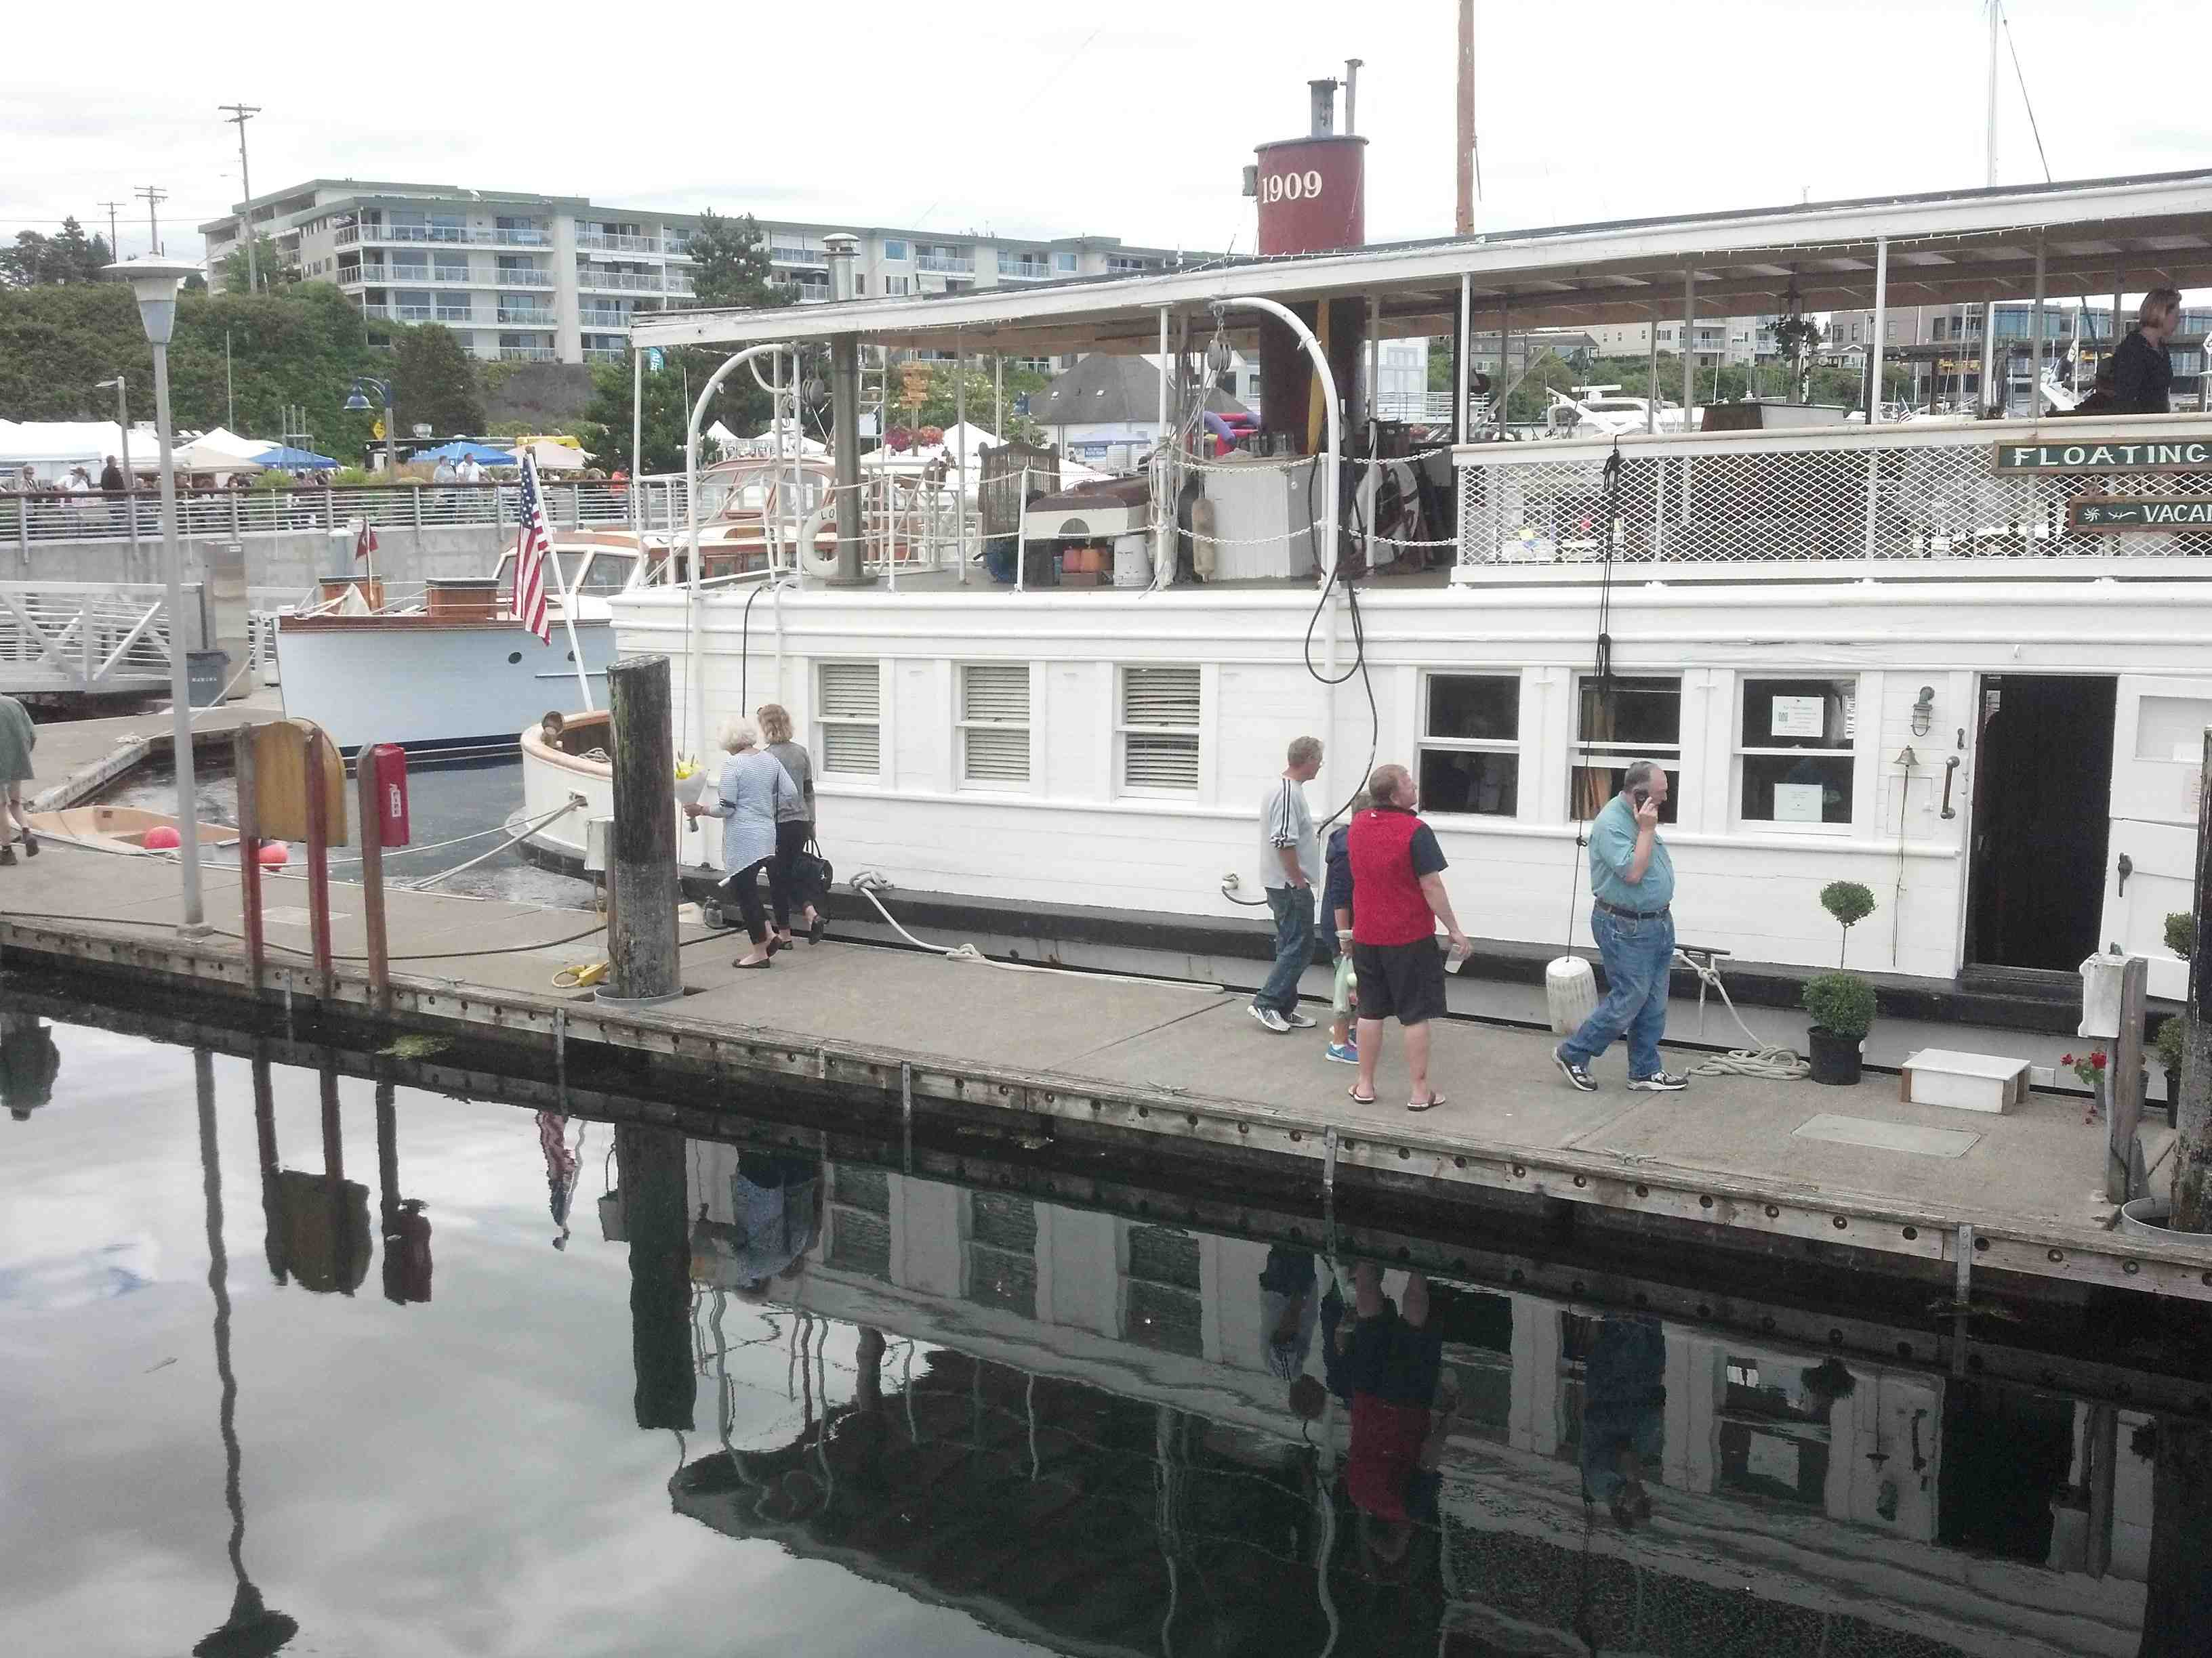

Slide 17
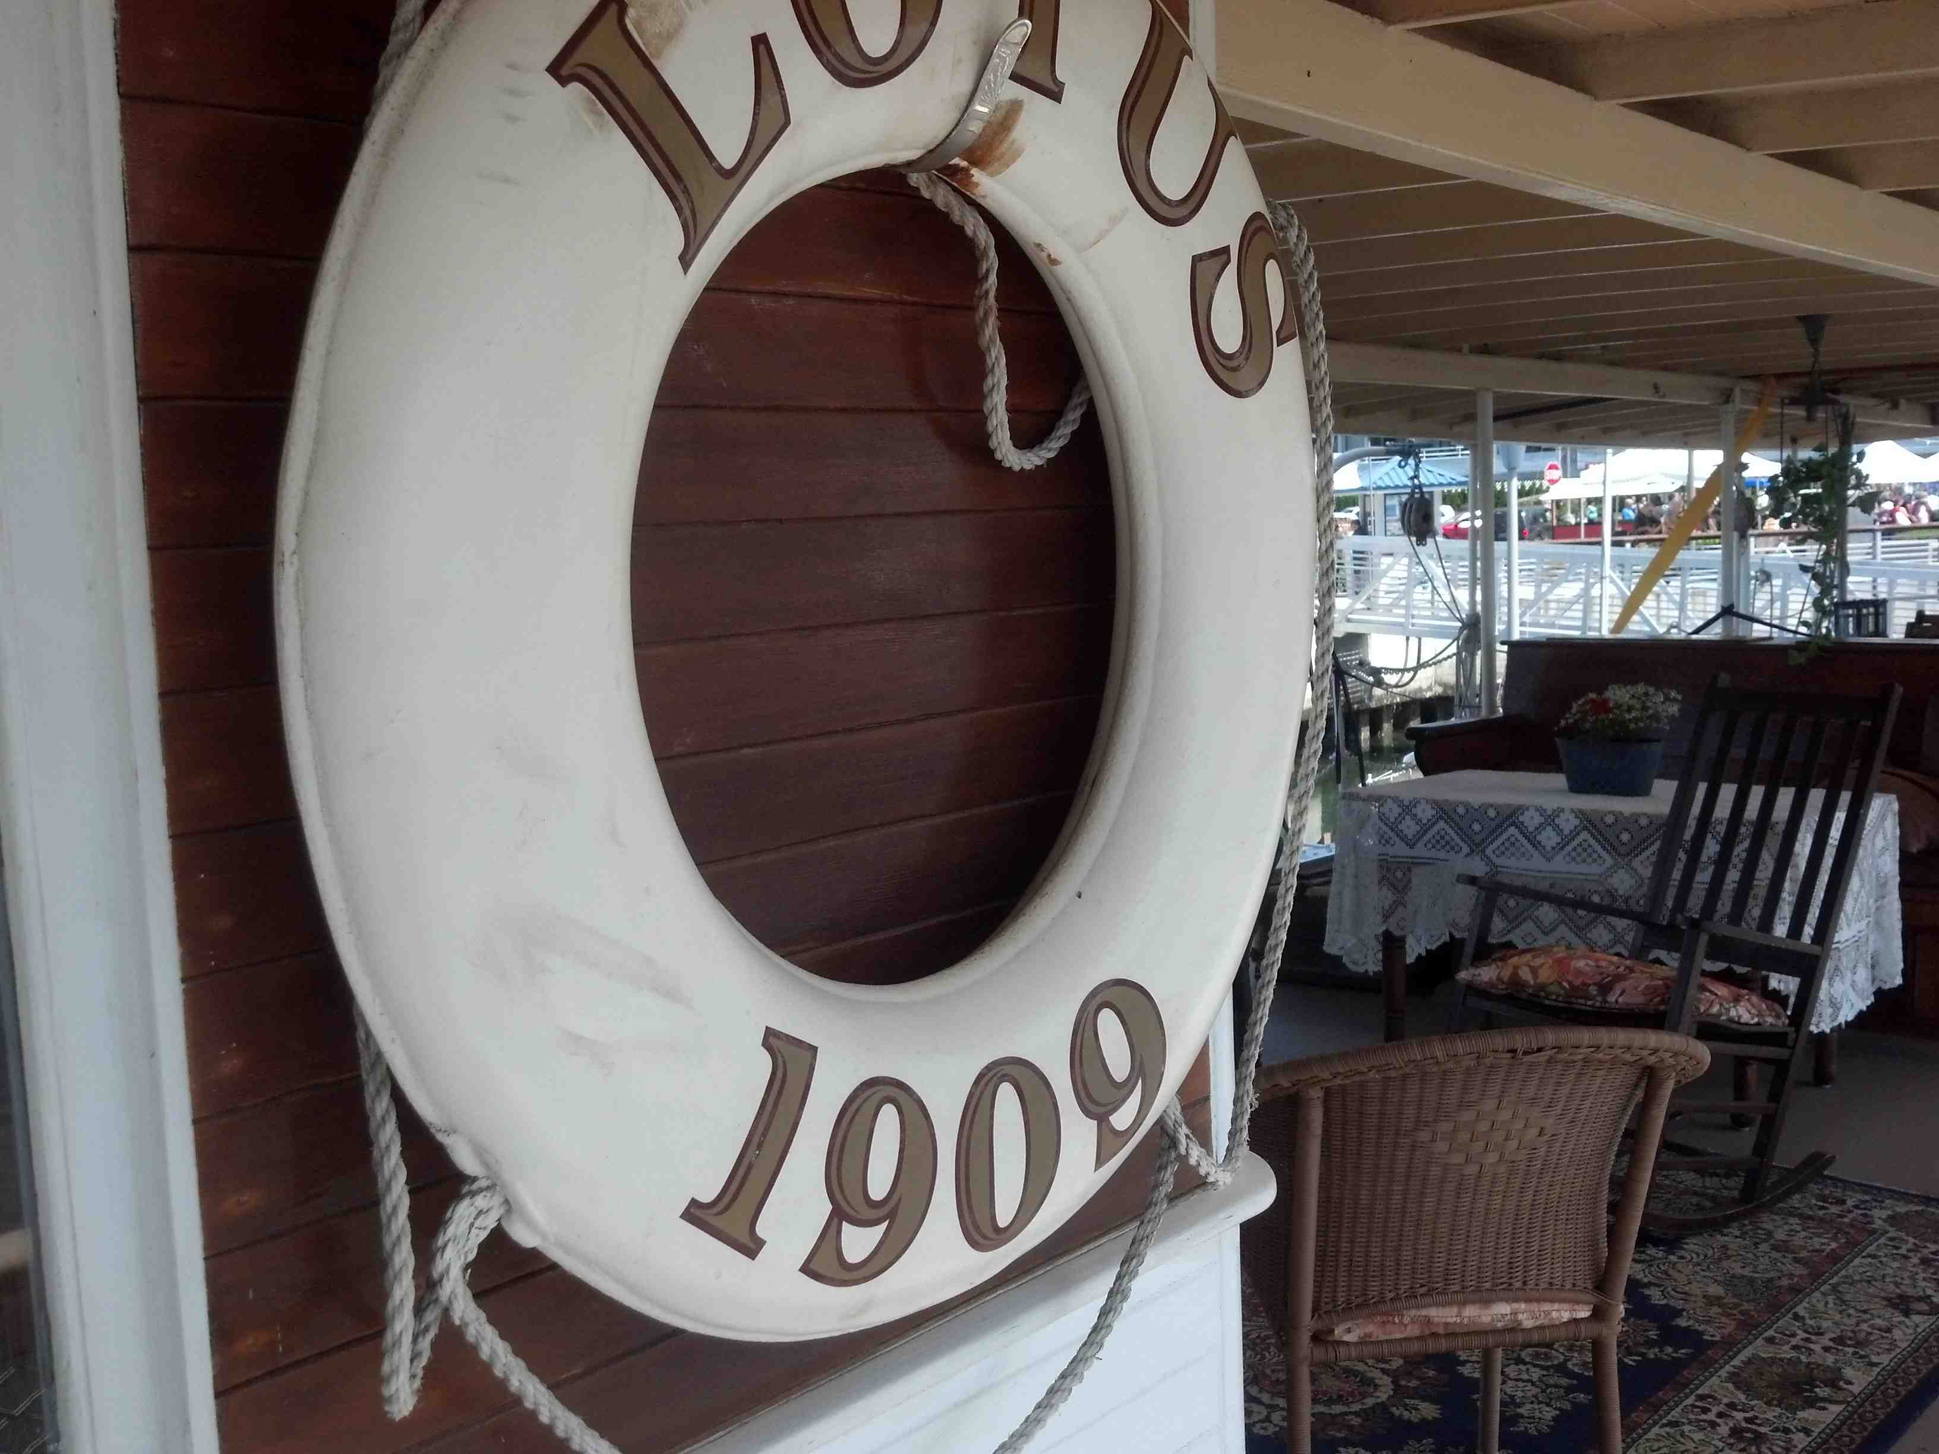

Slide 18
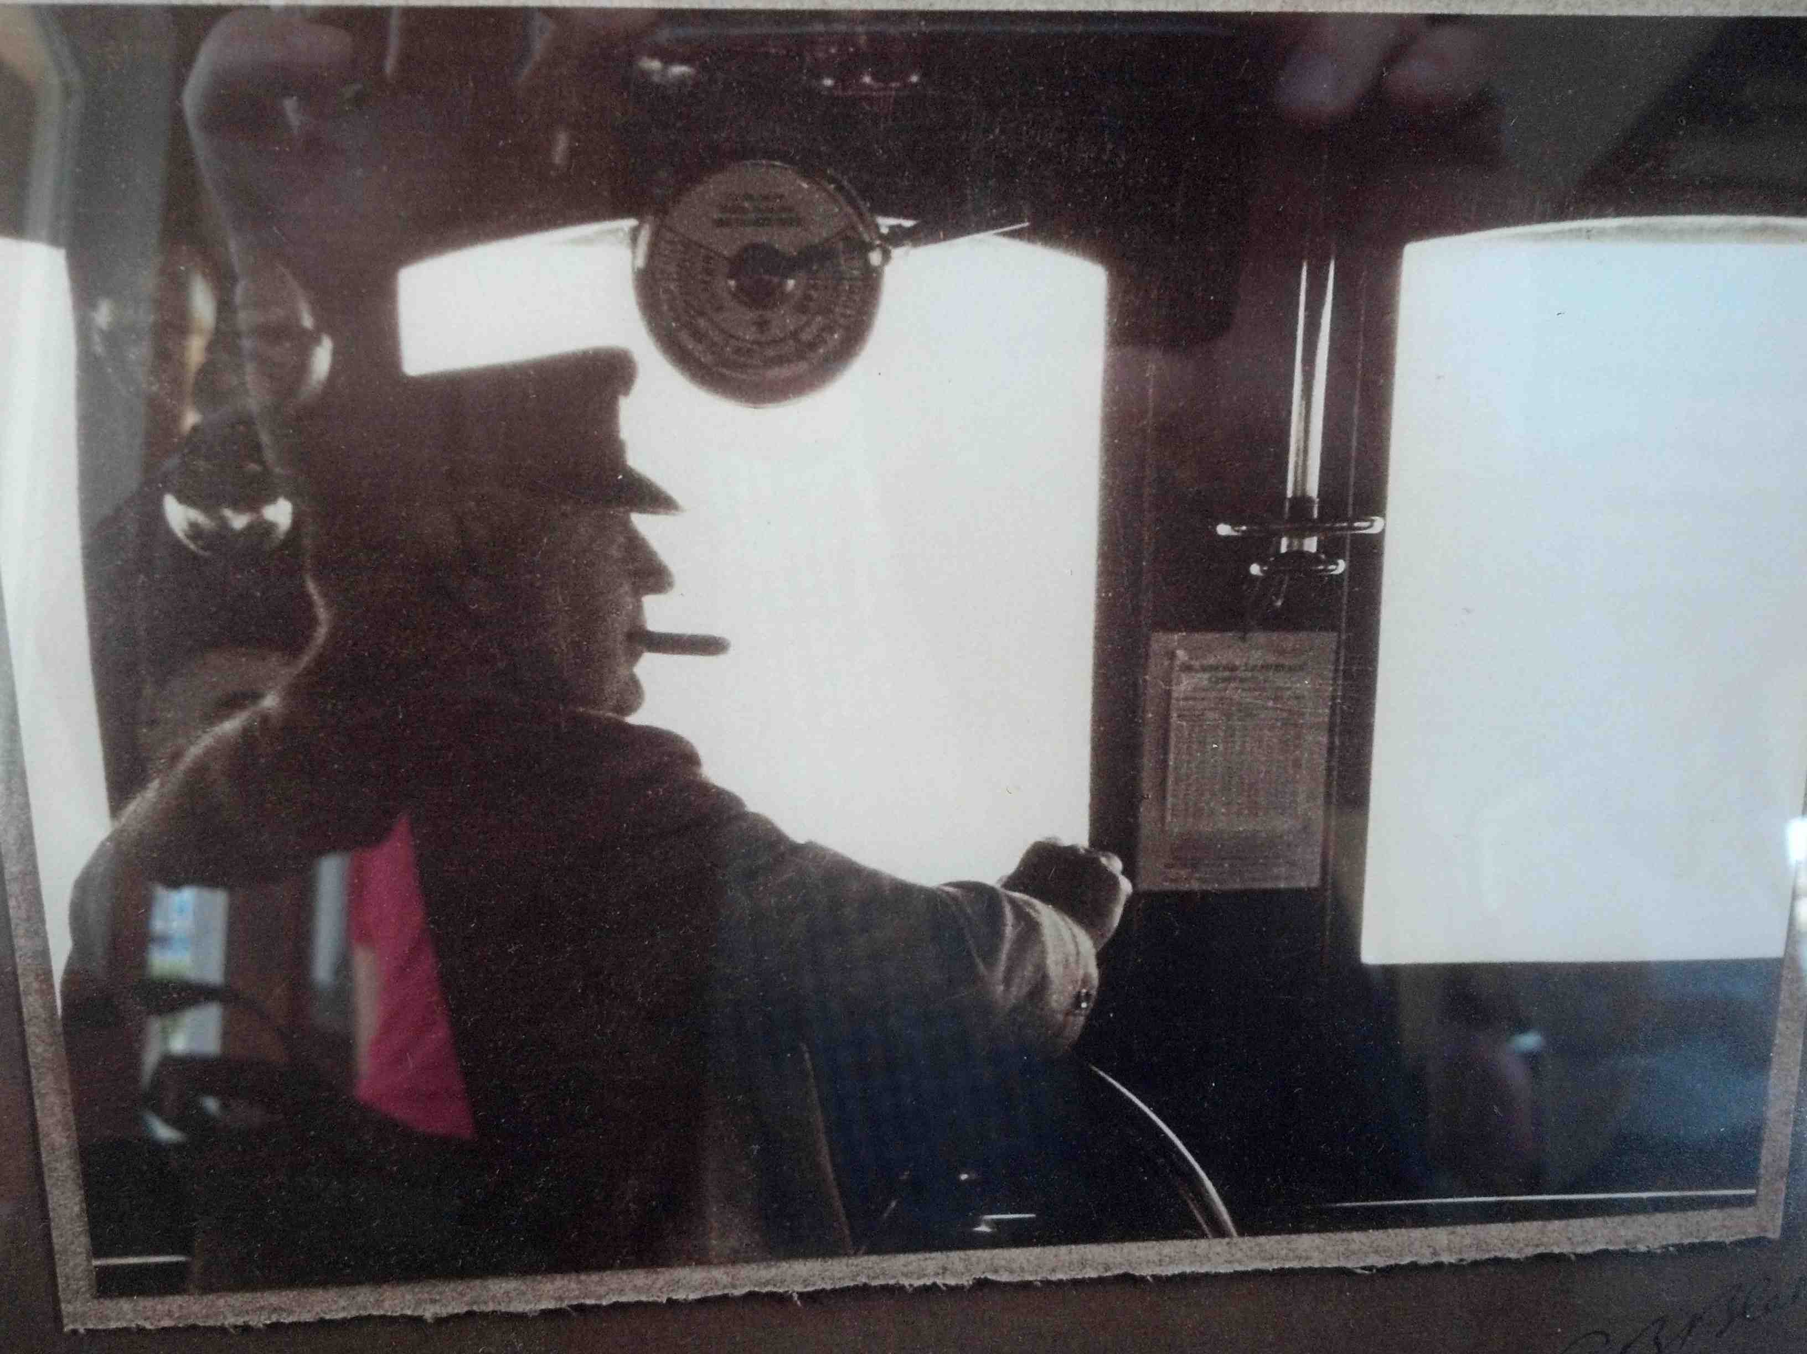

Slide 19
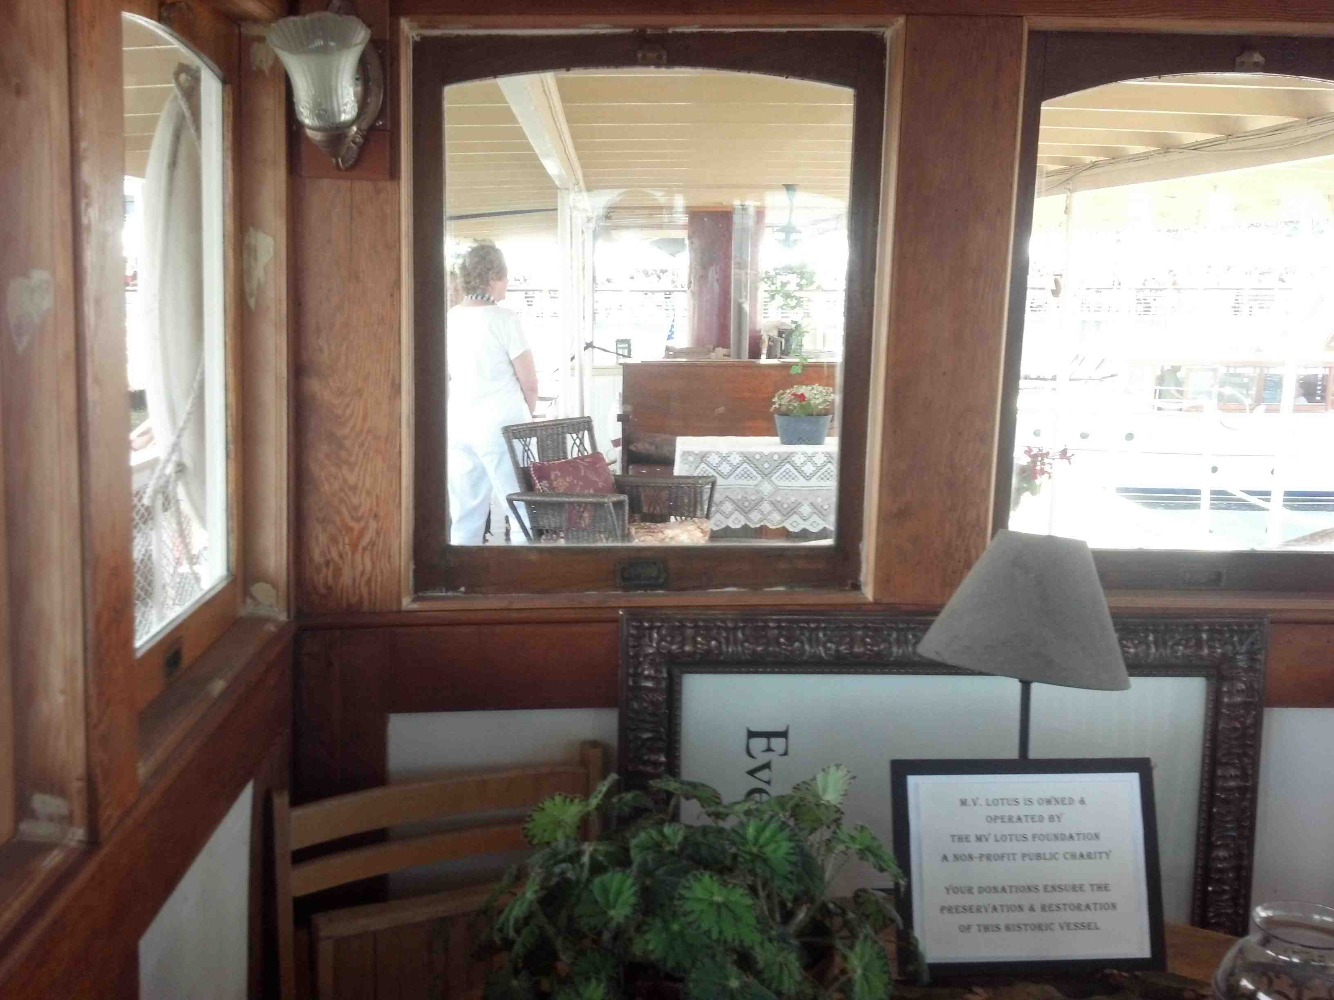

Slide 20
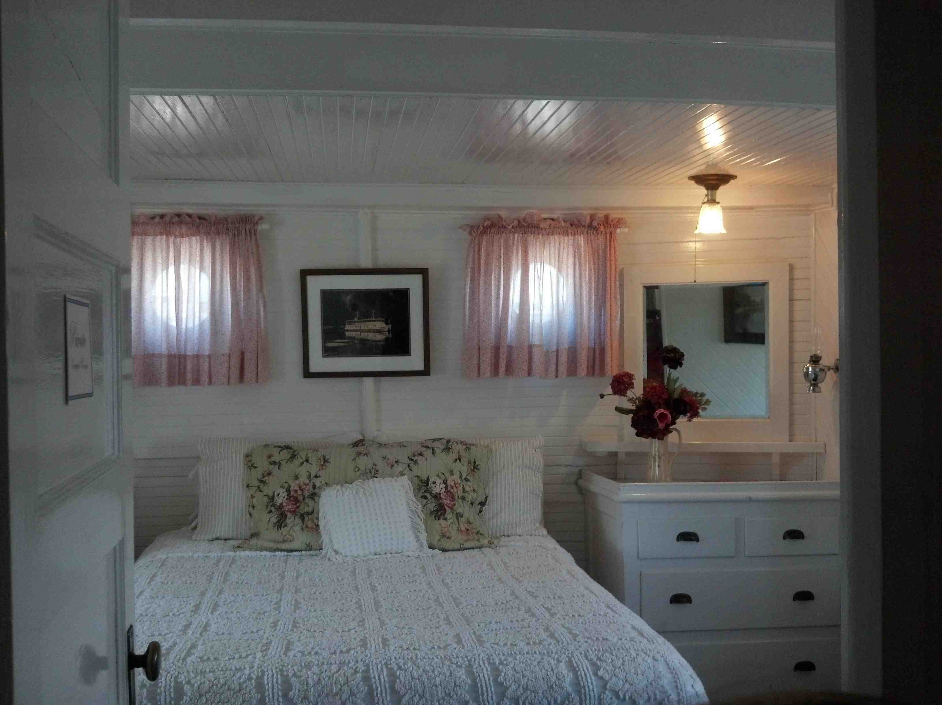

Slide 21
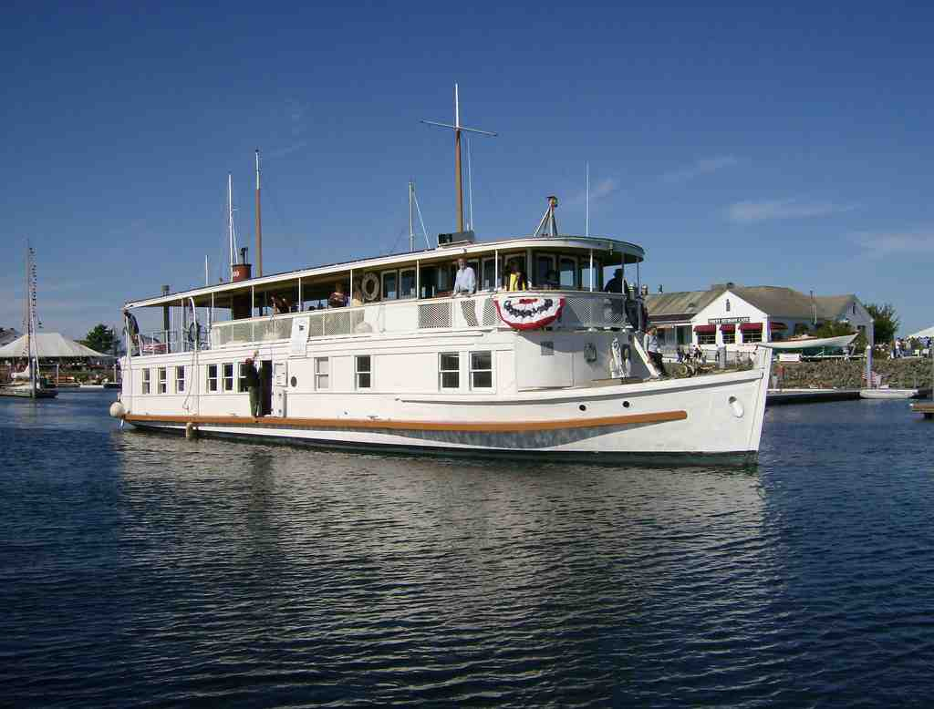
Still seaworthy after 105 years…

Slide 22
What will you choose?
Firm foundation or shifting sand?..

Slide 23
Building for Life
Matthew 7:24-27

