Slide 2
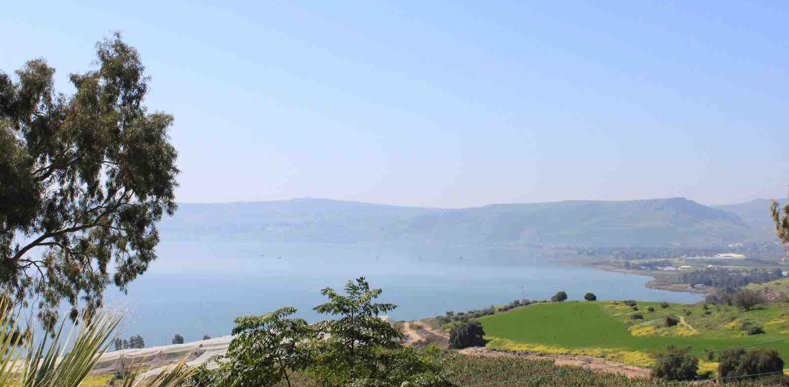
“Don’t worry, Be happy!”
Matthew 5:3-6 "Blessed are the poor in spirit, For theirs is the kingdom of heaven.
4 Blessed are those who mourn, For they shall be comforted.
5 Blessed are the meek, For they shall inherit the earth.
6 Blessed are those who hunger and thirst for righteousness, For they shall be filled.
5:11-12 Rejoice and be exceedingly glad, for great is your reward in heaven..

Slide 3
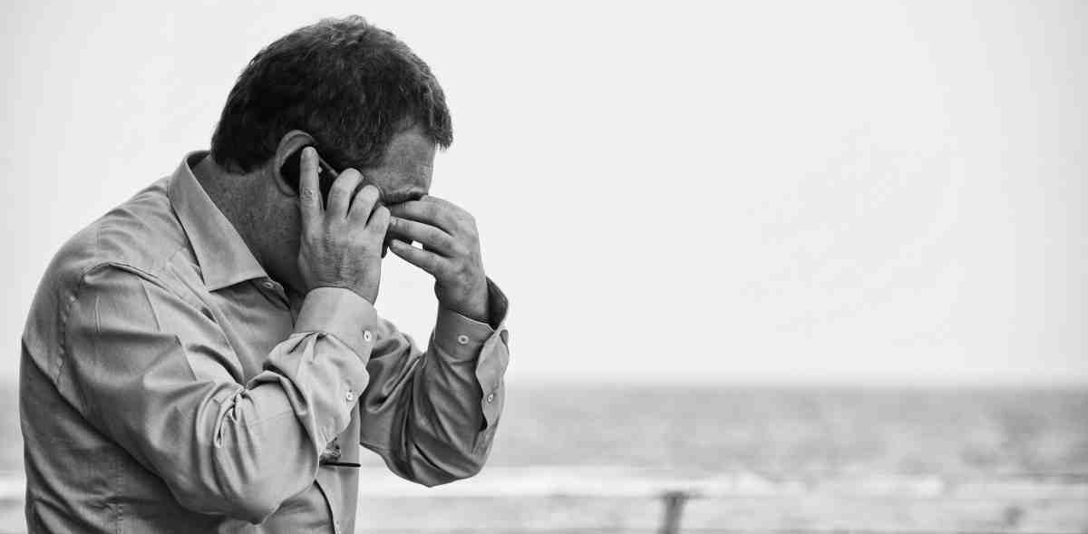
Many things we worry about..
Luke 8:14 choked with cares, riches, and pleasures of life…
Luke 10:40-42 .. “you are worried and troubled about many things.”
Luke 12:22 do not worry about your life, what you will eat; nor about the body, what you will put on.

Slide 4
What is Jesus prohibiting..
Matthew 6:25 "Therefore I say to you, do not worry about your life, what you will eat or what you will drink..
Anxious, troubled with cares, unease, nervousness..
A divided mind…
Phil. 4:6 Be anxious for nothing, but in everything by prayer and supplication, with thanksgiving, let your requests be made known to God..

Slide 5
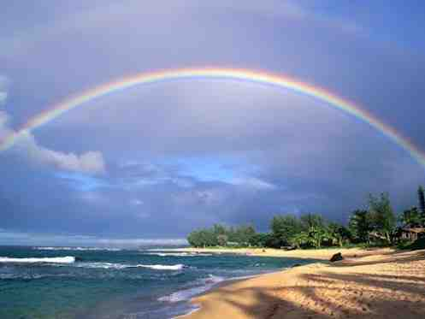
Don’t worry.. 19-21 Your treasure is secure..
Matthew 6:19-21 "Do not lay up for yourselves treasures on earth, where moth and rust destroy and where thieves break in and steal; 20 but lay up for yourselves treasures in heaven, where neither moth nor rust destroys and where thieves do not break in and steal.
1 Peter 1:4-5 an inheritance incorruptible and undefiled and that does not fade away, reserved in heaven for you, 5 who are kept by the power of God through faith for salvation ready to be revealed in the last time.

Slide 6
Don’t worry.. 21-24 Worry reveals what our heart really is..
Matthew 6:19-21 lay up for yourselves treasures in heaven, where neither moth nor rust destroys and where thieves do not break in and steal. 21 For where your treasure is, there your heart will be also.
Matthew 6:22-24 "The lamp of the body is the eye. If therefore your eye is good, your whole body will be full of light. 23 But if your eye is bad, your whole body will be full of darkness. If therefore the light that is in you is darkness, how great is that darkness! 24 "No one can serve two masters; for either he will hate the one and love the other, or else he will be loyal to the one and despise the other. You cannot serve God and mammon.

Slide 7
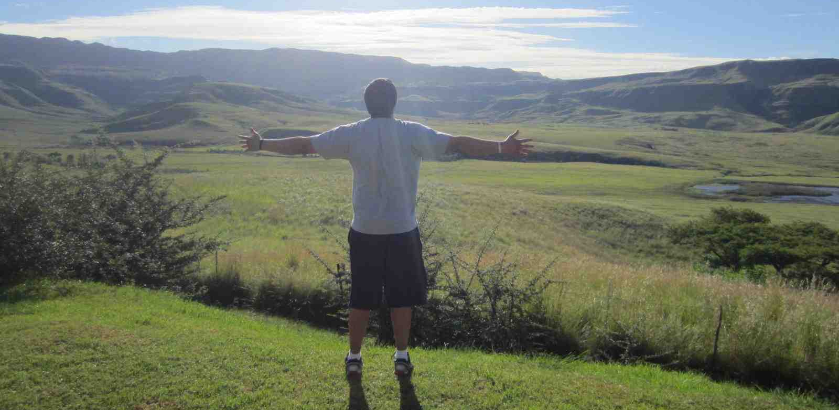
Don’t worry.. 24 Announce your king..
Matthew 6:24 "No one can serve two masters; for either he will hate the one and love the other, or else he will be loyal to the one and despise the other. You cannot serve God and mammon.
Psalm 5:3 My voice You shall hear in the morning, O Lord; In the morning I will direct it to You,And I will look up.

Slide 8
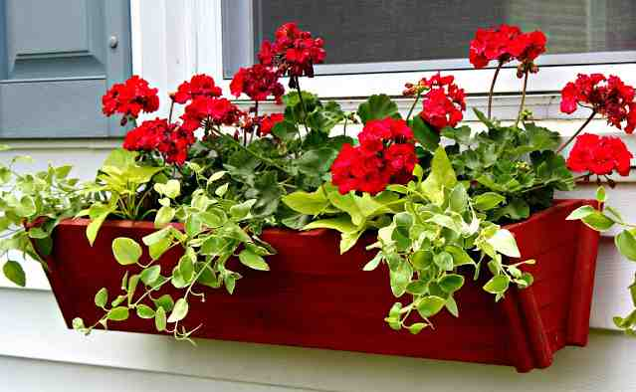
Don’t worry.. 25 Do not worry about your life..
Matt 6:25 "Therefore I say to you, do not worry about your life, what you will eat or what you will drink; nor about your body, what you will put on. Is not life more than food and the body more than clothing?
Acts 17:24-28 God, who made the world and everything in it, since He is Lord of heaven and earth.. gives to all life, breath, and all things...and has determined their preappointed times and the boundaries of their dwellings, … 28 for in Him we live and move and have our being, as also some of your own poets have said, 'For we are also His offspring.'

Slide 9
Don’t worry.. 26-27 It accomplishes nothing..
Matthew 6:25-27 "Is not life more than food and the body more than clothing? 26 Look at the birds of the air, for they neither sow nor reap nor gather into barns; yet your heavenly Father feeds them. Are you not of more value than they? 27 Which of you by worrying can add one cubit to his stature?
2 Cor 12:7-10 I pleaded with the Lord three times that it might depart from me. 9 And He said to me, "My grace is sufficient for you, for My strength is made perfect in weakness." Therefore most gladly I will rather boast in my infirmities, that the power of Christ may rest upon me. 10 Therefore I take pleasure in infirmities, in reproaches, in needs, in persecutions, in distresses, for Christ's sake. For when I am weak, then I am strong.

Slide 10
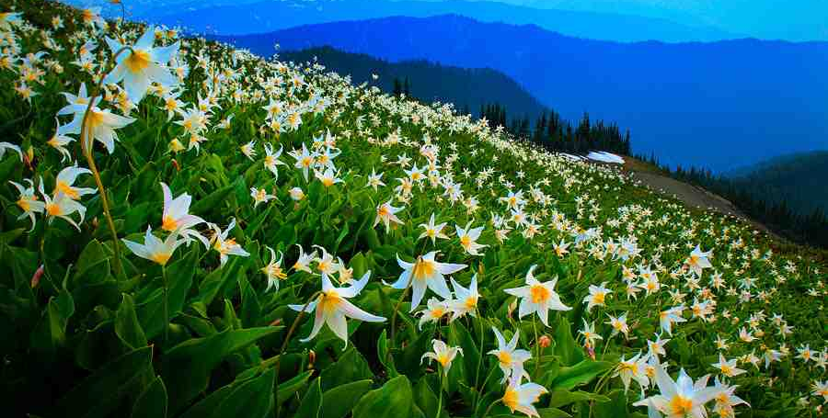
Don’t worry.. 28-30 It isn’t necessary..
Matthew 6:28-30 "So why do you worry about clothing? Consider the lilies of the field, how they grow: they neither toil nor spin; 29 and yet I say to you that even Solomon in all his glory was not arrayed like one of these. 30 Now if God so clothes the grass of the field, which today is, and tomorrow is thrown into the oven, will He not much more clothe you, O you of little faith?

Slide 11
Don’t worry.. 30-32 Everything we need will be provided..
Matthew 6:30-32 Now if God so clothes the grass of the field, which today is, and tomorrow is thrown into the oven, will He not much more clothe you, O you of little faith? 31 "Therefore do not worry, saying, 'What shall we eat?' or 'What shall we drink?' or 'What shall we wear?' 32 For after all these things the Gentiles seek. For your heavenly Father knows that you need all these things.
Matthew 7:7-8 "Ask, and it will be given to you; seek, and you will find; knock, and it will be opened to you. 8 For everyone who asks receives, and he who seeks finds, and to him who knocks it will be opened.

Slide 12
Don’t worry.. 33 Attend to the spiritual first..
Matthew 6:33 But seek first the kingdom of God and His righteousness, and all these things shall be added to you.
1 Timothy 4:7-8 exercise yourself toward godliness. 8 For bodily exercise profits a little, but godliness is profitable for all things, having promise of the life that now is and of that which is to come.

Slide 13
Don’t worry.. 34 Live one day at a time..
Matthew 6:34 Therefore do not worry about tomorrow, for tomorrow will worry about its own things. Sufficient for the day is its own trouble.
James 4:13-15 Come now, you who say, "Today or tomorrow we will go to such and such a city, spend a year there, buy and sell, and make a profit"; 14 whereas you do not know what will happen tomorrow. For what is your life? It is even a vapor that appears for a little time and then vanishes away. 15 Instead you ought to say, "If the Lord wills, we shall live and do this or that."

