Slide 1
Romans 1:13-17

Slide 2
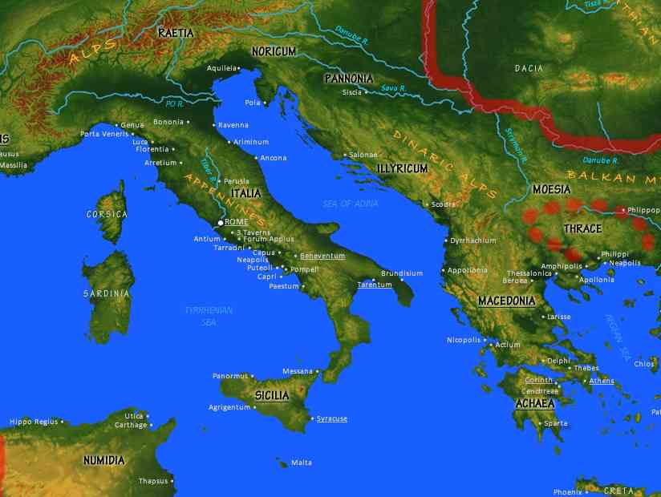
Paul to the Romans…
“For I am not ashamed of the gospel”..

Slide 3
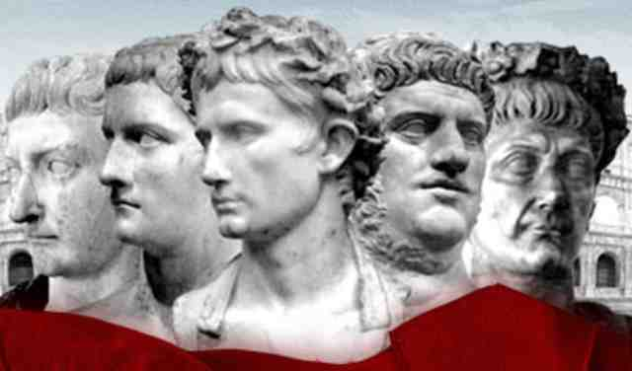
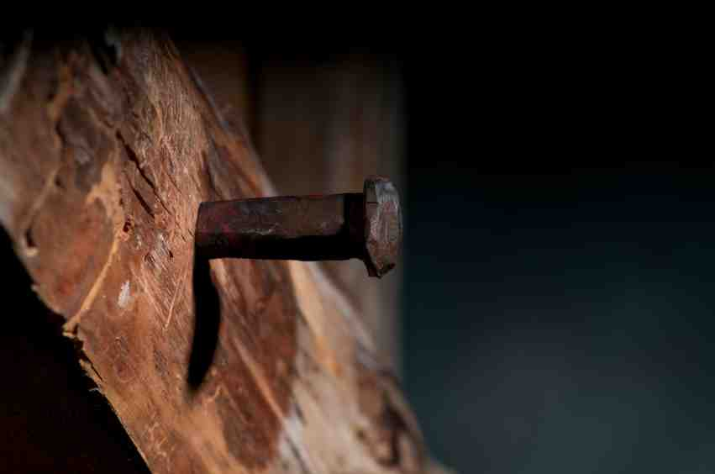
Why he could be ashamed..
The moral condition…
He was a Jew...
The message he preached…
The abuse he suffered…

Slide 4
Yet he remained committed..
Philippians 3:7-10 indeed I also count all things loss for the excellence of the knowledge of Christ Jesus my Lord, for whom I have suffered the loss of all things, and count them as rubbish, that I may gain Christ ..

Slide 5
Yet he remained committed..
2 Cor. 12:15-16 And I will very gladly spend and be spent for your souls; though the more abundantly I love you, the less I am loved. 16 But be that as it may, I did not burden you. Nevertheless, being crafty, I caught you by cunning!

Slide 6
Our culture is affecting us..
Are you willing to stand with Paul?

Slide 7
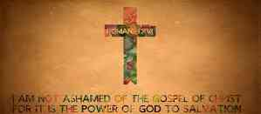
Why you shouldn’t be ashamed..
The gospel is God’s power..
Its only purpose is salvation..
It reveals how to be made righteous..
It is for everybody…

Slide 8
Take a personal inventory..
Jesus calls us to be unashamed…
Peter said he would never deny Him..
Don’t think it can’t happen to you..
If you have failed, don’t despair..

Slide 9
Romans 1:13-17

