Slide 1
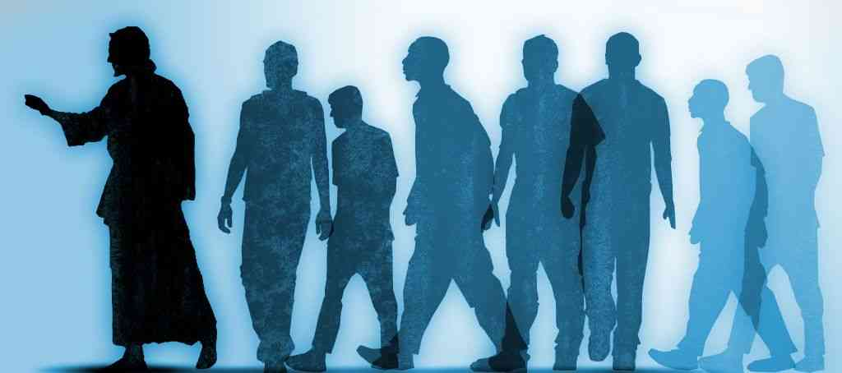
Disciples Like our Teacher
In His Humility

Slide 2
Luke 6:40
A disciple is not above his teacher, but everyone who is perfectly trained will be like his teacher.

Slide 3
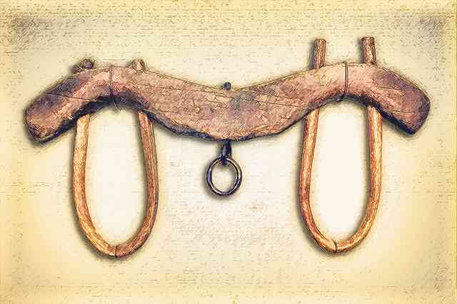
Matthew 11:28-30
Come to Me, all you who labor and are heavy laden, and I will give you rest. 29 Take My yoke upon you and learn from Me, for I am gentle and lowly in heart, and you will find rest for your souls. 30 For My yoke is easy and My burden is light."

Slide 5
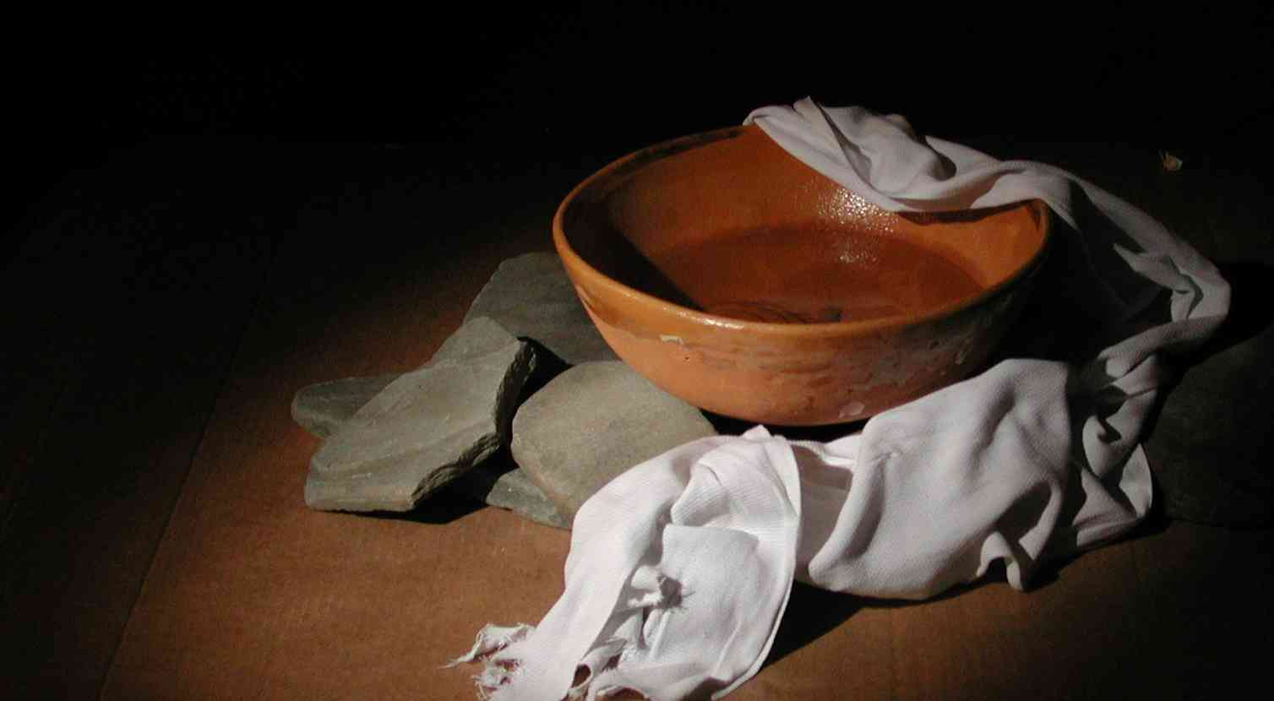
Philippians 2:1-11
5 Let this mind be in you which was also in Christ Jesus, 6 who, being in the form of God, did not consider it robbery to be equal with God, 7 but made Himself of no reputation, taking the form of a bondservant, and coming in the likeness of men. 8 And being found in appearance as a man, He humbled Himself and became obedient to the point of death, even the death of the cross.

Slide 6
What humility is…
Humility is mental .. Vs 3-5
Humility is chosen .. Vs 6
Humility is being what you are not .. 7
Humility is painful .. Vs 8

Slide 7
Humility defined..
Philippians 2:3-4
Considering others more significant ..
Put their interests ahead of your own..

Slide 8
Humility in action…
Means we need to serve..
Jesus lived His life to serve .. Mark 10:44-45
His service was done as people needed it ..
Willing to give our time and talents ..

Slide 9
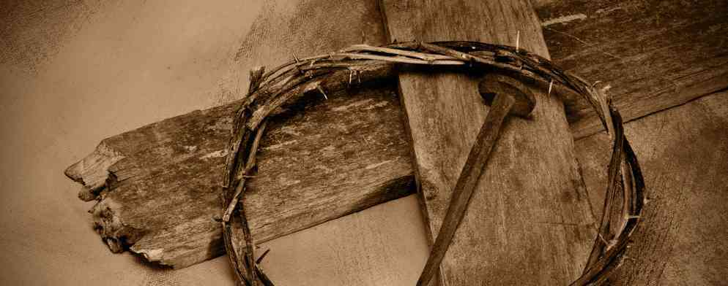
Humility in action…
Humility is obedience.. Vs. 8
Jesus learned obedience .. Heb 5:8-9
He obeyed even when discouraged..
He didn’t give up when it got hard..

Slide 10
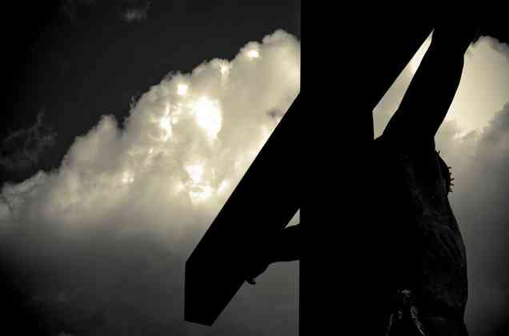
Humility in action…
Humility is complete dependence..
We see His dependence on God..
He also depended on others for help..

Slide 11
Why should we be humble?
Exaltation .. Vs 9-11
James 4:6-10 "God resists the proud, But gives grace to the humble." Humble yourselves in the sight of the Lord, and He will lift you up.
1 Peter 5:5 and be clothed with humility, for "God resists the proud, But gives grace to the humble."

Slide 12
Why should we be humble?
Deliverance for others .. Vs 15
Philippians 2:14-15 Do all things without complaining and disputing, 15 that you may become blameless and harmless, children of God without fault in the midst of a crooked and perverse generation, among whom you shine as lights in the world,

Slide 13
Disciples Like our Teacher
In His Humility

