Slide 1
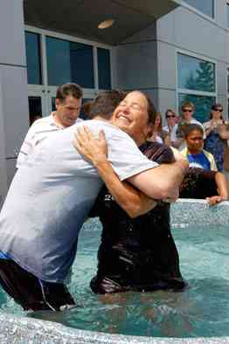
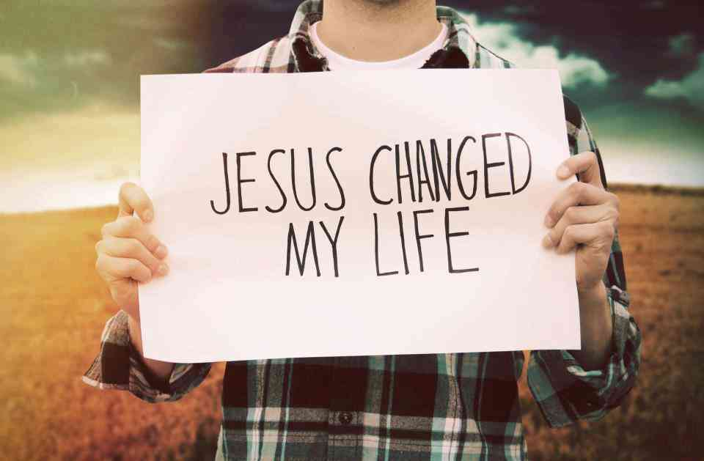
Added to the Lord
Acts 11:19-24

Slide 2
The work in Antioch..
Acts 11:21 And the hand of the Lord was with them, and a great number believed and turned to the Lord.
Acts 11:24 And a great many people were added to the Lord.

Slide 3
The Gospel is for all..
19-21 Now those who were scattered after the persecution that arose over Stephen traveled as far as Phoenicia, Cyprus, and Antioch, preaching the word to no one but the Jews only. 20 But some of them were men from Cyprus and Cyrene, who, when they had come to Antioch, spoke to the Hellenists, preaching the Lord Jesus. 21 And the hand of the Lord was with them, and a great number believed and turned to the Lord.

Slide 4
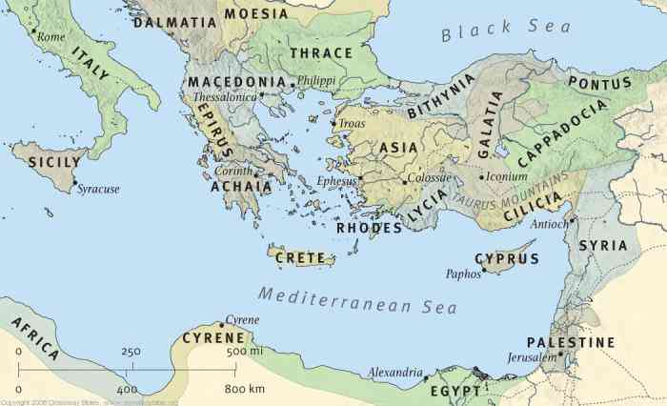

Slide 5
Lives powerfully changed..
21-23 a great number believed and turned to the Lord. 22 Then news of these things came to the ears of the church in Jerusalem, and they sent out Barnabas to go as far as Antioch. 23 When he came and had seen the grace of God, he was glad and encouraged them…

Slide 6
Lives powerfully changed..
Romans 6:3-5 Therefore we were buried with Him through baptism into death, that just as Christ was raised from the dead by the glory of the Father, even so we also should walk in newness of life. 5 For if we have been united together in the likeness of His death, certainly we also shall be in the likeness of His resurrection,
Romans 6:16-18 Do you not know that to whom you present yourselves slaves to obey, you are that one's slaves whom you obey, whether of sin leading to death, or of obedience leading to righteousness? 17 But God be thanked that though you were slaves of sin, yet you obeyed from the heart that form of doctrine to which you were delivered. 18 And having been set free from sin, you became slaves of righteousness.

Slide 7
Hearts committed…
23 When he came and had seen the grace of God, he was glad, and encouraged them all that with purpose of heart they should continue with the Lord.

Slide 8
Hearts committed…
Hebrews 10:23-25 Let us hold fast the confession of our hope without wavering, for He who promised is faithful. 24 And let us consider one another in order to stir up love and good works, 25 not forsaking the assembling of ourselves together, as is the manner of some, but exhorting one another, and so much the more as you see the Day approaching.

Slide 9
Godly character ..
22-24 they sent out Barnabas to go as far as Antioch. 23 When he came and had seen the grace of God, he was glad, and encouraged them all that with purpose of heart they should continue with the Lord. 24 For he was a good man, full of the Holy Spirit and of faith. And a great many people were added to the Lord.

Slide 10
What we need to learn..
When people turn to Christ, they are added by the Lord…
When the grace of God is seen in a church, growth will follow…
The seed of this growth is the word of the Lord…

Slide 11
Added to the Lord
Acts 11:19-24

