Slide 1
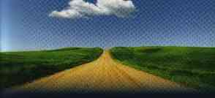
By This We Know
1 John 1:1-10

Slide 2
1 John 2:1-5
3 Now by this we know that we know Him, if we keep His commandments. 4 He who says, "I know Him," and does not keep His commandments, is a liar, and the truth is not in him. 5 But whoever keeps His word, truly the love of God is perfected in him. By this we know that we are in Him.

Slide 3
1 John..
A letter of love (51 times)..
That we may know (assurance)..

Slide 4
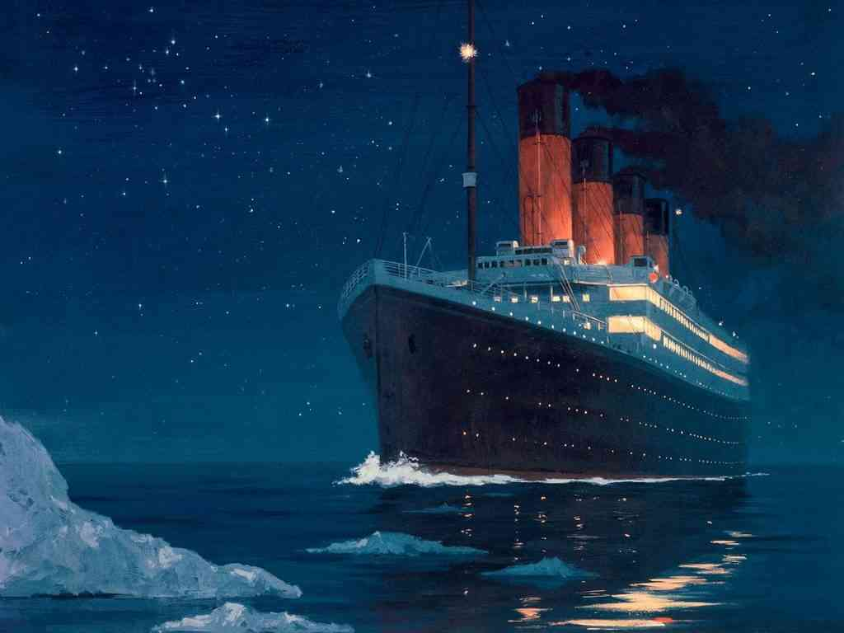
April 14, 1912..11:40 pm Titanic.. maiden voyage
1,312 passengers, 914 crew..
Six warnings not heeded..
Only 753 lives saved..

Slide 5
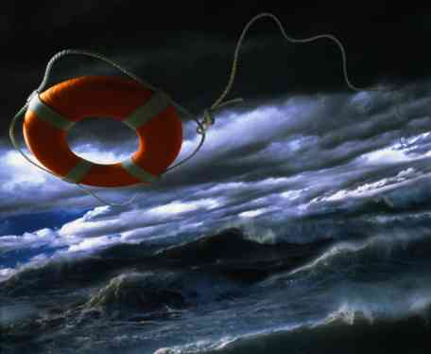
Are you saved?..
The world ignoring warnings..
Already struck iceberg..
Only hope of being saved..

Slide 6
Purpose of 1 John..
1 John 1:4 that your joy may be full.
1 John 5:13 that you may know that you have eternal life.

Slide 7
A.D. 90..
2nd/3rd Generation since Christ..
Gnostics.. Gr. gnosko (knowledge)
(Believed flesh inherently sinful)
- Chastise the body (Col 2:20-23)
- Eat, drink, be merry (Rev 2:6,14-15)

Slide 8
Doctrinal results..
Wrong view of Jesus Christ..
If all flesh is sinful, how could Jesus Christ have come in the flesh?
Two distorted explanations..

Slide 9
John’s answer to Gnostics..
1:1-4 That which was from the beginning, which we have heard, which we have seen with our eyes, which we have looked upon, and our hands have handled, concerning the Word of life — 2 the life was manifested, and we have seen, and bear witness, and declare to you that eternal life which was with the Father and was manifested to us —

Slide 10
2nd Doctrinal error..
Wrong view of living Christian life..
If all flesh is sinful, what we do in the flesh does not affect our inner spirit..

Slide 11
John’s answer.. Action vs Words
1:5-6 This is the message which we have heard from Him and declare to you, that God is light and in Him is no darkness at all. 6 If we say that we have fellowship with Him, and walk in darkness, we lie and do not practice the truth.
Words
Fellowship
Actions
Darkness
Hypocrisy
Lie

Slide 12
John’s answer.. Action vs Words
1 John 2:4 He who says, "I know Him," and does not keep His commandments, is a liar, and the truth is not in him.
Words
Know God
Actions
Not Keep His Commands
Hypocrisy
Liar

Slide 13
John’s answer.. Action vs Words
1 John 2:9 He who says he is in the light, and hates his brother, is in darkness until now.
Words
In Light
Actions
Hates brother
Hypocrisy
In Darkness

Slide 14
John’s answer.. Action vs Words
1 John 4:20 If someone says, "I love God," and hates his brother, he is a liar; for he who does not love his brother whom he has seen, how can he love God whom he has not seen?
Words
Love God
Actions
Hates brother
Hypocrisy
Liar

Slide 15
Walking in the Light
1 John 1:7 But if we walk in the light as He is in the light, we have fellowship with one another, and the blood of Jesus Christ His Son cleanses us from all sin.
Words Actions
Walks in Light as
He is in Light
True Christian
Fellowship

Slide 16
Walking in the Light
1 John 1:8-9 If we say that we have no sin, we deceive ourselves, and the truth is not in us. 9 If we confess our sins, He is faithful and just to forgive us our sins and to cleanse us from all unrighteousness.
Words Actions
Confesses Sins
Acts 8:22; James 5:16
True Christian
Forgiven

Slide 17
Continual cleansing, but not automatic..
1:7 But if we walk in the light as He is in the light, we have fellowship with one another, and the blood of Jesus Christ His Son cleanses us from all sin.
Light
Sin Does not Reign Romans 6:12
Sin is not Practiced
1 John 3:9
Darkness
Heart of Unbelief Departing from God
Heb 3:12,19
Heb. 4:1,11

Slide 18
Continual cleansing, but not automatic..
GOD
FALLEN FROM
GRACE
Light
Sin Does not Reign Romans 6:12
Sin is not Practiced
1 John 3:9
Darkness
Heart of Unbelief Departing from God
Heb 3:12,19
Heb. 4:1,11
MAN

Slide 19
By This We Know
1 John 1:1-10

