Slide 1
Savior of the Family
Ephesians 5:22-33

Slide 2
Christ and the church.. (Husband and his family)
Eph 5:23 For the husband is head of the wife, as also Christ is head of the church; and He is the Savior of the body..
25 Husbands, love your wives, just as Christ also loved the church and gave Himself for her..

Slide 3
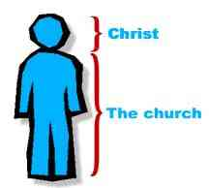
A great mystery (v 32) ..
Husbands
Loving leadership
Wives
Submission & respect

Slide 4
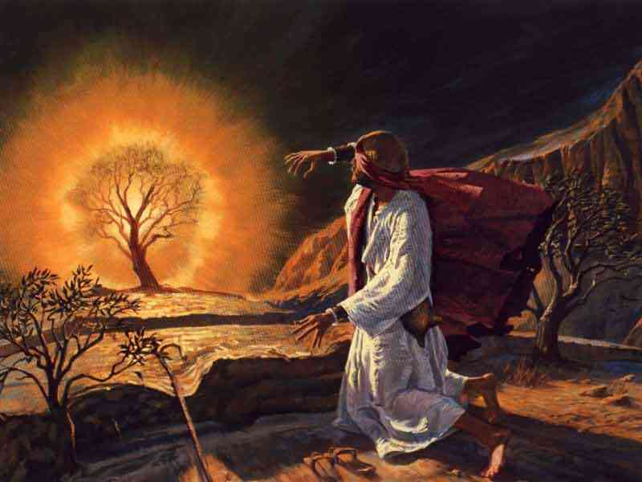
Moses didn’t want to go to Pharaoh as the leader..
God told him to go anyway and He would be with him..

Slide 5
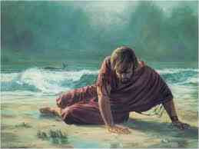
Jonah didn’t want to go to Nineveh..
God told him to go anyway and God would be with him..

Slide 6
God didn’t ask husbands if you wanted to be leader..
22 Wives, submit to your own husbands, as to the Lord. 23 For the husband is head of the wife, as also Christ is head of the church; and He is the Savior of the body.
He never asked wives if you wanted to be subject to your husband..

Slide 7
What is a husband? (What does God want?)
“Husband” (English) “house-band”..
“band” = a strip of metal or rope used to join or hold things together…
Have you ever looked at yourself as the Savior of your family?

Slide 8
How are we supposed to do this?
Like Jesus does for His church…
25 Husbands, love your wives, just as Christ also loved the church ..

Slide 9
Head of the family.. (Be the leader)
As Christ is head of the church..
Ephesians 1:22 And He put all things under His feet, and gave Him to be head over all things to the church..
God requires respect for this position..
33 Nevertheless let each one of you in particular so love his own wife as himself, and let the wife see that she respects her husband.

Slide 10
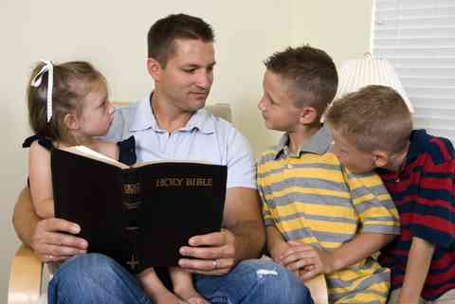
We are the teacher..
Jesus was a teacher, lead by teaching..
Ephesians 6:4 And you, fathers, do not provoke your children to wrath, but bring them up in the training and admonition of the Lord.

Slide 11
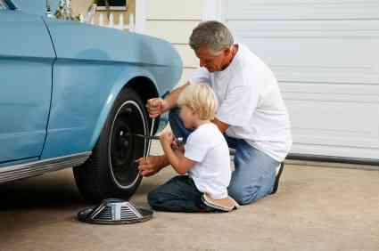
We are the provider..
Physically.. food, clothing, shelter
1 Timothy 5:8 But if anyone does not provide for his own, and especially for those of his household, he has denied the faith and is worse than an unbeliever.
Spiritually.. as Christ for the church
25 Christ also loved the church and gave Himself for her, 26 that He might sanctify and cleanse her with the washing of water by the word, 27 that He might present her to Himself a glorious church, not having spot or wrinkle or any such thing, but that she should be holy and without blemish.

Slide 12
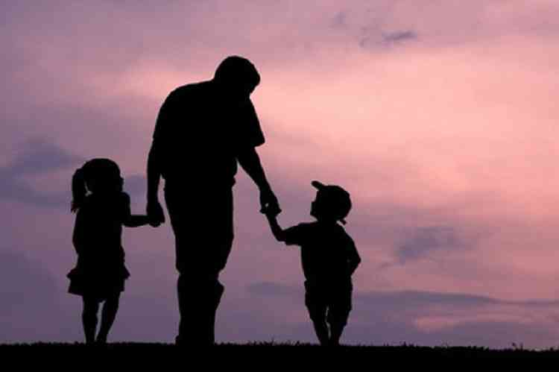
We are responsible for the condition of the family..
Responsible, accountable..
1 Corinthians 4:2 Moreover it is required in stewards that one be found faithful.
1 Peter 3:7 Husbands, likewise, dwell with them with understanding, giving honor to the wife, as to the weaker vessel.. that your prayers be not hindered.
1 Timothy 3:4-5 one who rules his own house well, having his children in submission with all reverence 5 (for if a man does not know how to rule his own house, how will he take care of the church of God?)…

Slide 13
We are to be a loving leader like Christ..
Like you care for your body..
28 So husbands ought to love their own wives as their own bodies; he who loves his wife loves himself. 29 For no one ever hated his own flesh, but nourishes and cherishes it, just as the Lord does the church.
With understanding and honor..
1 Peter 3:7 Husbands, likewise, dwell with them with understanding, giving honor to the wife, as to the weaker vessel, and as being heirs together of the grace of life, that your prayers may not be hindered.

Slide 14
Savior of the Family
Ephesians 5:22-33

