Slide 1
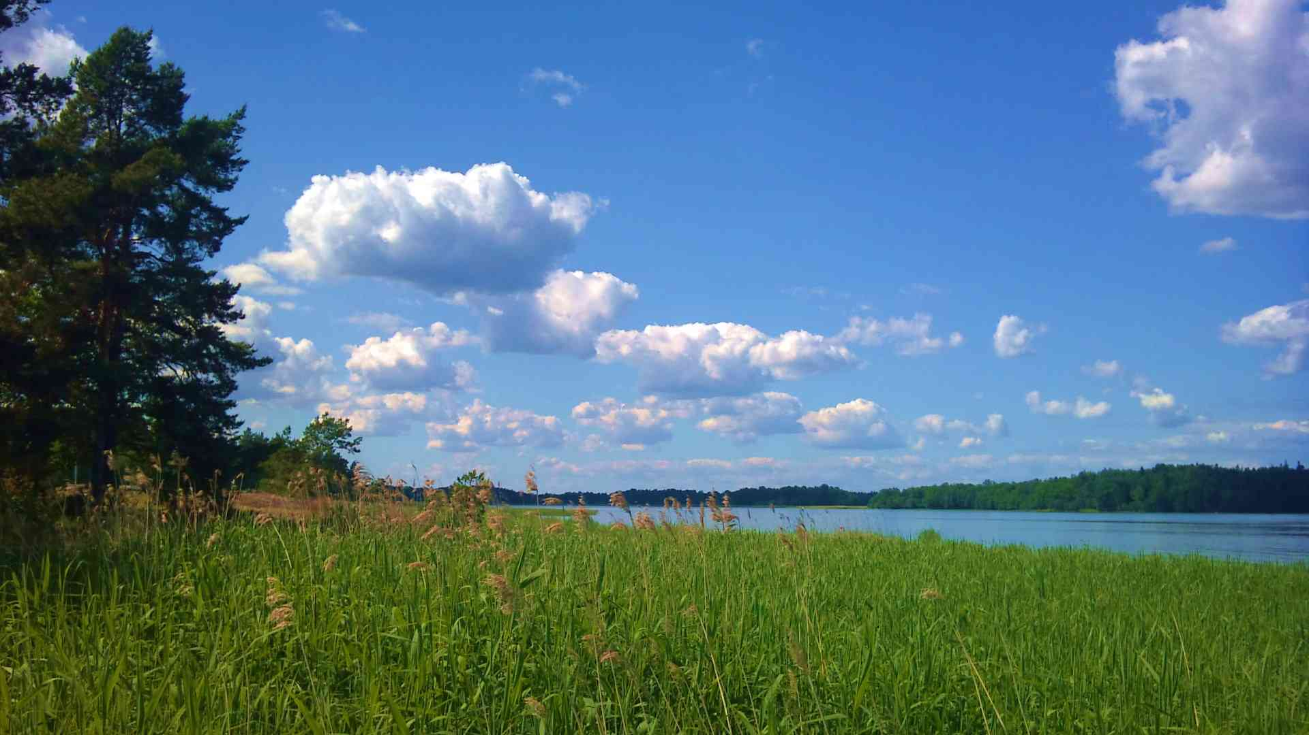
The Greatest Day of Your Life
2 Peter 3:1-12

Slide 2
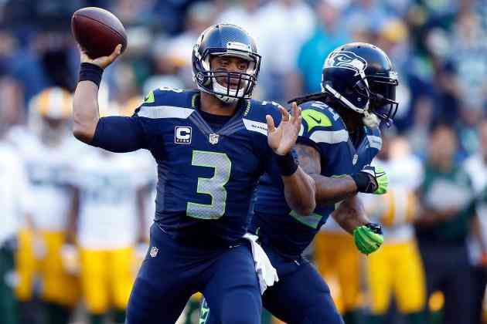
“a great game..”

Slide 3
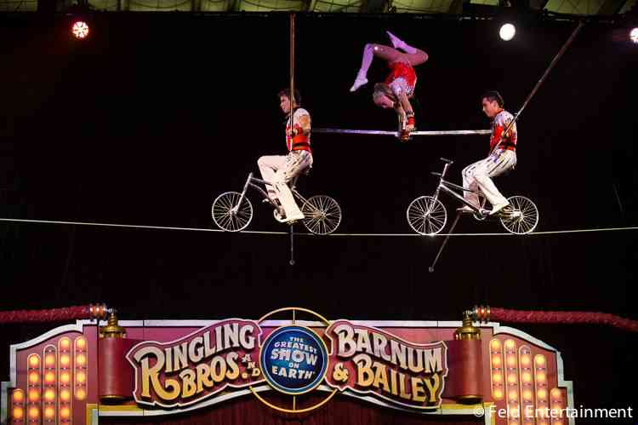

Slide 4
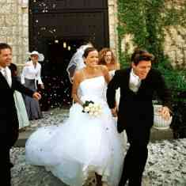
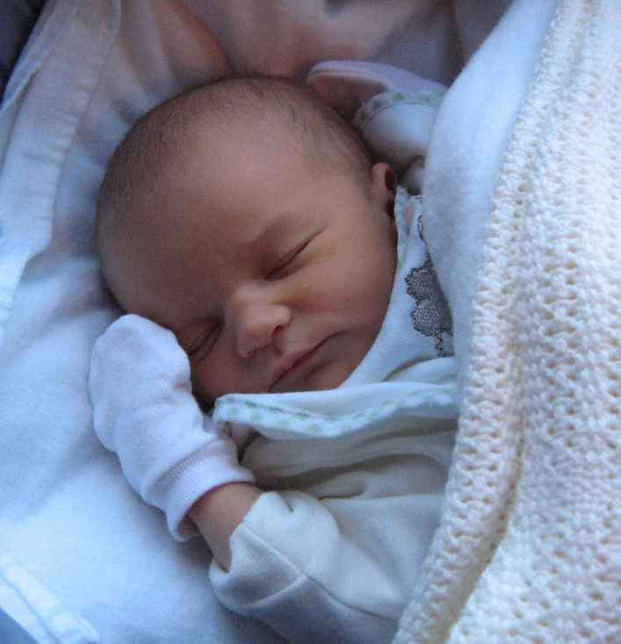
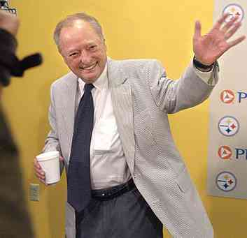
Your greatest day?..

Slide 5
The greatest day in your life, my life, and everybody’s life..
THE EXACT SAME DAY

Slide 6
2 Peter 3
1 Beloved, I now write to you this second epistle (in both of which I stir up your pure minds by way of reminder), 2 that you may be mindful of the words which were spoken before by the holy prophets, and of the commandment of us, the apostles of the Lord and Savior..

Slide 7
The greatest day.. Because of its Surety..
3 knowing this first: that scoffers will come in the last days, walking according to their own lusts, 4 and saying, "Where is the promise of His coming? For since the fathers fell asleep, all things continue as they were from the beginning of creation."

Slide 8
The greatest day.. Because of its Surety..
5 For this they willfully forget: that by the word of God the heavens were of old, and the earth standing out of water and in the water, 6 by which the world that then existed perished, being flooded with water.
7 But the heavens and the earth which are now preserved by the same word, are reserved for fire until the day of judgment and perdition of ungodly men.

Slide 9
The greatest day.. Because of its Surety..
8 But, beloved, do not forget this one thing, that with the Lord one day is as a thousand years, and a thousand years as one day.
9 The Lord is not slack concerning His promise, as some count slackness, but is longsuffering toward us, not willing that any should perish but that all should come to repentance.
10 But the day of the Lord will come ..

Slide 10
The greatest day.. Because of its Surety..
Hebrews 9:27 And as it is appointed for men to die once, but after this the judgment..
Acts 17:31 because He has appointed a day on which He will judge the world in righteousness by the Man whom He has ordained.

Slide 11
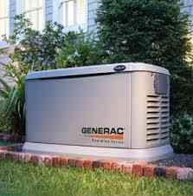
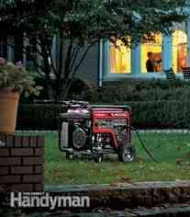
We often plan for what might happen..

Slide 12
The greatest day.. Because of its Surety..
Isaiah 2:12 For the day of the Lord of hosts Shall come upon everything proud and lofty, upon everything lifted up — And it shall be brought low —
Zechariah 14:1 Behold, the day of the Lord is coming..

Slide 13
The greatest day.. Because of its UNcertainty..
10 But the day of the Lord will come as a thief in the night..
1 Thessalonians 5:2-3 For you yourselves know perfectly that the day of the Lord so comes as a thief in the night. 3 For when they say, "Peace and safety!" then sudden destruction comes upon them, as labor pains upon a pregnant woman. And they shall not escape…

Slide 14
The greatest day.. Because of its UNcertainty..
Matthew 24:42-44 Watch therefore, for you do not know what hour your Lord is coming.
44 Therefore you also be ready, for the Son of Man is coming at an hour you do not expect…

Slide 15
Does right now qualify?..
3 For when they say, "Peace and safety!" then sudden destruction comes upon them, as labor pains upon a pregnant woman. And they shall not escape.

Slide 16
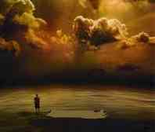
The greatest day.. Because of its UNcertainty..
2 Corinthians 5:10 For we must all appear before the judgment seat of Christ, that each one may receive the things done in the body, according to what he has done, whether good or bad.

Slide 17
The greatest day.. Because of its FINALITY..
10 But the day of the Lord will come as a thief in the night, in which the heavens will pass away with a great noise, and the elements will melt with fervent heat; both the earth and the works that are in it will be burned up.

Slide 18
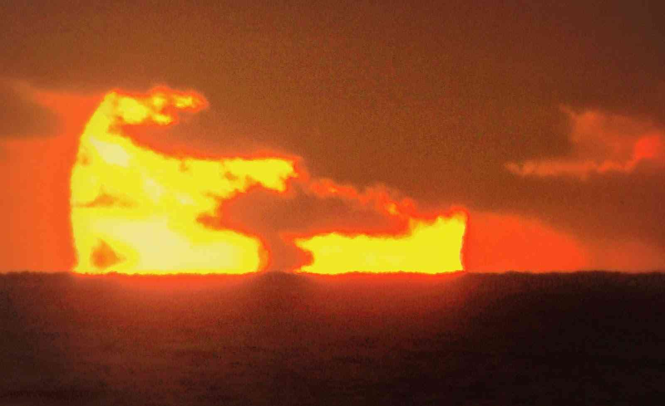
The greatest day.. Because of its FINALITY..
1st time… world destroyed by water
2nd time… to be destroyed by fire

Slide 19
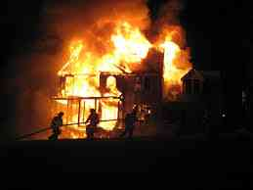
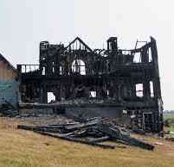
Fire speaks of finality..

Slide 20
The greatest day.. Because of its FINALITY..
2 Thessalonians 1:6-9 when the Lord Jesus is revealed from heaven with His mighty angels, 8 in flaming fire taking vengeance on those who do not know God, and on those who do not obey the gospel of our Lord Jesus Christ.

Slide 21
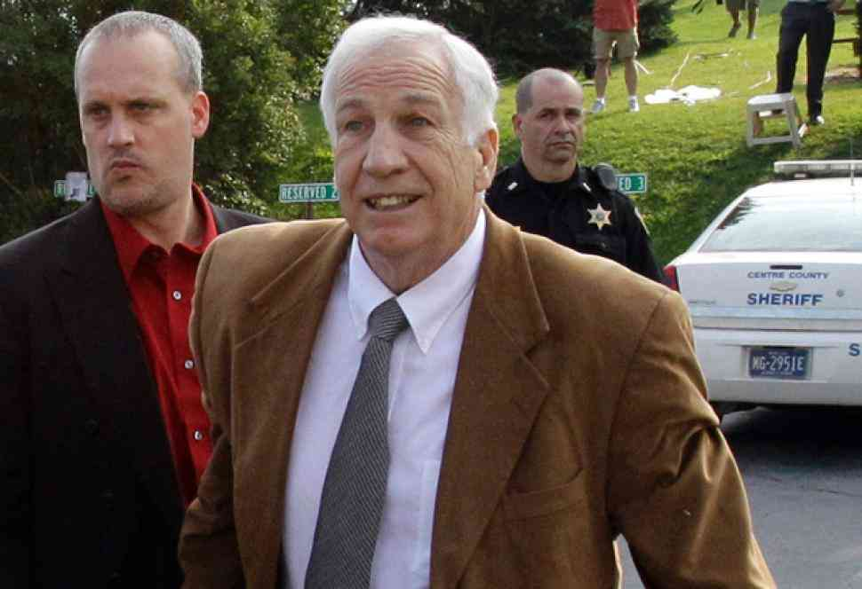
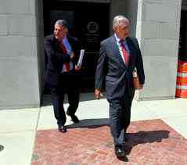
We expect another chance..

Slide 22
The greatest day.. Because of its FINALITY..
Luke 16:24-28 "Then he cried and said, 'Father Abraham, have mercy on me, and send Lazarus that he may dip the tip of his finger in water and cool my tongue; for I am tormented in this flame.' 25 But Abraham said, 'Son, remember that in your lifetime you received your good things, and likewise Lazarus evil things; but now he is comforted and you are tormented. 26 And besides all this, between us and you there is a great gulf fixed, so that those who want to pass from here to you cannot, nor can those from there pass to us.'

Slide 23
Do we have to fear this day?
2 Peter 3:11-12 Therefore, since all these things will be dissolved, what manner of persons ought you to be in holy conduct and godliness, 12 looking for and hastening the coming of the day of God, because of which the heavens will be dissolved, being on fire, and the elements will melt with fervent heat?

Slide 24
Do we have to fear this day?
Acts 2:17-20 The sun shall be turned into darkness, and the moon into blood, Before the coming of the great and awesome (glorious) day of the Lord.

Slide 25
The greatest day..
It is sure..
It is uncertain..
It is final..
“What manner of persons ought you to be in holy conduct and godliness?”..

Slide 26
The Greatest Day of Your Life
2 Peter 3:1-12

