Slide 1
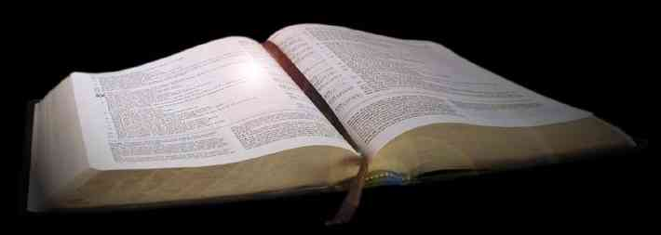
The Importance of Context
1 Corinthians 2:9-16

Slide 2
1 Corinthians 2:9
"Eye has not seen, nor ear heard, Nor have entered into the heart of man the things which God has prepared for those who love Him."

Slide 3
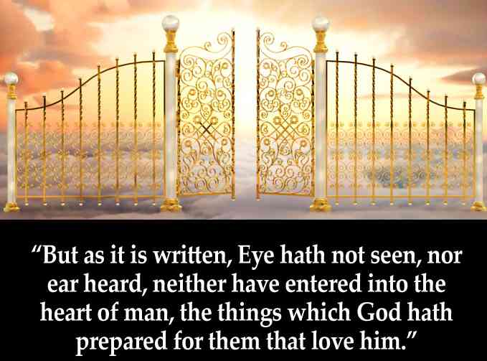
Heaven?...

Slide 4
What was Paul talking about?
1 Cor 2:7-8 But we speak the wisdom of God in a mystery, the hidden wisdom which God ordained before the ages for our glory, 8 which none of the rulers of this age knew; for had they known, they would not have crucified the Lord of glory.

Slide 5
The mystery of God’s wisdom..
2:9-10 But as it is written: "Eye has not seen, nor ear heard, Nor have entered into the heart of man The things which God has prepared for those who love Him." 10 But God has revealed them to us through His Spirit. For the Spirit searches all things, yes, the deep things of God.
God’s plan revealed in the Gospel

Slide 6
Following context..
2:11-13 For what man knows the things of a man except the spirit of the man which is in him? Even so no one knows the things of God except the Spirit of God. 12 Now we have received, not the spirit of the world, but the Spirit who is from God, that we might know the things that have been freely given to us by God.

Slide 7
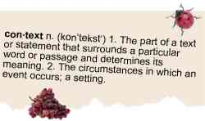
Definition..
con·text
the situation in which something happens
the parts of a discourse that surround a word or passage and can throw light on its meaning
Environment, setting, surroundings, circumstances
“to weave together”

Slide 8
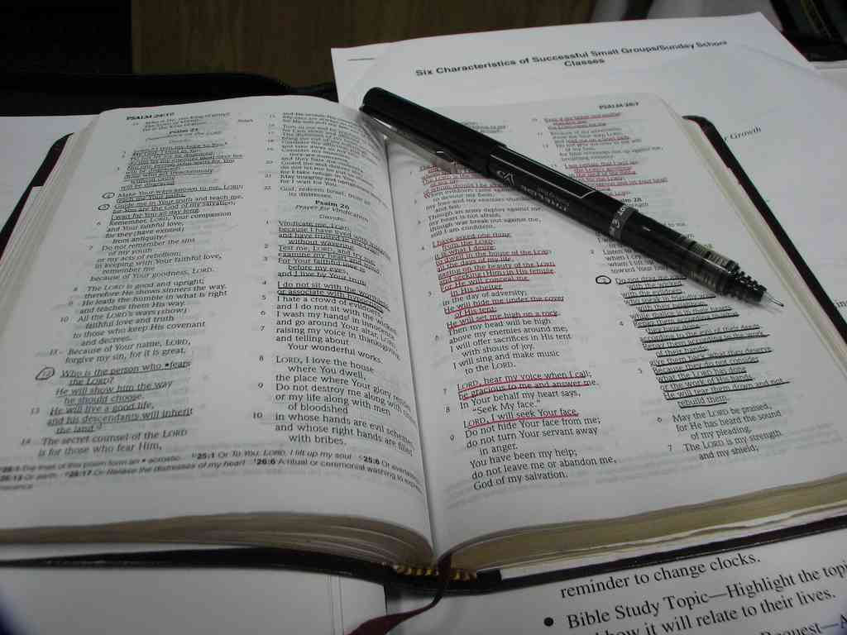
The “4 x 4” Rule…

Slide 9
Jeremiah 29:11..
For I know the thoughts that I think toward you, says the Lord, thoughts of peace and not of evil, to give you a future and a hope.

Slide 10
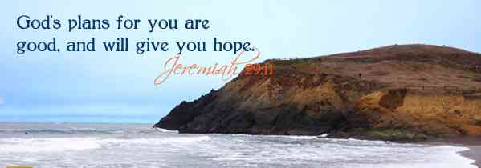

Slide 11
Examine the context..
1 Now these are the words of the letter that Jeremiah the prophet sent from Jerusalem to the remainder of the elders who were carried away captive — to the priests, the prophets, and all the people whom Nebuchadnezzar had carried away captive from Jerusalem to Babylon.

Slide 12
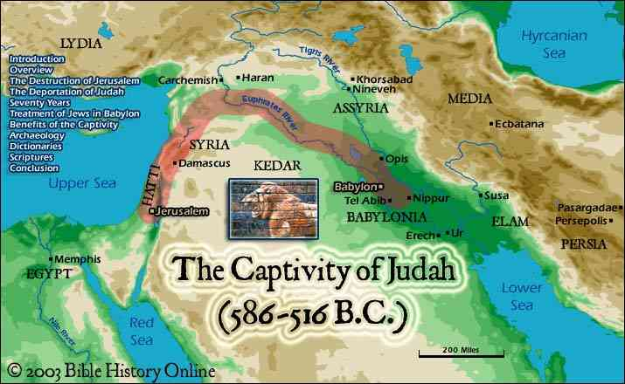

Slide 13
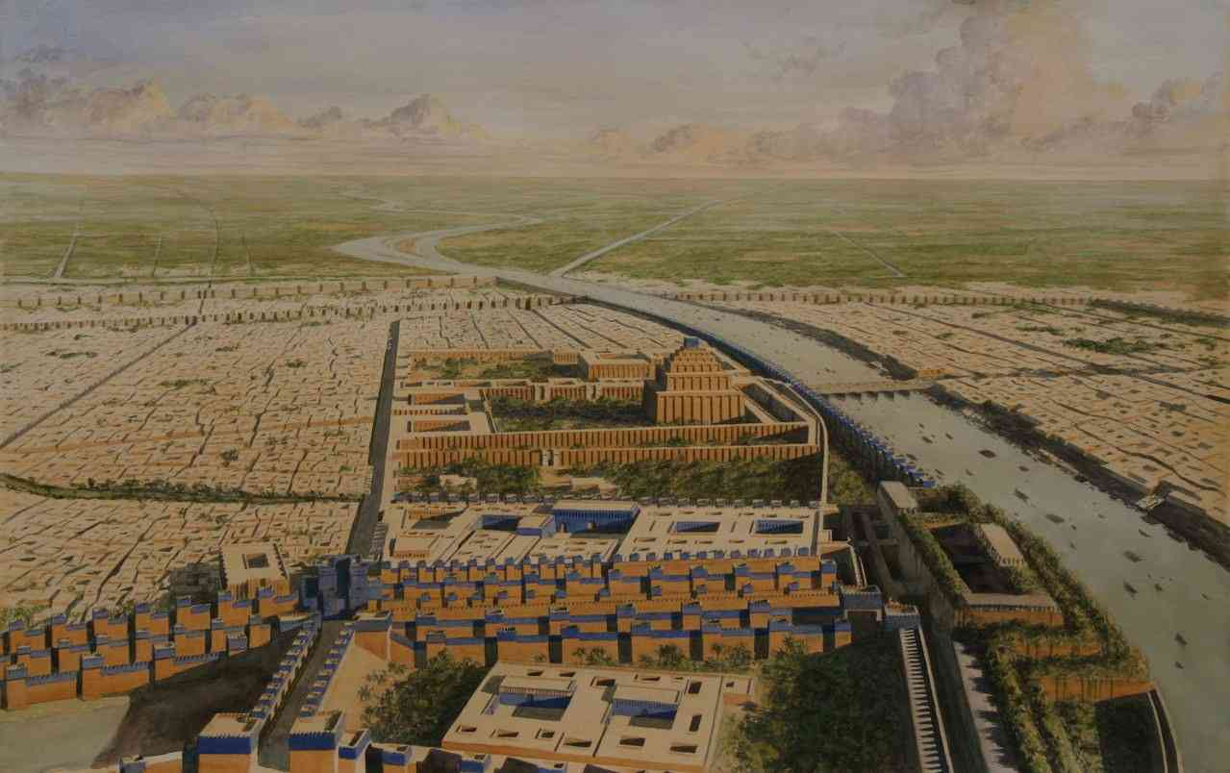
The word of the Lord to the exiles in Babylon..
4 Thus says the Lord of hosts, the God of Israel, to all who were carried away captive, whom I have caused to be carried away from Jerusalem to Babylon..

Slide 14
The word of the Lord to the exiles in Babylon..
10 For thus says the Lord: After seventy years are completed at Babylon, I will visit you and perform My good word toward you, and cause you to return to this place.

Slide 15
The word of the Lord to the exiles in Babylon..
11 For I know the thoughts that I think toward you, says the Lord, thoughts of peace and not of evil, to give you a future and a hope. 12 Then you will call upon Me and go and pray to Me, and I will listen to you. 13 And you will seek Me and find Me, when you search for Me with all your heart.

Slide 16
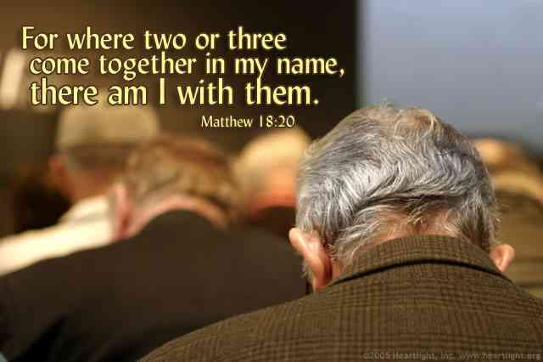
Matthew 18:20..
For where two or three are gathered together in My name, I am there in the midst of them."

Slide 17
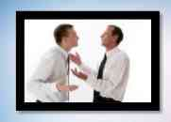
Previous context..
Matthew 18:15 "Moreover if your brother sins against you, go and tell him his fault between you and him alone. If he hears you, you have gained your brother.

Slide 18
Previous context..
16 But if he will not hear, take with you one or two more, that 'by the mouth of two or three witnesses every word may be established.'
17 And if he refuses to hear them, tell it to the church. But if he refuses even to hear the church, let him be to you like a heathen and a tax collector.

Slide 19
Previous context..
18 "Assuredly, I say to you, whatever you bind on earth will be bound in heaven, and whatever you loose on earth will be loosed in heaven.
19 "Again I say to you that if two of you agree on earth concerning anything that they ask, it will be done for them by My Father in heaven.
20 For where two or three are gathered together in My name, I am there in the midst of them."
The subject is reconciliation..

Slide 20
Ephesians 2:8-9
For by grace you have been saved through faith, and that not of yourselves; it is the gift of God, 9 not of works, lest anyone should boast.
Man has no response other than faith?..

Slide 21
How to answer?...
By grace (God’s Part)…
Through faith (Man’s Part)..
But is faith the only response?
John 6:29 Jesus answered and said to them, "This is the work of God, that you believe in Him whom He sent."

Slide 22
Ephesians 2 context..
For by grace you have been saved through faith, and that not of yourselves; it is the gift of God, 9 not of works, lest anyone should boast.
What works was Paul referring to which were causing some to boast?

Slide 23
Ephesians 2 context..
11 Therefore remember that you, once Gentiles in the flesh — who are called Uncircumcision by what is called the Circumcision made in the flesh by hands — 12 that at that time you were without Christ, being aliens from the commonwealth of Israel and strangers from the covenants of promise, having no hope and without God in the world.
The Jewish Christians were boasting in their Jewish exclusiveness..

Slide 24
Is baptism a work?
Colossians 2:11-12 In Him you were also circumcised with the circumcision made without hands, by putting off the body of the sins of the flesh, by the circumcision of Christ, 12 buried with Him in baptism, in which you also were raised with Him through faith in the working of God, who raised Him from the dead.

Slide 25
The Importance of Context
1 Corinthians 2:9-16

