Slide 1
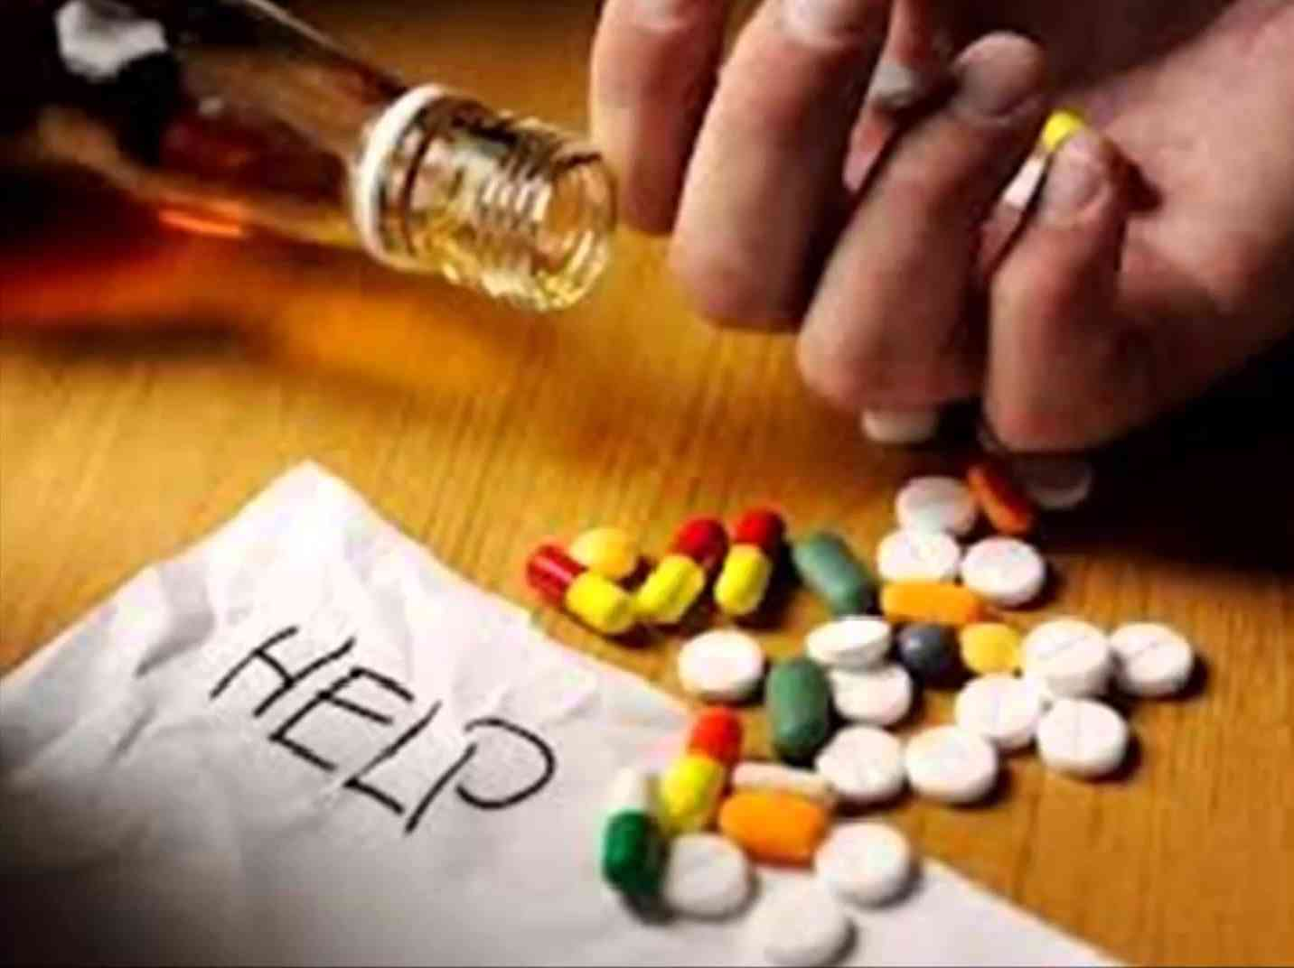
Finding Help for Addiction
1 Peter 4:1-4

Slide 2
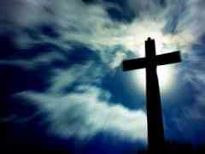
Jesus came to our world..
Hebrews 2:9 But we see Jesus, who was made a little lower than the angels, for the suffering of death crowned with glory and honor, that He, by the grace of God, might taste death for everyone.

Slide 3
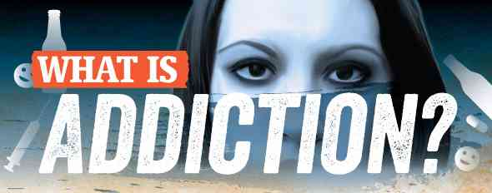
Things that control us..
1 Corinthians 6:12 All things are lawful for me, but all things are not helpful. All things are lawful for me, but I will not be brought under the power of any.

Slide 4
Things that control us..
2 Cor 10:4-5 For the weapons of our warfare are not carnal but mighty in God for pulling down strongholds, 5 casting down arguments and every high thing that exalts itself against the knowledge of God, bringing every thought into captivity to the obedience of Christ

Slide 5
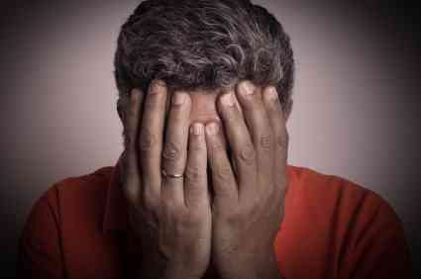
Struggling in silence..
The longer we do not acknowledge we need help, the sicker we get…

Slide 6
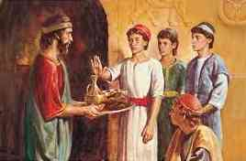
A model of doing right..
Daniel 1:8 But Daniel purposed in his heart that he would not defile himself with the portion of the king's delicacies, nor with the wine which he drank; therefore he requested of the chief of the eunuchs that he might not defile himself.

Slide 7
Two areas of focus..
Keeping unspotted from the world..
Able to help others who struggle with going back to past behaviors..

Slide 8
The lure of sin..
“Devour” 1 Peter 5:8
Drunkenness, witchcraft (pharmakeia)
“Snare of the devil” 1 Tim 3:6
“Deceiver” Prov 20:1

Slide 9
1 Peter 4:1-4
1 Peter 4:1-4 Therefore, since Christ suffered for us in the flesh, arm yourselves also with the same mind, for he who has suffered in the flesh has ceased from sin, 2 that he no longer should live the rest of his time in the flesh for the lusts of men, but for the will of God.

Slide 10
1 Peter 4:1-4
3 For we have spent enough of our past lifetime in doing the will of the Gentiles — when we walked in lewdness, lusts, drunkenness, revelries, drinking parties, and abominable idolatries. 4 In regard to these, they think it strange that you do not run with them in the same flood of dissipation, speaking evil of you.

Slide 11
1 Peter 4:1-4
Drunkenness .. excess of wine (staggering drunk)
Revelries.. carousing
Drinking parties .. sipping drinks

Slide 12
Addiction symptoms..
Increased or decreased tolerance..
Withdrawal symptoms..
Inability to quit..
Continued use despite consequences..
Preoccupation..

Slide 13
Addiction symptoms..
Blackout..
Cravings..
Strange abnormal behaviors..
Psychological changes..

Slide 14
Chemical progression..
Riding it out (white knuckling)..
Increasing the dosage..
Using something stronger..

Slide 15
Addictive drugs..
Designer drugs (synthetics)..
Methamphetamenes (meth)..
Prescription drugs..

Slide 16
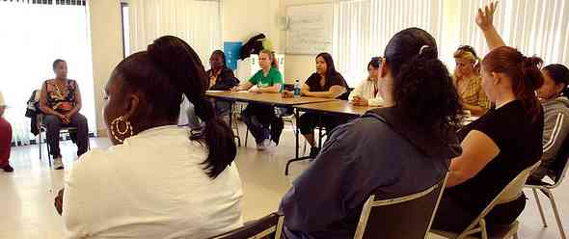
Finding help..
Jesus reaches out in love (John 8:9-11)
The church the greatest support group (Galatians 6:1-2)

Slide 17
Finding Help for Addiction
1 Peter 4:1-4

