Slide 1
Christians and Politics
Mark 12:13-17

Slide 2
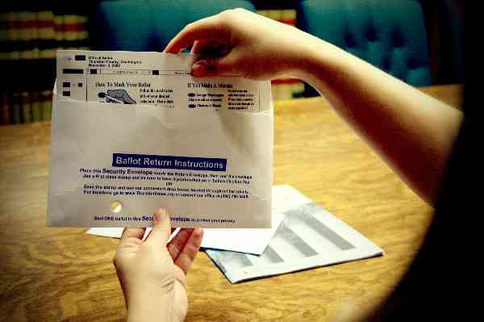
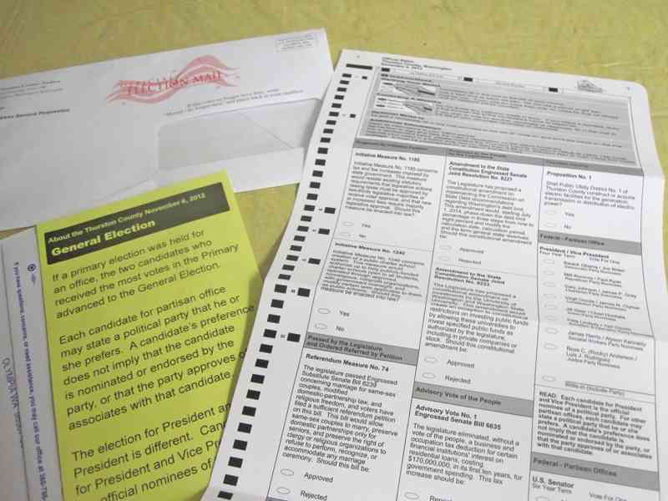
Election time again…
Citizen responsibility…
“The punishment which the wise suffer who refuse to take part in the government, is to live under the government of worse men.” - Plato

Slide 3
Biblical view of government..
God is sovereign.. don’t panic
Psalms 97:1-2 The Lord reigns; Let the earth rejoice; Let the multitude of isles be glad! 2 Clouds and darkness surround Him; Righteousness and justice are the foundation of His throne.
Seek His glory first..
Psa 97:6-7 The heavens declare His righteousness, And all the peoples see His glory. 7 Let all be put to shame who serve carved images, Who boast of idols.
Hate evil..
Psa 97:10-12 You who love the Lord, hate evil! He preserves the souls of His saints; He delivers them out of the hand of the wicked. 12 Rejoice in the Lord, you righteous, And give thanks at the remembrance of His holy name.

Slide 4
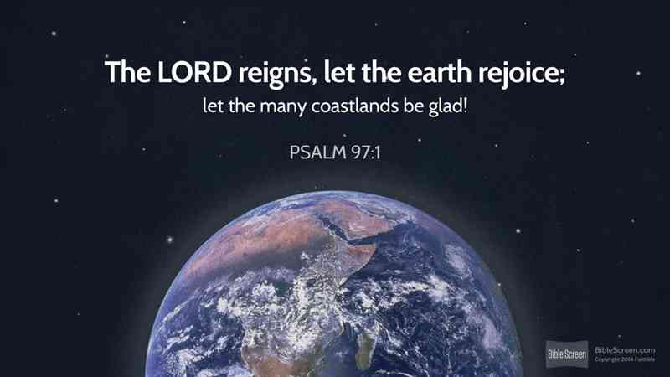

Slide 5
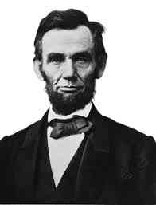
“I believe it is the duty of all nations as well as men to own their dependence upon the overruling power of God.” – Abraham Lincoln

Slide 6
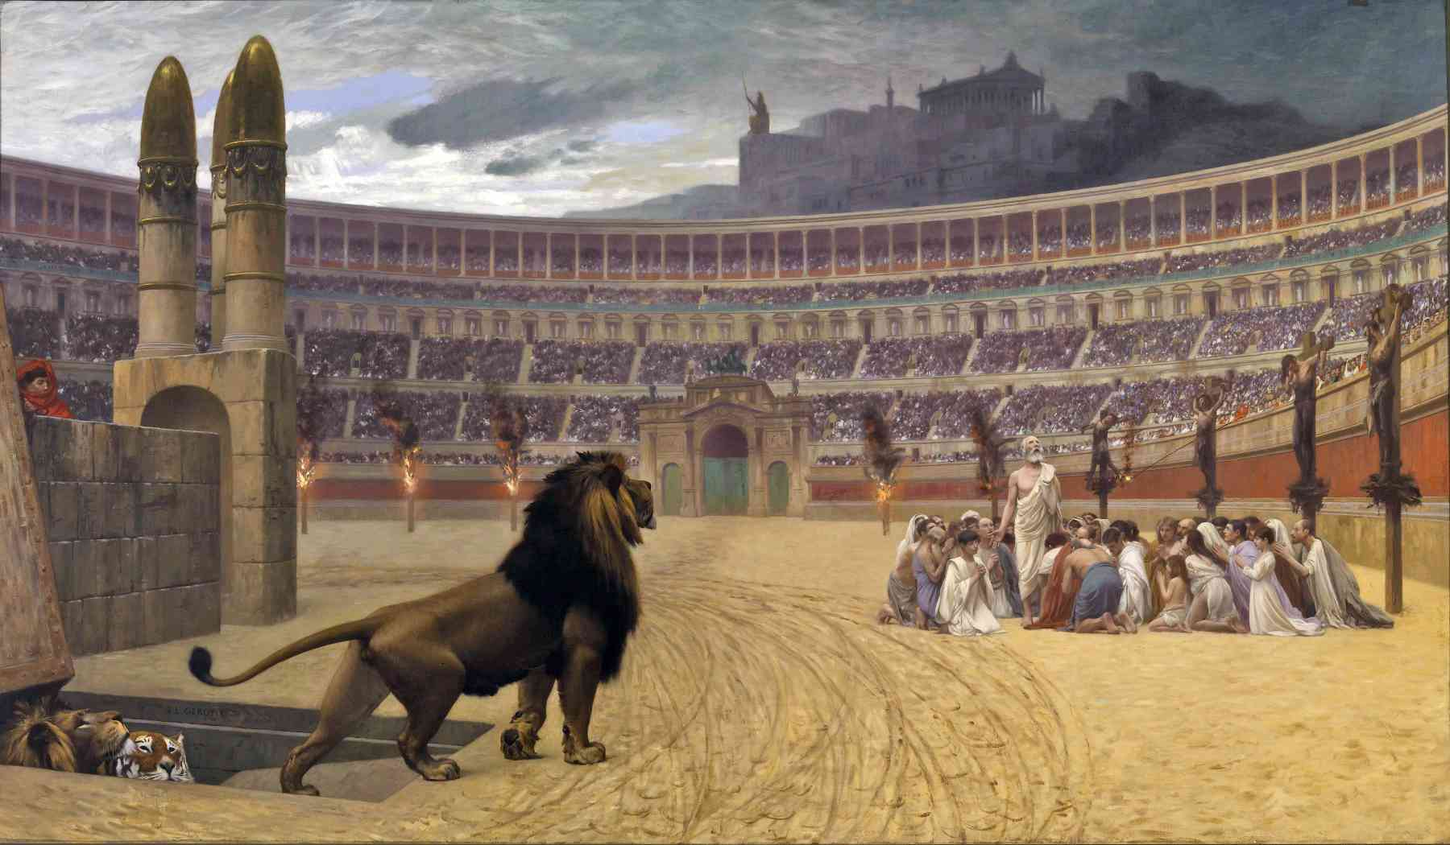
Christians in Colosseum..

Slide 7
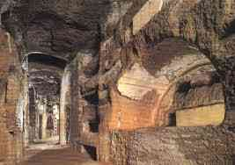
Catacombs..
As their brethren were being killed, Christians were worshipping below..

Slide 8
Jesus talks politics..
Mark 12:13-17 "Teacher, Is it lawful to pay taxes to Caesar, or not?... Shall we pay, or shall we not pay?"
15 He..said to them, "Why do you test Me? Bring Me a denarius that I may see it." 16 So they brought it. And He said to them, "Whose image and inscription is this?" They said to Him, "Caesar's." 17 And Jesus answered and said to them, "Render to Caesar the things that are Caesar's, and to God the things that are God's."

Slide 9
Distinction between human government and God..

Slide 10
Purpose of Government..
Romans 13:1-4 Let every soul be subject to the governing authorities. For there is no authority except from God, and the authorities that exist are appointed by God. 2 Therefore whoever resists the authority resists the ordinance of God, and those who resist will bring judgment on themselves.
3-4 For rulers are not a terror to good works, but to evil. Do you want to be unafraid of the authority? Do what is good, and you will have praise from the same. 4 For he is God's minister to you for good. But if you do evil, be afraid; for he does not bear the sword in vain; for he is God's minister, an avenger to execute wrath on him who practices evil.

Slide 11
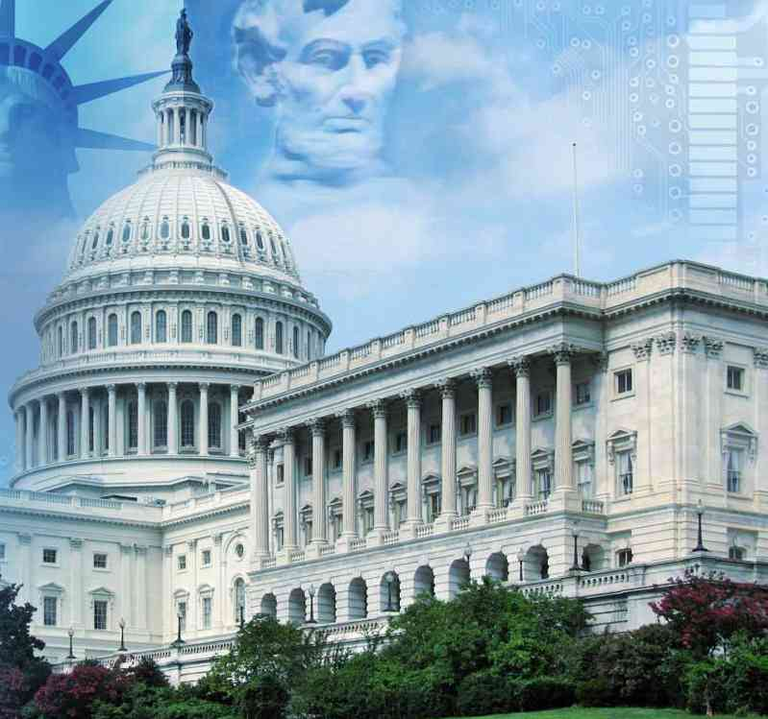
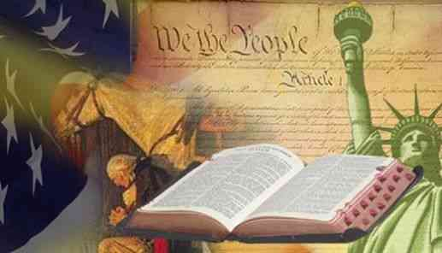
Uniqueness of American government..

Slide 12
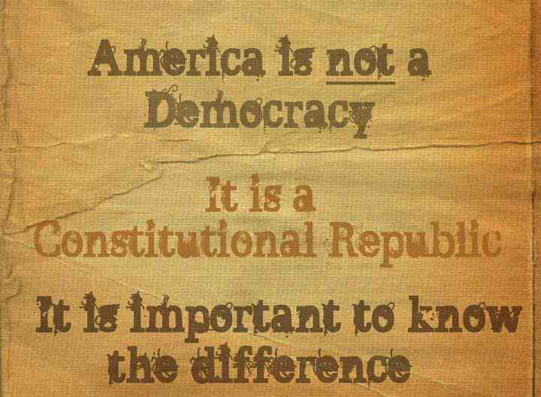
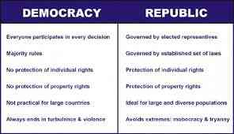
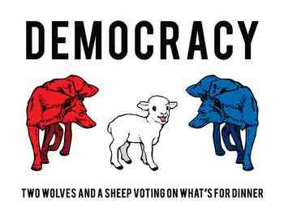
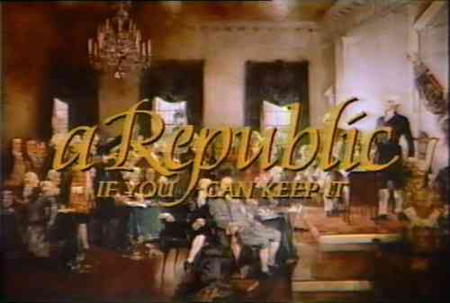

Slide 13
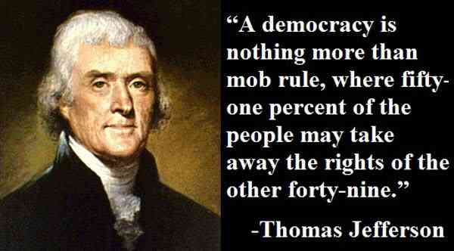

Slide 14
Our first concern..
Proverbs 29:2 When the righteous are in authority, the people rejoice; But when a wicked man rules, the people groan.

Slide 15
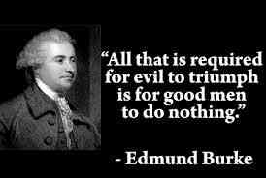

Slide 16
Pray for government..
1 Timothy 2:1-4 Therefore I exhort first of all that supplications, prayers, intercessions, and giving of thanks be made for all men, 2 for kings and all who are in authority, that we may lead a quiet and peaceable life in all godliness and reverence. 3 For this is good and acceptable in the sight of God our Savior, 4 who desires all men to be saved and to come to the knowledge of the truth.

Slide 17
Respect for government..
1 Peter 2:13-17 Therefore submit yourselves to every ordinance of man for the Lord's sake, whether to the king as supreme, 14 or to governors, as to those who are sent by him for the punishment of evildoers and for the praise of those who do good. 15 For this is the will of God, that by doing good you may put to silence the ignorance of foolish men — 16 as free, yet not using liberty as a cloak for vice, but as bondservants of God. 17 Honor all people. Love the brotherhood. Fear God. Honor the king.

Slide 18
Your life matters..
Matthew 5:13-14 "You are the salt of the earth; but if the salt loses its flavor, how shall it be seasoned? It is then good for nothing but to be thrown out and trampled underfoot by men. 14 "You are the light of the world. A city that is set on a hill cannot be hidden.

Slide 19
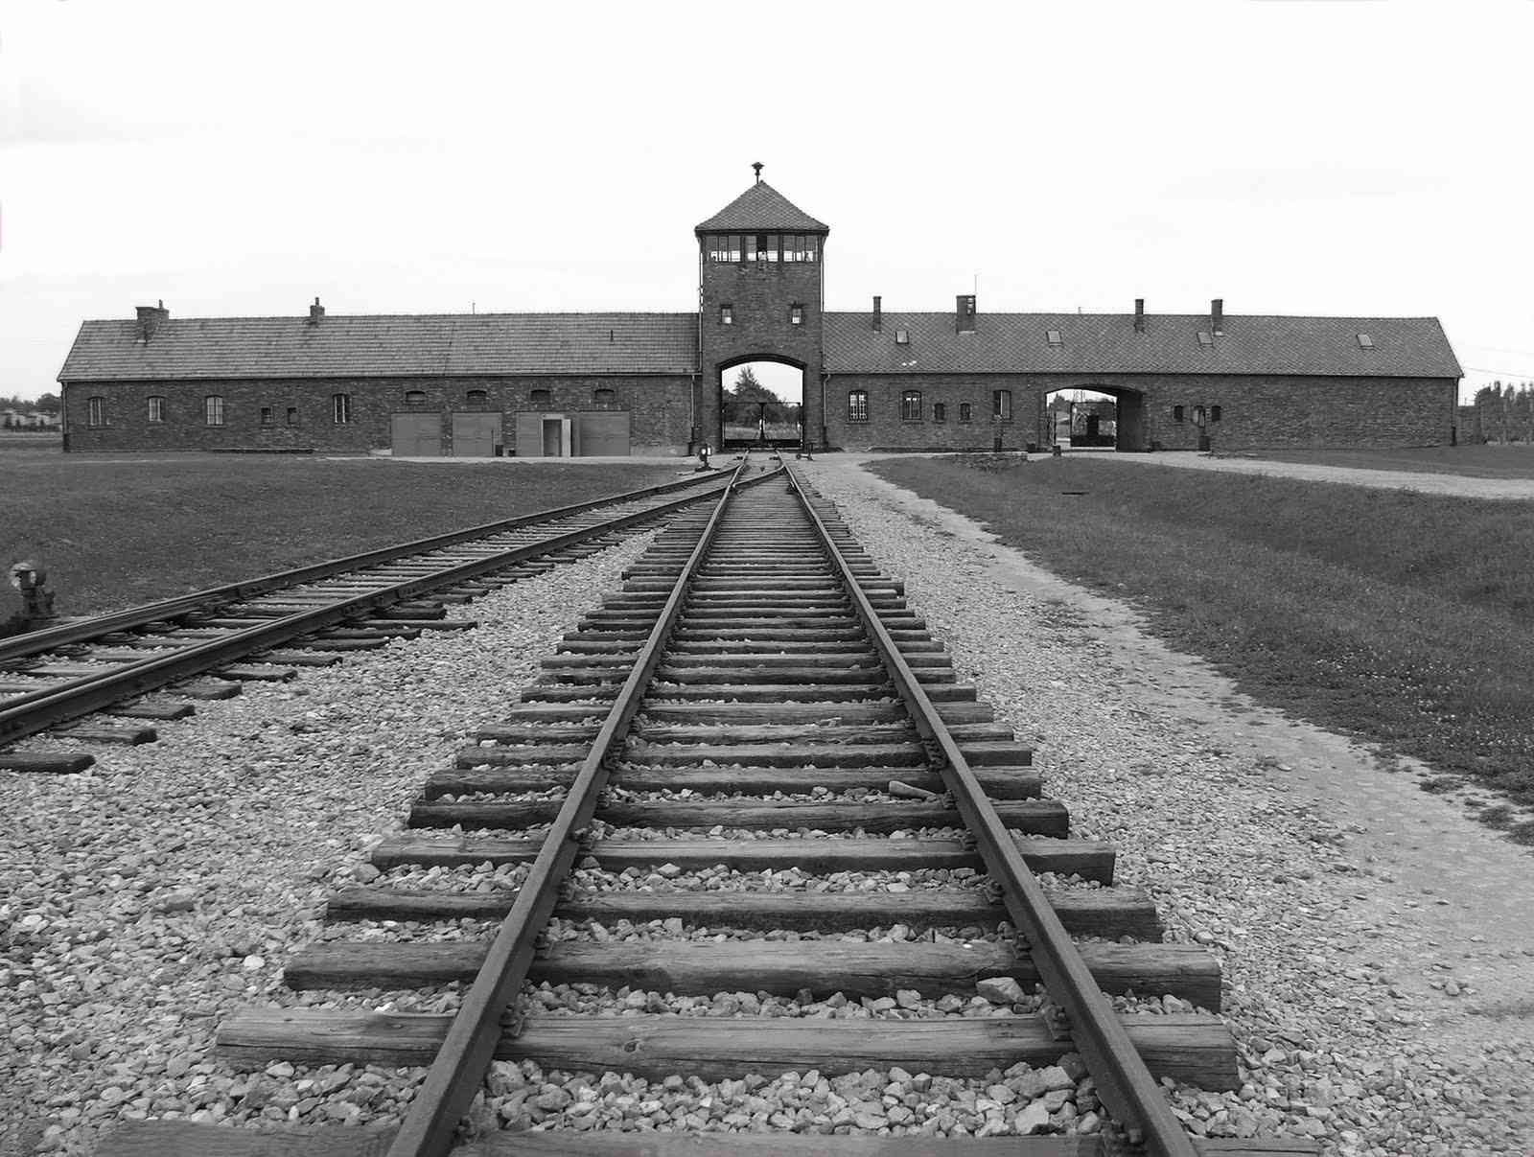
The holocaust (1933-1945)..
Number killed by Adolf Hitler..
11,283,000 exterminated in Nazi prison camps
5,200,000 German civilians and war dead
28,736,000 Europeans killed during war

Slide 20
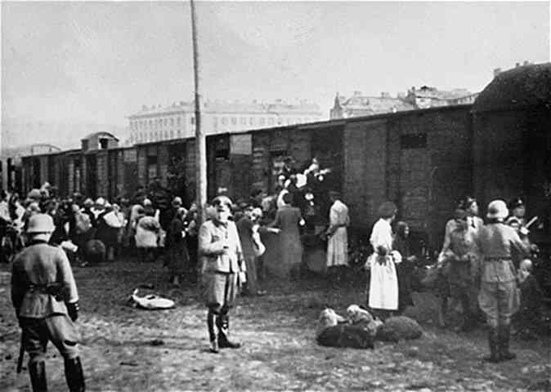
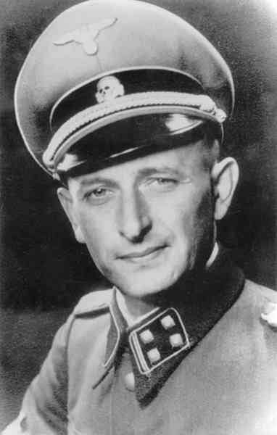
“The final solution..”
Adolf Eichmann
“The great masses of the people will more easily fall victim to a big lie than a small one.” – Mein Kampf

Slide 21
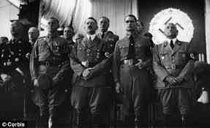
Third Reich inner circle..
Hitler: “How fortunate for leaders that men do not think. Make the lie big, make it simple, keep saying it, and eventually they will believe it.”

Slide 22
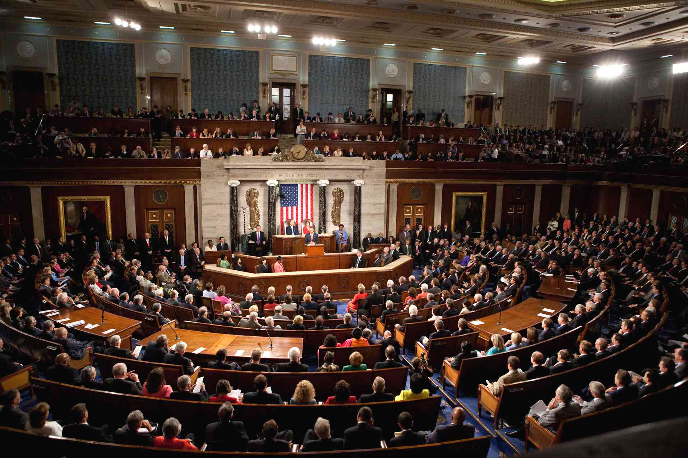
545 People directly responsible for America…
1 President
9 Supreme court justices
100 Senators (2 for each state)
435 House of Representatives

Slide 23
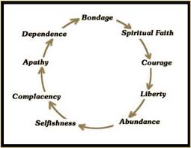
Average age of Greatest Civilizations.. 200 years

Slide 24
Christians and Politics
Mark 12:13-17

