Slide 1
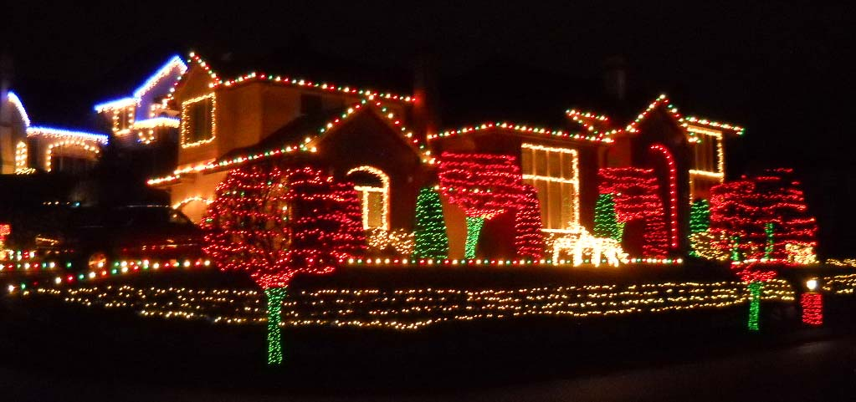
Lights in the World
Matthew 5:13-16

Slide 2
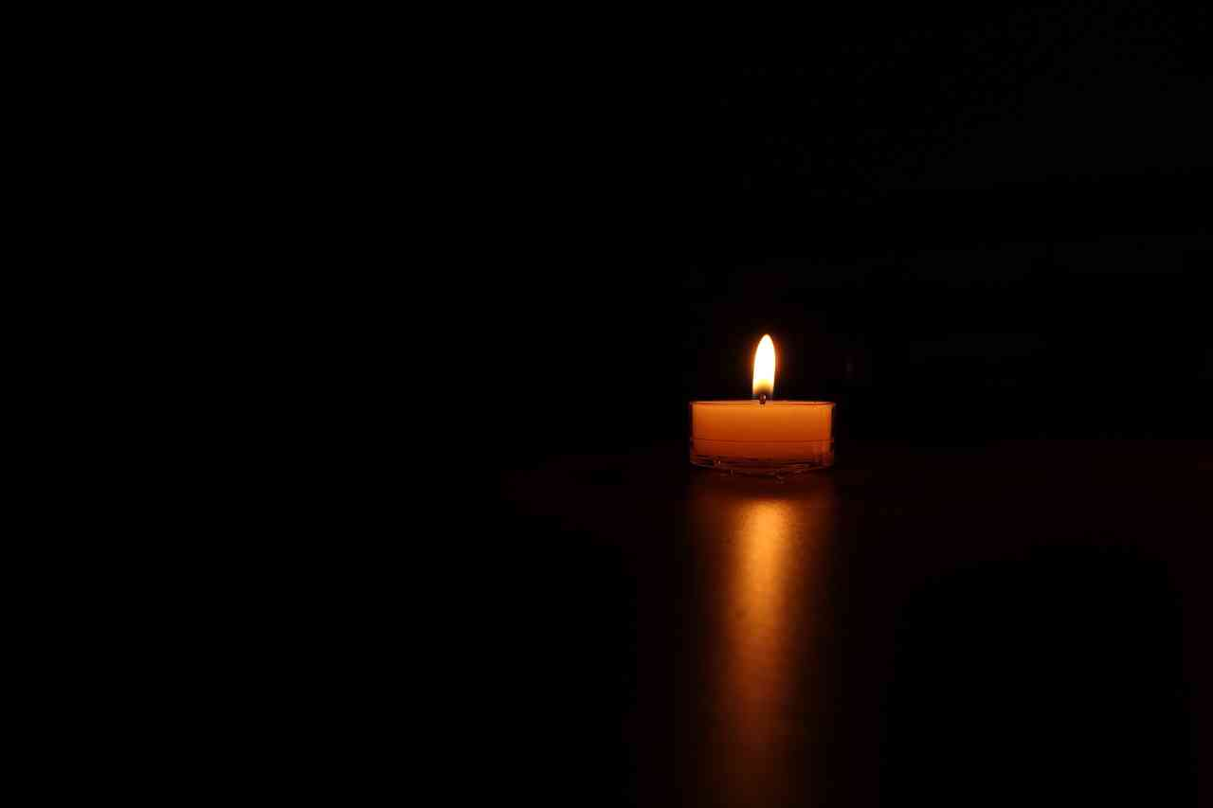
Light is needed in a dark world …

Slide 3
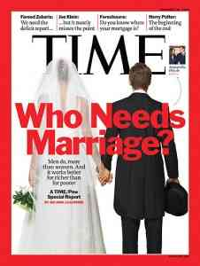
Marriage in America..
50% couples choosing not to marry..
Convenience..
Sociological experts..
Economic reasons..
Religious leaders..

Slide 4
Census questions..
Plan to eliminate marriage questions..

Slide 5
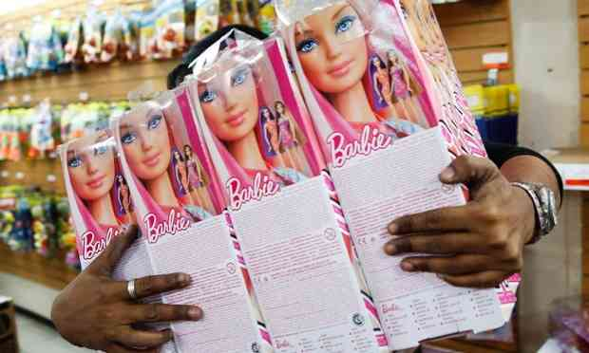
No gender campaign..
Toys not defined as boys or girls..

Slide 6
Be a light set on a hill..
Matthew 5:13-16 You are the light of the world. A city that is set on a hill cannot be hidden. 15 Nor do they light a lamp and put it under a basket, but on a lampstand, and it gives light to all who are in the house. 16 Let your light so shine before men, that they may see your good works and glorify your Father in heaven.

Slide 7
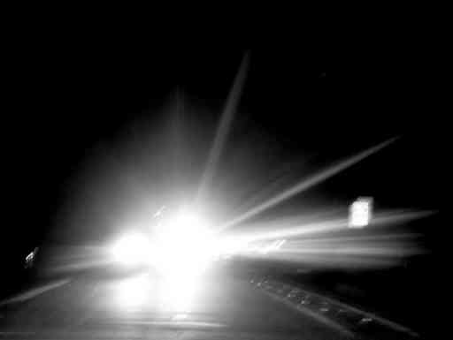
How can we be helpful light?
Give illumination without blinding ..

Slide 8
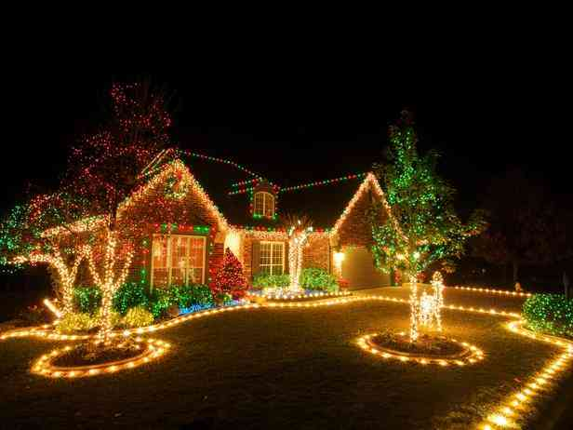
Being lights in the world..
Live as a true follower of Jesus …
Matthew 7:1-4 "Judge not, that you be not judged... 3 And why do you look at the speck in your brother's eye, but do not consider the plank in your own eye?...
Acts 16:25 But at midnight Paul and Silas were praying and singing hymns to God, and the prisoners were listening to them.

Slide 9
Being lights in the world..
We ARE the light… but we pass the glory upward…
Let YOUR light so shine…
That they may SEE your good works…
And glorify your FATHER in heaven..

Slide 10
Being lights in the world..
The darker the world gets, the brighter we can shine…
Philippians 2:15-16 that you may become blameless and harmless, children of God without fault in the midst of a crooked and perverse generation, among whom you shine as lights in the world, 16 holding fast the word of life...

Slide 11
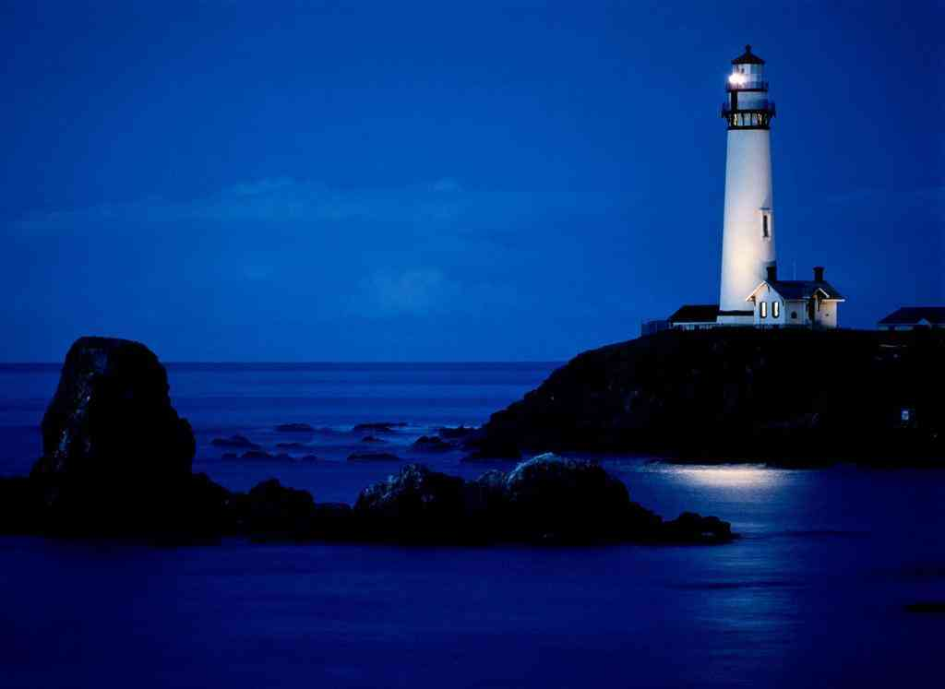
The lower lights..
Brightly beams our Father’s mercy from His lighthouse ever more…
But to us He gives the keeping of the lights along the shore…

Slide 12
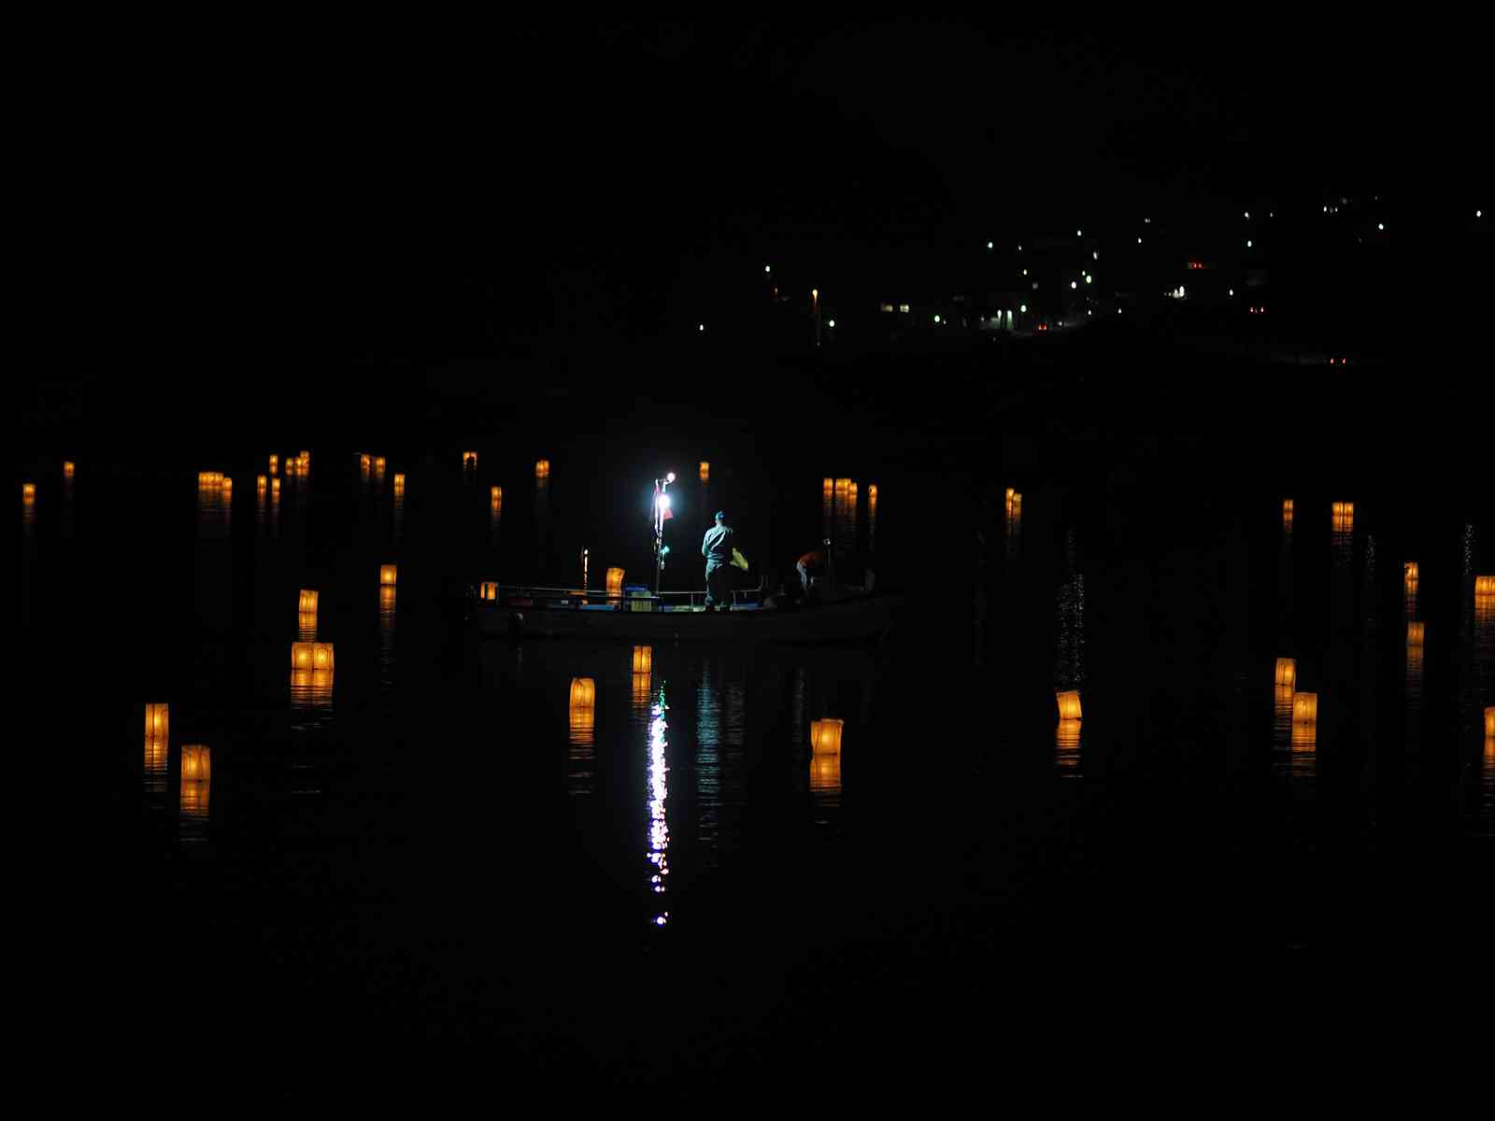

Slide 13
Lights in the World
Matthew 5:13-16

