Slide 1
Personality God Likes
Matthew 5:1-12

Slide 2
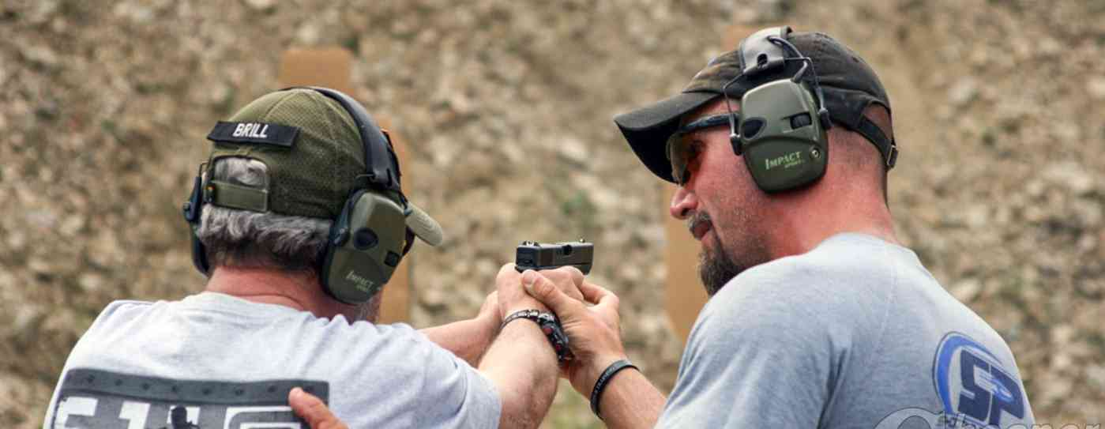
Accepting instruction..
Why not accept help and coaching in things that really matter?...

Slide 3
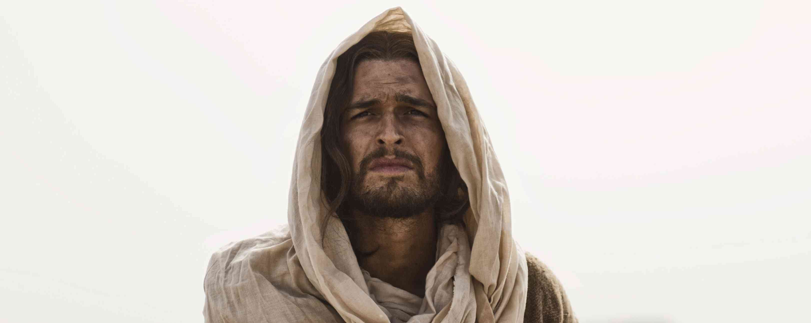
Accept Jesus’ help..
Train me in what type of personality to develop to be pleasing to God…

Slide 4
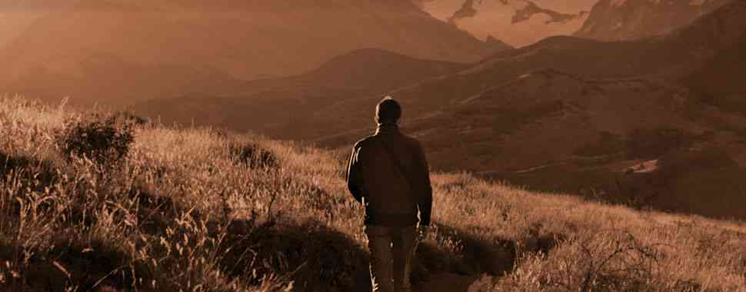
Learn what pleases God..
Ephesians 5:6-10 Let no one deceive you with empty words.. Therefore do not be partakers with them. ...Walk as children of light.. trying to learn what is pleasing to the Lord.

Slide 5
Following Jesus begins with inward character..
Blessed are the…. they shall receive..
Attitudes which set us apart…

Slide 6
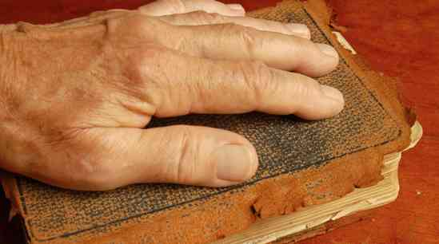
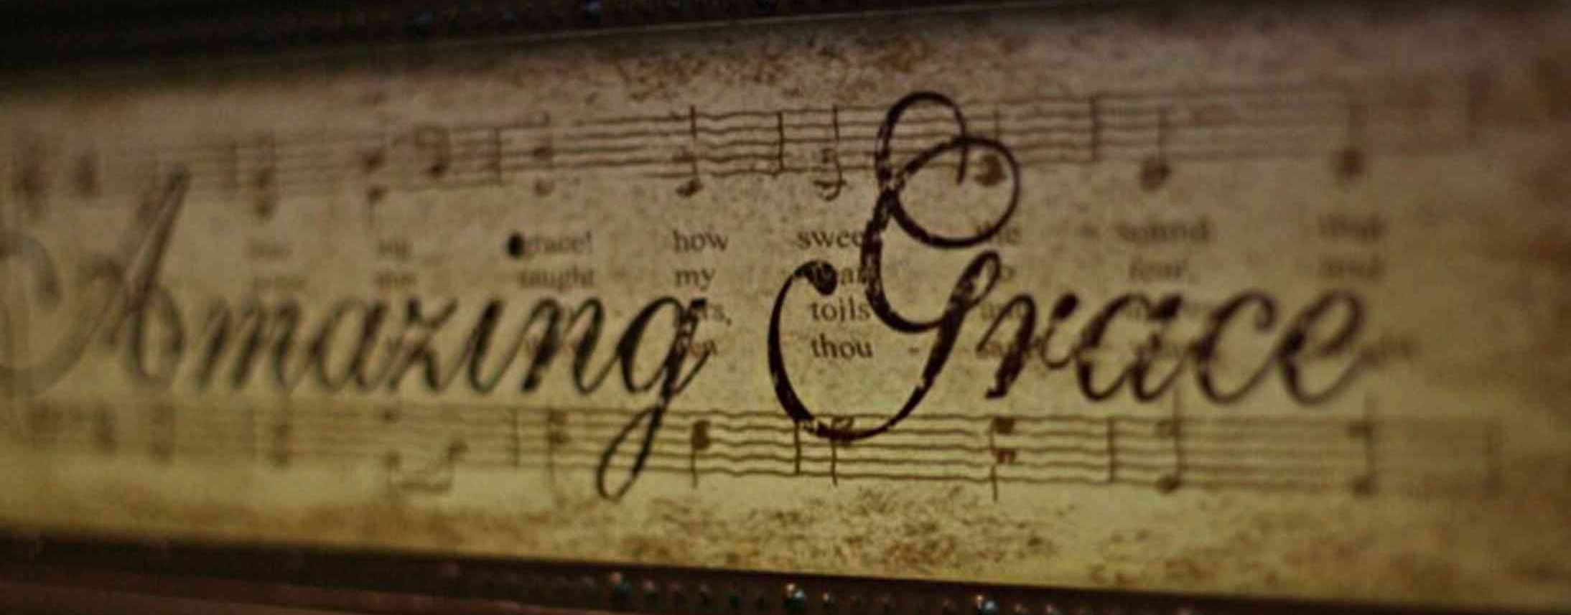
Dependent..
5:3 Blessed are the poor in spirit, for theirs is the kingdom of heaven...
Isaiah 57:15 "I dwell in the high and holy place, with him who has a contrite and humble spirit, to revive the spirit of the humble, and to revive the heart of the contrite ones.

Slide 7
Repentant..
5:4 "Blessed are they that mourn, for they shall be comforted.”
Isaiah 61:1-2 "He has sent Me to heal the brokenhearted, proclaim liberty to the captives, and the opening of the prison to those who are bound.. to comfort all who mourn."

Slide 8
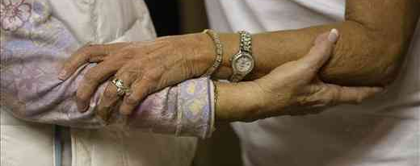
Gentleness..
5:5 Blessed are the meek, For they shall inherit the earth.
Psalms 37:5-11 Commit your way to the Lord, trust also in Him, and He shall bring it to pass. For evildoers shall be cut off; 11 But the meek shall inherit the earth, and shall delight themselves in the abundance of peace.

Slide 9
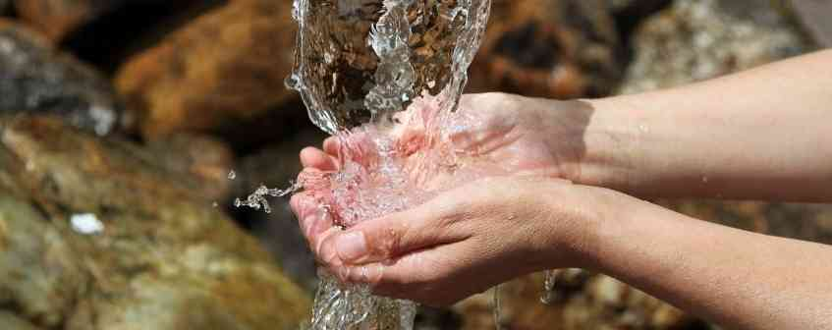
Righteousness..
5:6 Blessed are those who hunger and thirst for righteousness, For they shall be filled.
Psalms 42:1-2 As the deer pants for the water brooks, So pants my soul for You, O God. 2 My soul thirsts for God, for the living God. When shall I come and appear before God?

Slide 10
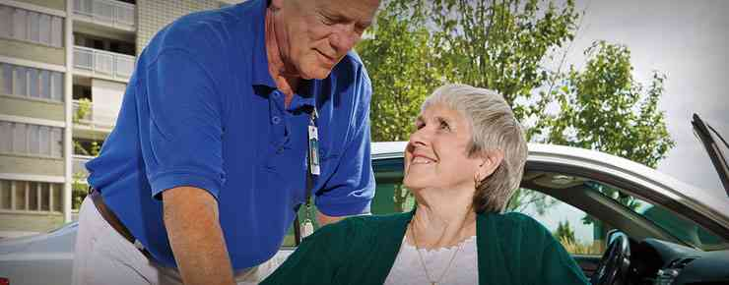
Kindness..
7 Blessed are the merciful, For they shall obtain mercy.
James 2:15-16 If a brother or sister is naked and destitute of daily food, 16 and one of you says to them, "Depart in peace, be warmed and filled," but you do not give them the things which are needed for the body, what does it profit?

Slide 11
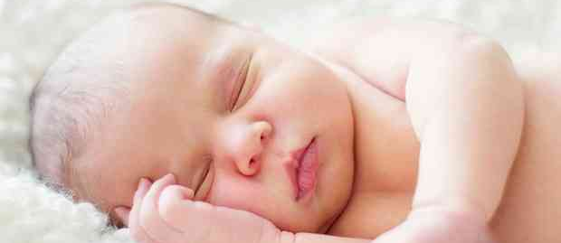
Purity..
5:8 Blessed are the pure in heart, For they shall see God.
1 John 3:1-3 Behold what manner of love the Father has bestowed on us, that we should be called children of God! 3 And everyone who has this hope in Him purifies himself, just as He is pure.

Slide 12
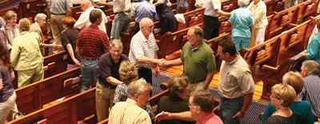
Peacemaker..
9 Blessed are the peacemakers, For they shall be called sons of God.
James 3:17 But the wisdom that is from above is first pure, then peaceable, gentle, willing to yield, full of mercy and good fruits, without partiality and without hypocrisy.

Slide 13
Rejoicing..
10 Blessed are those who are persecuted for righteousness' sake, For theirs is the kingdom of heaven.
2 Timothy 3:12 Yes, and all who desire to live godly in Christ Jesus will suffer persecution.

Slide 14
Personality God Likes
Matthew 5:1-12

