Slide 1
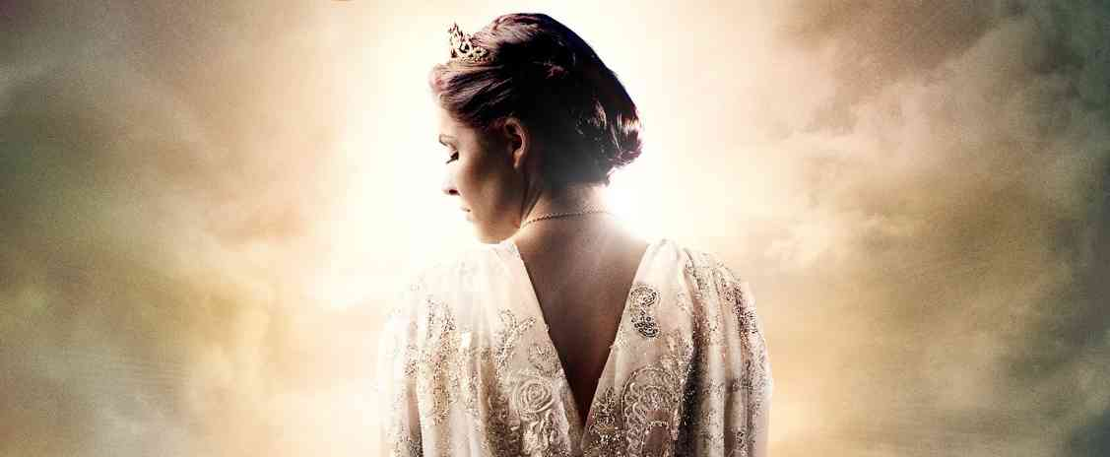
Risking It All for God
Esther 4:14-16

Slide 2
Esther (“Star”)…
Esther 2:7 The young woman was lovely and beautiful..
Mordecai had brought up Hadassah, that is, Esther, his uncle's daughter…. when her father and mother died, Mordecai took her as his own daughter.

Slide 3
Her uncle’s challenge..
“Yet who knows whether you have come to the kingdom for such a time as this?" (Esther 4:14)

Slide 4
Providence.. God’s hand in human history
Only book the name God is not found…
No mention of worship, sacrifices, Word of God, His laws…

Slide 5
God behind the scenes..
God not always seen, but is always involved in what is happening…

Slide 6
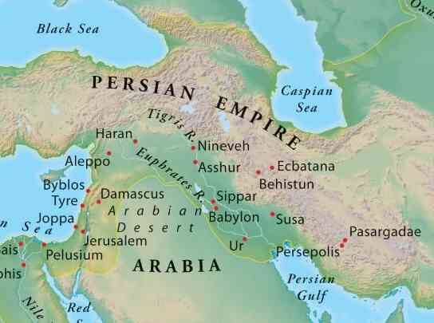
Why is God’s name not mentioned..
God’s people had become comfortable living outside God’s will..

Slide 7
The Story Unfolds..
Vashti is vanished .. Ch 1,2
Esther 1:12 But Queen Vashti refused to come at the king's command..
The king was furious, his anger burned…
1:16-19 Advice of Prince Memucan ..
2:1 The king’s anger subsides… can’t reverse

Slide 8
The Rise of Esther..
Search for new queen… 2:2-4
Esther makes first impression .. 2:8-10
12 months preparation … 2:12
Esther follows Hegai’s advice .. 2:13-16
The king’s decision .. 2:17

Slide 9
The evil Haman…
Haman is promoted .. 3:1-2
His high position demand people bow
Mordecai refuses
Haman determined to annihilate the Jews
King’s decree is irreversible

Slide 10
Mordecai appeals to Esther…
Now is time to go to the king…
Esther’s response… she is helpless 4:11
Mordecai’s response… 4:13-14
“For such a time as this”…
Esther responds … 4:16

Slide 11
Esther’s risks it all…
Her plan set in motion…
Assemble people to fast and pray 3 days..
Her first visit … 5:2
Invitation to the King and Haman..
Haman had built a gallows…

Slide 12
What Esther doesn’t know..
God works it out..
The king can’t sleep … 6:8-9
Asks Haman what they should do…
The tables are turned… 6:12
The final banquet … 7:2-10

Slide 13
Never give up on God..
God can work it out..
He won’t bow to your stardom…
Your blessings are not just about you..
If God can’t use you for His Kingdom purposes He will find someone else
God is looking for servants, not celebrities
Matthew 23:11 But he who is greatest among you shall be your servant.

Slide 14
Risking It All for God
Esther 4:14-16

