Slide 1
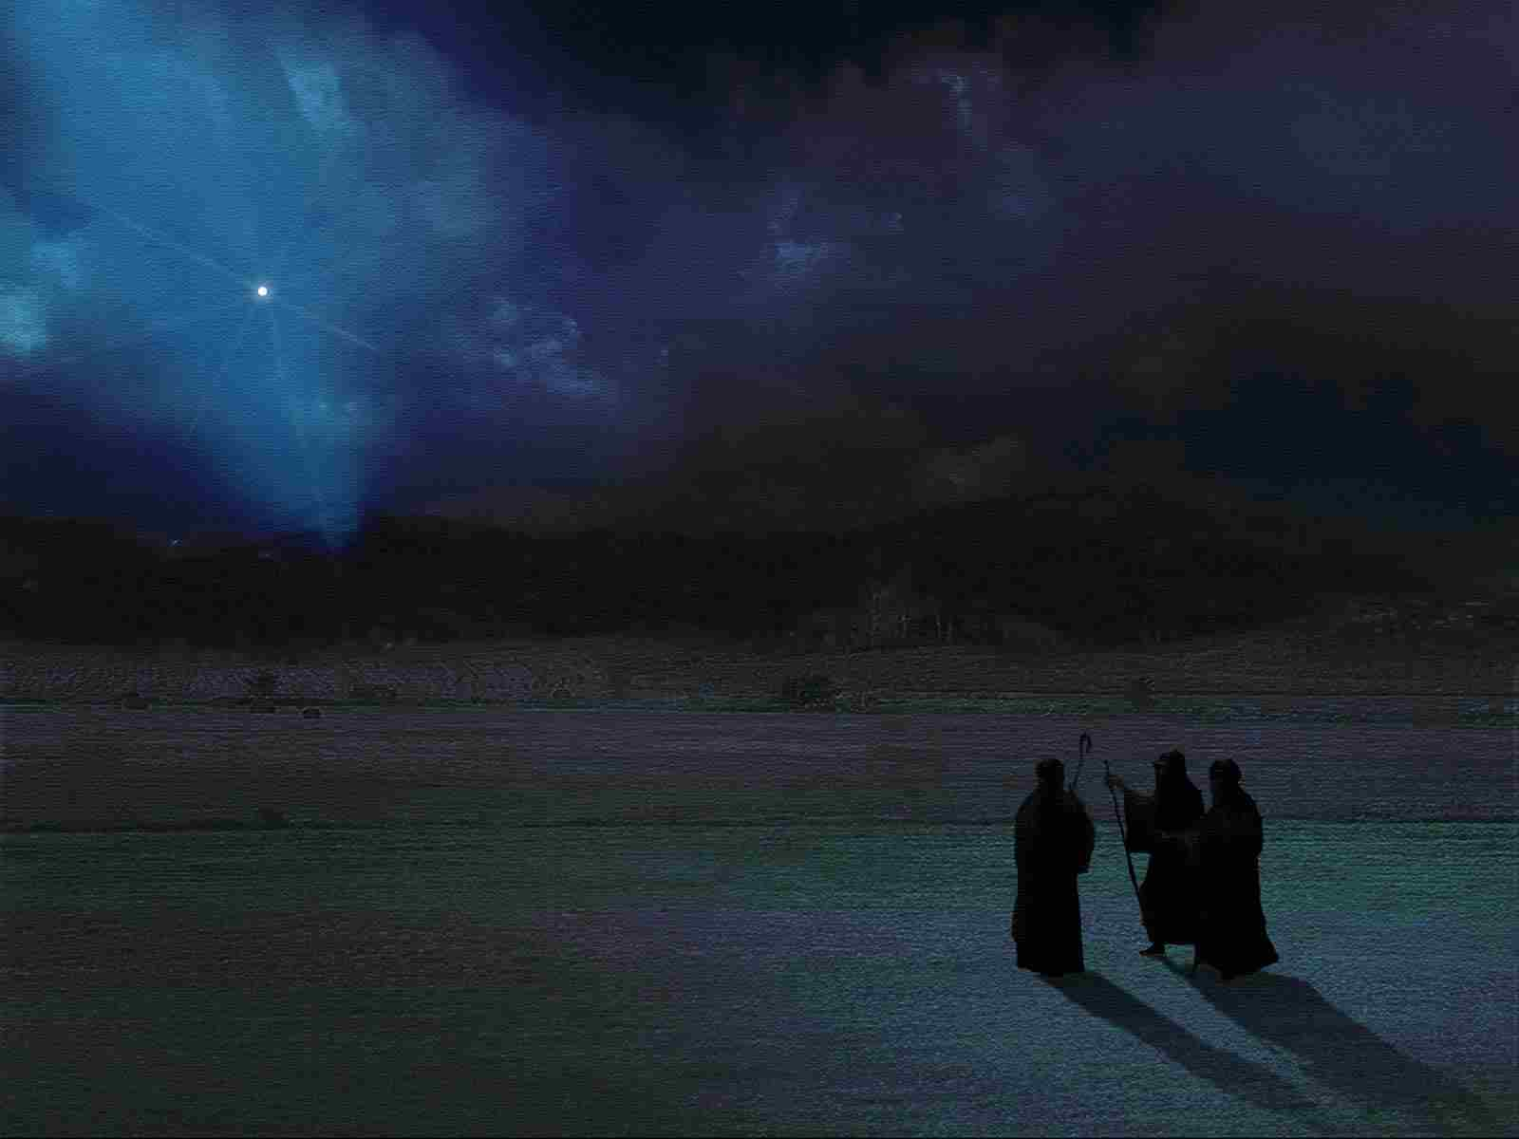
Who is Jesus to Me?
Luke 2:1-11

Slide 2
Joseph and Mary travel to Bethlehem..
Luke 2:1-11 And it came to pass in those days that a decree went out from Caesar Augustus that all the world should be registered. 2 This census first took place while Quirinius was governing Syria. 3 So all went to be registered, everyone to his own city.

Slide 3
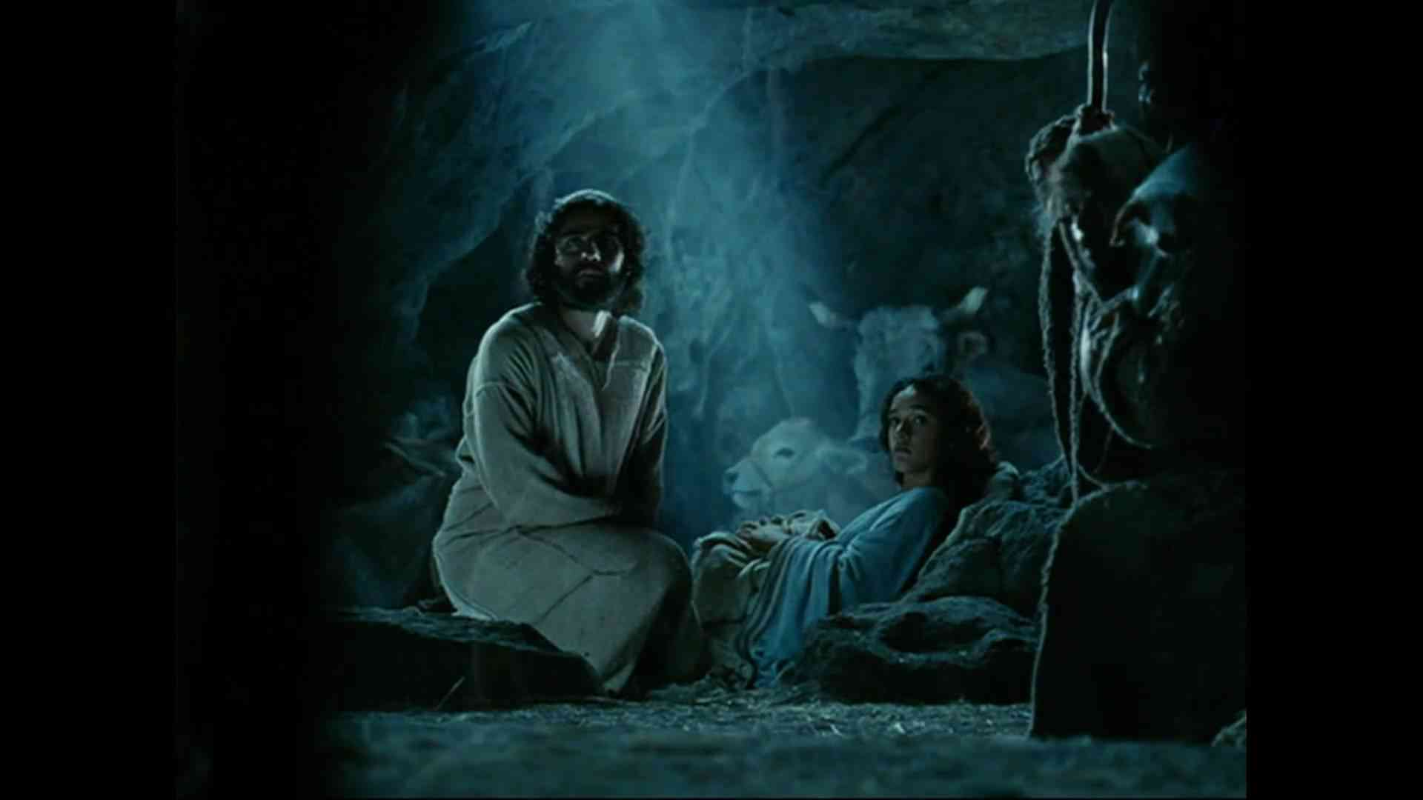
No room in the inn..
4 Joseph also went up from Galilee, out of the city of Nazareth, into Judea, to the city of David, which is called Bethlehem, because he was of the house and lineage of David, 5 to be registered with Mary, his betrothed wife, who was with child. 6 So it was, that while they were there, the days were completed for her to be delivered. 7 And she brought forth her firstborn Son, and wrapped Him in swaddling cloths, and laid Him in a manger, because there was no room for them in the inn.

Slide 4
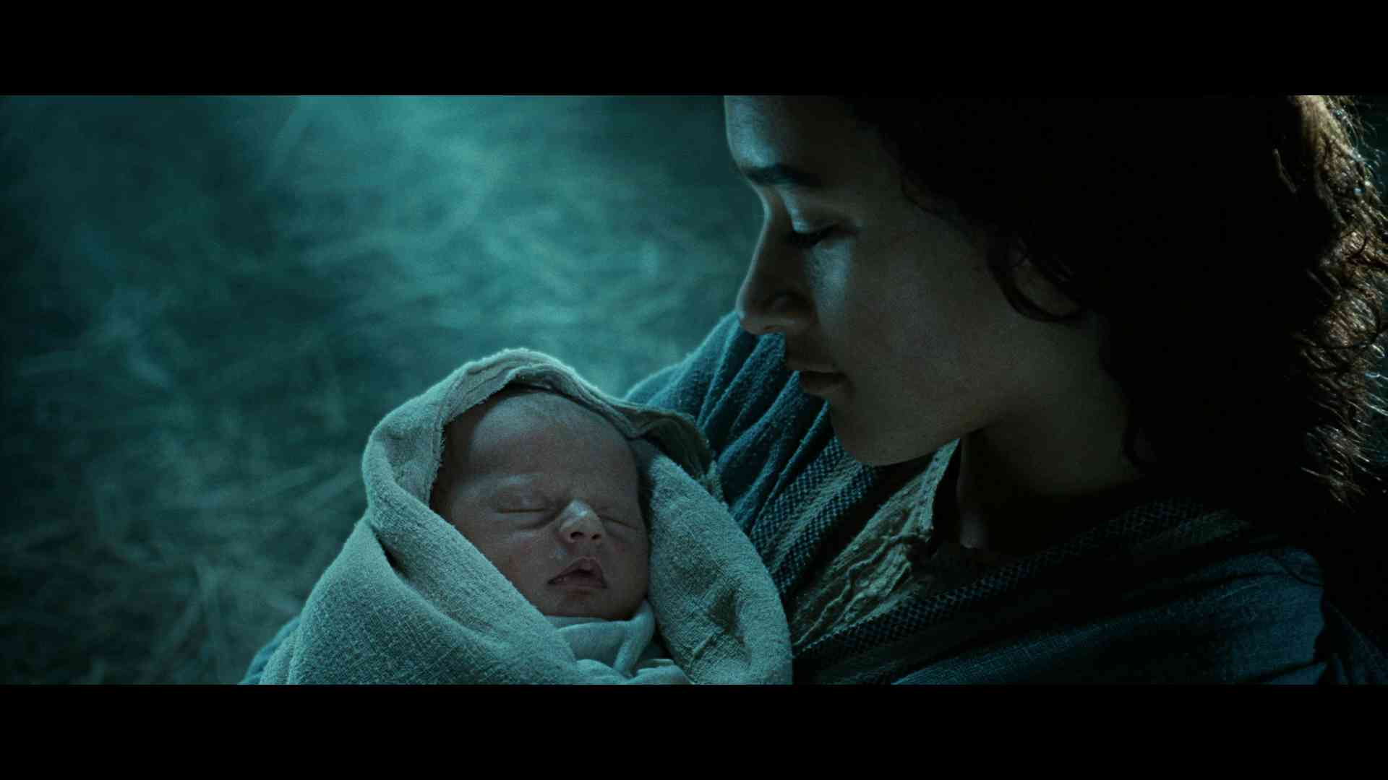
Angels announce the birth of a Savior..
8 Now there were in the same country shepherds living out in the fields, keeping watch over their flock by night. 9 And behold, an angel of the Lord stood before them, and the glory of the Lord shone around them, and they were greatly afraid. 10 Then the angel said to them, "Do not be afraid, for behold, I bring you good tidings of great joy which will be to all people. 11 For there is born to you this day in the city of David a Savior, who is Christ the Lord.

Slide 5
He is my Savior…
Matthew 1:21 And she will bring forth a Son, and you shall call His name Jesus, for He will save His people from their sins."
Luke 2:11 For there is born to you this day in the city of David a Savior, who is Christ the Lord.

Slide 6
He is my Savior…
Luke 19:10 for the Son of Man has come to seek and to save that which was lost."
Acts 4:12 Nor is there salvation in any other, for there is no other name under heaven given among men by which we must be saved."
Acts 5:31 Him God has exalted to His right hand to be Prince and Savior, to give repentance to Israel and forgiveness of sins.

Slide 7
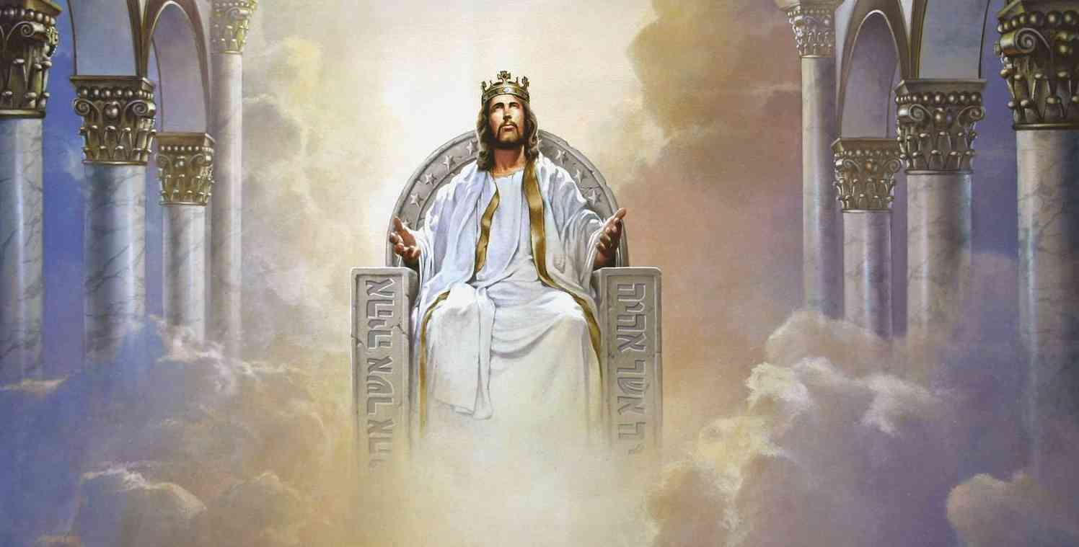
He is my Lord…
Acts 2:36 "Therefore let all the house of Israel know assuredly that God has made this Jesus, whom you crucified, both Lord and Christ."
Philippians 2:9-11 Therefore God also has highly exalted Him and given Him the name which is above every name, 10 that at the name of Jesus every knee should bow, of those in heaven, and of those on earth, and of those under the earth, 11 and that every tongue should confess that Jesus Christ is Lord, to the glory of God the Father.

Slide 8
He is my Lord…
1 Timothy 6:14-15 that you keep this commandment without spot, blameless until our Lord Jesus Christ's appearing, 15 which He will manifest in His own time, He who is the blessed and only Potentate, the King of kings and Lord of lords..

Slide 9
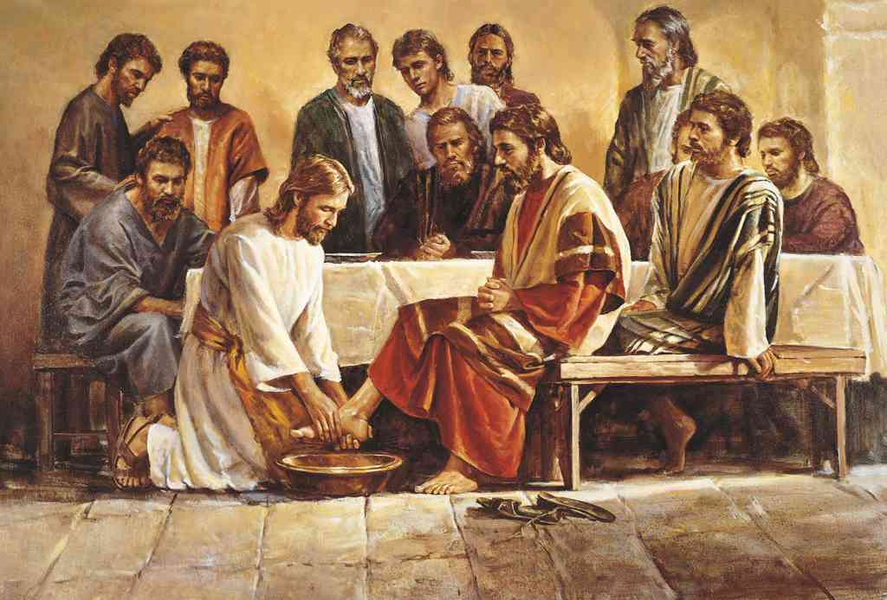
He is my Example…
John 13:13-15 You call Me Teacher and Lord, and you say well, for so I am. 14 If I then, your Lord and Teacher, have washed your feet, you also ought to wash one another's feet. 15 For I have given you an example, that you should do as I have done to you.

Slide 10
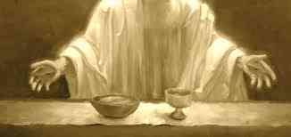
He is my Example…
1 Cor. 11:1 Imitate me, just as I also imitate Christ.
1 Peter 2:21 For to this you were called, because Christ also suffered for us, leaving us an example, that you should follow His steps..
Hebrews 12:2 looking unto Jesus, the author and finisher of our faith, who for the joy that was set before Him endured the cross, despising the shame, and has sat down at the right hand of the throne of God.

Slide 11
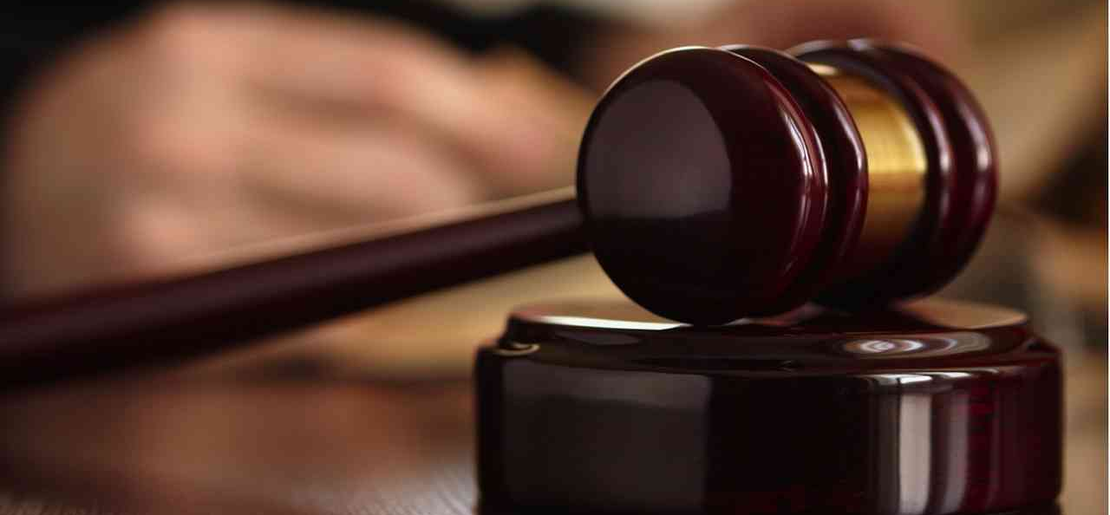
He is my Advocate…
Hebrews 7:25 Therefore He is also able to save to the uttermost those who come to God through Him, since He always lives to make intercession for them.
1 John 2:1-2 My little children, these things I write to you, so that you may not sin. And if anyone sins, we have an Advocate with the Father, Jesus Christ the righteous. 2 And He Himself is the propitiation for our sins, and not for ours only but also for the whole world.

Slide 12
He is my Advocate…
Hebrews 7:25 Therefore He is also able to save to the uttermost those who come to God through Him, since He always lives to make intercession for them.
1 John 2:1-2 My little children, these things I write to you, so that you may not sin. And if anyone sins, we have an Advocate with the Father, Jesus Christ the righteous. 2 And He Himself is the propitiation for our sins, and not for ours only but also for the whole world.

Slide 13
Who is Jesus to Me?
Luke 2:1-11

