Slide 1
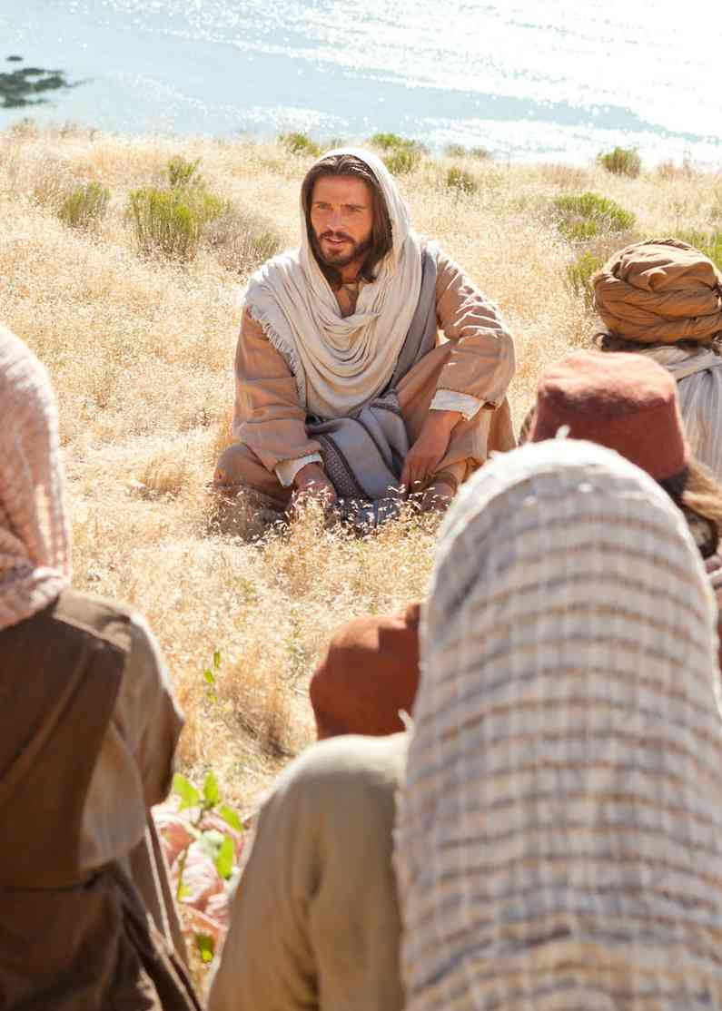
You Have Heard It Said
Matthew 5:21-37
What the Bible says..

Slide 2
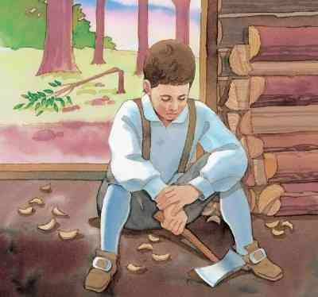
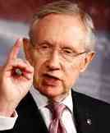
What happened to honesty?

Slide 3
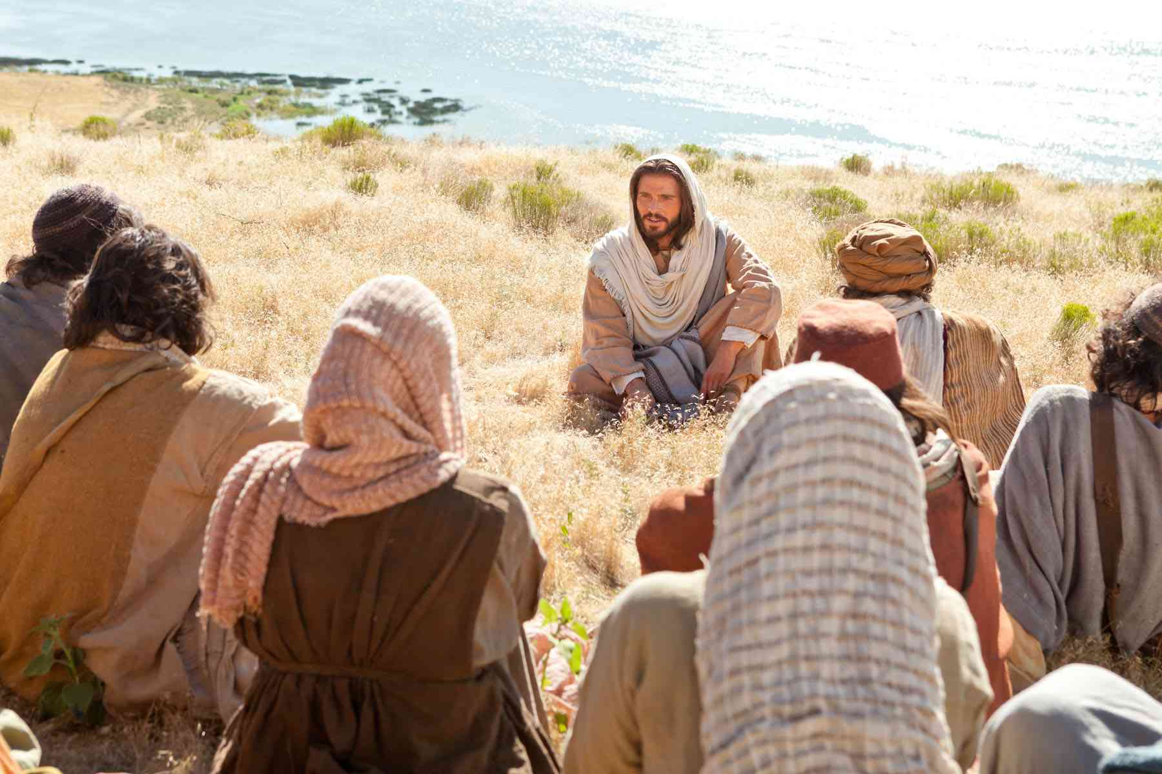
Jesus addresses the hot topics…
You have heard that it was said to those of old. . . . But I say to you . . . (Matt 5:22, 26-28, 31-32, 33-34, 38-39, 43-44)

Slide 4
Relating to others..
Matthew 5:21-22 "You have heard that it was said to those of old, 'You shall not murder, and whoever murders will be in danger of the judgment.'
22 But I say to you that whoever is angry with his brother without a cause shall be in danger of the judgment. And whoever says to his brother, 'Raca!' shall be in danger of the council. But whoever says, 'You fool!' shall be in danger of hell fire.
Anger..
Insults..

Slide 5
Relating to others..
Matthew 5:23-26 Therefore if you bring your gift to the altar, and there remember that your brother has something against you, 24 leave your gift there before the altar, and go your way. First be reconciled to your brother, and then come and offer your gift.
25 Agree with your adversary quickly, while you are on the way with him, lest your adversary deliver you to the judge, the judge hand you over to the officer, and you be thrown into prison. 26 Assuredly, I say to you, you will by no means get out of there till you have paid the last penny.
Live in peace and love..

Slide 6
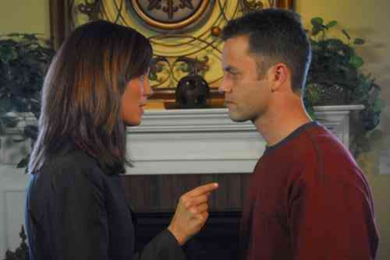
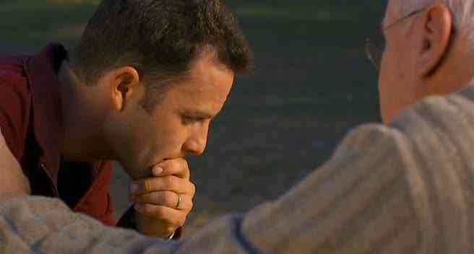
Marital fidelity…
Matthew 5:27-28 "You have heard that it was said to those of old, 'You shall not commit adultery.'
28 But I say to you that whoever looks at a woman to lust for her has already committed adultery with her in his heart.

Slide 7
Marital fidelity…
Matthew 5:29-30 If your right eye causes you to sin, pluck it out and cast it from you; for it is more profitable for you that one of your members perish, than for your whole body to be cast into hell.
30 And if your right hand causes you to sin, cut it off and cast it from you; for it is more profitable for you that one of your members perish, than for your whole body to be cast into hell.

Slide 8
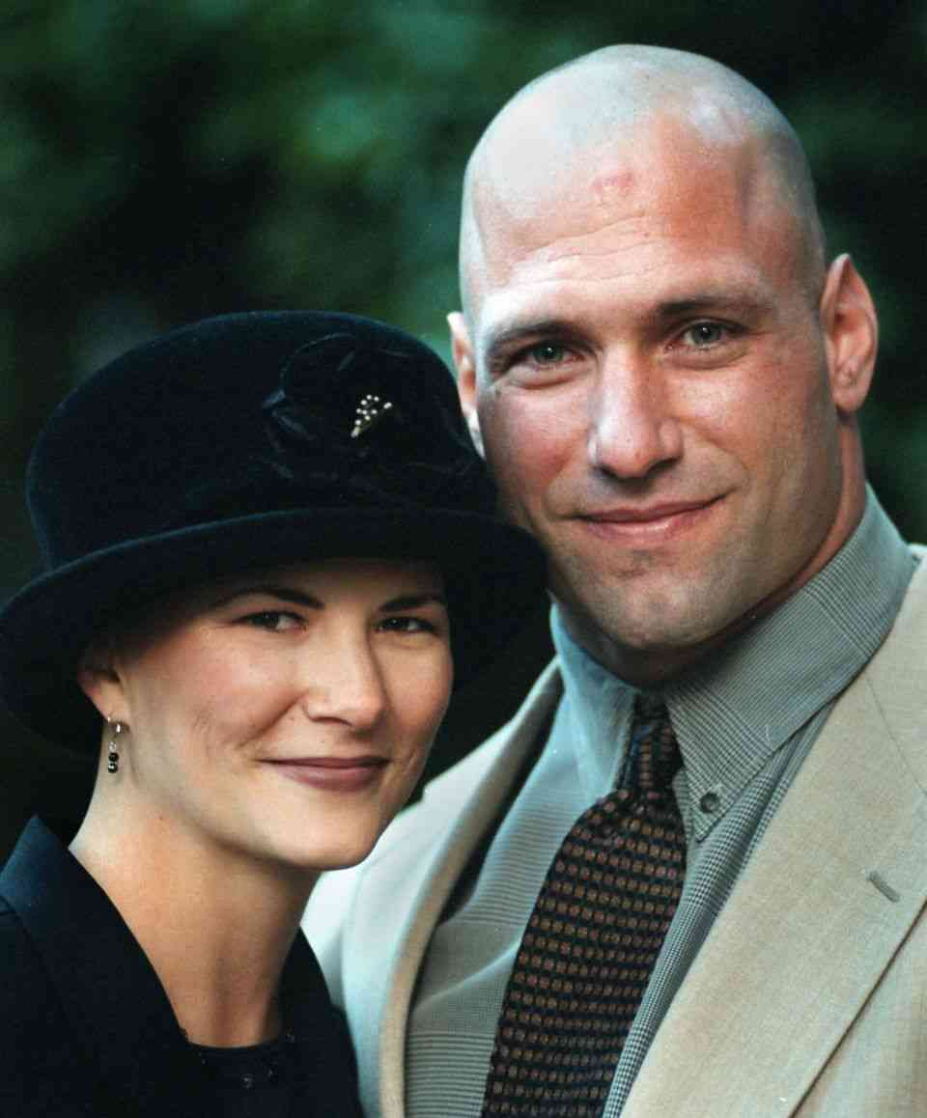
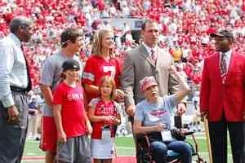
Issue of Divorce…
Matthew 5:31-32 "Furthermore it has been said, 'Whoever divorces his wife, let him give her a certificate of divorce.'
32 But I say to you that whoever divorces his wife for any reason except sexual immorality causes her to commit adultery; and whoever marries a woman who is divorced commits adultery.

Slide 9
Verbal Integrity..
Matthew 5:33-37 "Again you have heard that it was said to those of old, 'You shall not swear falsely, but shall perform your oaths to the Lord.' 34 But I say to you, do not swear at all: neither by heaven, for it is God's throne; 35 nor by the earth, for it is His footstool; nor by Jerusalem, for it is the city of the great King. 36 Nor shall you swear by your head, because you cannot make one hair white or black. 37 But let your 'Yes' be 'Yes,' and your 'No,' 'No.' For whatever is more than these is from the evil one.

Slide 10
What happened to honesty?

Slide 11
Where character begins..

Slide 12
You Have Heard It Said
Matthew 5:21-37
What the Bible says..

