Slide 1
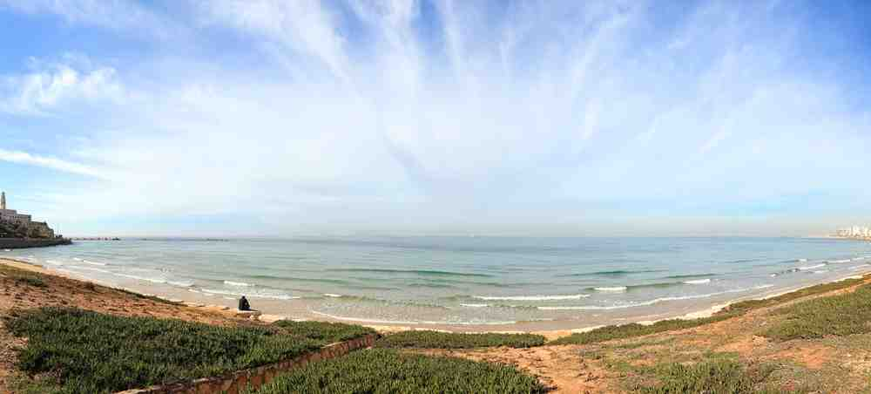
Searching for the Sacred
Isaiah 6:1-7

Slide 2
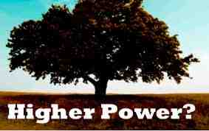
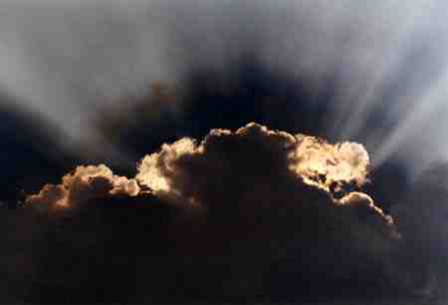
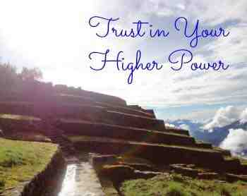
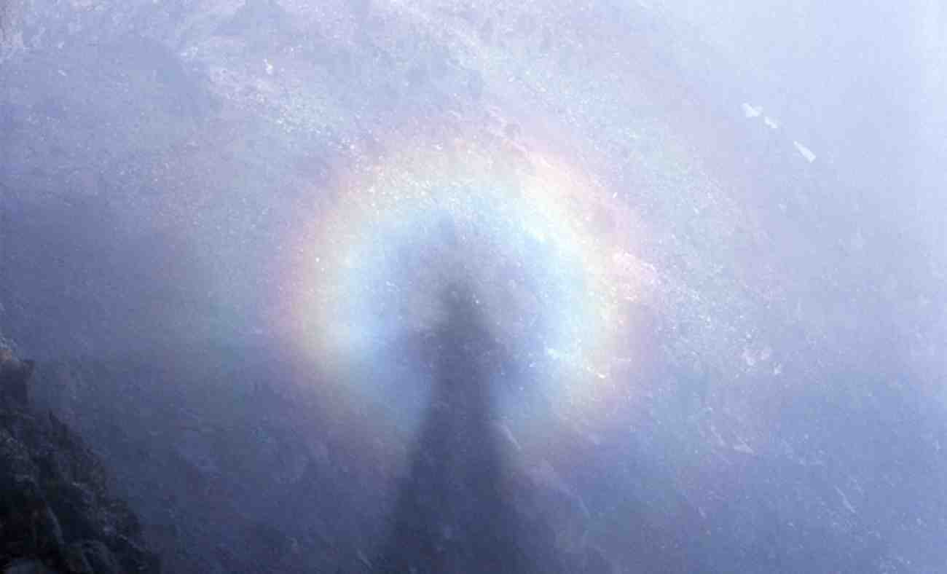
Rebecca’s question..
Belief in higher power instead of God..
In dream, met Jesus, was ok..
God is too constricting..
Bible is not literal, but just stories..

Slide 3
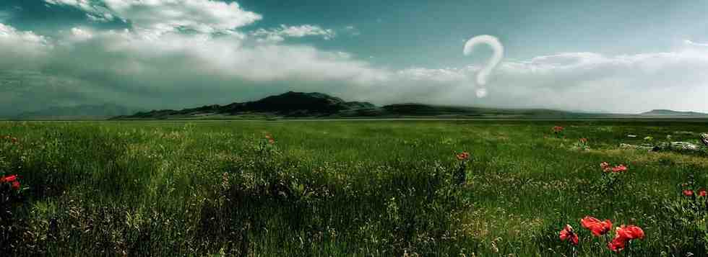
Interest in the spiritual..
Trying to find self
Looking for meaning
Trying to find God
Alternative religions
Career/Possessions
Relationships
A hunger only our Creator can fill…

Slide 4
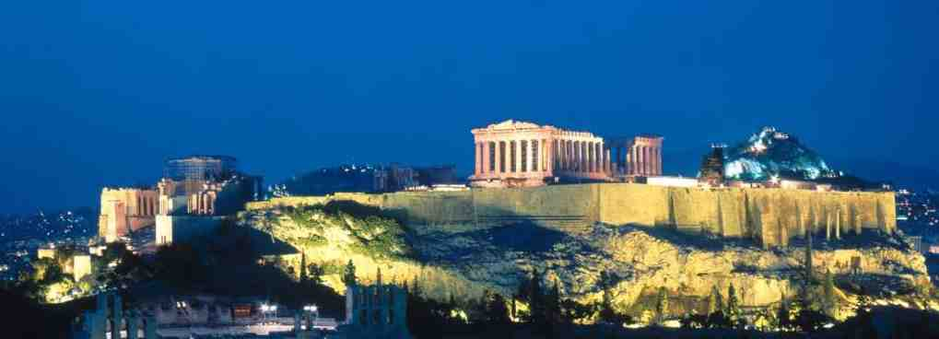
Paul in Athens..
Acts 17:16 his spirit was provoked within him when he saw that the city was given over to idols.
Acts 17:22-23 "Men of Athens, I perceive that in all things you are very religious; 23 as I was passing through and considering the objects of your worship, I even found an altar with this inscription: TO THE UNKNOWN GOD.

Slide 5
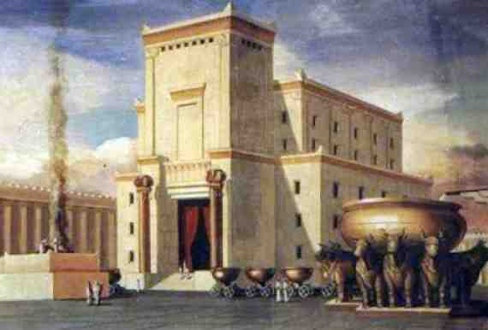
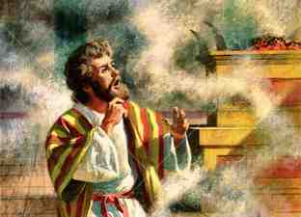
Isaiah calling for repentance..
Isaiah 6:9-10 .. God’s people blessed but spiritually deaf, blind, insensitive

Slide 6
Isaiah’s encounter..
Isaiah 6:1-4 I saw the Lord sitting on a throne, high and lifted up, and the train of His robe filled the temple. 2 Above it stood seraphim; each one had six wings: with two he covered his face, with two he covered his feet, and with two he flew. 3 And one cried to another and said:"Holy, holy, holy is the Lord of hosts; The whole earth is full of His glory!" 4 And the posts of the door were shaken by the voice of him who cried out, and the house was filled with smoke.

Slide 7
Seeking God without knowing why..
Seeking God without being changed..
Our first motive is to see His glory…

Slide 8
God will never leave His Throne..
Isaiah 6:1-4 I saw the Lord sitting on a throne, high and lifted up..

Slide 9
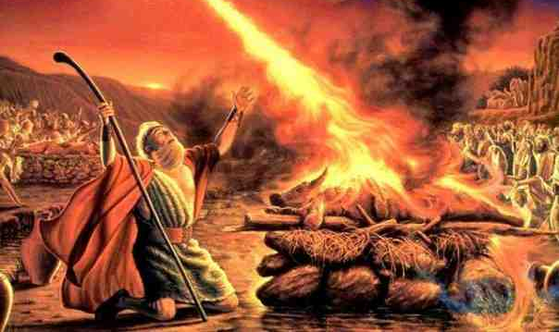
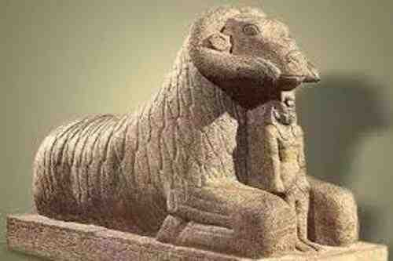
Elijah’s contest..
1 Kings 18:27-29 at noon, that Elijah mocked them and said, "Cry aloud, for he is a god; either he is meditating, or he is busy, or he is on a journey, or perhaps he is sleeping and must be awakened."
29 And when midday was past, they prophesied until the time of the offering of the evening sacrifice. But there was no voice; no one answered, no one paid attention.

Slide 10
Our God is always available to us..
Hebrews 4:15-16 For we do not have a High Priest who cannot sympathize with our weaknesses, but was in all points tempted as we are, yet without sin. 16 Let us therefore come boldly to the throne of grace, that we may obtain mercy and find grace to help in time of need.

Slide 11
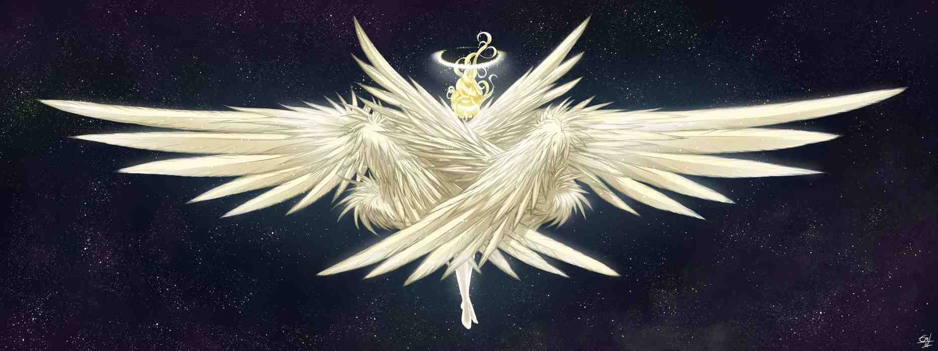
Our God is worthy of praise..
Isaiah 6:2-3 Above it stood seraphim; each one had six wings: with two he covered his face, with two he covered his feet, and with two he flew. 3 And one cried to another and said:"Holy, holy, holy is the Lord of hosts; The whole earth is full of His glory!"

Slide 12
Why does God want us to praise Him?
So He can bless us and allow us a glimpse of His glory…

Slide 13
The unclean made clean..
Isaiah 6:5-7 So I said: "Woe is me, for I am undone! Because I am a man of unclean lips, And I dwell in the midst of a people of unclean lips; For my eyes have seen the King, The Lord of hosts."
6 Then one of the seraphim flew to me, having in his hand a live coal which he had taken with the tongs from the altar. 7 And he touched my mouth with it, and said: "Behold, this has touched your lips; Your iniquity is taken away, And your sin purged."

Slide 14
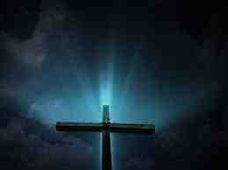
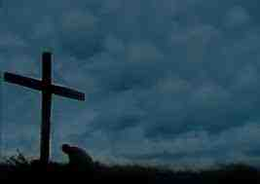
God’s provision for righteousness..
He’s done more than send an angel to purify our lips with a burning coal..
He’s sent His very own Son to purify our entire being…

Slide 15
Searching for the Sacred
Isaiah 6:1-7

