Slide 1
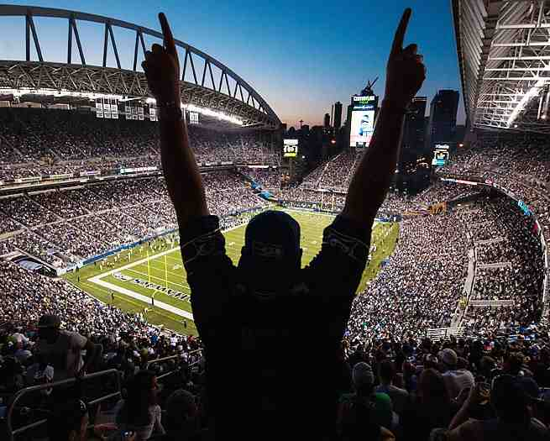
The Road to Victory
2 Peter 1:3-11

Slide 2
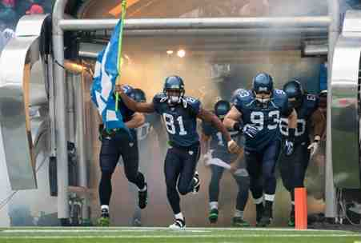
Winning is never automatic…
Back to basics… find their identity, face each game, play as a team…

Slide 3
Victorious living is not automatic…
Philippians 3:12-14 I do not count myself to have apprehended; but one thing I do, forgetting those things which are behind and reaching forward to those things which are ahead, 14 I press toward the goal for the prize of the upward call of God in Christ Jesus…

Slide 4
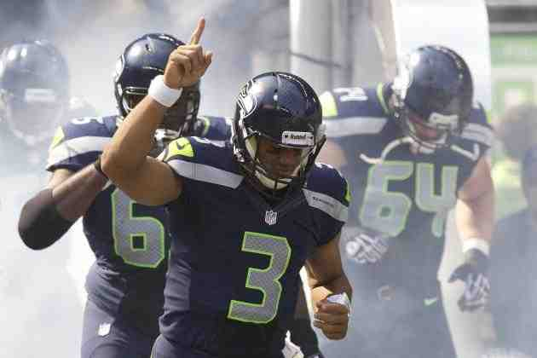
Realizing our new identity…
Ephesians 2:4-6 But God, who is rich in mercy, because of His great love with which He loved us, 5 even when we were dead in trespasses, made us alive together with Christ (by grace you have been saved), 6 and raised us up together, and made us sit together in the heavenly places in Christ Jesus....

Slide 5
Who are you ..
Romans 6:4-5 we were buried with Him through baptism into death, that just as Christ was raised from the dead by the glory of the Father, even so we also should walk in newness of life. 5 For if we have been united together in the likeness of His death, certainly we also shall be in the likeness of His resurrection..

Slide 6
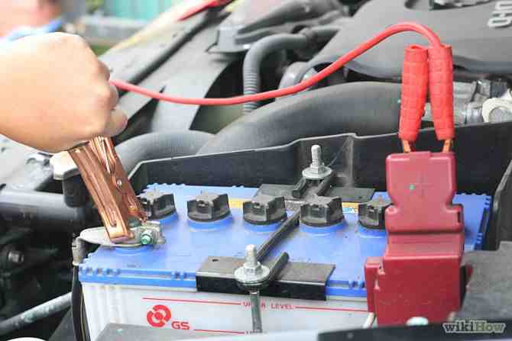
New energy connection..
In Christ.. the cable of Jesus’ victory on the cross is connected with our dead spirit.. I am raised to new life…

Slide 7
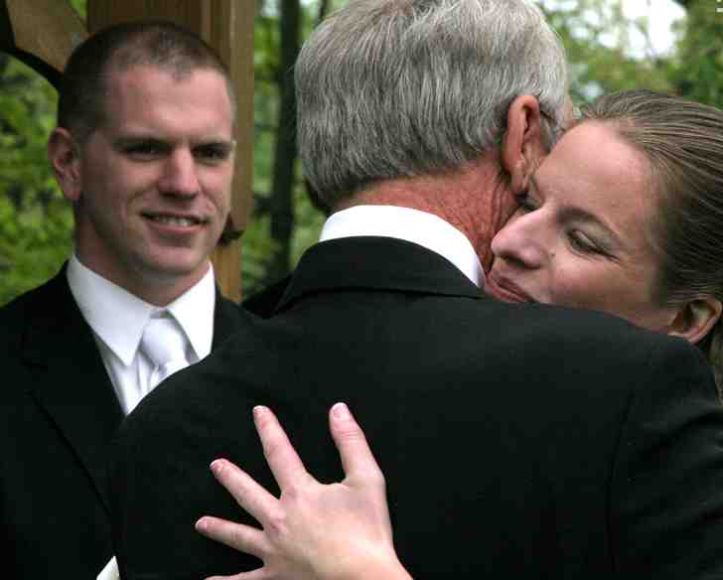
Wedding ceremony..
Father gives daughter away… she leaves belonging to her new husband

Slide 8
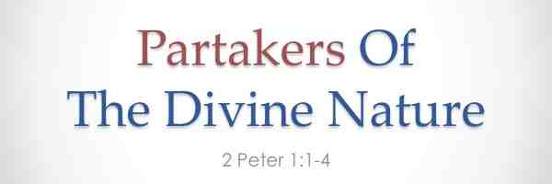
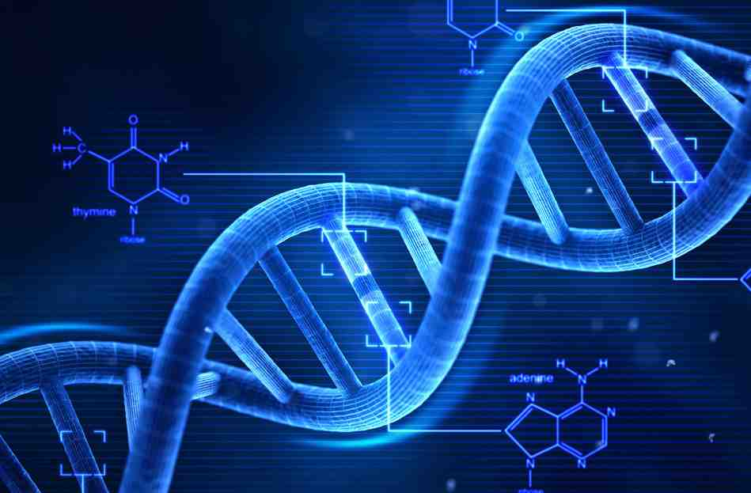
Our new nature…
2 Peter 1:3-4 His divine power has given to us all things that pertain to life and godliness, through the knowledge of Him who called us by glory and virtue, 4 by which have been given to us exceedingly great and precious promises, that through these you may be partakers of the divine nature, having escaped the corruption that is in the world through lust.

Slide 9
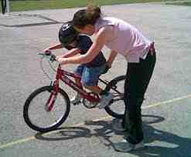
Spiritual growth takes effort..
2 Pet 1:5-8 give diligence add to your faith… maintain forward motion..
RATE X TIME = DISTANCE

Slide 10
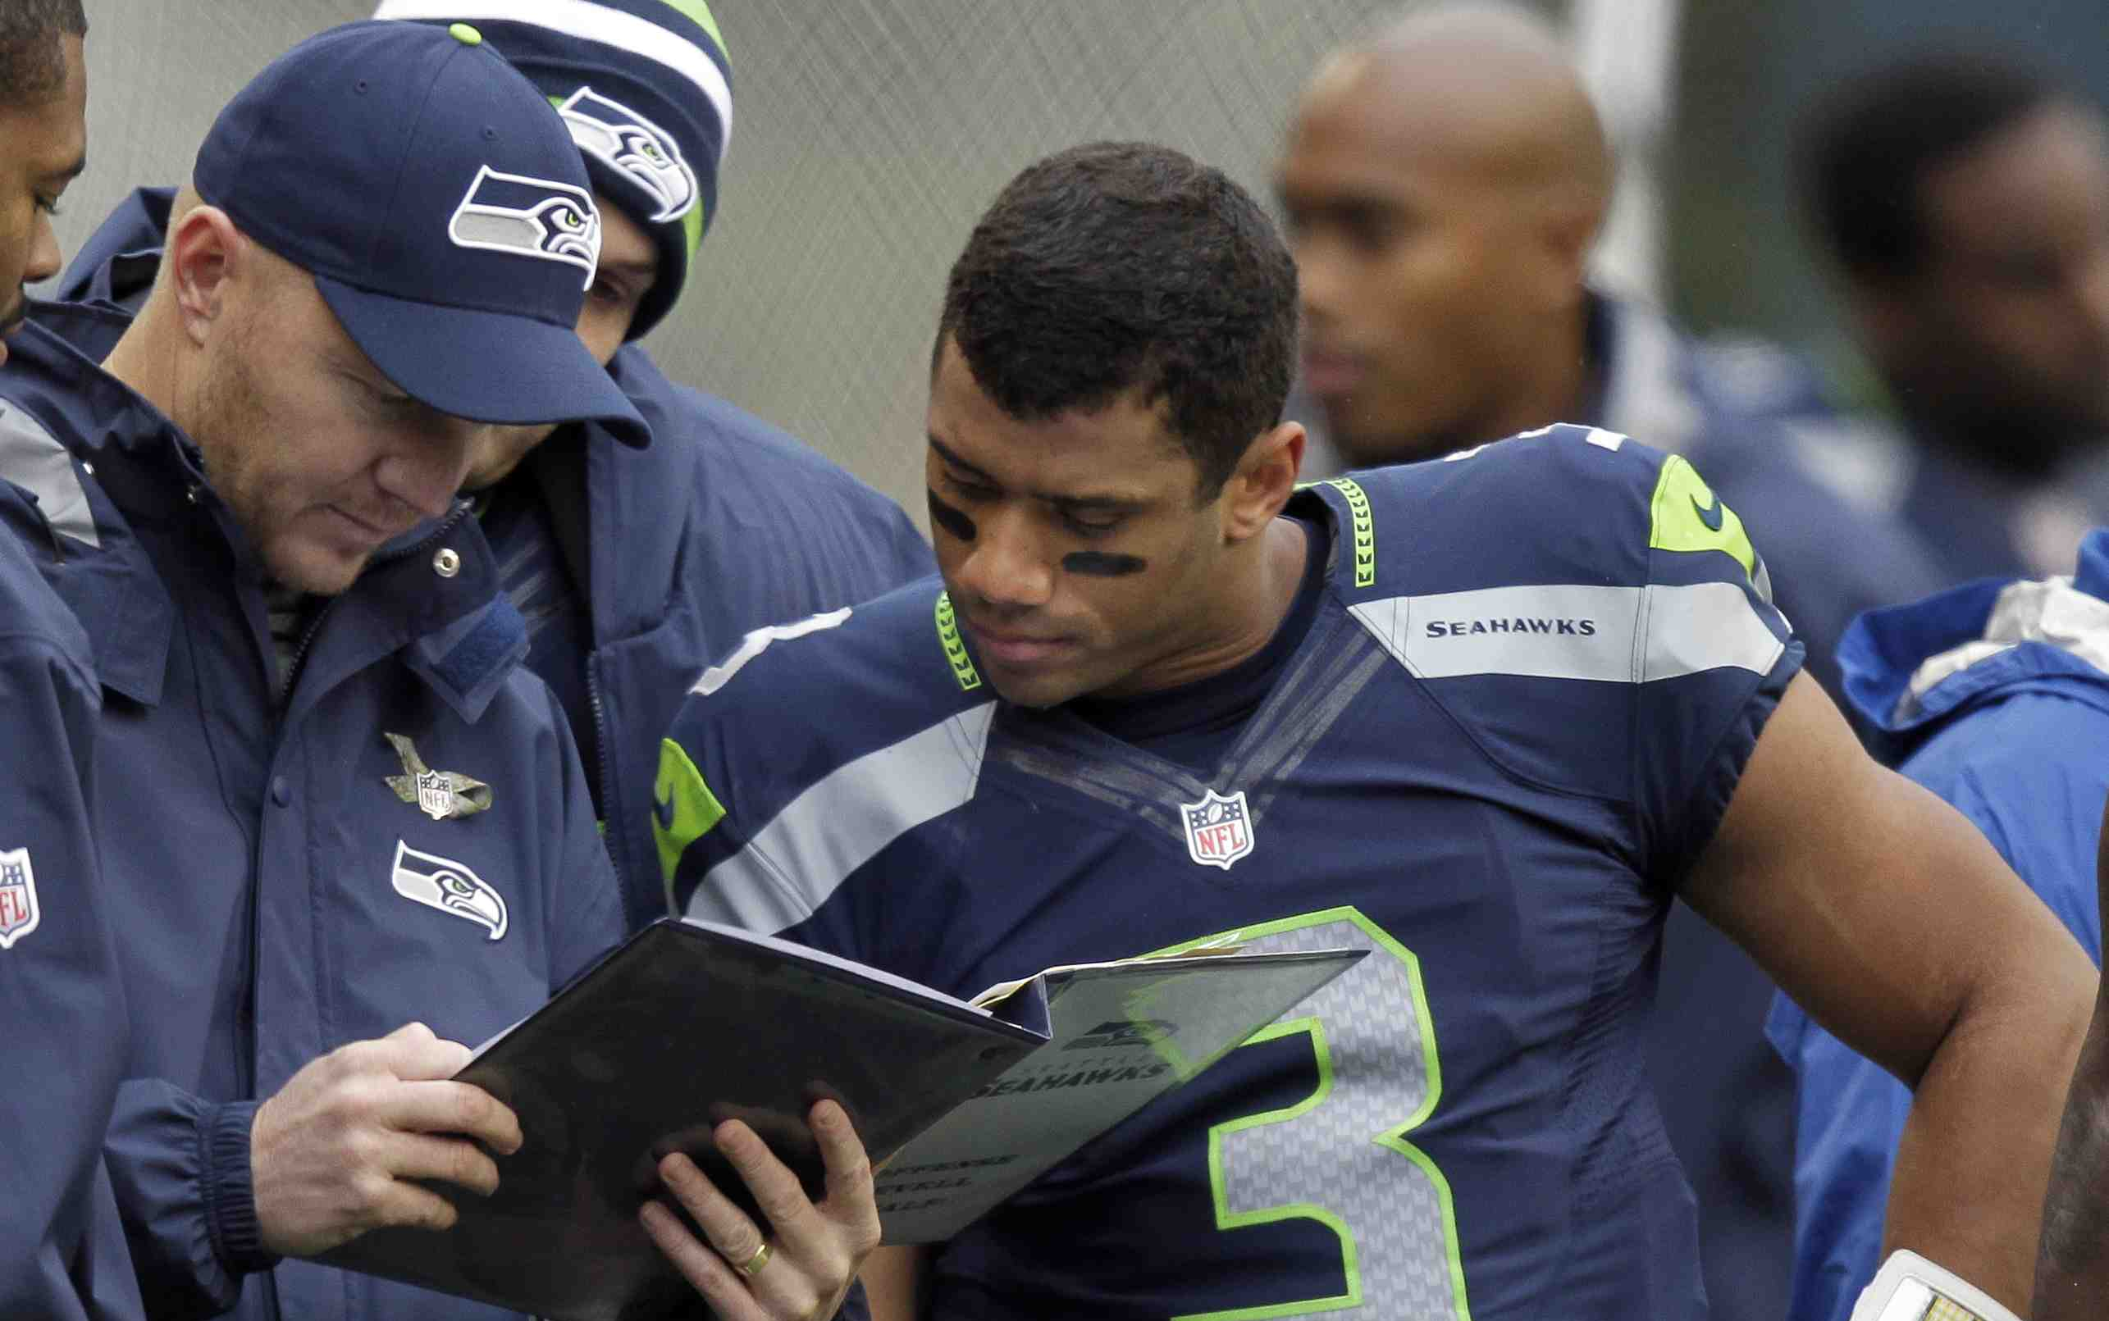
Knowing the playbook..
Hebrews 4:12 For the word of God is living and powerful, and sharper than any two-edged sword, piercing even to the division of soul and spirit, and of joints and marrow, and is a discerner of the thoughts and intents of the heart.

Slide 11
Knowing the playbook..
2 Timothy 3:16-17 All Scripture is given by inspiration of God, and is profitable for doctrine, for reproof, for correction, for instruction in righteousness, 17 that the man of God may be complete, thoroughly equipped for every good work.

Slide 12
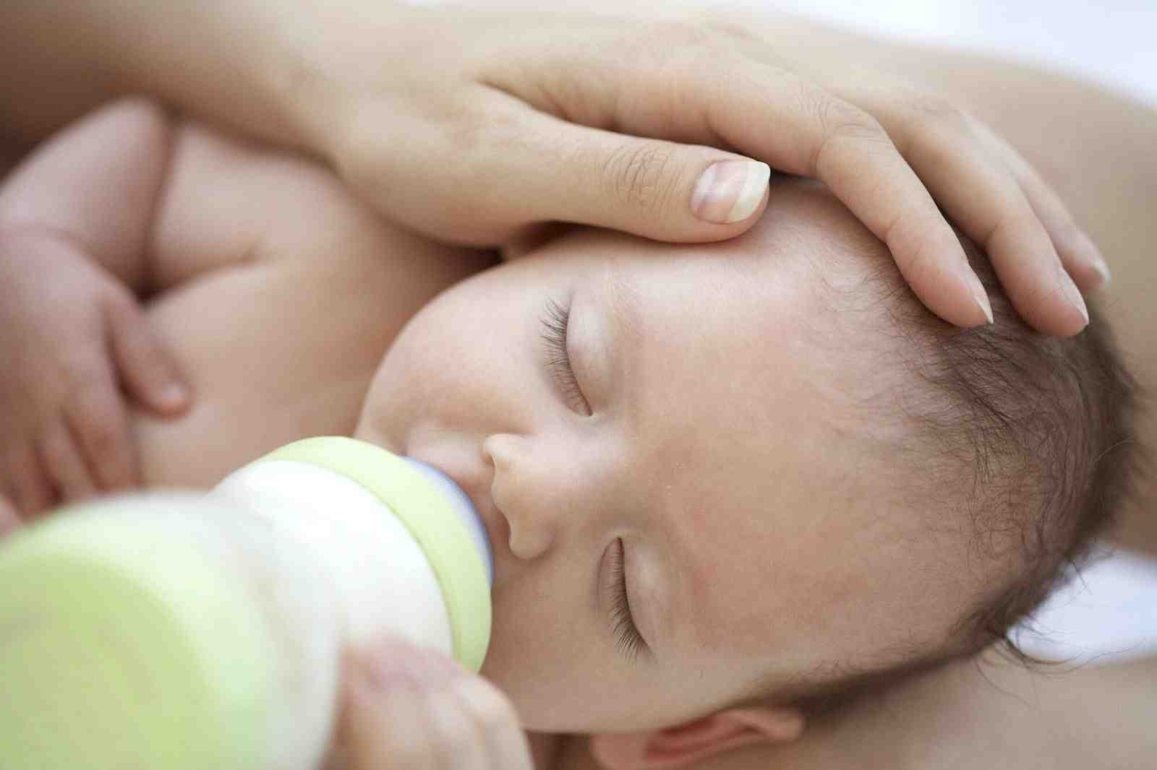
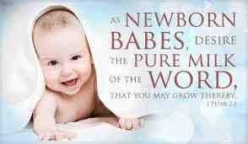
The ideal diet..
1 Peter 2:2 as newborn babes, desire the pure milk of the word, that you may grow thereby

Slide 13
Understanding God and His ways…
2 Peter 3:18 but grow in the grace and knowledge of our Lord and Savior Jesus Christ..
Psalms 1:1-2 Blessed is the man Who walks not in the counsel of the ungodly, Nor stands in the path of sinners, Nor sits in the seat of the scornful; 2 But his delight is in the law of the Lord, And in His law he meditates day and night.
Colossians 3:16 Let the word of Christ dwell in you richly in all wisdom...

Slide 14
The Road to Victory
2 Peter 1:3-11

