Slide 1
Victorious Christian Living
Romans 8:1-11

Slide 2
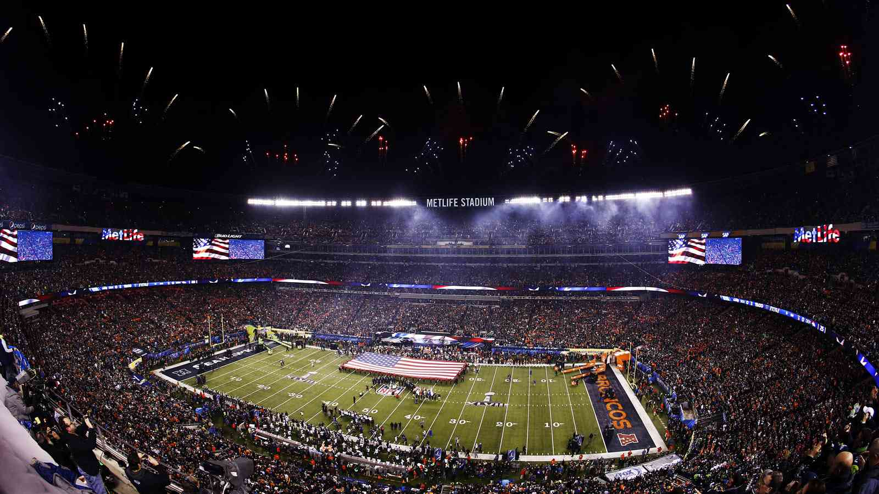
The thrill of victory..
Superbowl XLVIII

Slide 4
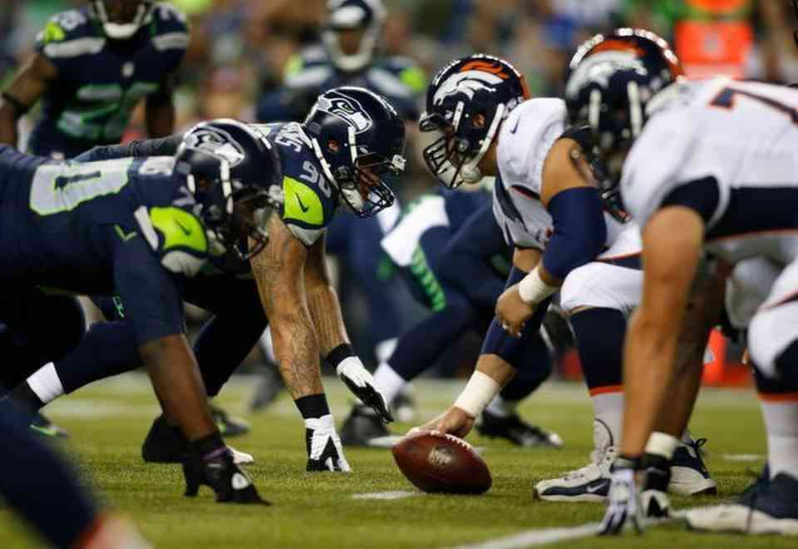
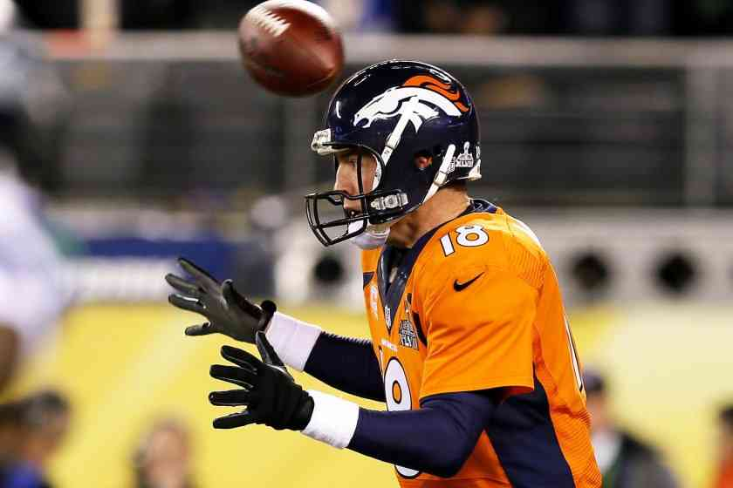
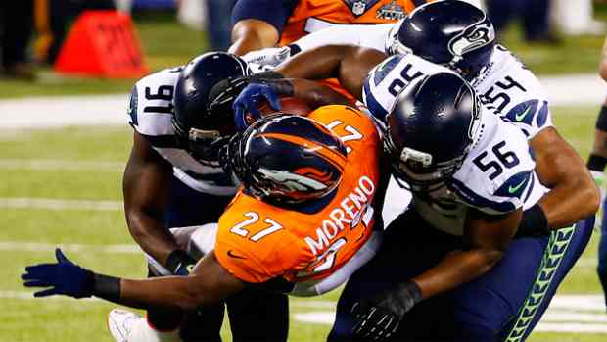
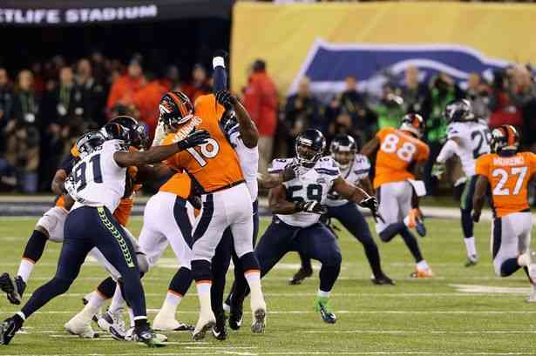
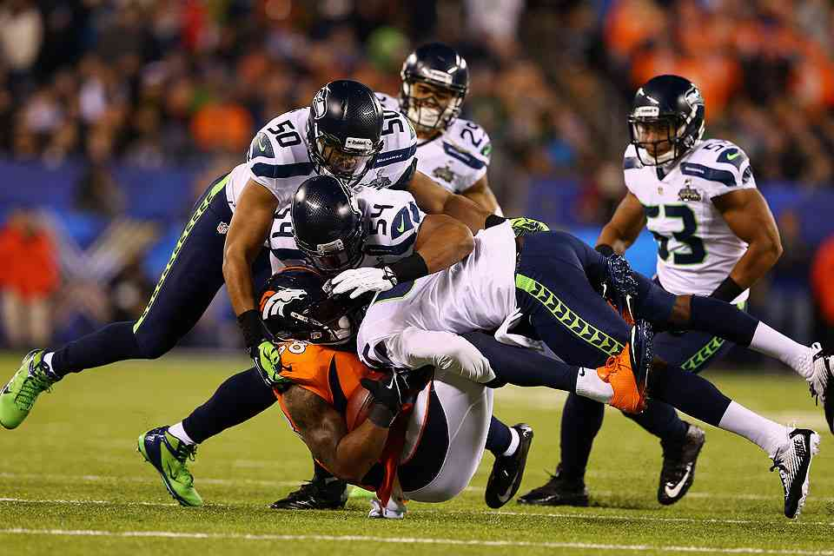
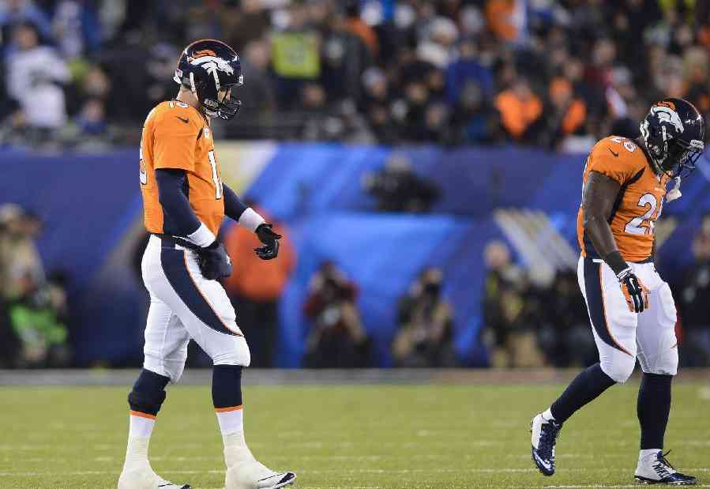
Seahawks realize victory..
For Bronco fans… the agony of defeat

Slide 5
The Christian life…
Some win battle… rejoicing in Christ
Others overcome, cannot sustain life of holiness..

Slide 6
God wants us to live victorious lives…
He is willing to help us achieve victory and provide all we ever will need…

Slide 7
Satan wants us to feel defeated…
John 8:44 a murderer, father of lies..
Rev. 12:10 accuser of the brethren..

Slide 8
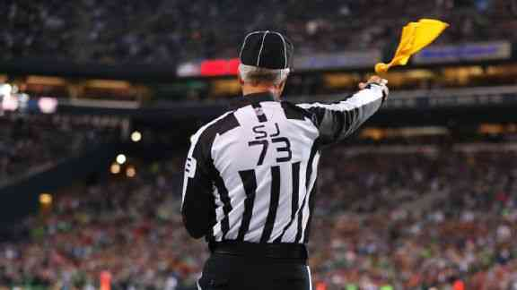
Satan is crafty…
When we think we have scored, but discover it didn’t count…

Slide 9
Ecclesiastes 1:1-2 The words of the Preacher, the son of David, king in Jerusalem. 2 "Vanity of vanities," says the Preacher; "Vanity of vanities, all is vanity."

Slide 10
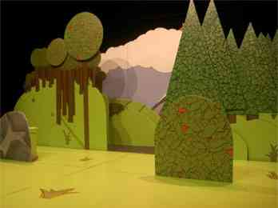
Cardboard imitations..
Worldly pleasure, immoral living, alcohol, drugs…

Slide 11
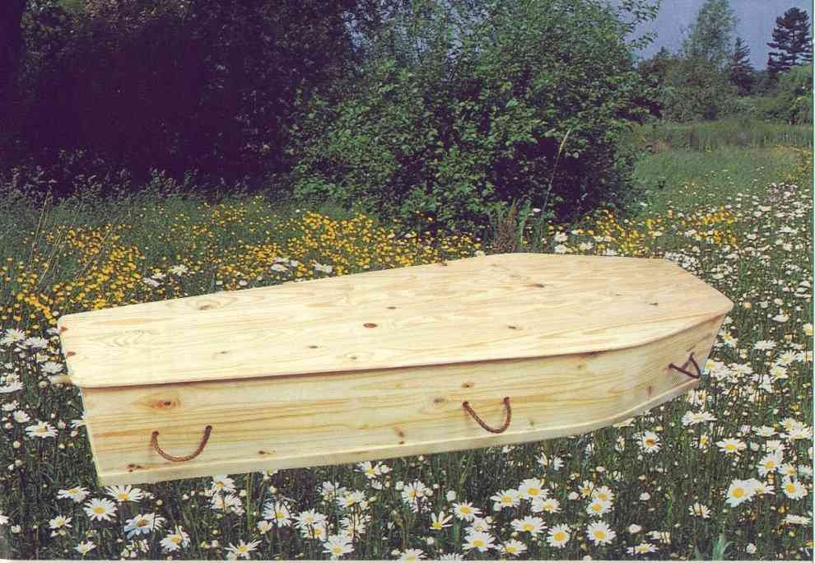
A time to be born, a time to die…
Ecclesiastes 3:11 He has made everything beautiful in its time. Also He has put eternity in their hearts, except that no one can find out the work that God does from beginning to end

Slide 12
Romans 7:20-25 I find then a law, that evil is present with me, the one who wills to do good. 22 For I delight in the law of God according to the inward man. 23 But I see another law in my members, warring against the law of my mind, and bringing me into captivity to the law of sin which is in my members. 24 O wretched man that I am! Who will deliver me from this body of death? 25 I thank God — through Jesus Christ our Lord! So then, with the mind I myself serve the law of God, but with the flesh the law of sin.

Slide 13
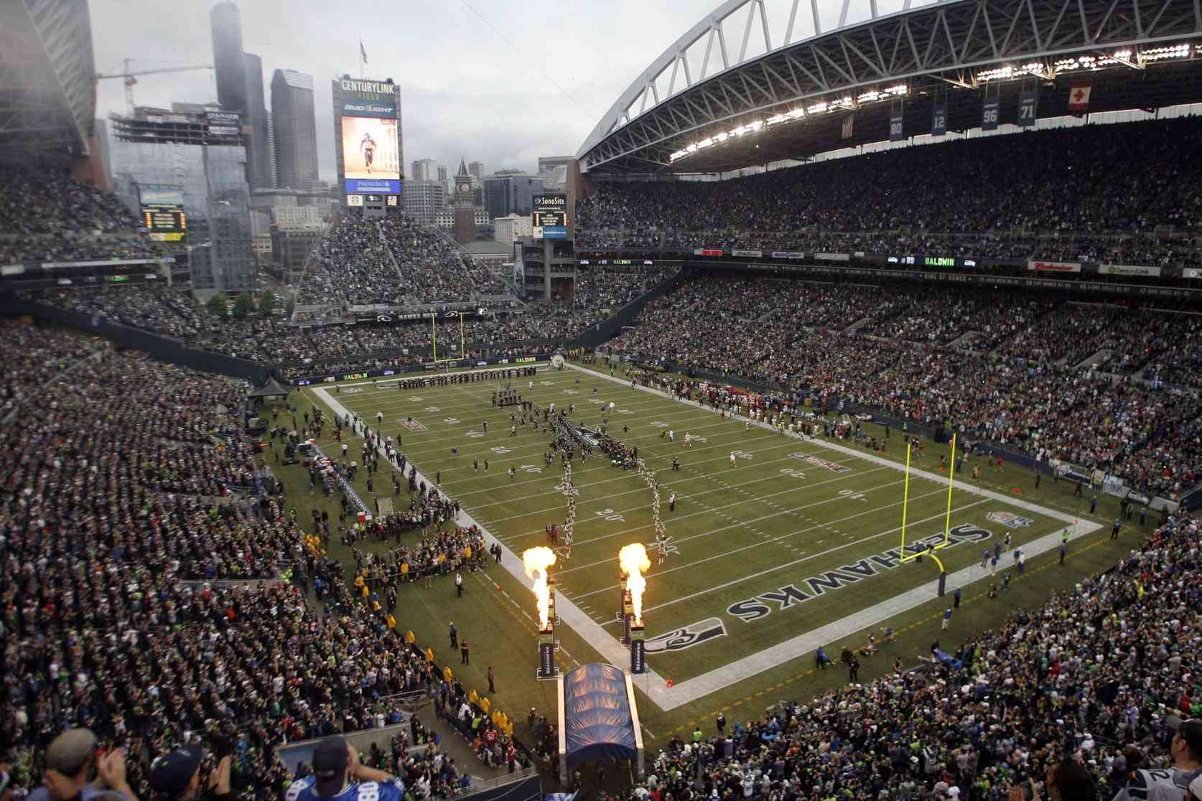
God’s game plan..
Eph 2:1-3 And you He made alive, who were dead in trespasses and sins, 2 in which you once walked according to the course of this world, according to the prince of the power of the air, the spirit who now works in the sons of disobedience, 3 among whom also we all once conducted ourselves in the lusts of our flesh, fulfilling the desires of the flesh and of the mind, and were by nature children of wrath, just as the others.

Slide 14
God’s game plan..
Eph 2:4-6 But God, who is rich in mercy, because of His great love with which He loved us, 5 even when we were dead in trespasses, made us alive together with Christ (by grace you have been saved), 6 and raised us up together, and made us sit together in the heavenly places in Christ Jesus,

Slide 15
God’s unmerited favor..
Romans 8:1-4 There is therefore now no condemnation to those who are in Christ Jesus, who do not walk according to the flesh, but according to the Spirit. 2 For the law of the Spirit of life in Christ Jesus has made me free from the law of sin and death. 3 For what the law could not do in that it was weak through the flesh, God did by sending His own Son in the likeness of sinful flesh, on account of sin: He condemned sin in the flesh, 4 that the righteous requirement of the law might be fulfilled in us who do not walk according to the flesh but according to the Spirit.

Slide 16
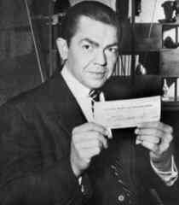
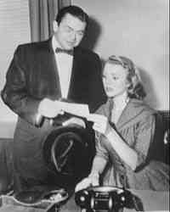
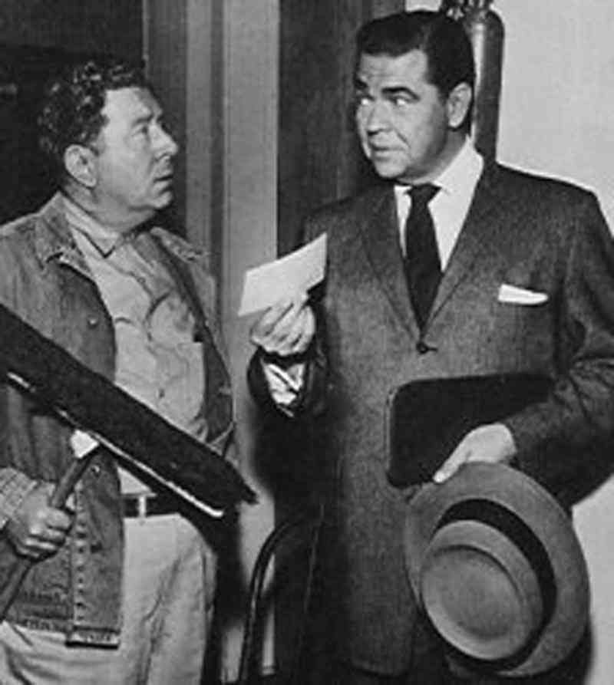
The Millionaire…
Are we willing to accept God’s gift ..
How will we choose to use it?

Slide 17
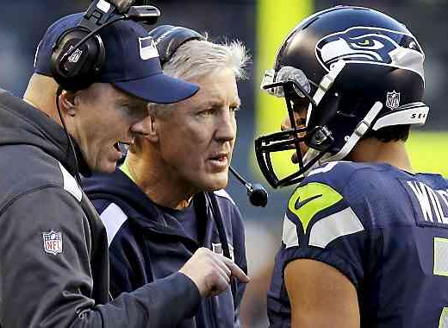
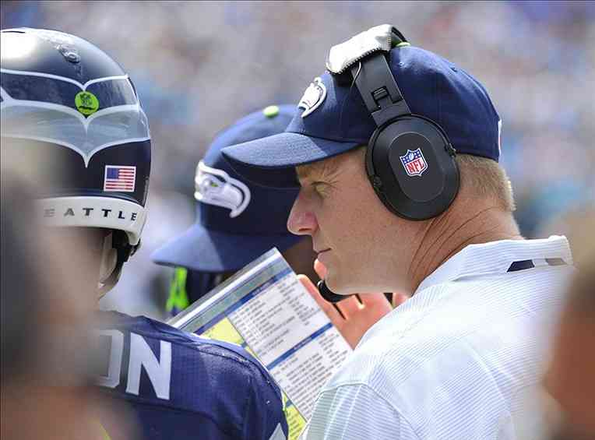
God’s presence and resources assure victory…
9 But you are not in the flesh but in the Spirit, if indeed the Spirit of God dwells in you. Now if anyone does not have the Spirit of Christ, he is not His. 10 And if Christ is in you, the body is dead because of sin, but the Spirit is life because of righteousness. 11 But if the Spirit of Him who raised Jesus from the dead dwells in you, He who raised Christ from the dead will also give life to your mortal bodies through His Spirit who dwells in you.

Slide 18
God’s presence and resources assure victory…
2 Corinthians 9:8 And God is able to make all grace abound toward you, that you, always having all sufficiency in all things, may have an abundance for every good work.
Ephesians 1:3 Blessed be the God and Father of our Lord Jesus Christ, who has blessed us with every spiritual blessing in the heavenly places in Christ...

Slide 19
Victorious Christian Living
Romans 8:1-11

