Slide 1
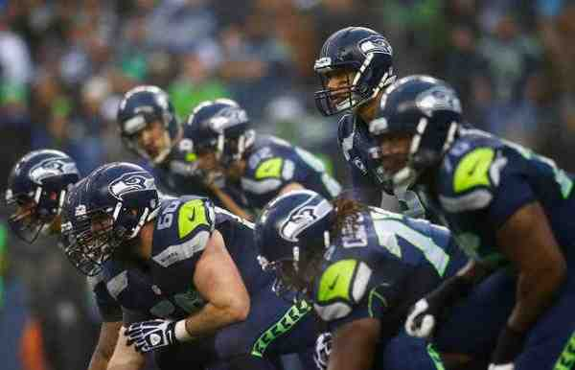
Winning as a Team
Hebrews 10:23-25

Slide 2
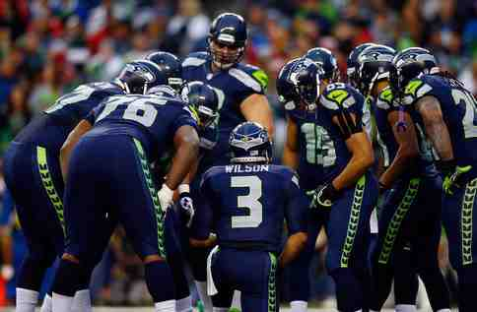
Playing together..
Every player is important and knows the value of every member of the team..

Slide 3
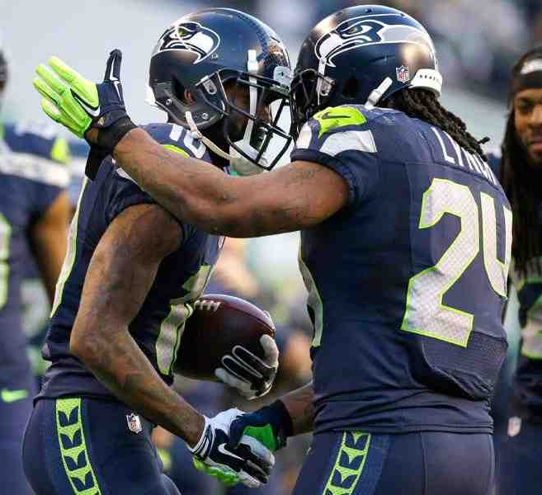
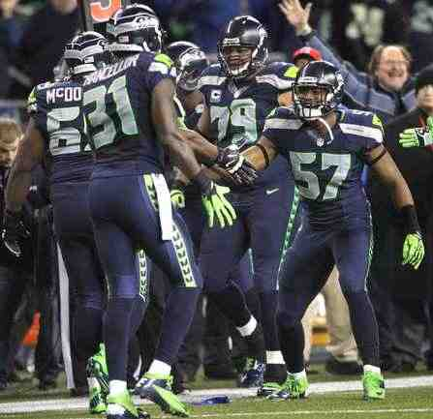
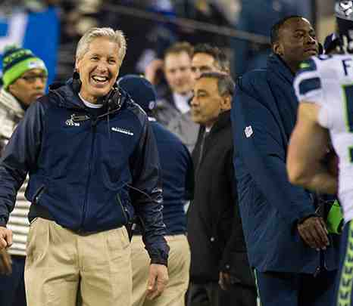
Good of the team…
Players are quick to commend each other and urge each other on to victory..

Slide 4
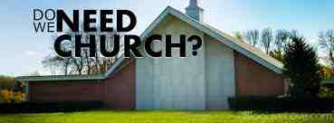
Why the church?..
“I don’t have to belong to the church”…
“I can worship God in my heart..”

Slide 5
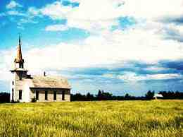
Hebrews 10:23-25
Let us hold fast the confession of our hope without wavering, for He who promised is faithful. 24 And let us consider one another in order to stir up love and good works, 25 not forsaking the assembling of ourselves together, as is the manner of some, but exhorting one another, and so much the more as you see the Day approaching.

Slide 6
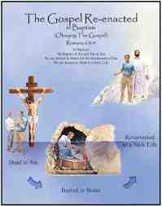
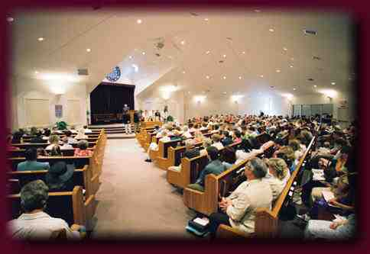
Do I need the church?...
Our relationship to a body of fellow Christians is crucial to the growth of our own relationship with God…

Slide 7
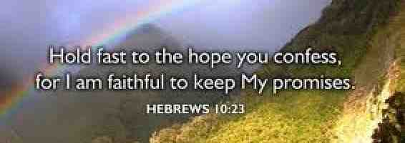
Hold fast our hope…
Stand up for what you believe rather than giving up…
Don’t be ashamed of Jesus…

Slide 8
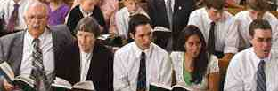
Not forsake assembling..
Why do I need the church?...
To keep us from defecting from the faith..

Slide 9
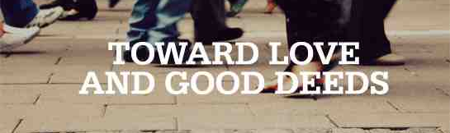
Stir up love & good deeds..
By coming together we build each other up to continue faithful…

Slide 10
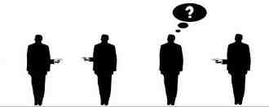
Four people in church..
Everybody
Someboy
Anybody
Nobody

Slide 11
Jigsaw puzzle..
Each has strengths and weaknesses… but put together they form a beautiful picture..

Slide 12
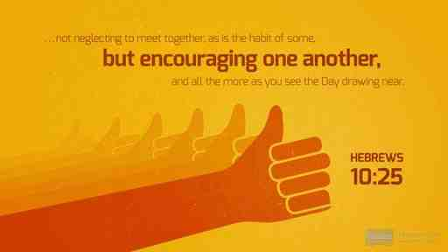
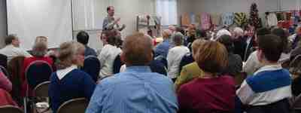
Ways to encourage...
Galatians 6:1-2 Brethren, if a man is overtaken in any trespass, you who are spiritual restore such a one in a spirit of gentleness, considering yourself lest you also be tempted. 2 Bear one another's burdens, and so fulfill the law of Christ.

Slide 13
Come alongside the undisciplined...
1 Timothy 3:14-15 These things I write to you, though I hope to come to you shortly; 15 but if I am delayed, I write so that you may know how you ought to conduct yourself in the house of God, which is the church of the living God, the pillar and ground of the truth.

Slide 14
Be sure to encourage each other...
Hebrews 13:2 Do not forget to entertain strangers, for by so doing some have unwittingly entertained angels.

Slide 15
Unwrap our gifts...
1 Peter 4:10 As each one has received a gift, minister it to one another, as good stewards of the manifold grace of God.

Slide 16
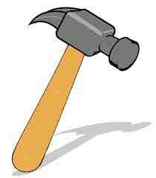
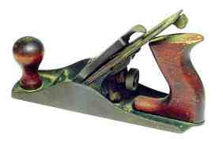
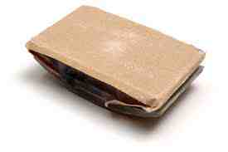
Valuing each gift…
We can make the mistake of seeing only the faults and not the value…

Slide 17
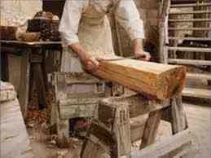
In the Master Carpenter’s hands…
He takes the tools and forms a beautiful masterpiece…

Slide 18
Winning as a Team
Hebrews 10:23-25

