Slide 1
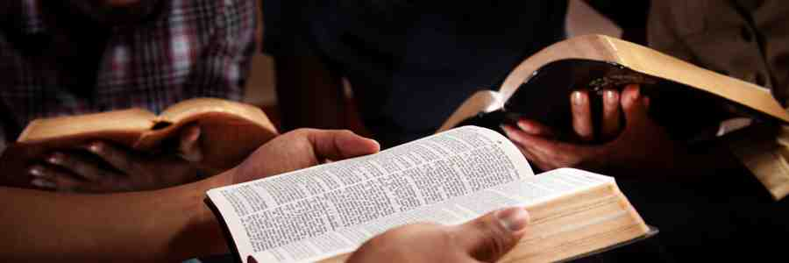
For Lack of Knowledge
Hosea 4:1-6

Slide 2
Prophets of Israel..
Hosea … “harlotry of Israel”
Symbolized in his marriage..
Israel on a path of judgment..

Slide 3
Cause of their destruction..
Hosea 4:6 My people are destroyed for lack of knowledge…
4:1 There is no truth or mercy or knowledge of God in the land…
4:6b .. because you have rejected knowledge, I also will reject you ..

Slide 4
Spiritual gifts in NT..
1 Cor 12:8 for to one is given the word of wisdom through the Spirit, to another the word of knowledge through the same Spirit,

Slide 5
Same danger today..
God’s people perishing eternally … for lack of knowledge

Slide 6
#1 You can’t believe what you don’t know..
Hosea 4:1 the Lord has a controversy against the inhabitants of the land: "There is no truth or mercy or knowledge of God in the land.

Slide 7
#1 You can’t believe what you don’t know..
2 Timothy 1:8-13 … for I know whom I have believed and am persuaded that He is able to keep what I have committed to Him until that Day.

Slide 8
#1 You can’t believe what you don’t know..

Slide 10
#1 You can’t believe what you don’t know..
John 8:24 Therefore I said to you that you will die in your sins; for if you do not believe that I am He, you will die in your sins."

Slide 11
#2 You can’t practice what you don’t know..
Hosea 4:2 By swearing and lying, killing and stealing and committing adultery, they break all restraint, with bloodshed upon bloodshed. 3 Therefore the land will mourn…

Slide 12
#2 You can’t practice what you don’t know..
John 8:31-32 Then Jesus said to those Jews who believed Him, "If you abide in My word, you are My disciples indeed. 32 And you shall know the truth, and the truth shall make you free."

Slide 13
Afraid something is wrong, but if don’t know, won’t have to make life changes..

Slide 14
#2 You can’t practice what you don’t know..
Romans 10:1-2 Brethren, my heart's desire and prayer to God for Israel is that they may be saved. 2 For I bear them witness that they have a zeal for God, but not according to knowledge.

Slide 15
#2 You can’t practice what you don’t know..
1 John 5:13 These things I have written to you who believe in the name of the Son of God, that you may know that you have eternal life, and that you may continue to believe in the name of the Son of God.
2 Peter 1:5 But also for this very reason, giving all diligence, add to your faith virtue, to virtue knowledge..
2 Peter 3:18 but grow in the grace and knowledge of our Lord and Savior Jesus Christ.

Slide 16
#3 You can’t teach what you don’t know..
1 Peter 3:15 But sanctify the Lord God in your hearts, and always be ready to give a defense to everyone who asks you a reason for the hope that is in you, with meekness and fear…

Slide 17
Sharing what we know..

Slide 18
The Necessity of Knowledge
Ezra 7:10 For Ezra had prepared his heart to seek the Law of the Lord, and to do it, and to teach statutes and ordinances in Israel.

Slide 19
For Lack of Knowledge
Ezra 7:10 For Ezra had prepared his heart to seek the Law of the Lord, and to do it, and to teach statutes and ordinances in Israel.
Hosea 4:1-6

