Slide 1
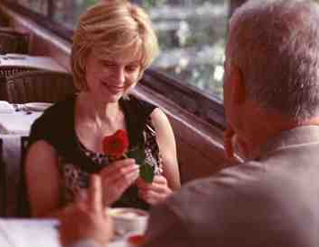
Keeping Romance in Marriage
Ephesians 5:25-33

Slide 2
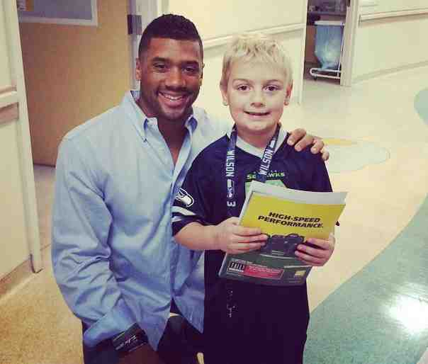
Russell Wilson after loss..
“I will love you, O Lord, my strength”…
Psalm 18:1

Slide 3
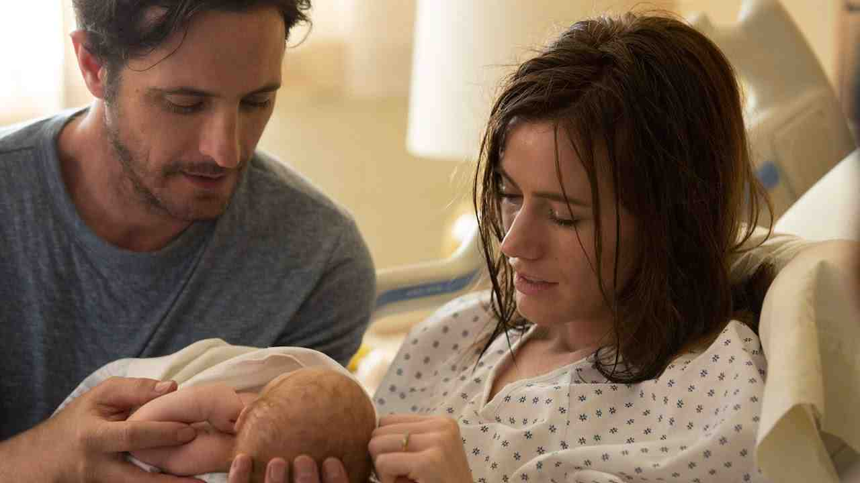
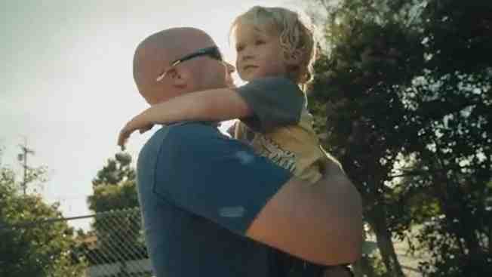
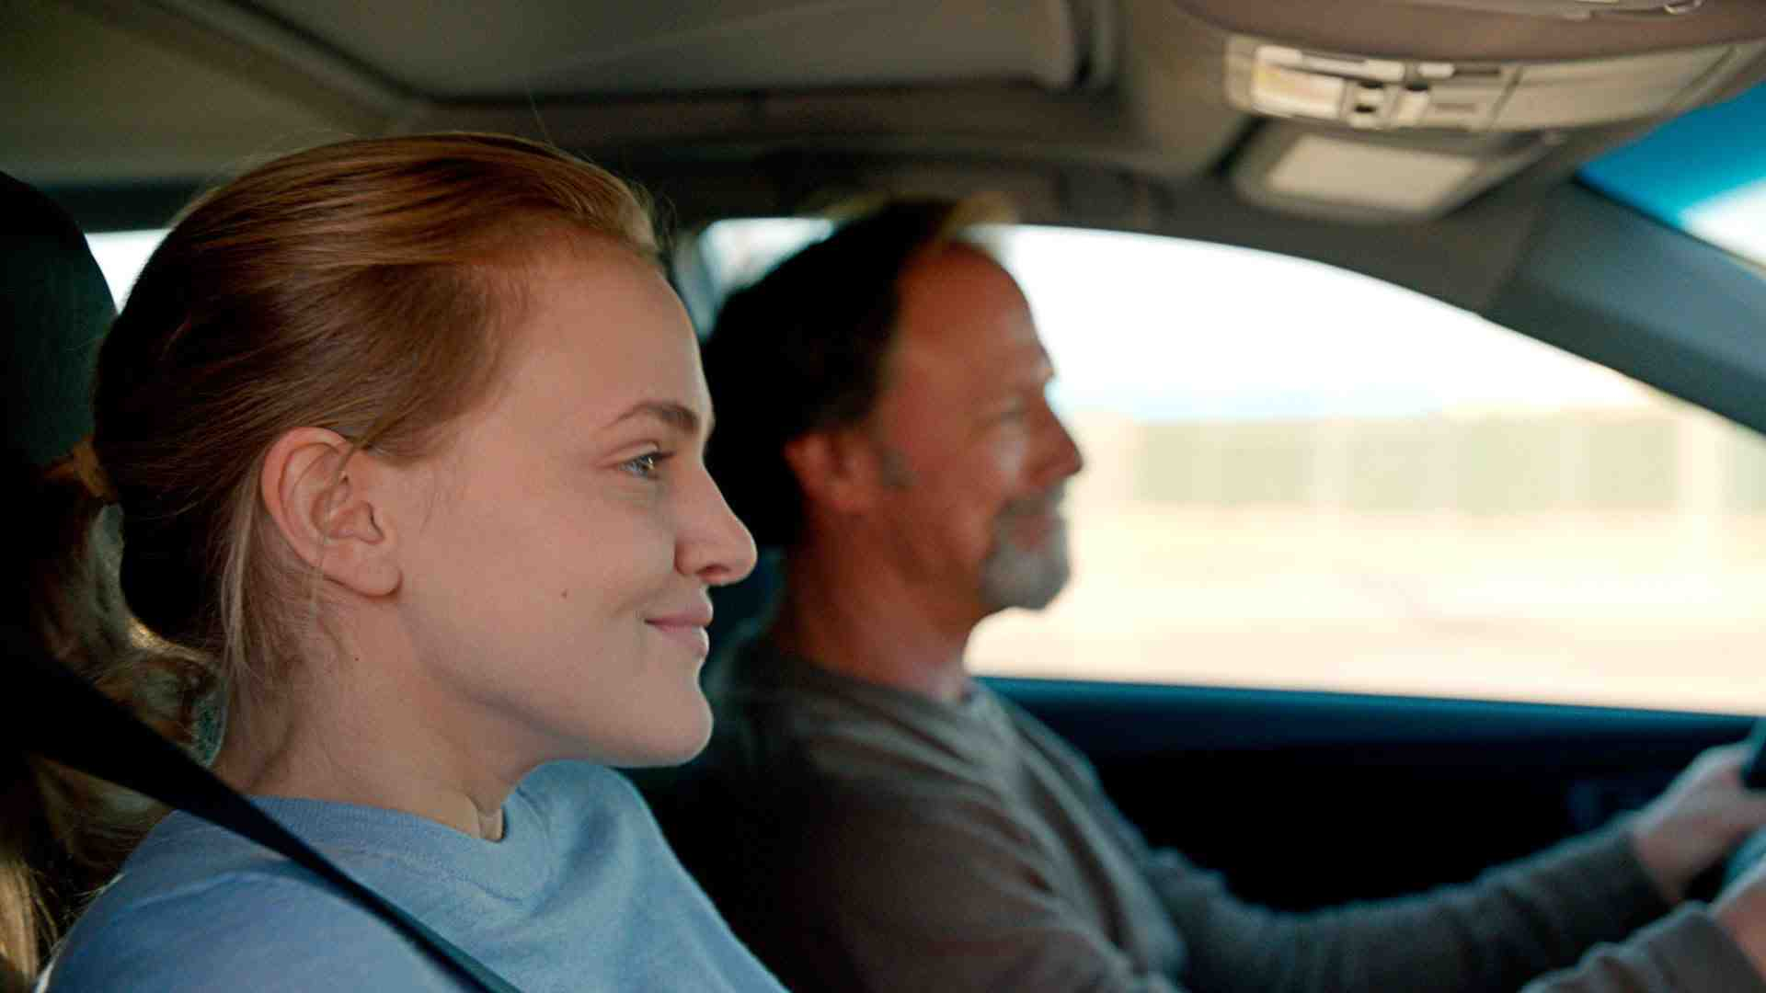
Superbowl commercials..

Slide 4
Keeping romance in marriage…
A feeling of excitement and mystery associated with love..
The feelings or behavior typical of people who love each other..
To court, to woo, to chase or pursue..
An exciting and usually short romantic relationship

Slide 5
How to tell if you need to work on romance..
If your “special” restaurant has a drive thru window.. you might need to work on your romance..

Slide 6
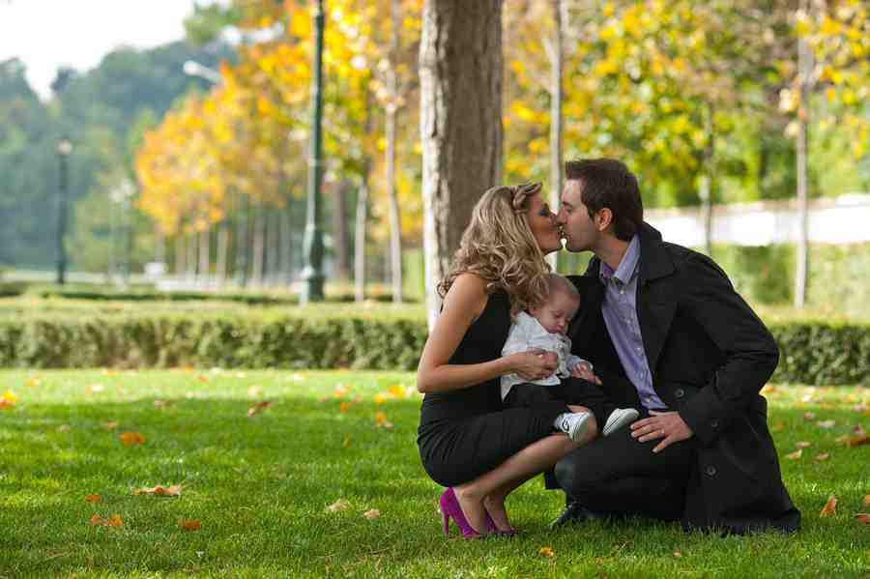
God’s standard…
Ephesians 5:25 love your wives, just as Christ also loved the church and gave Himself for her…
Eph 5:32-33 let each one of you in particular so love his own wife as himself, and let the wife see that she respects her husband.

Slide 7
One of biggest mistakes couples make..
Before marriage you put a lot of effort into winning your future mate’s heart..
After being married you quit pursuing one another as you once did..

Slide 8
One thing every marriage needs…
Praise and admiration…
Praising your spouse…
Ephesians 4:29 Let no corrupt word proceed out of your mouth, but what is good for necessary edification, that it may impart grace to the hearers.

Slide 9
Five ways to tell your wife “I love you”…
Words of affection or praise…
Gifts (not expensive)…
Acts of kindness..
Time together…
Physical touch…

Slide 10
A good marriage takes work..
Don’t give up..
Invest time and effort into restoring and building a great marriage..
Educate yourself.. how to improve..
Go away together.. weekend away
Be patient..

Slide 11
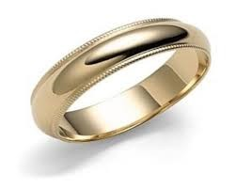
My wedding ring..
Reminds me of the night she gave it to me…
Symbolizes the life we have shared and the family we’ve built..

Slide 12
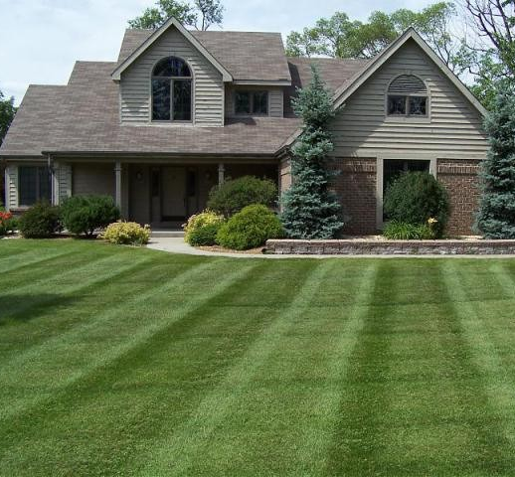
Maintain your marriage..
Set aside one night a week for a date..
Take trips together..
Go for walks together.
Call during the day to say hello..
Do courtship types of things..

Slide 13
Be best friends..
Friendship is the foundation of your happiness in marriage…
Soulmates… not just roommates

Slide 14
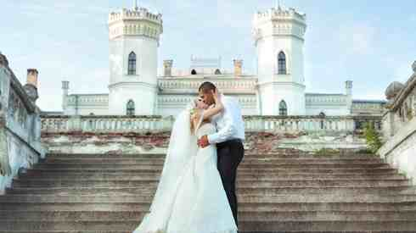
Richer than a millionaire..
Because of your marriage and family..

Slide 15
Keeping Romance in Marriage
Ephesians 5:25-33

