Slide 1
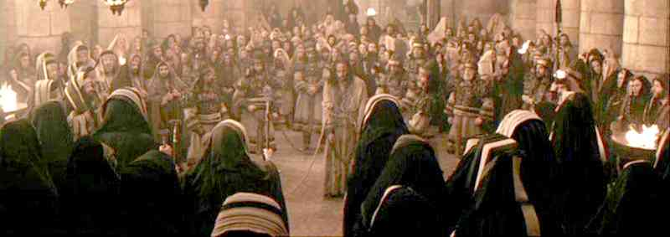
Condemned by the Righteous
Mark 14:53-72

Slide 2
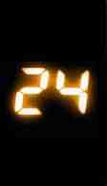
Hours…
That Changed the World
7:00 to 11:00 PM The Last Supper…
The Passover.. New Memorial..
11:00 PM to 1:00 AM… to Mt of Olives..
Gethsemane .. Jesus’ prayer.. Arrested..
John 18:11 “Put your sword into the sheath. Shall I not drink the cup which My Father has given Me?”..

Slide 3
Hours…
That Changed the World
1:00 AM Jesus led back into Jerusalem
Mark 14:53 And they led Jesus away to the high priest; and with him were assembled all the chief priests, the elders, and the scribes. 54 But Peter followed Him at a distance, right into the courtyard of the high priest.

Slide 5
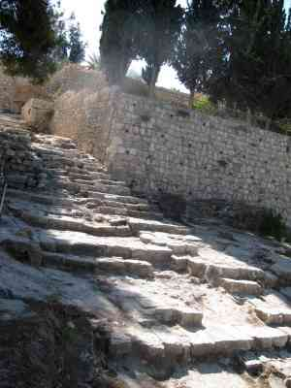
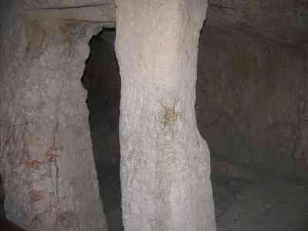
House of Caiaphas..
Steps Jesus walked..
Holding cell in home of Caiaphas..
Matt 26:57 those who had laid hold of Jesus led Him away to Caiaphas the high priest, where the scribes and the elders were assembled.

Slide 6
Sanhedrin (71 men council)
Numbers 11:16 the Lord said to Moses: "Gather to Me seventy men of the elders of Israel, whom you know to be the elders of the people and officers over them; bring them to the tabernacle of meeting, that they may stand there with you..

Slide 7
Justice in law of Moses..
Deuteronomy 16:18-20 "You shall appoint judges and officers in all your gates, which the Lord your God gives you, according to your tribes, and they shall judge the people with just judgment.
19 You shall not pervert justice; you shall not show partiality, nor take a bribe... 20 You shall follow what is altogether just, that you may live and inherit the land which the Lord your God is giving you.

Slide 8
Jesus condemned by the most pious men of Israel..
Mark 14:63 Then the high priest tore his clothes and said, "What further need do we have of witnesses? 64 You have heard the blasphemy! What do you think?"And they all condemned Him to be deserving of death.
65 Then some began to spit on Him, and to blindfold Him, and to beat Him, and to say to Him, "Prophesy!" And the officers struck Him with the palms of their hands.

Slide 9
The leaders were afraid.. threat to their power..
John 11:49-50 And one of them, Caiaphas, being high priest that year, said to them, "You know nothing at all, 50 nor do you consider that it is expedient for us that one man should die for the people, and not that the whole nation should perish."

Slide 10
Fear and its poison..
When afraid, we react predictively ..
Self-preservation instinct ..
Can also cause us to do what is wrong..

Slide 11
Fear and its poison..
Fear can performs its work inside us..
Affect us to personally react in wrong ways
Motivate groups to do the unthinkable..

Slide 12
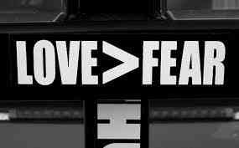
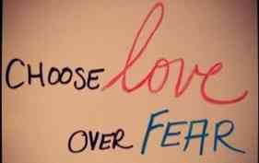
Fear and its poison..
1 John 4:16-20 And we have known and believed the love that God has for us. God is love, and he who abides in love abides in God, and God in him.17 Love has been perfected among us in this: that we may have boldness in the day of judgment; because as He is, so are we in this world. 18 There is no fear in love; but perfect love casts out fear, because fear involves torment. But he who fears has not been made perfect in love. 19 We love Him because He first loved us.

Slide 13
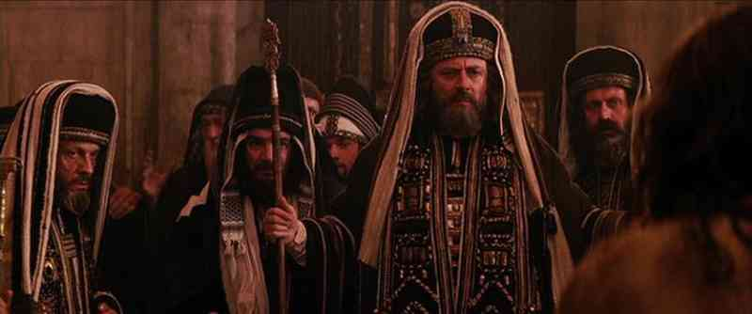
Jesus’ testimony.. “I Am”..
55 Now the chief priests and all the council sought testimony against Jesus to put Him to death, but found none. 56 For many bore false witness against Him, but their testimonies did not agree.
57 Then some rose up and bore false witness against Him, saying, 58 "We heard Him say, 'I will destroy this temple made with hands, and within three days I will build another made without hands.'" 59 But not even then did their testimony agree.

Slide 14
Jesus’ testimony.. “I Am”..
60 the high priest stood up in the midst and asked Jesus, saying, "Do You answer nothing? What is it these men testify against You?"
61 But He kept silent and answered nothing. Again the high priest asked Him, saying to Him, "Are You the Christ, the Son of the Blessed?"
62 Jesus said, "I am. And you will see the Son of Man sitting at the right hand of the Power, and coming with the clouds of heaven."

Slide 15
Three well known texts..
Mark 14:62 Jesus said “I am.. And you shall see the Son of Man sitting at the right hand of power and coming with the clouds of heaven.”
Exodus 3:14 "I AM WHO I AM." And He said, "Thus you shall say to the children of Israel, 'I AM has sent me to you.'“
Daniel 7:13-14 "behold, One like the Son of Man, Coming with the clouds of heaven! He came to the Ancient of Days..14 Then to Him was given dominion and glory and a kingdom, That all peoples, nations, and languages should serve Him.
Psalms 110:1-4 The Lord said to my Lord, "Sit at My right hand, Till I make Your enemies Your footstool."... 4 The Lord has sworn And will not relent,"You are a priest forever According to the order of Melchizedek."

Slide 16
Three well known texts..
63 Then the high priest tore his clothes and said, "What further need do we have of witnesses? 64 You have heard the blasphemy! What do you think?"And they all condemned Him to be deserving of death.

Slide 17
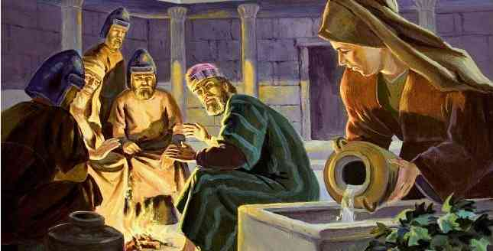
“I do not know this man..”
66 Now as Peter was below in the courtyard, one of the servant girls of the high priest came. 67 And when she saw Peter warming himself, she looked at him and said, "You also were with Jesus of Nazareth."
68 But he denied it, saying, "I neither know nor understand what you are saying." And he went out on the porch, and a rooster crowed.

Slide 18
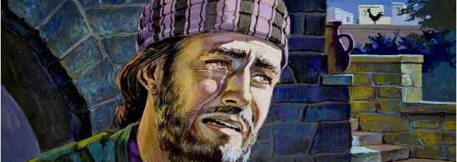
“I do not know this man..”
69 And the servant girl saw him again, and began to say to those who stood by, "This is one of them." 70 But he denied it again. And a little later those who stood by said to Peter again, "Surely you are one of them; for you are a Galilean, and your speech shows it."
71 Then he began to curse and swear, "I do not know this Man of whom you speak!" 72 A second time the rooster crowed. Then Peter called to mind the word that Jesus had said to him, "Before the rooster crows twice, you will deny Me three times." And when he thought about it, he wept.

Slide 19
Condemned by the Righteous
Mark 14:53-72

