Slide 1
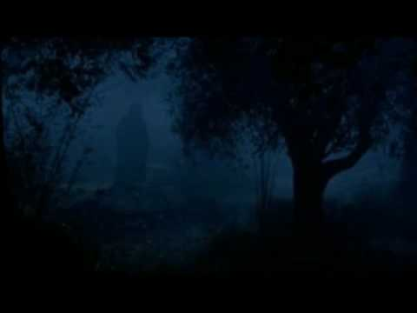
The Garden of Gethsemane
Mark 14:32-42

Slide 2
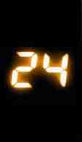
Hours…
That Changed the World
7:00 to 11:00 PM The Last Supper…
The Passover..
Betrayal..
New Memorial..

Slide 3
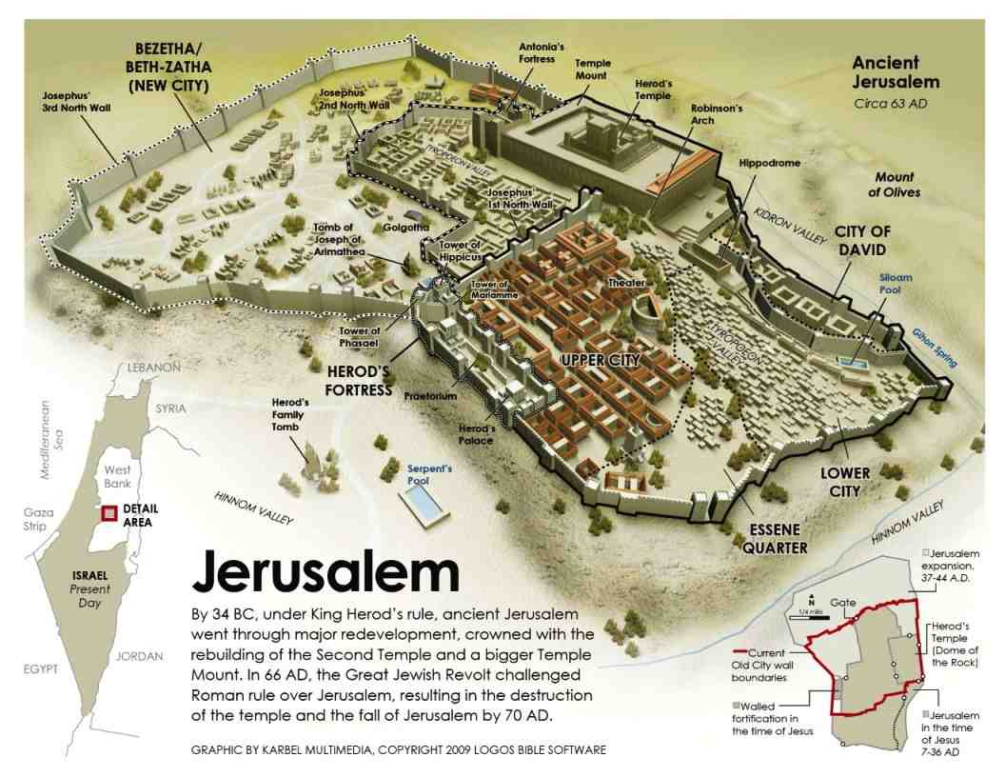

Slide 4
11:00 PM…Upper Room to Mt of Olives..
Mark 14:26 when they had sung a hymn, they went out to the Mount of Olives.
Psalm 113-118 “Hallel” (praise)
Psa 118:5-6 I called on the Lord in distress; The Lord answered me and set me in a broad place. The Lord is on my side; I will not fear.What can man do to me? The Lord is my strength and song, He has become my salvation.
Psalms 118:22-24 The stone which the builders rejected Has become the chief cornerstone. 23 This was the Lord's doing; It is marvelous in our eyes. 24 This is the day the Lord has made; We will rejoice and be glad in it.

Slide 5
11:00 PM…Upper Room to Mt of Olives..
Mark 14:27 27 Jesus said to them, "All of you will be made to stumble because of Me this night, for it is written:'I will strike the Shepherd,And the sheep will be scattered.' 28 "But after I have been raised, I will go before you to Galilee."
29 Peter said to Him, "Even if all are made to stumble, yet I will not be." 30 Jesus said to him, "Assuredly, I say to you that today, even this night, before the rooster crows twice, you will deny Me three times." 31 But he spoke more vehemently, "If I have to die with You, I will not deny You!"And they all said likewise.

Slide 6
11:00 to 1:00 PM.. Garden of Gethsemane..
Mark 14:32 Then they came to a place which was named Gethsemane; and He said to His disciples, "Sit here while I pray."
33 And He took Peter, James, and John with Him, and He began to be troubled and deeply distressed. 34 Then He said to them, "My soul is exceedingly sorrowful, even to death. Stay here and watch."

Slide 7
A Transcendent Affliction.. The Anguish of Jesus
33 He took Peter, James, and John with Him, and He began to be troubled and deeply distressed.
A lack of courage, lack of faith?
Knowing God would turn away? (Psalm 22)
A struggle unlike ours… for holiness to become our sin bearer (“drink the cup”)
Luke 22:43-44 Then an angel appeared to Him from heaven, strengthening Him. 44 And being in agony, He prayed more earnestly. Then His sweat became like great drops of blood falling down to the ground.

Slide 8
A Passionate Petition..
Mark 14:35 He went a little farther, and fell on the ground, and prayed that if it were possible, the hour might pass from Him. And He said, "Abba, Father, all things are possible for You. Take this cup away from Me; nevertheless, not what I will, but what You will."
Not possible.. there was no other way (Heb 9:22)
The cup of God’s wrath (Psalm 75:8, Isa 51:17-22)
Matt 20:22 “Can you drink the cup that I drink?”
John 18:11 “The cup which the Father has given Me, shall I not drink it?”

Slide 9
Affectionate Exhortation..
Mark 14:37 Then He came and found them sleeping, and said to Peter, "Simon, are you sleeping? Could you not watch one hour? 38 Watch and pray, lest you enter into temptation. The spirit indeed is willing, but the flesh is weak."
Matthew 6:13 And do not lead us into temptation, But deliver us from the evil one.
1 Pet 5:8 Be sober, be vigilant; your adversary the devil walks about like a roaring lion, seeking whom he may devour.

Slide 10
Triumphant Submission..
Mark 14:36 And He said, "Abba, Father, all things are possible for You. Take this cup away from Me; nevertheless, not what I will, but what You will."
41 Then He came the third time and said to them, "Are you still sleeping and resting? It is enough! The hour has come; behold, the Son of Man is being betrayed into the hands of sinners. 42 Rise, let us be going. See, My betrayer is at hand."

Slide 11
Triumphant Submission..
Hebrews 5:7-8 who, in the days of His flesh, when He had offered up prayers and supplications, with vehement cries and tears to Him who was able to save Him from death, and was heard because of His godly fear, 8 though He was a Son, yet He learned obedience by the things which He suffered.
Psalms 16:10 For You will not leave my soul in Sheol, Nor will You allow Your Holy One to see corruption.
Romans 1:3-4 concerning His Son Jesus Christ our Lord, who was born of the seed of David according to the flesh, 4 and declared to be the Son of God with power according to the Spirit of holiness, by the resurrection from the dead.

Slide 12
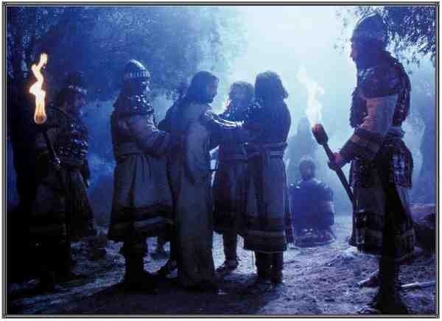
Jesus is now ready..
John 18:4-8 Jesus therefore, knowing all things that would come upon Him, went forward and said to them, "Whom are you seeking?" 5 They answered Him, "Jesus of Nazareth.“ Jesus said to them, "I am He." And Judas, who betrayed Him, also stood with them.
6 Now when He said to them, "I am He," they drew back and fell to the ground. 7 Then He asked them again, "Whom are you seeking?“ And they said, "Jesus of Nazareth." 8 Jesus answered, "I have told you that I am He. Therefore, if you seek Me, let these go their way…"

Slide 13
The scriptures must be fulfilled..
Mark 14:48-49 Then Jesus answered and said to them, "Have you come out, as against a robber, with swords and clubs to take Me? 49 I was daily with you in the temple teaching, and you did not seize Me. But the Scriptures must be fulfilled."
Mark 14:50-52 Then they all forsook Him and fled. 51 Now a certain young man followed Him, having a linen cloth thrown around his naked body. And the young men laid hold of him, 52 and he left the linen cloth and fled from them naked.

Slide 14
The Garden of Gethsemane
Mark 14:32-42

