Slide 1
The Lamp of the Body
Matthew 6:19-24

Slide 2
Seeing clearly…
Our treasure (19-21)
Treasures on earth / Treasures in heaven
(outer/visible) (inner/invisible)
Our focus (22-23)
If the eye is clear / If the eye is bad
(full of light) (full of darkness)

Slide 3
Impossibility of both…
Either/or…
DO NOT lay up treasures on earth…
YOU CANNOT serve God and mammon..
We choose…
Foolish: wrong choice..
Wisdom: right choice..
But we can’t choose both..

Slide 4
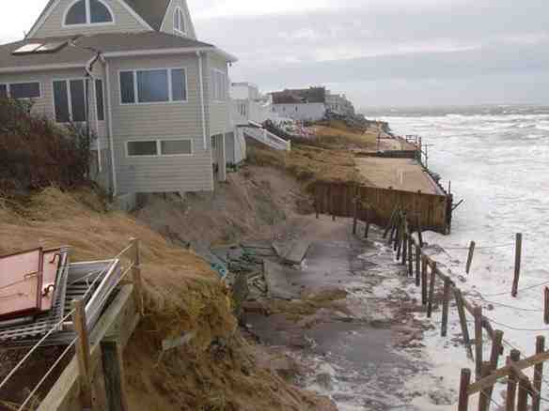
Erosion is gradual..
Choosing the lesser loyalty..
King Solomon (1 Kings 11:4)
Elisha’s servant Gehazi (2 Kings 5)
Demas (2 Tim 4:10)
Guarding the heart..
Proverbs 4:23 Keep your heart with all diligence, for out of it spring the issues of life.

Slide 5
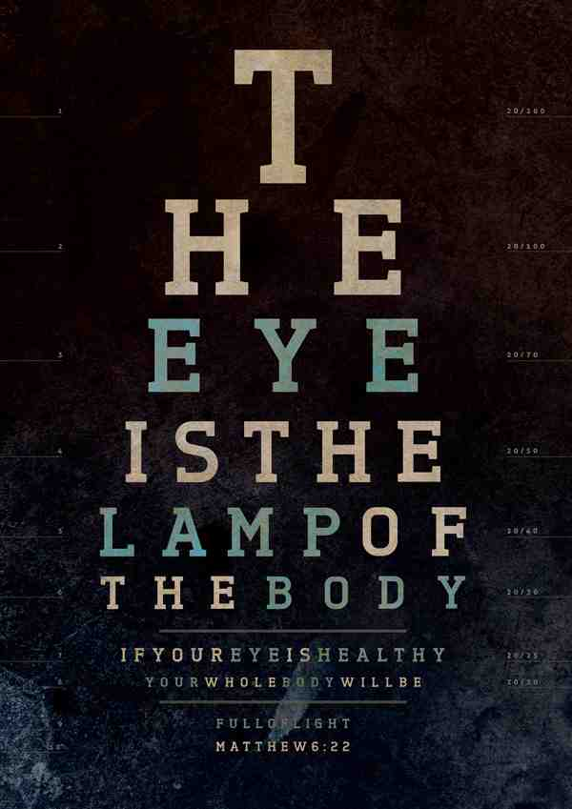
The lamp of the body..
The Good Eye (vs 22) ..
If therefore your eye is good…
Haplous “single, whole, sound, fulfilling its office”
Your whole body will be full of light..
Photeinos “of bright character, full of light, well lit”
The Bad Eye (vs 23) ..
But if your eye is bad ..
Poneros “diseased, defective, or blind… evil”
Your whole body will be full of darkness..
Skoteinos “opaque, covered with darkness”

Slide 6
Some applications..
Immediate application…
Vs 19-21 Treasures on earth or in heaven..
Vs 24 Serving two masters (God or mammon)
Some additional opposites..
Christ’s doctrine or men’s (Matt 15:7-9; Col 2:8)
Christ’s church or men’s (Matt 16:18; Eph 4:4)
True worship or vain worship (John 4:23-24)
Transforming or conforming (Romans 12:1-2)

Slide 7
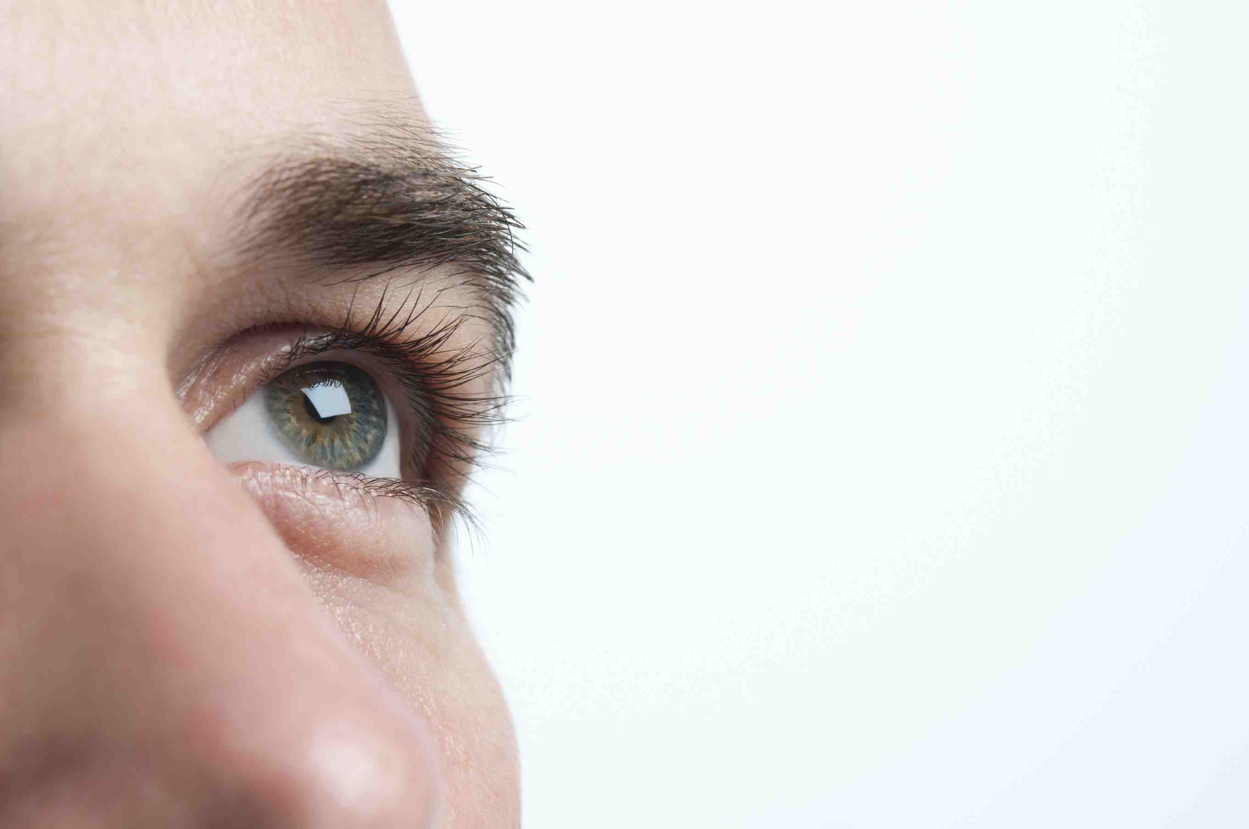
The Window of the Soul..
The eyes tell of the inner person…

Slide 8
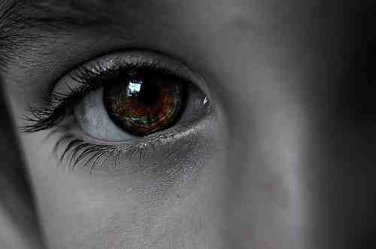
The eyes tell of the inner person…

Slide 9
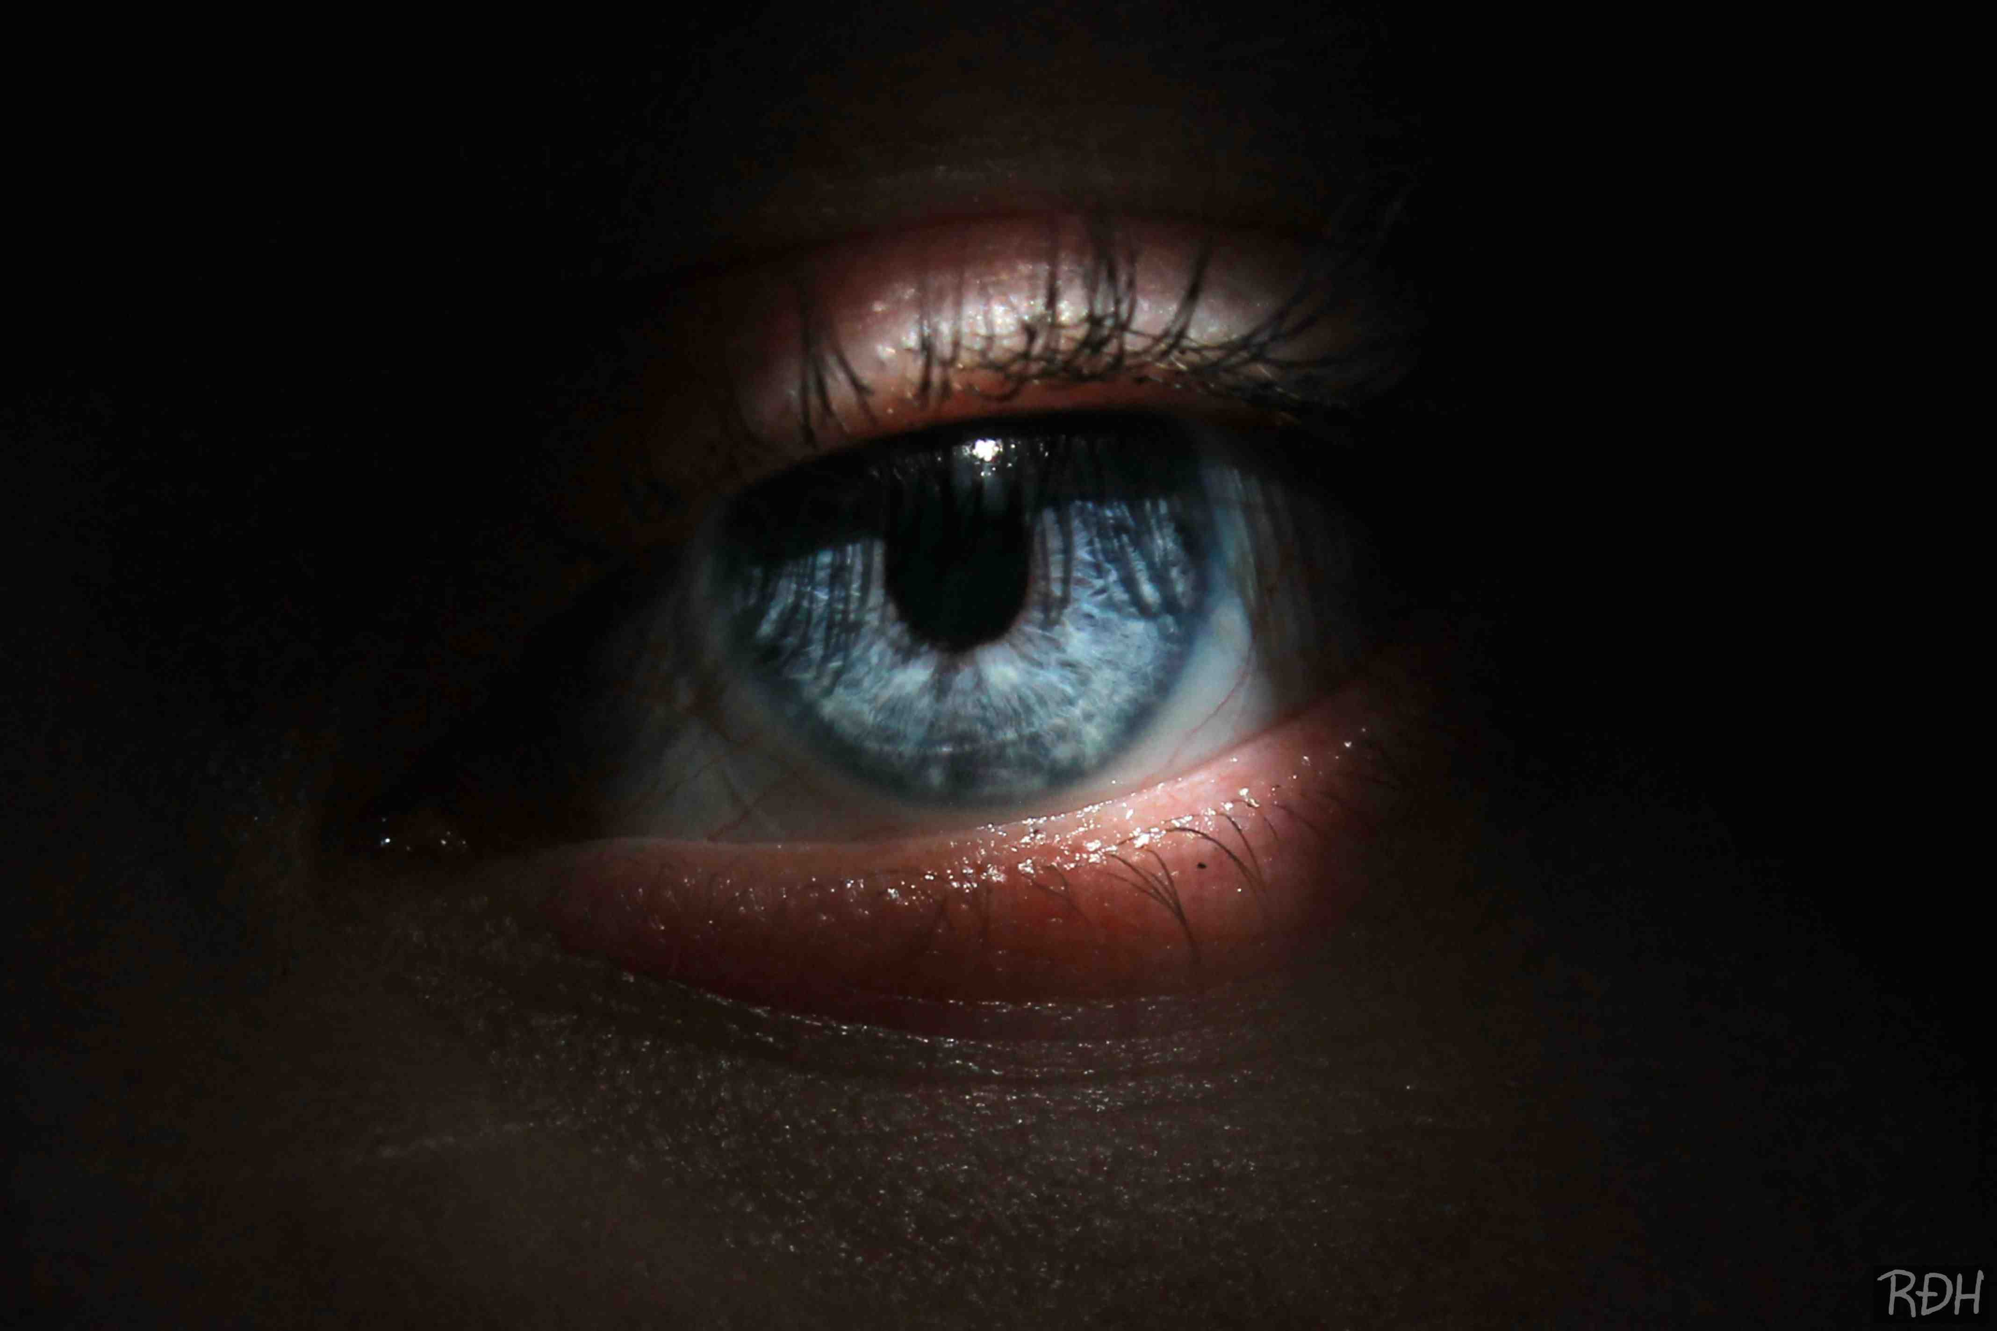
The eyes tell of the inner person…

Slide 10
Proper vision..
Colossians 3:1-2 If then you were raised with Christ, seek those things which are above, where Christ is, sitting at the right hand of God. 2 Set your mind on things above, not on things on the earth.

Slide 11
The Lamp of the Body
Matthew 6:19-24

