Slide 1
The Last Supper
Mark 14:12-25

Slide 2
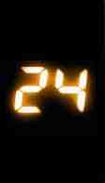
Hours…
That Changed the World
1 Corinthians 2:1-2 For I determined not to know anything among you except Jesus Christ and Him crucified..

Slide 3
Things changed quickly as tension grew…
Sunday.. Triumphal entry
“Hosanna to the Son of David! Blessed is the one who come in the name of the Lord!” (Matt 21:9)
Monday.. Cleansing the Temple
“My house shall be called a house of prayer for all nations, but you have made it a den of robbers..”
Tues/Wed.. Pressing the religious leaders
“Woe to you, scribes and Pharisees, hypocrites.. You are like whitewashed tombs .. but inside full of dead bones

Slide 4
12:00 PM.. Preparing the Passover Meal..
Mark 14:12 Now on the first day of Unleavened Bread, when they killed the Passover lamb, His disciples said to Him, "Where do You want us to go and prepare, that You may eat the Passover?"
14 say to the master of the house, 'The Teacher says, "Where is the guest room in which I may eat the Passover with My disciples?”…

Slide 5
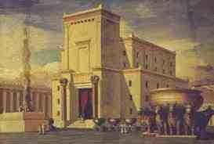
3:00 PM Going to the temple…
Peter and John take lamb to temple for sacrifice..
Then take the meat back to kitchen at upper room to roast the meat..

Slide 6
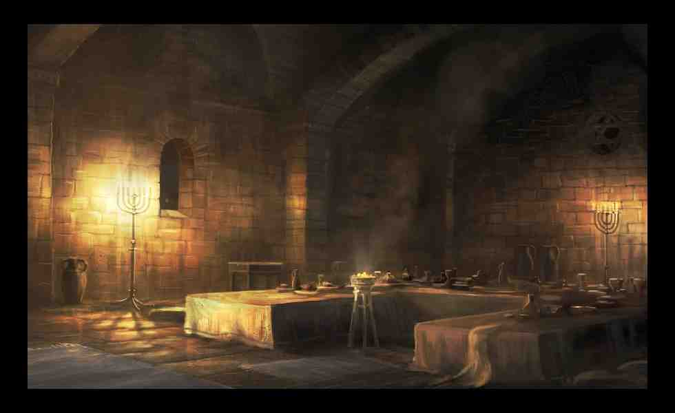
7:00 PM The Passover..
Special meal commemorating God’s deliverance of Israel in Exodus 6-13..
Filled with ritual to help relive their history and know their identity..
Exodus 12:8 Then they shall eat the flesh on that night; roasted in fire, with unleavened bread and with bitter herbs they shall eat it.

Slide 7
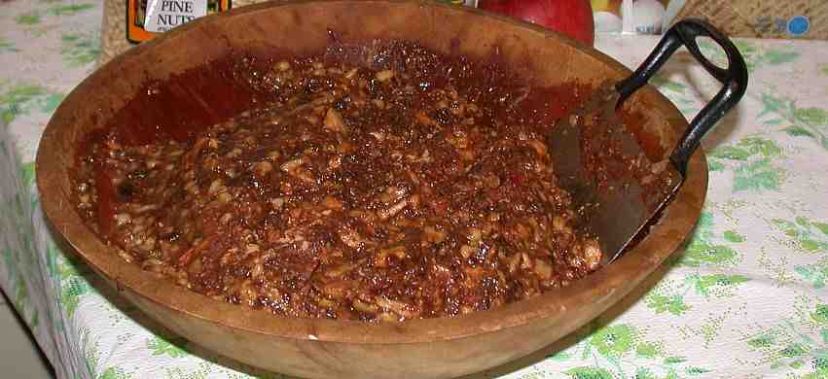
7:00 PM The Passover..
Food items with lamb.. Charoset mixture, egg, bitter herbs..
Four cups of wine (pressed grapes)..
Exodus 6:6 'I am the Lord; I will bring you out from under the burdens of the Egyptians, I will rescue you from their bondage, and I will redeem you with an outstretched arm and with great judgments.

Slide 8
Betrayal..
18 Now as they sat and ate, Jesus said, "Assuredly, I say to you, one of you who eats with Me will betray Me." 19 And they began to be sorrowful, and to say to Him one by one, "Is it I?" And another said, "Is it I?“..
20 He answered and said to them, "It is one of the twelve, who dips with Me in the dish…

Slide 9
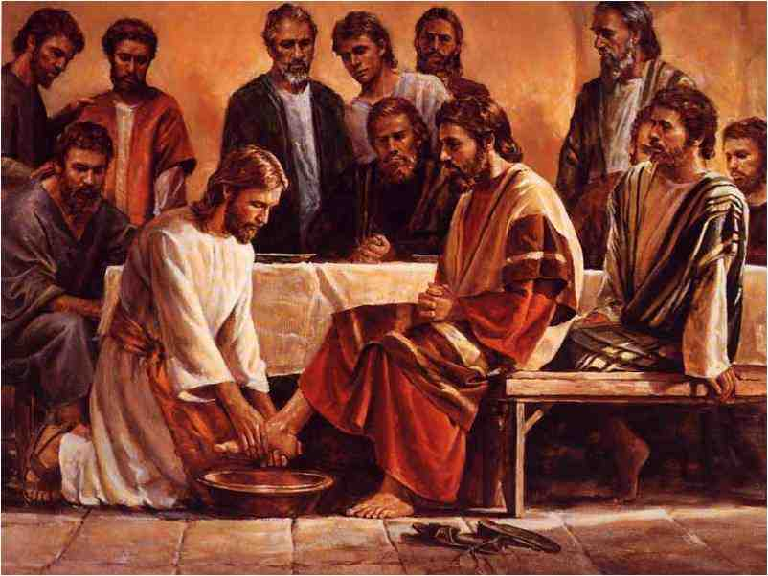
Jesus knew but still washed their feet..

Slide 10
This is my body..
22 And as they were eating, Jesus took bread, blessed and broke it, and gave it to them and said, "Take, eat; this is My body."
23 Then He took the cup, and when He had given thanks He gave it to them, and they all drank from it. 24 And He said to them, "This is My blood of the new covenant, which is shed for many.

Slide 11
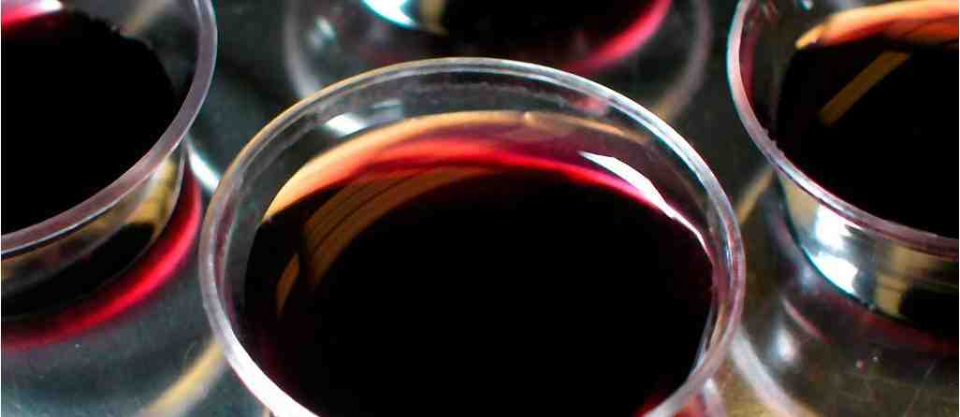
A meal that defines us..
How our freedom came..
We are not defined by the hurts we have suffered in life…
Points both backward and forward..
1 Corinthians 11:26 For as often as you eat this bread and drink this cup, you proclaim the Lord's death till He comes.

Slide 12
Jesus found comfort in His friends..
Luke 22:15 Then He said to them, "With fervent desire I have desired to eat this Passover with you before I suffer;
John 15:15 No longer do I call you servants, for a servant does not know what his master is doing; but I have called you friends, for all things that I heard from My Father I have made known to you.

Slide 13
The Last Supper
Mark 14:12-25

