Slide 1
Never Alone
Psalm 139:1-6

Slide 2
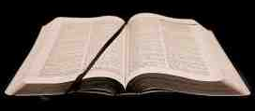
Loneliness today..
44% unmarried ..
102,000,000 people ..
College students ..
Divorced, elderly, single mothers..
1 in 4 people ..

Slide 3
Living alone is difficult..
Genesis 2:18 the Lord God said, "It is not good that man should be alone; I will make him a helper comparable to him."

Slide 4
God’s nearness ..
Psalms 139:1-5 O Lord, You have searched me and known me. 2 You know my sitting down and my rising up; You understand my thought afar off. 3 You comprehend my path and my lying down, and are acquainted with all my ways. 4 For there is not a word on my tongue, But behold, O Lord, You know it altogether. 5 You have hedged me behind and before, And laid Your hand upon me.

Slide 5
Feelings of loneliness..
Sad and empty..
Need for companionship
Anxiety..

Slide 6
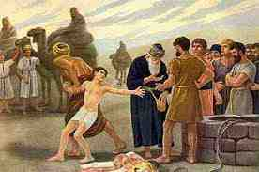
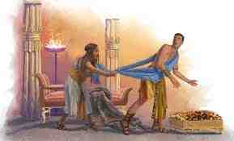
Joseph’s lonely life..
Genesis 39:21 But the Lord was with Joseph and showed him mercy, and He gave him favor in the sight of the keeper of the prison.

Slide 7
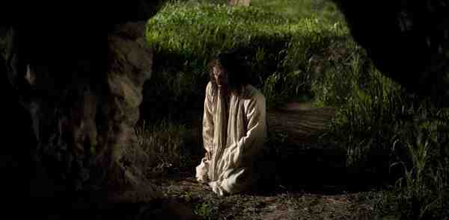
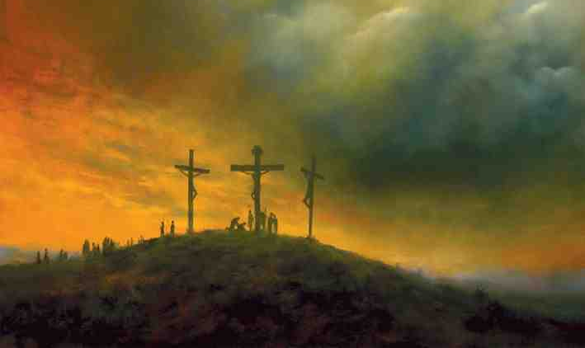
Jesus was alone..
John 16:32 Indeed the hour is coming, yes, has now come, that you will be scattered, each to his own, and will leave Me alone. And yet I am not alone, because the Father is with Me.

Slide 8
Jesus was alone..
Hebrews 5:7 who, in the days of His flesh, when He had offered up prayers and supplications, with vehement cries and tears to Him who was able to save Him from death, and was heard because of His godly fear..

Slide 9
Jesus was alone..
Psalms 22:1 My God, My God, why have You forsaken Me? Why are You so far from helping Me, And from the words of My groaning?
22:27 All the ends of the world Shall remember and turn to the Lord, And all the families of the nations shall worship before You.

Slide 10
Jesus was alone..
1 Peter 2:23 who, when He was reviled, did not revile in return; when He suffered, He did not threaten, but committed Himself to Him who judges righteously..
1 Peter 4:19 Therefore let those who suffer according to the will of God commit their souls to Him in doing good, as to a faithful Creator.

Slide 11
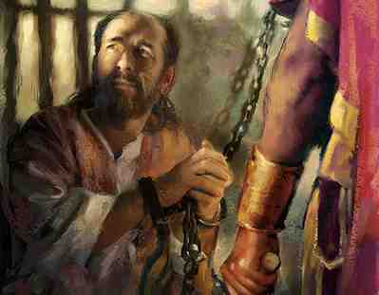
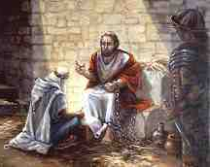
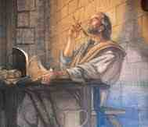
Paul’s loneliness..
1 Corinthians 7:8 But I say to the unmarried and to the widows: It is good for them if they remain even as I am..

Slide 12
Paul’s loneliness..
Philippians 4:12-13 I know how to be abased, and I know how to abound. Everywhere and in all things I have learned both to be full and to be hungry, both to abound and to suffer need. 13 I can do all things through Christ who strengthens me.

Slide 13
Paul’s loneliness..
2 Timothy 4:16-18 At my first defense no one stood with me, but all forsook me. May it not be charged against them. 17 But the Lord stood with me and strengthened me, so that the message might be preached fully through me, and that all the Gentiles might hear. Also I was delivered out of the mouth of the lion. 18 And the Lord will deliver me from every evil work and preserve me for His heavenly kingdom. To Him be glory forever and ever. Amen!

Slide 14
Promises of God ..
Psalms 68:5-6 A father of the fatherless, a defender of widows, Is God in His holy habitation. 6 God sets the solitary in families; He brings out those who are bound into prosperity; But the rebellious dwell in a dry land.

Slide 15
Promises of God ..
John 14:23 "If anyone loves Me, he will keep My word; and My Father will love him, and We will come to him and make Our home with him.

Slide 16
Promises of God ..
Joshua 1:5 No man shall be able to stand before you all the days of your life; as I was with Moses, so I will be with you. I will not leave you nor forsake you.
Hebrews 13:5 Let your conduct be without covetousness; be content with such things as you have. For He Himself has said, "I will never leave you nor forsake you."

Slide 17
Promises of God ..
Psalms 37:25 I have been young, and now am old; Yet I have not seen the righteous forsaken, Nor his descendants begging bread.
Psalms 27:10 When my father and my mother forsake me, Then the Lord will take care of me.

Slide 18
God’s nearness ..
Psalms 139:1-5 O Lord, You have searched me and known me. 2 You know my sitting down and my rising up; You understand my thought afar off. 3 You comprehend my path and my lying down, and are acquainted with all my ways. 4 For there is not a word on my tongue, But behold, O Lord, You know it altogether. 5 You have hedged me behind and before, And laid Your hand upon me.

Slide 19
God’s nearness ..
Psalms 139:13-14 For You formed my inward parts; You covered me in my mother's womb. 14 I will praise You, for I am fearfully and wonderfully made; Marvelous are Your works, And that my soul knows very well.

Slide 20
God’s invitation..
Revelation 3:20 Behold, I stand at the door and knock. If anyone hears My voice and opens the door, I will come in to him and dine with him, and he with Me.

Slide 21
Never Alone
Psalm 139:1-6

